Slide 1
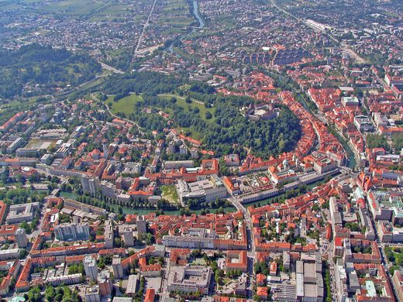
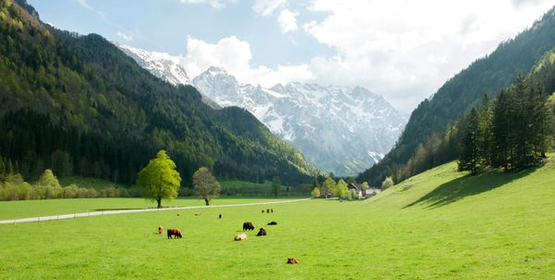

May 23-25, 2018 David Lin, Ph.D Director of Research Global Footprint Network
Ecological Footprint and Biocapacity: Basic Equations

Slide 2

What is a Footprint?
F
?
P(t)
=
A footprint can be production
Example: Production of CO₂
1 tonne CO₂

Slide 3
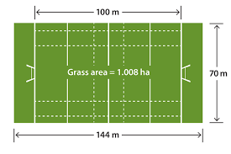
What is a Footprint?
F
P(t)
= Area(ha)
=
Y(t/ha)
A footprint can be a physical area
Example: P = 10 tonnes of wheat
Y = 2 tonnes of wheat per hectare
A = 10/2 = 5 hectares

Slide 4
What is a Footprint?
P(t)
E
F
^{x} YF
^{x} EQF
=
Y(t/ha)

Slide 5
Normalization Factors conserve consumption
Yield Factor (YF)
Normalizes productivity within a single land type
Ratio of national yield (Yn) to world yield (Yw)
Equivalence Factor (EQF)
Normalizes productivity between land types
Agriculture centric calculation
Dimensionless
Conserve consumption

Slide 6
Footprint and Biocapacity
P(t)
E
F
^{x} YF
^{x} EQF
=
Y(t/ha)
B
C
A(ha)
^{x} YF
^{x} EQF
=
*note – all 3 types of footprints are included within the accounts

Slide 7
Footprint Description Simplified
The function of the Ecological Footprint calculations is simple: we start with reported values of physical harvest(tonnes etc.) or waste production of CO₂(eg. tonnes) then convert these values into the amount of global-average bioproductive area (global hectares:gha) that is needed to provide these ecosystem services (bioproduction and assimilation).
Similarly the biocapacity calculation starts with a physical report or measure of area then converts this area into the equivalent amount of world average bioproductive area on the basis of bioproductivity.

Slide 8
Footprint Formula Simplified
P
E
F
YF
=
^{x}
^{x} EQF
Yn
P
F =
E
Yn
^{x} EQF
YF =
Yw
Yw

Slide 9
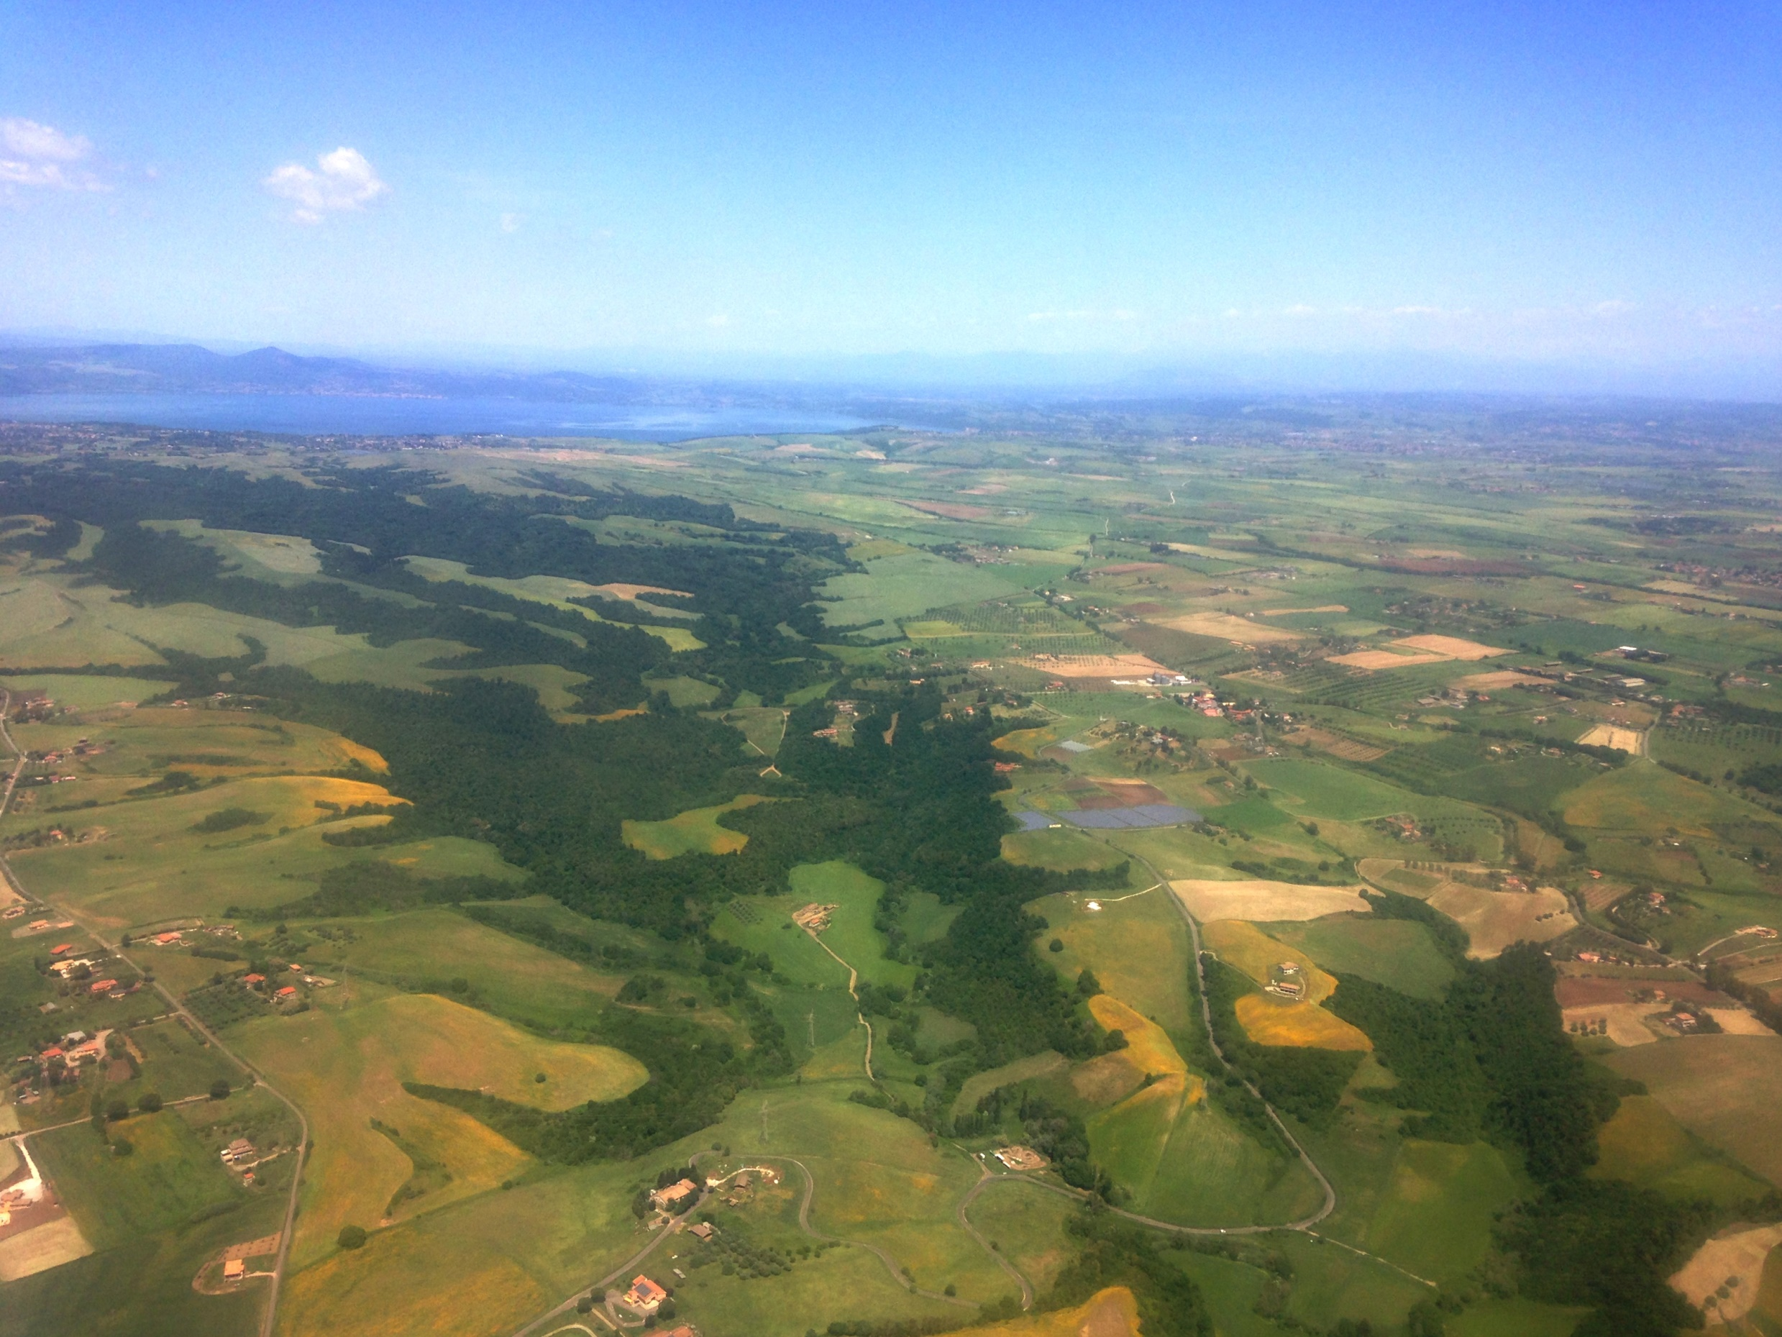
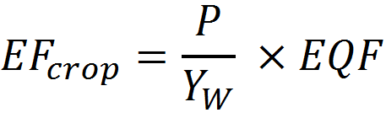
The Cropland Footprint
Total cropland area required to produce crops consumed by people

Slide 10

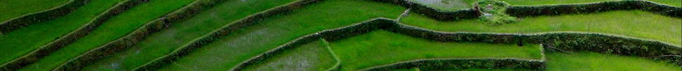
Thank you!
Contact info
David.Lin@Footprintnetwork.org

Slide 11
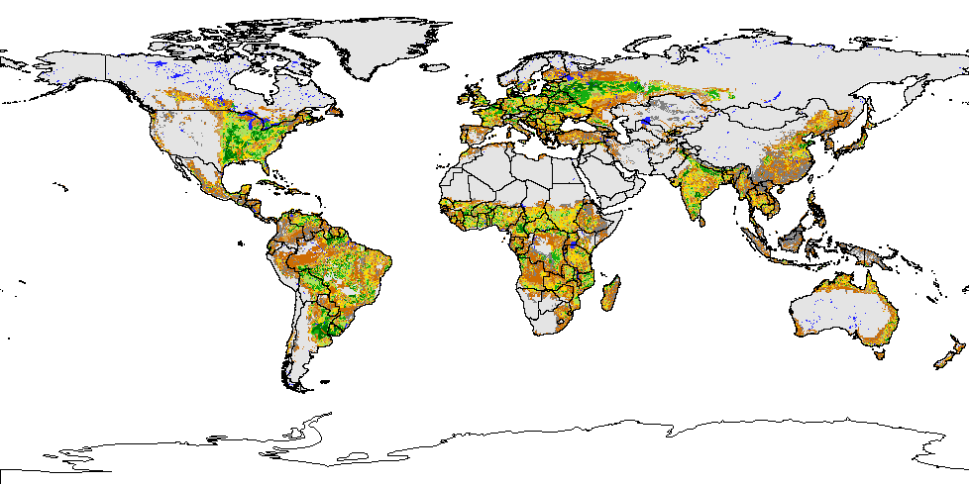
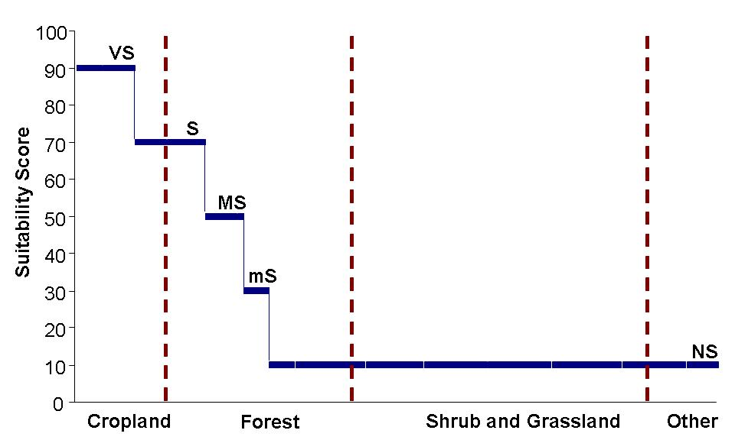
Equivalence of land types: (EQF) calculation
Equivalence factors use agricultural suitability as a proxy for productive potential of land

