Slide 1
PLACARD Foresight workshop 24-25 October 2016
Global trends relevant for European environment
Anita Pirc Velkavrh
Head of Foresight and sustainability group
Integrated assessment programme
Notes:
Dober dan,
V moji presentaciji bi rada predstavila EEA GMT in njihov pomen za evropsko okolje in politike.
Se Anita Pirc Velkavrh, in vodim skupino za Foresight and Sustaoinability na EEA.

Slide 2
EEA
EEA global megatrends relevant for European environment – what are they?
Impacts, risks
Challenges for sustainable development
Notes:
Na kratko bom predstavila vlogo EAO potem pa 11 GMT, ki so jih izbrali in anlizirali v povezavi z njihovim pomenom za okolje. Predstavila bom tudi zakljucke v zvezi z njihovi vplivi na evropsko okolje in izzive za trajnosti razvoj.

Slide 3
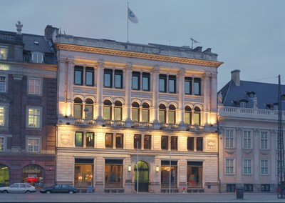
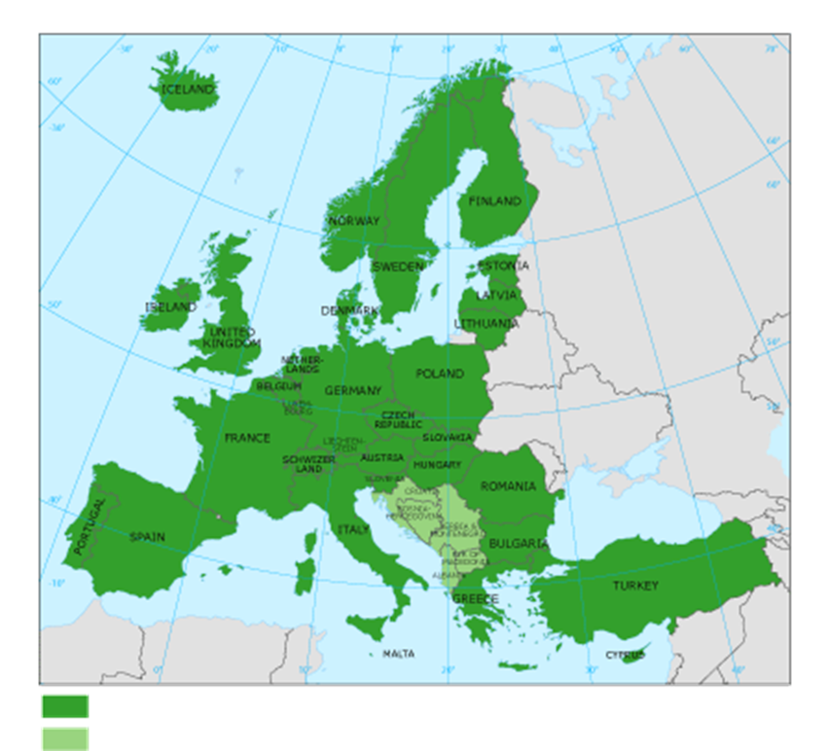
About the European Environment Agency
The European Environment Agency:
is established by EEC regulation
- is an independent information provider
- is an analyst and assessor
- is building bridges between science and policy
- is co-ordinating network (Eionet)
  a network of more than 300 institutions in 39 European countries
  National Reference Centres for State of environment and
  NRC for Forward Looking Information
.
Foresight and Sustainability Unit in Integrated assessment programme
  • Strategic unit for detecting drivers of change and new issues with a long-term relevance for the
  European environmental policymaking
  Responsible for SOER development
… to support policy processes and inform the public
Copenhagen, Denmark
Notes:
3
EAO
Ustanovljena z EEC regulation
Neodvisna instituicija, ki zagotovvlja informacije o okolju, jih anlizira ion ocenjuje.
EAO tudi coordinira Eionet omrezje sestavljeno iz Nacionalnih koordinatorskih tock, nacionalnih tematski referencnih centrov (ienovani s strani drzave) in Evropskih tematskih centrov (pogodbeni konzorcij evropskih inistitucij).
Posebaj relevantna za to temo sta NRC FLIS in NRC SoE.
V agenciji se analize in koordinacija Eioneta na odrocju izgledov za prihodnost vrsijo v oddelku za Foresight and Sustainability. Ta oddelek je tudi odgovoren za pripravo .evropksega SOER

Slide 4
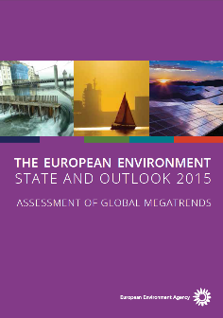
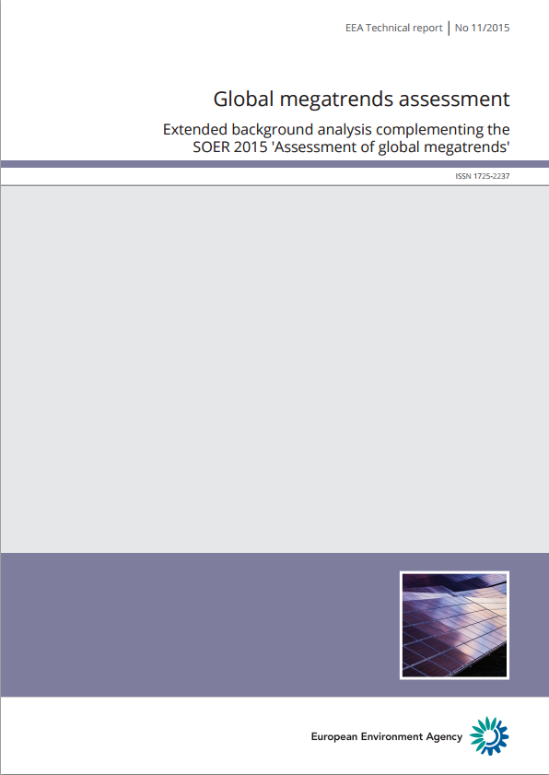
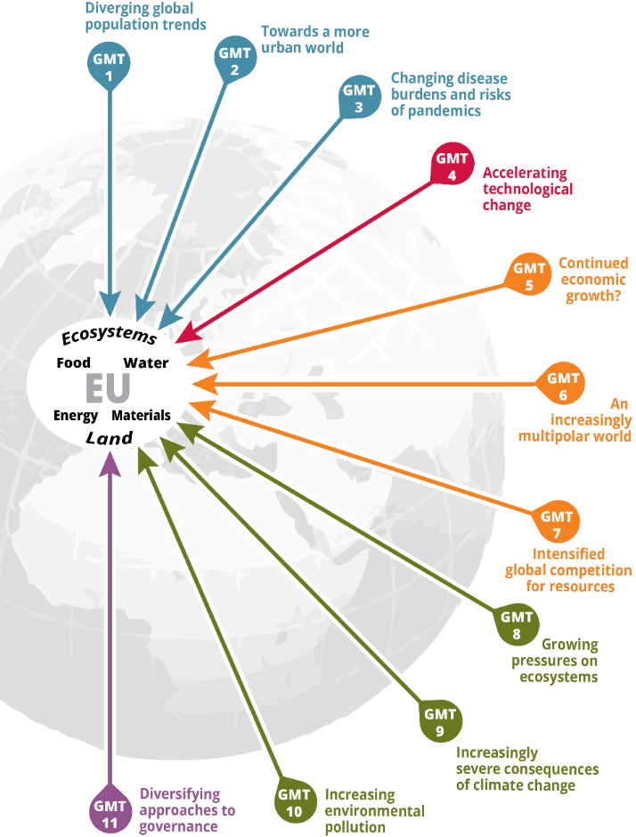
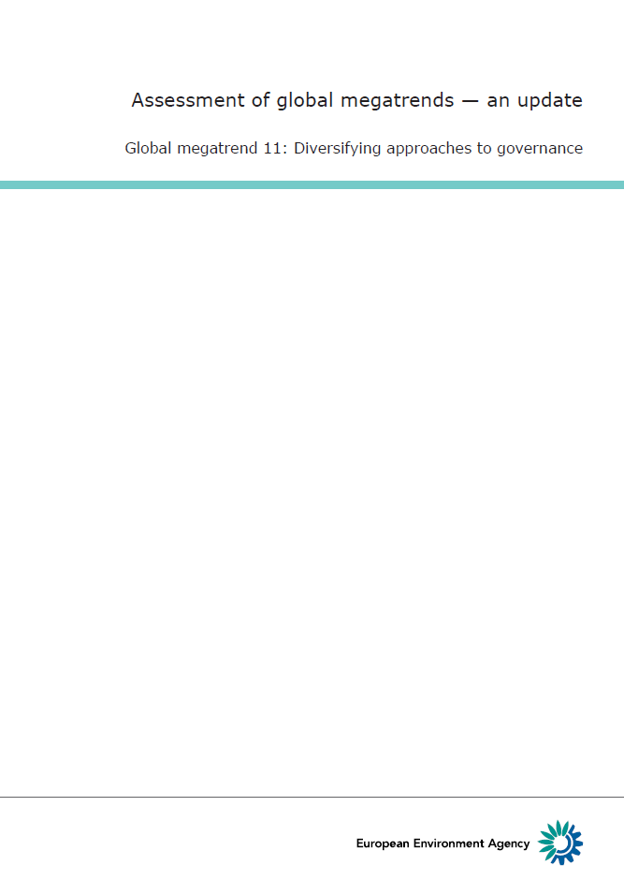
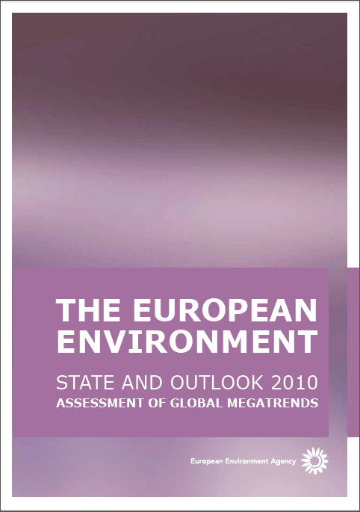
Global megatrends & European environment
Background analysis
Update
EEA, Foresight and sustainability group
Notes:
Agencija je leta 2010 objavila 11 GMT, ki so pomembni za okolje. Podporne anlize so bile obsezne, kakor tudi vkljucevanje deleznikov in svetovalcev. V nadaljevanju jih je posodabljala in bolj natancno razdelala glede njihov vplivov na okolje 2010-2015).
3 so socialni, 1 tehnoloski, 3 ekonoskega znacaja, 3 okoljski in 1 politicen (STEEP)
Mislim da jih na te mestu ni treba nasteti. Itak bodo bolj natancno predstabvljeni kasneje.
1 Razhajanje v svetovnih prebivalstvenih trendih:
2 Na poti k bolj urbaniziranemu svetu:
3 Spreminjajoča se bremena bolezni in nevarnost pandemij:
4 Pospešene tehnološke spremembe:.
5 Nadaljnja gospodarska rast?:
6 Čedalje bolj večpolarni svet:
7 Okrepljeno svetovno tekmovanje za vire:
8 Vse večji pritiski na ekosisteme:
9 Vse hujše posledice podnebnih sprememb:
10 Vse večja onesnaženost okolja:
11 Vse večja raznovrstnost pristopov k upravljanju:

Slide 5
  Setting the scene: global megatrends definition
Global megatrends are large-scale, high impact and often interdependent trends visible today that are expected to extend over the decades, changing slowly and exerting considerable force that will influence a wide array of areas including social, technologic, economic, environmental and political dimensions in Europe until 2050.
EEA, 2007
long term – high probability – high impact
Notes:
Slovenski prevod definicije?

Slide 6
Why are GMT important?
Europe is bound to the rest of the world through multiple and complex non-linear systems.
Europe’s environment security and social resilience and its response options will be significantly affected by GMT.
What are the global megatrends of relevance for Europe and environment future and how we assessed them?
Notes:
Evropa je povezana z ostalim svetom skozi vecplastne sistemske kompleksne povezave. Evropka okoljsa varnost in druzbena proznost bosta odlocilno odvisna od GMT.
Kateri so ti GMT?

Slide 7
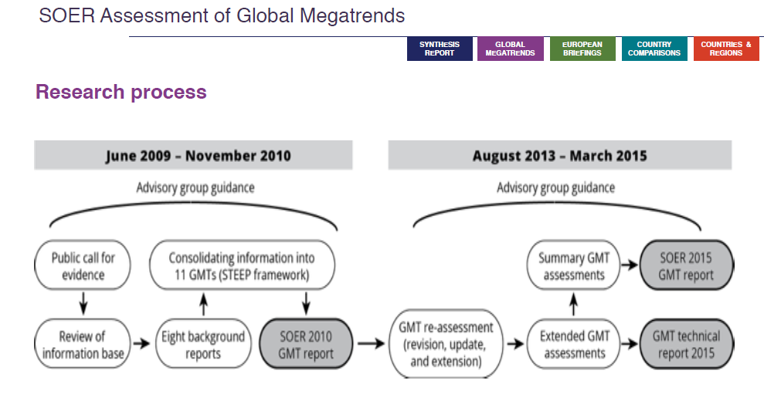
Process for GMT selection and development
Research process
Horizon scanning
Drivers analyses
STEEP
Trends analyses
-selection
consolidation
Horizon scanning
Trends and impacts analyses
updates
Trends and IMPACTS analyses
Notes:
Raziskovavalni process identifikacije GMT je vkljcueval sirso strokovno javnost (publicly published expression of identification relevant), trends), svetovalno skupino s strani politkov, ustvarjlacev politik, strokovnjakov na nacionalni, evropski in globalni ravni), delo tematskih strokovnjakov na EEA in pgodbenikov.
Na osnovi Horizon scanning smo idenficiarli gonilne sile globalnih sprembe v okviru STEEP in jih anlizirali and objevali 2010. V novem procesu smo spet izvedli Horizon scaning v namen posodobitve in naredili poglobljene analize ucinkov na okolje. Objavili smo jih 2015.
V nadaljevanju bomo posodobitve indikatorjev in morebitna dopolnila ( npr. GMT digatalizacija in o vrednotah manjkata) objavljali na Platformi za informacije o prihodnosti (Platform for forward-looking information)

Slide 8
11 Global megatrends
Identified by the EEA of the relevance for European environment

Slide 9
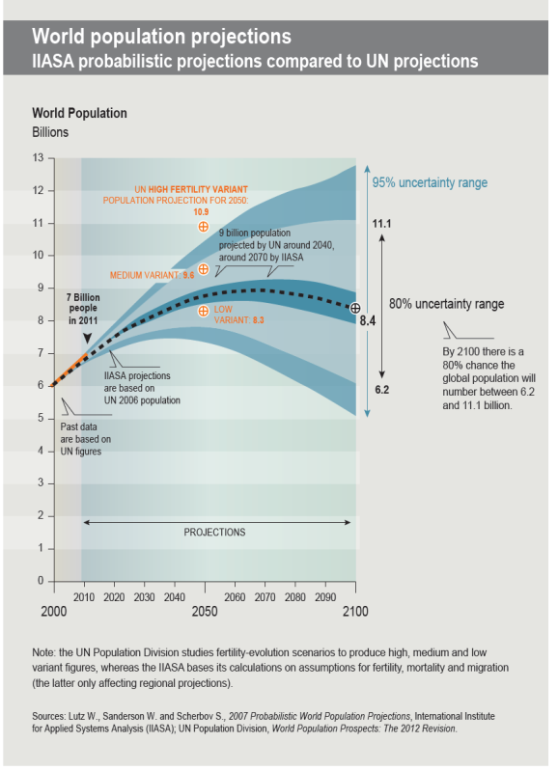
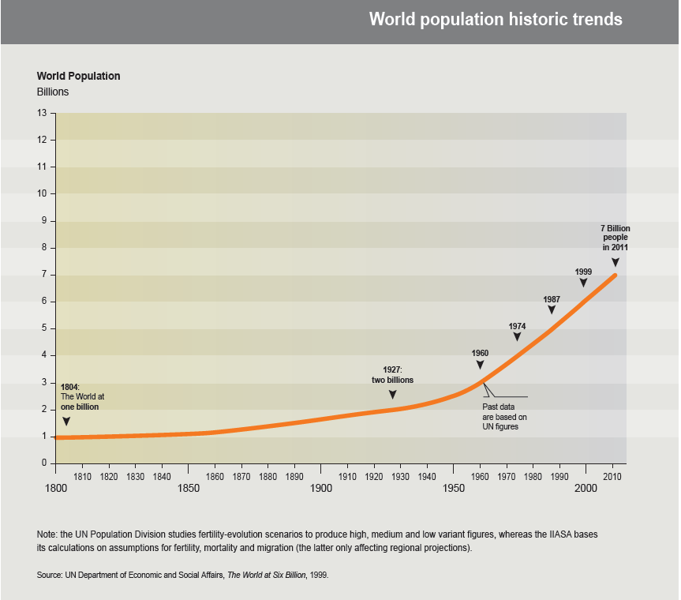
GMT 1: Diverging global population trends
The world population may rise beyond 9.6 billion by 2050, despite the rate of growth slowing.
43%
...more of the global population by 2050
Notes:
Svetovno prebivalstvo lahko doseze 9,6 mio v letu 2050, kljub dejstvu da se globalna rast prebivalstva upocasnjuje (max 11,2 mio, min 6,2) . To pomeni 45% vec prebivalcev na zemlji do leta 2050. Dodatek

Slide 10
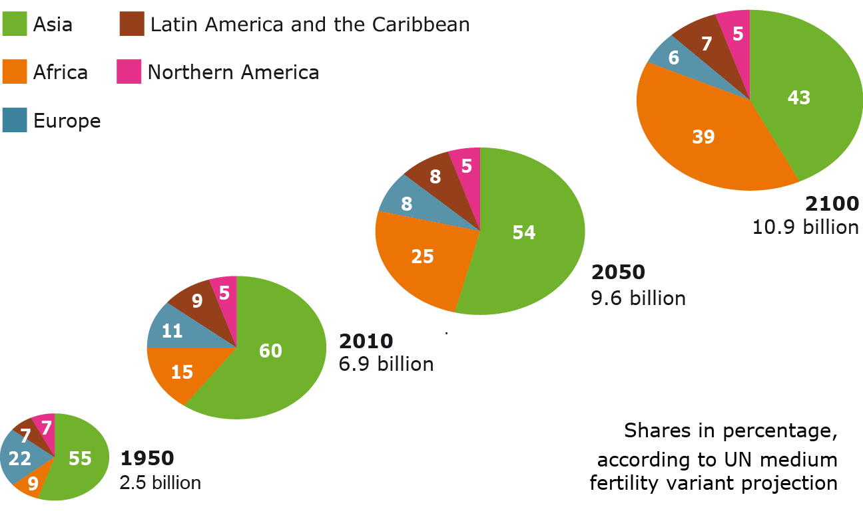
GMT 1: Diverging global population trends
Most of the increase will occur in developing-world urban areas, particularly slums and megacities with Africa’s rising especially fast.
Africa
Source: UN World population prospects: The 2012 revision.
Unequal development is likely to increase migration. Europe could face pressure for and from immigration.
Notes:
Njahiterje rastoca regija absolutno in relativno bo Africa. Vecino prebivalcev se bo naselila v urbanih regijah, predvsem SLUMS in v mega mestih. Neenakomeren razvoj bo tudi gonilan sila narascajoce revscine. V Evropi (in po svetu) se bodo povecale migracije

Slide 11
GMT 1: Diverging global population trends
Aging and shifting wealth of human capital
Growing and younger populations in the developing world, the growth of an affluent middle class in Asia, and aging populations in developed countries will impact resource use and the environment.
Notes:
Globalno gledano se prebivalstvo stara, v razvitih dezelah (Eu) bolj kot v razvijajocih, kjer bodo imeli se vedno velik velik kohort mlade delovne sile, ker predstavlja ekonomsko priloznost (Kitajska) ali nevarnost za konflikte, ce niso druizbeno ustvarjalni (Bliznji vzhod). V tujih drzavah se pojavijo kot emigranti.
Strukturne spremembe v sestavi prebivalstva so tesno povezane z izobrazevanjem Skupaj predstavljajo druzbeni capital, ki bo v najvecjem porastu v Aziji. Na sliki vidimo narascajoce stranje Evrope in mnozicni porsst izpobrazenih ljudi v Aziji.
Ti trendi bodo odlocujoci za vpliv na rabo naravnih virov, tudi v Evropi.

Slide 12
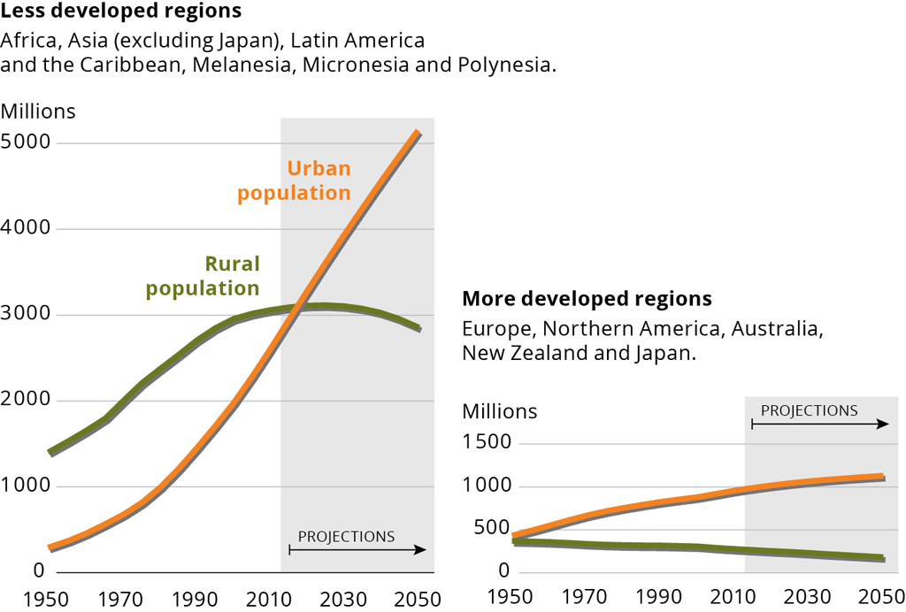

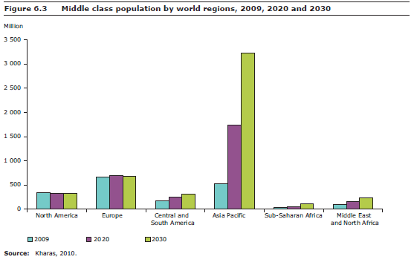
GMT 2: Towards a more urban world
Urban areas in developing countries will absorb most of the global population increase
67%
… of the world population will live in cities by 2050
… growth of middel class in Asia with spiralling consumption
Middle class
Urban population
Source: UN World urbanization prospects: The 2012 revision
Developing c.
Developed c.
Notes:
Danes smo na kriziscu trendov, ko je svetovni delez urbanega prebivalstva prerastel podezelskega. 67% svetovnega prebivalstva bo 2050 zivelo v mestih. Skoraj vsa rast prebivalstva do leta 2050 bo locirana v urbanih obmocjih razvijajocih se drzav, v slamih in mega mestih.
Kompaktne urbane zdruzbe bodo v okviru dobrega upravljanja naujcinkovitejsi in okoljsko najprimernejsi nacini naseljevanja prebivalstva.
V Evropi peri-urbana obmocja rastejo 5x hitreje kot urbana.

Slide 13
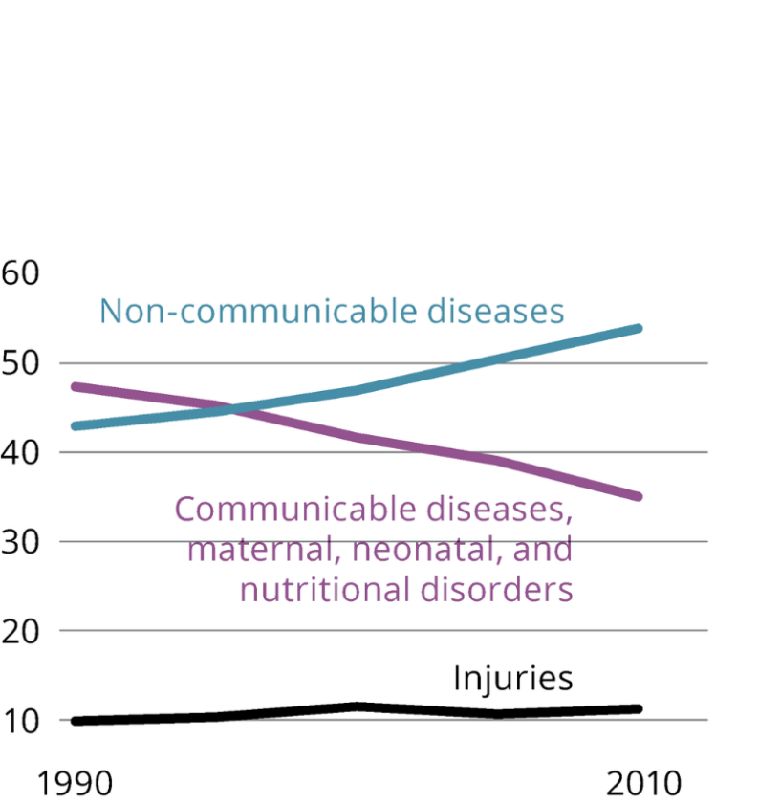

GMT 3: Changing disease burdens and risks of pandemics
Non-communicable diseases (e.g. obesity) now outweigh communicable diseases (e.g. malaria). The threat of global pandemics continues.
25%
...of the global burden of disease and deaths can be attributed to environmental causes
(mostly urban air pollution, PM, ozone)
Source: IHME Global health data exchange database, 2014; WHO Global health estimates, 2014.
Notes:
Danes smo tudi na kriziscu trendov ko non- communicable bolezni prevladujejo nad communicable (infekcijske?)
Nevarnost globalnih pnademij je se vedno globalni trend. 25% vzrokov za bolezni in smrti je po anlizah WHO zaradi okoljskih vzrokov: predvsem onesnazenje zraka v mestih, delci in ozon.
V Evropi bo kljub dosezkom izziv starnje prebivalcev in ucinki klimatskih sprememb.

Slide 14
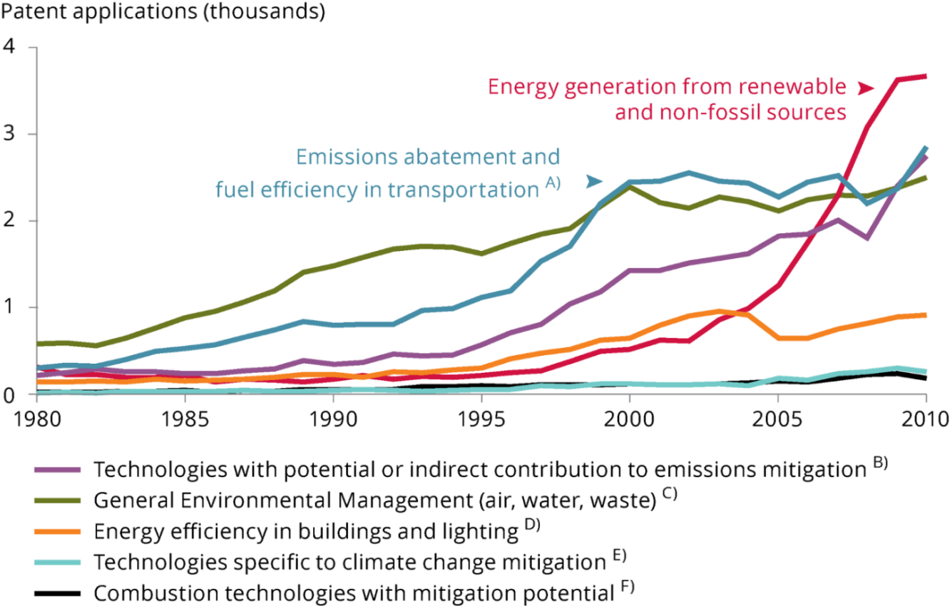
GMT 4: Technological innovation is rapid and accelerating, including in the field of green technology
Environment-related patent applications to the European Patent Office, 1980–2010
The unprecedented pace of technological change provides opportunities to reduce humanity’s impact on the environment and reliance on non-renewable natural resources, while improving lifestyles, stimulating innovation and green growth.
Innovation, however, brings also risks, which could be minimised with policies.
Source: OECD, 2014.
Notes:
Nove tehnologije korenito spereminjajo svet. Se zlasti na podrocju nano in biotehnologije in informacijske in komunikaijske tehnologije. To odpira moznosti za zmanjsanje vplivov na okolje, povecanje preskrbe z viri, a tudi prinasea negotovisti in tveganja ker som nam mnogi ucinki se neznani.
Okoljski patenti registrirani na evropskem patentnem uradu - narascajoci trendi. Evropa ima priloznost postati vodilna v svetovnem merilu na podrocju okoljskih tehnologij.

Slide 15
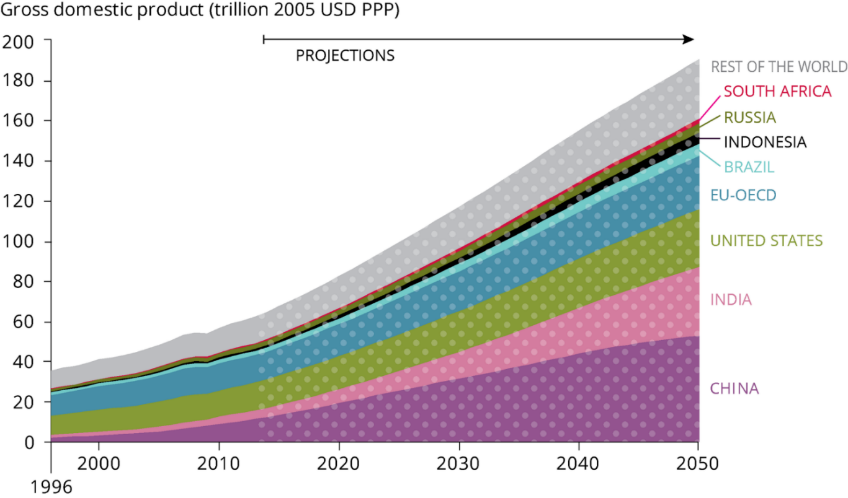
GMT 5: Continued economic growth?
GMT 6: An increasingly multipolar world
World economic output has increased 25-fold since 1900
In the period 2010-2050, global GDP is expected to grow by…
300%
but growth rates are slowing as countries become more prosperous
Shrink of OECD share
of global GDP
2000 2050
77%
42%
Growing middle consumer class in Asia
Source: OECD Long-term Baseline Projections 2014.
Notes:
Nadaljna gospodarska rast? Multipolaren svet.
Pricakuje se nadaljna gospodarsk rast kar za 300%. Evropa bo v tem pogledu realtivno manj vplivna saj se najvecji porast pricakuje na vzhodu. Izgledi za netrajnostne vzorce proizvodnje in potrosnje so veliki (porast srednjega potrosniskega razreda) in to predstavlja veliko tveganje za trajnostni razvoj. Nekatere studije predvidevajo da obstajajo moznosti ekonoskega porasta ob zmanjsanju uporabe virov. Kljucnega pomena je pri temm vkljucevanje okoljskih racunov v druzbene racune.

Slide 16
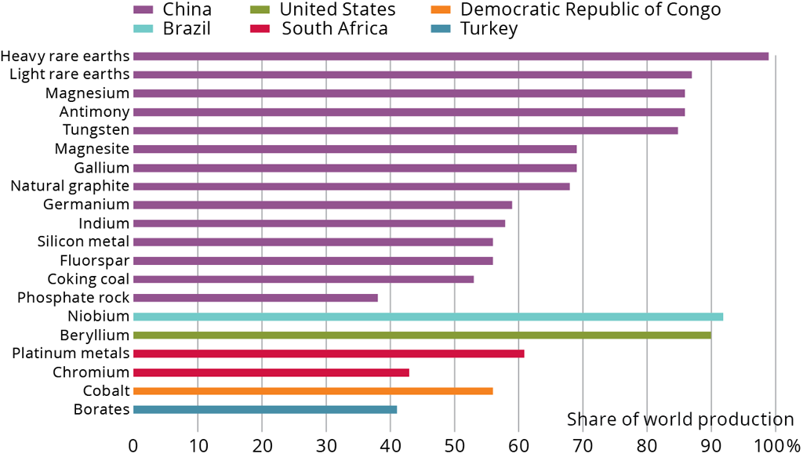
GMT 7: Intensified global competition for resources
World materials use has grown 10-fold since 1900 and may double again by 2030
The geographic concentration of some reserves creates supply risks and could lead to conflicts.
Source: European Commission 2014.
Proportion of global production of EU critical raw materials within a single country, 2010–2012
Imports from outside the EU accounted for 58 % of EU-27 consumption of metal ores and products in 2011 and 79 % of fossil fuels.
Notes:
Okrepljeno svetovno tekomovanje za vire.
Gospodarstva v razvoju porabijo vec obnovljivih in neobnovljivih virov (indistrijski razvoj in vzorci potrosnje).
Neenakomerna razporeditev zalog virov predtavlja prihodnje tveganje za zagotovljen dostop do osnovnih virov,
Kar lahko povzroca omejitve v dobavi, nizanje kvalitete zivljenja in celo geopoliticne konflikte.
Povecano pomanjkanje virov in porst cen bi lahko vzpodbudila vlade da investirajo v znanost in inovacije.

Slide 17
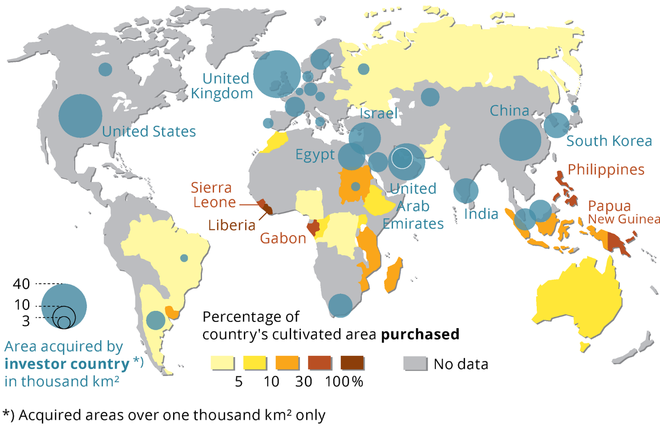
GMT 8: Growing pressures on ecosystems
Demand for meat, water and bioenergy is driving global competition for land resources. Food, mobility and energy are exerting increasing pressures on Earth’s ecosystems. Climate change exuberates those impacts.
Transnational land acquisition, 2005–2009
Source: Rulli et al., 2013.
Notes:
Vse vecji pritiski na ekosisteme
Porast potreb po hrani in energiji in hitro se razvijajoci vzorci potrosnje bodo se naprej povzrocali pad bioioiverzitete, in zivljenski standard/eksistenco predvsem ze itak bolj ogrozenih ljudi in narodnosti. V Evropi se predvideva velik vpliv na ekosisteme.
S tem povezan je tudi pojav land grab- prisvajanje zemljisc:
Modri krogi so drzave, ki si prisvajajo zemljo, drzava vlagateljica
Rumeni do rdeci odtenki so prisvojena/kupljena zemlja
The demands of a growing global population with evolving consumption patterns for food, mobility and energy are exerting ever-increasing pressure on the Earth's ecosystems and their life-supporting services. Current trends also challenge existing meat-heavy consumption patterns and strategies for bioenergy production.
Exacerbated by climate change and continued pollution, rates of global habitat destruction and biodiversity loss are predicted to increase, including in Europe.
The effects of continued ecosystem degradation on poverty and inequality in regions outside Europe may lead to increased immigration to Europe.
Grabbing countries – blue circles
Grabbed countries - coulors

Slide 18

GMT 9: Increasingly severe consequences of climate change
Recent changes in the global climate are unprecedented over millennia and will continue.
Climate change is expected increasingly to threaten natural ecosystems and biodiversity, slow economic growth, erode global food security, harm human health and increase inequality.
The risks of pervasive and irreversible impacts are expected to increase. They could, however, be reduced by further emissions abatement and adaptation measures, building on past actions in Europe and internationally.
Key risks for Europe include flood events, droughts and other weather extremes that damage ecosystems and biodiversity, as well as infrastructure and human well-being.
© Manuela Aldeghi, Environment & Me /EEA
Notes:
Nedavne klimatske spremembe so rekordnega znacaja skozi stoletja in se bodo nadaljevale.
Povezan je z drugimi GMT, ki predstavljajo gonilne sile klimatskih spremembe (prebivalstvo, urbanizaija, tehnoloske spremembe..), kakor je tudi sam po sebi ta gmt gonilan sila prihodnjih okoljskih sprememb. Ti spiralni feedback mehanismi pridajajo k zapletenosti problemov in stopnjujenjo njihove uinke na okolje in druzbo.
Vplivi so stresni za ekosisteme, zmanjsujejo njihovo odpornost proti drugim pritiskom
Tudi ce bi izpuste toplogrednih plinov danes ustavili, bi se podnebne spremembe nadaljevala se veliko desetletij zaradi preteklih izpustov in inercije podnebnega sistema (IPPCC2013)
Na splosno je sposobnost prilagajanja Evrope relativno visoka, vendar obstajajo obutne razlike med razlicnimi deli Evrope glede vplivov, ki jim bodo izpostavljeni in njihove sposobnosti prilagajanja.
Morja-zakisljevanje
Obale –erozija in dvig morske gladine
Pretoki rek-manjsi, intenzivnost sus, visje T vode
Tujerodne vrste
Kmetijstvo: spremenjene fenoloske razmere za poljscine, spremenjen obseg in razporeditev poljscin
Spremenjeni donosi
Povecana potreba po namakanju
Gore v Sredozemlju: okrnjeni ekosistemske storitve
Ocene tveganj in obcutljivosti so narejene za 22 drzav, vendar pogosto ni podatkov o stroskih in koristih prilagajanja in tudi vplivov na biodiverziteto.

Slide 19
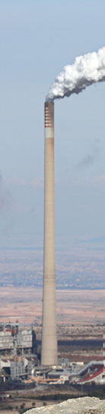
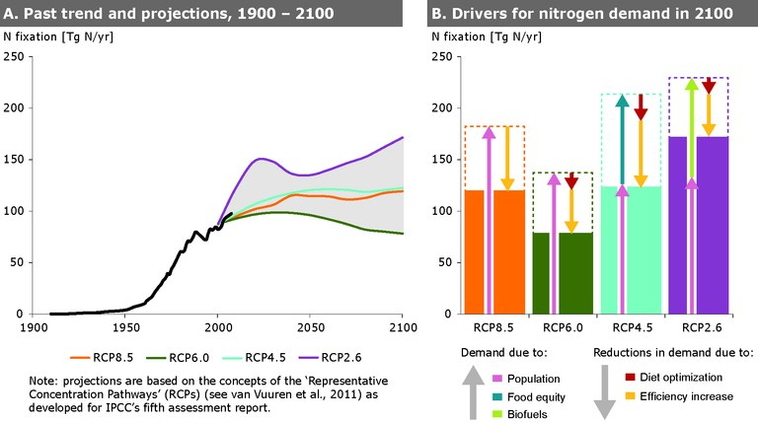
GMT 10: Increasing environmental pollution
Globally, levels of air pollution and releases of nutrients from agriculture and wastewater remain high, causing acidification and eutrophication in ecosystems, and losses in agricultural yield.
In the coming decades, overall pollution levels are projected to increase strongly, particularly in Asia.
Although Europe’s pollutant releases are expected to continue declining, Europe is likely to be affected by developments in other regions.
  Despite a fall in air pollutant emissions there has not been an equivalent improvement in air quality across Europe, partly as a result of the transboundary transport of air pollutants.
Global nitrogen demand
2000 2100
© Jonathan Díaz Marbá, Environment & Me /EEA
200 ?
million
tonnes
90 million tonnes
Notes:
Ekosistemi so po svetu izpostavljeni kriticnemu onesnazenju z vse bolj kompleksnimi mesanicami onesnazeval.
Onesnazenje s hranili je velikega pomena za dusikov globalnega krozni tok -zakisljevanje
Prekomejno onesnazenje bo pomemben vir onesnazenja.
Recent changes in the global climate are unprecedented over millennia and will continue. Climate change is expected to increasingly threaten natural ecosystems and their biodiversity, slow economic growth, erode global food security, threaten human health and increase inequality.
The risk of pervasive and irreversible impacts is expected to increase. They could, however, be reduced by emissions abatement and adaptation measures, both in Europe and internationally.
Key risks for Europe include flood events, droughts and other weather extremes, threatening human well-being and infrastructure as well as ecosystems and biodiversity.

Slide 20
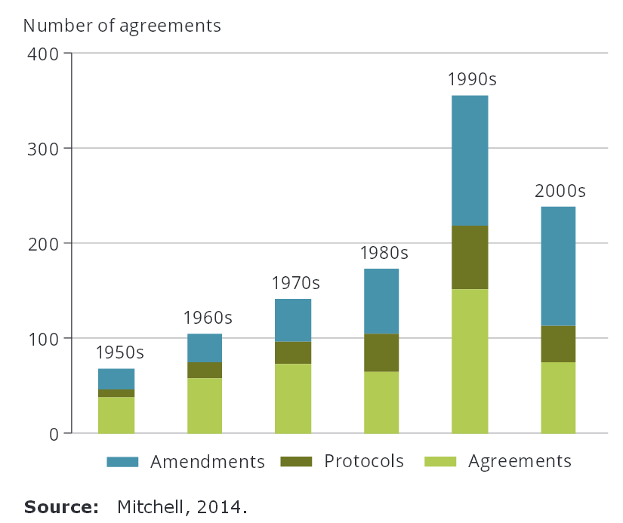
GMT 11: Increase of the role of non-state actors and proliferation of international environmental agreements
Number of international environmental agreements, 1950s-2000s
Source: Mitchel, 2014.
Notes:
Raznovrstnost pristopov k upravljanju
Vse vec je globalnih in bilateralnih sporazumov a tudi regionalnih povezav za doseganje politicnih ciljev. Nevladni delezniki imajo vse vecjo vlogo
While governments are likely to remain the primary mechanism for coordinating human activity, there is growing evidence of a shift towards a more diverse mixture of governance approaches.
Some can be seen as extensions of state authority, operating via international agreements and some pooling of sovereignty in regional blocs. Others involve an increasing engagement of non-state actors.
Changes and shifts in governance are driven by mismatches of scale which create a gap in global governance and by new technologies and norms which offer new approaches to governance

Slide 21
  Challenges and opportunities
Global challenges:
Food ( + 70% meat by 2050)
Good water availability
Energy (+30-40% in 20 years)
Raw materials (+100% by 2030)
Ecosystem depletion (10-40% loss by 2050)
WEF Global Risks 2016 report
By impact | By likelihood
failure of climate change mitigation and adaptation | large-scale involuntary migration
weapons of mass destruction, | interstate conflict with regional consequences
water crises | extreme weather events
large-scale involuntary migration | failure of climate change mitigation and adaptation
severe energy price shock (increase or decrease) | major natural catastrophes.
Notes:
V povzetku boo globalno potreovali
70% vec mesa
30-40% energije
Vec kot 100% virov
Dobro kakovist vode. Ekosistemska degradacija se pricakuje v okviru 10-40% izgub.
Tudi WEF je prvic v svoji seriji letnih ocen o globalnih risks/tveganjih zaznal vec kot polovico tveganj okoljskega izvora.

Slide 22
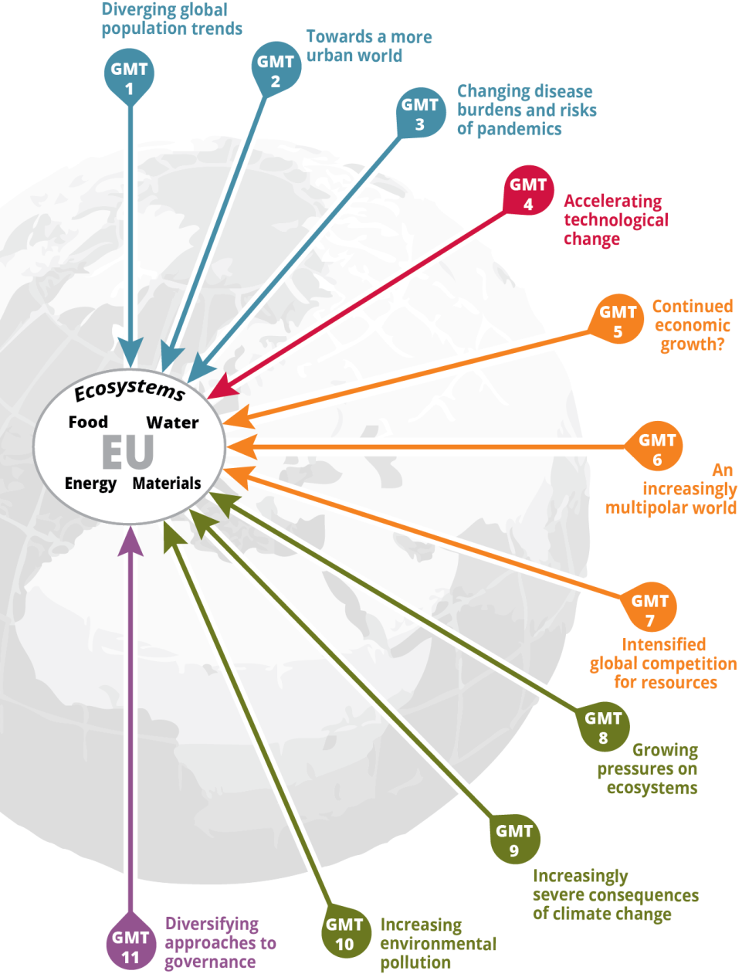
  Impacts of GMTs - Europe
Global megatrends strongly impact Europe’s ability to meet its basic resource needs:
Food
(price volatilities, poverty induced immigration, reduced quality and volume produced in Eu (cc.), adverse impacts to yields from transboundary pollution
Water
Drought and water scarcity in south, eutrophication, transboundary pollution
Energy
Materials
Competition fro resources, import depndancy
Ecosystems and their services
Europe has opportunities through different response options to
shape and adapt to global megatrends
land
We basically have three choices: mitigation, adaptation and suffering.
We’re going to do some of each. The question is what the mix is going to be. The more mitigation we do, the less adaptation will be required and the less suffering there will be.
John Holdren (Obama’s Science Advisor)
© NASA Earth Observatory
Notes:
V Evropi
Dolgorocna oskrba s hrano, vodo, energijo, surovinami ni odvisna le od izboljsane ucinkovitosti njihove rabe in povecevanja odpornosti ekositemov, temvec je tudi odvisna od svetovne dinamike nad katero Evropa nima nadzora, ali le v omeji meri. Evropska prizadevanja za zmanjsanje pritiskov na okolje imajo vse manjsi ucinek zaradi neustavljivih trendov v drugih delih sveta.
Morda je najvecja tezava za evropsko okoljsko upravljanje izhaja iz dejstva da so gonila, trendi in vplivi ki se nanasajo na okolje vse bolj globalizirani
Citat lahko umaknes ali ga poves.

Slide 23
  Impacts of GMTs – National level
EIONET NRC FLIS –project coordinated by CH to collectively investigate national impacts of GMT under the same methodology (2015-2016-2017)
Some countries already specifically included GMTs and their impacts in latest SoE reports (Belgium, Switzerland, Austria, Slovakia, Hungary)
ARSO- indicator database – many links to GMT can enable assessment, lack of forward-looking indicators
Slovenian national indicator | Link to GMT
6 | Diverging global population trends:
13 | Towards a more urban world:.
18 | Changing disease burdens and risks of pandemics:
 | Accelerating technological change:
3 | Continued economic growth?:
1 | An increasingly multipolar world:.
20 | Intensified global competition for resources:
18 | Growing pressures on ecosystems:
18 | Increasingly severe consequences of climate change:
41 | Increasing environmental pollution:
5 | Diversifying approaches to governance
Notes:
GMT project z nRC FLIS (sedaj zacetek v Slo)
Nekatere drzave ze vkljucile v Soe
Preglednica indicatorjev glede na GMT iz leta 2015. Mogoce je ze vec. mBarbarra bo imela predstavitev in se naveze nanjo.

Slide 24
11 Global megatrends and sustainability challenges

Slide 25
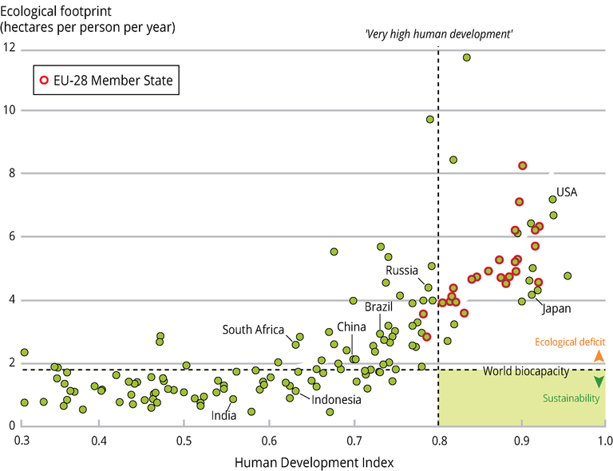
7th EAP: « Living well…within the ecological limits of our planet«
Long term sustainability transition
Within environmental limits
‘good life’
Source: UNEP 2012 - GEO5
Notes:
This figure plots countries on the basis of two indicators: the Human Development Index (HDI) and the ecological footprint per person. Red circels EU.
In order to achieve sustainability, countries must move towards the bottom right hand corner marked in green and as such decouple human development from natural resource use and environmental impacts.
The figure shows that worldwide, no country held that position in 2007.
We should also look to avoid, we can’t afford, to take the path the red arrows take us: higher human wellbeing yet an increase in the ecological footprint followed by a realisation for the need for change, leading to a decrease in the footprint.

Slide 26
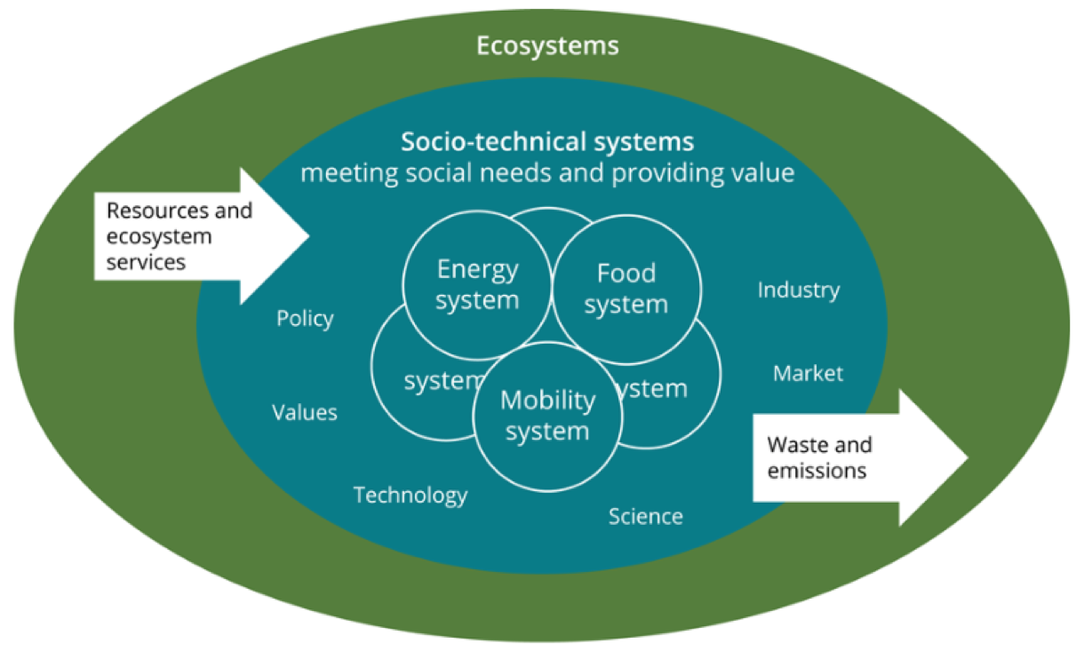
Systemic challenges require systemic solutions
Second, because the co-evolution of technological and societal systems creates lock-ins, feedbacks and trade-offs, implying the need for a systemic perspective.
NATIONAL LEVEL
GLOBAL MEGATRENDS
ENVIRONMENT
ENVIRONMENTAL POLICIES
Source: EEA
Notes:
To se odraza v novem pristopu k porocanju o okolju,ki ga bomo implementirali za SOER 2020.
Globalne anlize morajo biti tesno povezane z evropskimi sitemskimi analizima (hrana, energija, promet, urbana obomcja) da lahko ocenimo kompleksnost problemov in priporocila za izdelavo politik.
Na levi GMT vp;iovi na evropsko innacionalno raven, v sreidni kroga bazicni druzbeni sitemi v okviru ekosistemskih podpor.
Pr zagotavljanju ciljev bomo morali psoebaj ocneiti kje obstaja in v kaksnem razredu ujetost v siteme (ne zmoznost za tranzicijo, npr izgradnja energetske infrastructure v obstojecih energetskih sitemih sedaj, bo v prihodnosti neizkoriscena ce bomo presli na obnovljive vire in nizkoogljicno druzbo) (Lock-in)
Enaki feedback mehanizme, npr vecja ucinkovitost avtomobilov povzroca padec cen in povecano rabo avtomobilov. In oceniti kje se bodo pojavile potrebe po kompromisih (trade-offs), saj niso vsi cilji uresnicljivi simultano ( project GMT SLO bo dal odlicne osnove za te ocene ki so zelo primerne za izdelavao novega NPVO.

Slide 27
Thank you

Slide 28
The European environment –
state and outlook 2020
SOER 2020
Anita Pirc Velkavrh
Head of Foresight and Sustainability group
Integrated assessment programme
EEA
5.7.2017, Ljubljana
Notes:
You have received the SOER 2020 Project plan as a background information.
I will present the logic of the SOER structure and some aspects of the project plan, especially those planned for 2017.

Slide 29


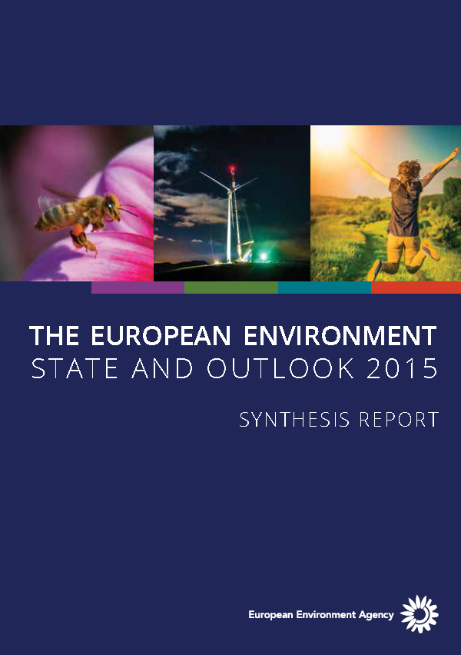
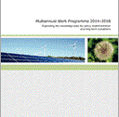
Environmental acquis, 7th EAP
Europe 2020 strategy
Env. acquis, 7th EAP, SDGs
Circular, low-carbon economy transition
2016
2017
2018
SOER 2020
From mainly problem-focused knowledge
To more solutions-oriented knowledge
Notes:
V preteklih SOER porocilih smo izdatno ana;lizirali okoljske problem in jih ocenili v zvezi z Evropskimi programi. Zelo smo vplivali na zadnji 7EAP.
V prihodnjem porocilu bomo analizo problemov in okoljskih politik nadgradili z analizo moznosti in potreb za tranzicjo k dolgorocnim ciljem v Evropi. Porocilo 2015 je zakjucilo da je Visija 7EAP do 2050 neuresnicljiva ce ne spremenimo korenito delovanje osnovnih sistemov v drzavi, hrana, energija, promet, urbani. Posvetili se bomo isaknju moznih resitev, ki jih lahko predlagamo politikam za dosego dolgorocnih ciljev EAP in SDG.

Slide 30
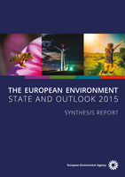

SOER 2020 assessment logic
Fisheries & acquaculture
Forestry
Agriculture
PEOPLE
Energy
Human health &
well-being
Transport
7EAP
Industry
Biodiversity & nature
Chemicals & health
Freshwater
Marine
Land & soil
Climate change
Air pollution
Waste & resources
ENVIRONMENT
ECONOMY
Sectors
Natural
capital
Resource efficiency
Themes*
Context
Policy context
SOER2015
Integrated assesments from a
thematic perspective
Environmental acquis
Integrated assessments from a
cross-cutting perspective
Sectors, 7th EAP objectives, summary assessment
2030 perspective
aquis
Notes:
Na osnovi izsledkov porocila 2015 in zahtev 7EAP bomo pristopili k analizi klasicnih tematskih podrocij-8: biodiverziteta, voda, morja, tla, klimatske spremembe, odaptki in ucnikovita raba virov, kemikalije, hrup in zdravje. To bomo nadgradili z anlizo sektorjev kako se okoljski vidiki upostevajo in pojavljajo v sektorskih politikah (energetika,kmetijstvo, promet, gozdarstvo, ribistvo itd).
V sintezi bomo ocenili vlogo in dosezge na podrocju okolja (zavarovani naravni capital), ekonomije (ucinkovita raba virov) in bv zvezi z ljudmi-zdravje in well being. Analize bodo opremljne z kazalci in izgledi do 2030, podalga bo okoljski aquis.

Slide 31
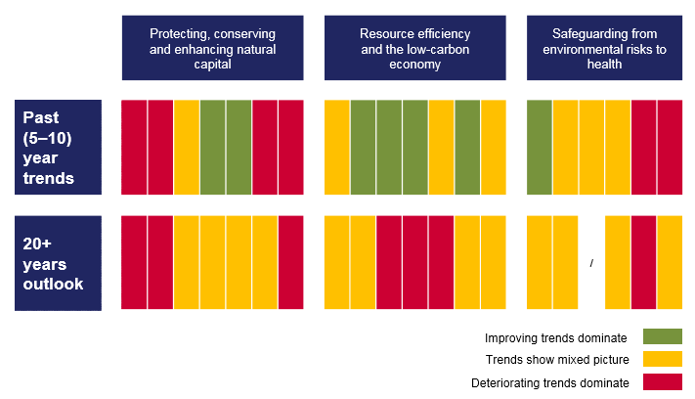
The long-term outlook is not as positive as recent trends suggest
Living well within the planet’s ecological limits in 2050 requires foundamental transitions in systems of production and consumptions (e.g. energy, mobility, food)
(SOER 2015)
EU policy agendas for long term transitions
Low – carbon economy
Worsening long term trends
Bio-economy, Blue economy
Circular economy
Notes:
Pricakujemo da bodo tematske anlize pokazale podobno sliko kot 2015, nezasciten naravni capital, narascajoci problem v zvezi z zdravjem in wellbeing, in nekaterimi naravnimi viri (morja, tla..) Leta 2015 smo tudi ugotovili da dogorocni trendi niso tako pozitivni ceprav so v kratkem roku pozitivni ali neutralni. (glej spodnjo vrstico na piano table,kjer se rumena prelevi v rdeco). Vzrok so globalni trendi in kompleksnost problemov.
Piano table: kolone so
Trendi za zascito naravnegag kapitala
2.ucinkovita raba naravnih virov
3.zdravje in wellbeing
Vrstice so
1. kratkorocni trendi
2. dogorocni trendi.
Vizija 7 EAP ni uresnicljica v sedanjih okvirih in trendih.
Na osnovi the kazalcev so politike ze pristopile k prestrukturiranju: dobili smo Low-carbon economy politico, politico za krozno gospodarstvo in v rpedlogih in ocenah so bio ekonomija in modra ekonomija.
Zatomoramo v drugem delu anliz pristopiti in razviti se druge analize, ki niso bile prej tako prisotne v nashi porocilih.
---------------

Slide 32
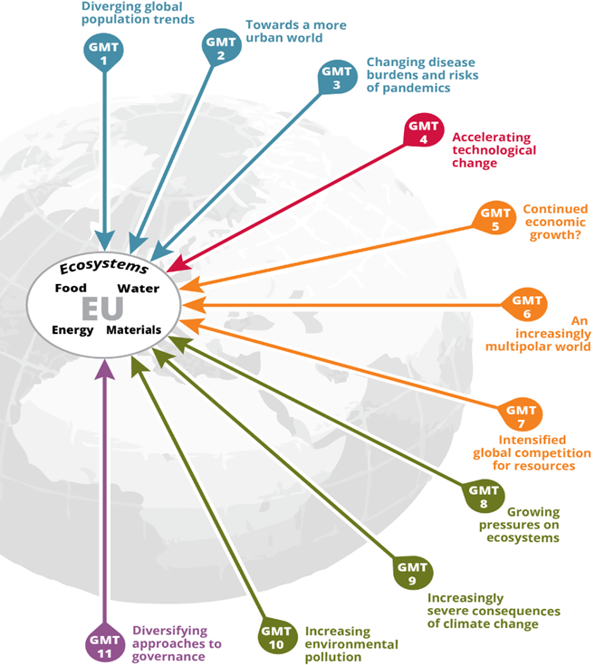
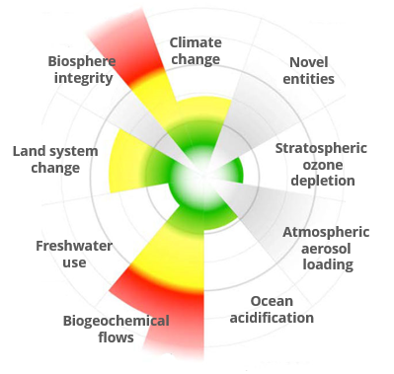
(Produkcijsko potrošniški sistemi )
Global
&
European
ecosystems
Food system
Energy system
Food
Transport
Mobility system
Fiscal
Human well-being
Housing system
Finance
Housing
Energy
Context: Europe’s sustainability goals
and long-term challenges
Global megatrends
Planetary boundaries
Integrated assessment of priority production-consumption systems
Resource flows and impacts
Actors and economic dimensions
Systemic characteristics
Integrated assessment for transitions towards sustainability
Interactions of systems and GMTs
Resource nexus
Governance
Knowledge for transitions
Context: Europe’s sustainability goals
and long-term challenges
Global megatrends
Planetary boundaries
2050 perspective
7EAP, LCE, CE, SDGs
Notes:
Analizirali bomo osnovne druzbene sisteme (energetski, prometni, zivilski, urbani) in njihovo vplivena naravne vire v medsebojni povezavi. To bo pokazalo na neizbezne compromise,ki jih bomo morali preuciti in ponuditi politiki. Analizirali jih bomo tudi v odnosu do finanacnih in fiskalnih sitemov. (sredina slike)
Te analize bomo morali postaviti v tesne povezave z globalnimi trendi in ekoloskimi omejitvami planeta,saj je Evropski vpliv v drugih delih sveta precejsni ( outsoursing of industry, uvoz materialov etc.) (leva stran slike).
Koncno bomo morali napraviti ocene kaj topomeni za uresnicitev nizko ogljicne politike, kroznega gospodarstva, SDG in 7 EAP. Kaksne tranzicije so potrebne,v akterih sistemih, kje so najvecji problem. Podali bomo tudi primere drzav o dobrih praksah izvedbe tranzicij.
Kajti te koncne ocene vplivajo na well being celotne druzbe. (desna stran)

Slide 33
SOER 2020 planning: overall timeline and milestones
2016
2017
2018
2019
2020
ROADMAP & INFORMATION MAPPING
METHODOLOGIES, LEARNING & PARTNERSHIPS
ASSESSMENTS IN PARTNERSHIP
1ST PUBLICATION &
STAKEHOLDERS
2ND PUBLICATION &
DISSEMINATION
Definition, organisation and preparation
Produce Parts 1 and 2
Produce Synthesis
Outreach
December: agree SOER 2020 Project plan
Map knowledge development for 2017–2019
Scope analytical methods and EEA-Eionet learning needs
Develop prototypes for Parts 1 and 2
Identify knowledge needs, develop building blocks
Formalise partnerships and networking
Implement staff learning and capacity-building with Eionet
Develop Communication Plan
Approve Implementation Plan
Continued work on building blocks, partnerships, networking
Draft Parts 1 and 2 and internal review
Annotated outline for the Synthesis
Parts 1 and 2 for external stakeholder consultation
Mid-year: publish Parts
1 and 2 in English
Events and outreach
Engage MS, EU, global stakeholders in discussing Parts 1 and 2
Draft the Synthesis
Short EEA stakeholder consultation on draft Synthesis
Translation of the Synthesis
Mid-year: publish Synthesis in all languages
2020–2021: Events and outreach
EU Presidency
Romania-Finland
EU Presidency
Croatia-Germany
Notes:
Planiramo objaviti te analize v letu 2019. potem bomo vkljucili deleznike z njihovimi perspektivami na ocenjene probleme in v letu 2020 objavili sintezo ki vkljucuje vse perspektive delznikov.

Slide 34
Thank you

Slide 35
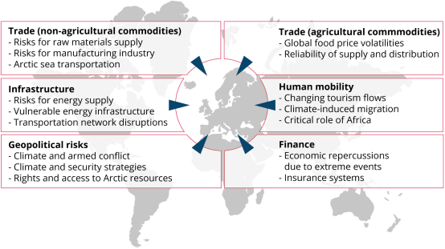
European vulnerability to climate change impacts that occur outside Europe
Notes:
Lead author(s): Tobias Lung (EEA) Contributing author(s): Lisa Eichler (Triple-E), Hans-Martin Füssel (EEA) Key messages
• Several recent studies have suggested that climate change will have much stronger negative impacts on the global economy than previously assumed, with poor countries being disproportionally affected.
• In a highly interconnected and globalised world, Europe is susceptible to spill-over effects from climate change impacts occurring outside the European territory through various pathways. Past extreme events, such as the Russian heat wave in 2010, have had negative economic consequences for Europe (here understood as the EEA member and cooperating countries).
• Six major pathways have been identified from the available literature: trade of agricultural commodities, trade of non-agricultural commodities, infrastructure and transport, geopolitics and security risks, human migration, and finance. Many of these pathways affect the value chains of European products, which are increasingly complex.
• The strongest evidence for Europe’s sensitivity to cross-border impacts exists for economic effects through climate-caused global price volatilities; for transportation networks such as ports; and for changes in the Arctic environment, such as new shipping routes. The Mediterranean area has been identified as the most vulnerable to shocks in the flow of agricultural commodities, while small, open and highly developed European economies are regarded as particularly vulnerable to shocks in the flow of non-agricultural commodities.
• An increasing body of recent literature suggests that unprecedented climatic changes in North African regions, such as the Sahel and Maghreb, as well as in the Middle East will increase the strategic importance of these regions for Europe, with respect both to potential climate-induced human migration flows and to geopolitical and security considerations.
• European vulnerability to cross-border effects is expected to increase in the coming decades, although quantitative projections are not yet available.

