Slide 1
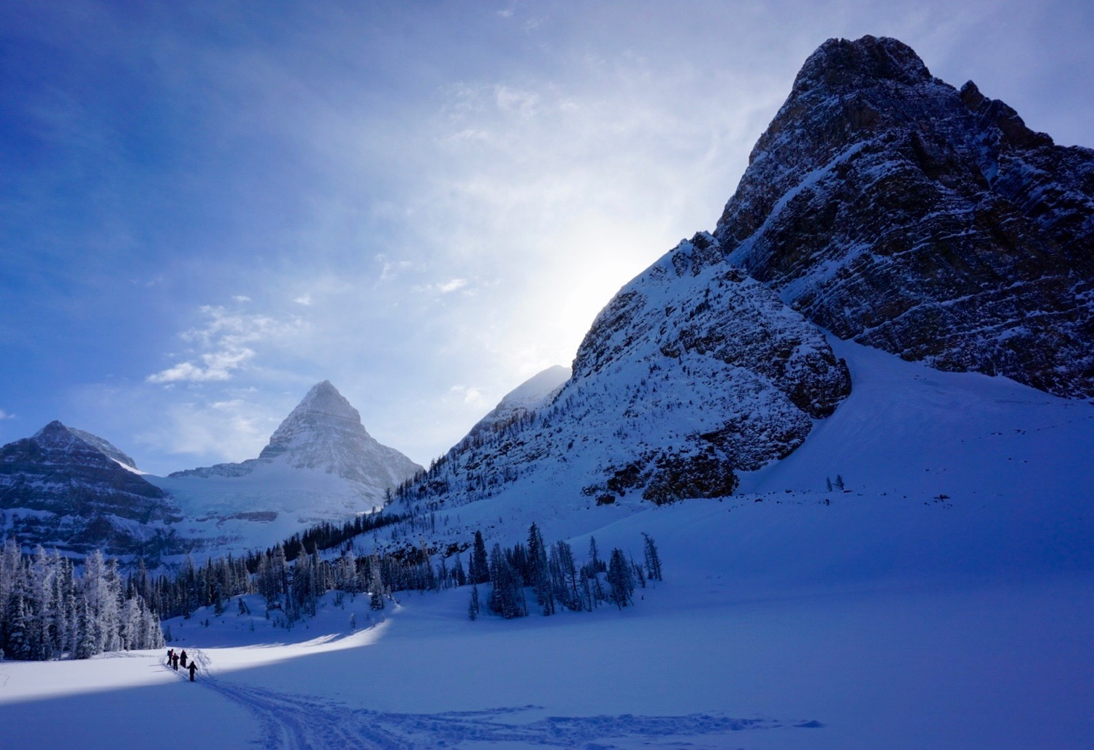
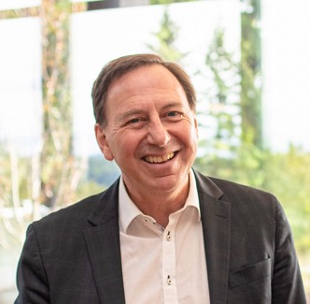

Economy of Well-Being and Regenerative Growth
in Slovenia, Europe, World
October 12, 2022
Guest Lecture
Univerza v Mariboru
Maribor, Slovenia
Mark Anielski
Professor, Economist and Author, The Economics of Happiness &
An Economy of Well-being

Slide 2
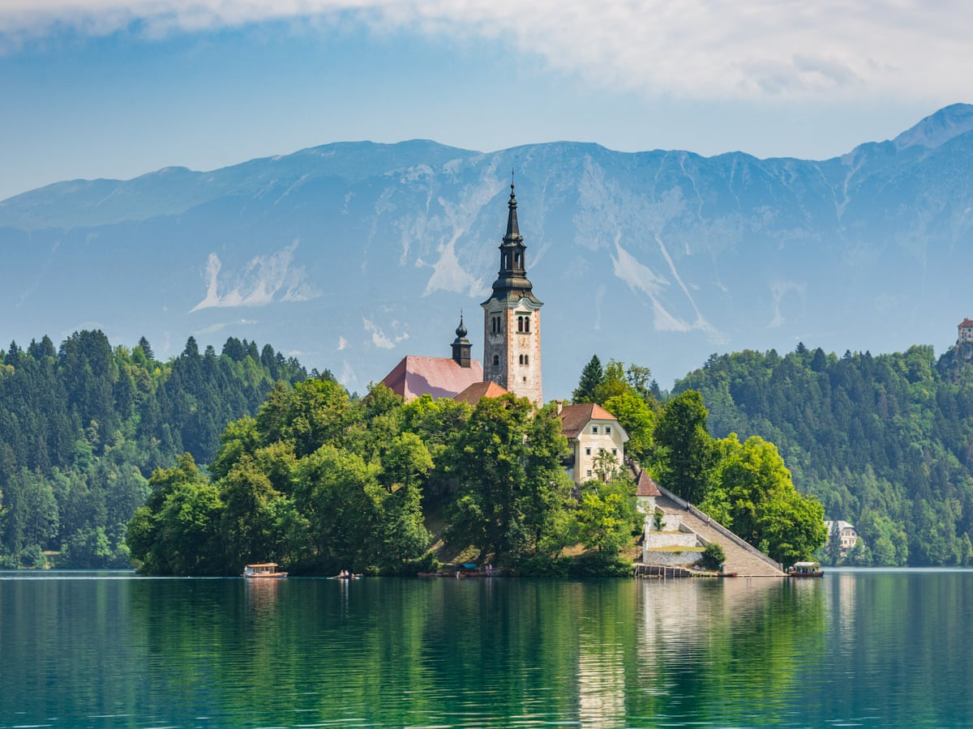
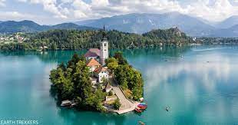
I have a dream.....
To co-create economies of well-being
enduring happiness and
joyful lives
.
"One cannot change an existing system; one must create a new system that makes the old system obsolete"
--- Buckminster Fuller

Slide 3
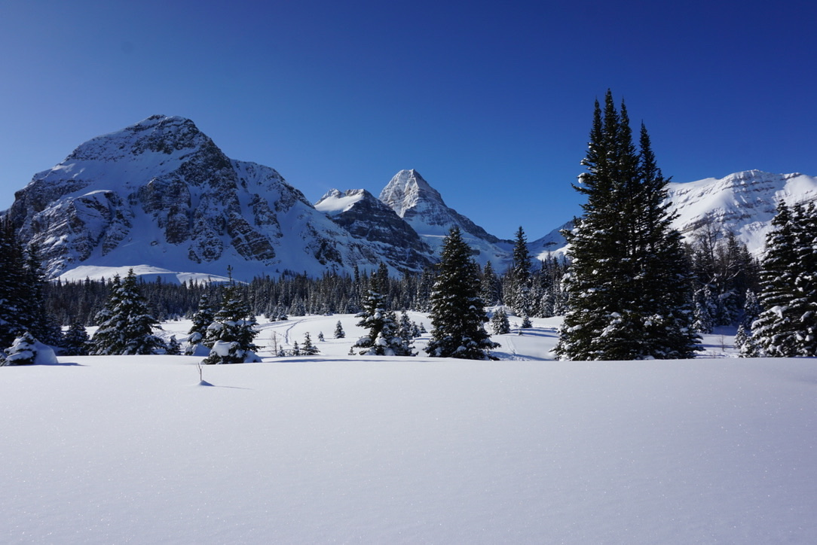
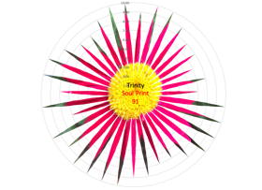
Well-being

Slide 4
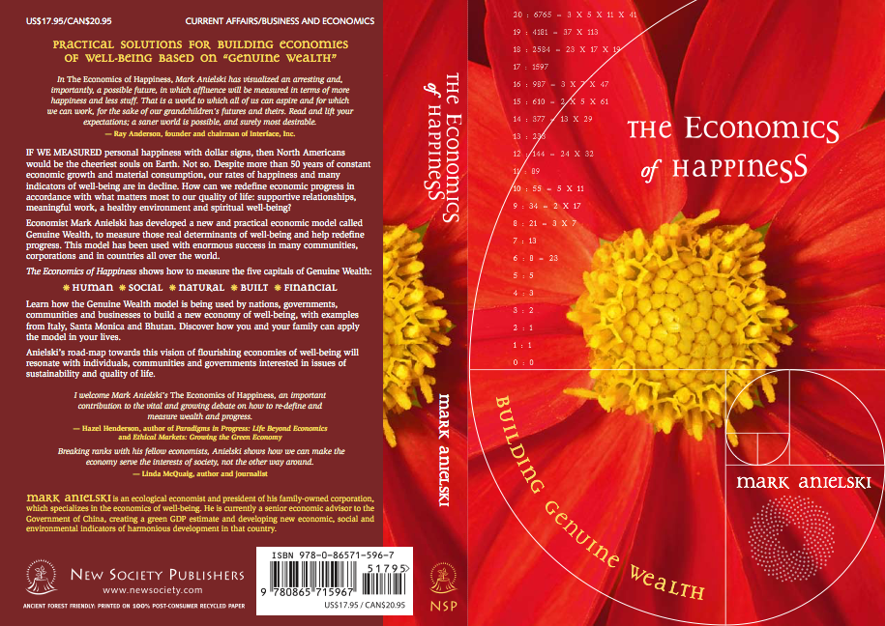
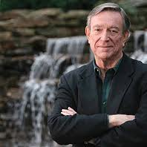
In the Economics of Happiness, Mark Anielski has visualized an arresting, and more importantly, a possible future, in which affluence will be measured in terms of more happiness and less stuff. That is a world to which all of us can aspire and for which we can work, for the sake of our grandchildren’s futures and theirs. Read this and lift your expectations; a saner world is possible, and surely most desirable.
Ray Anderson, Interface, Inc.

Slide 5
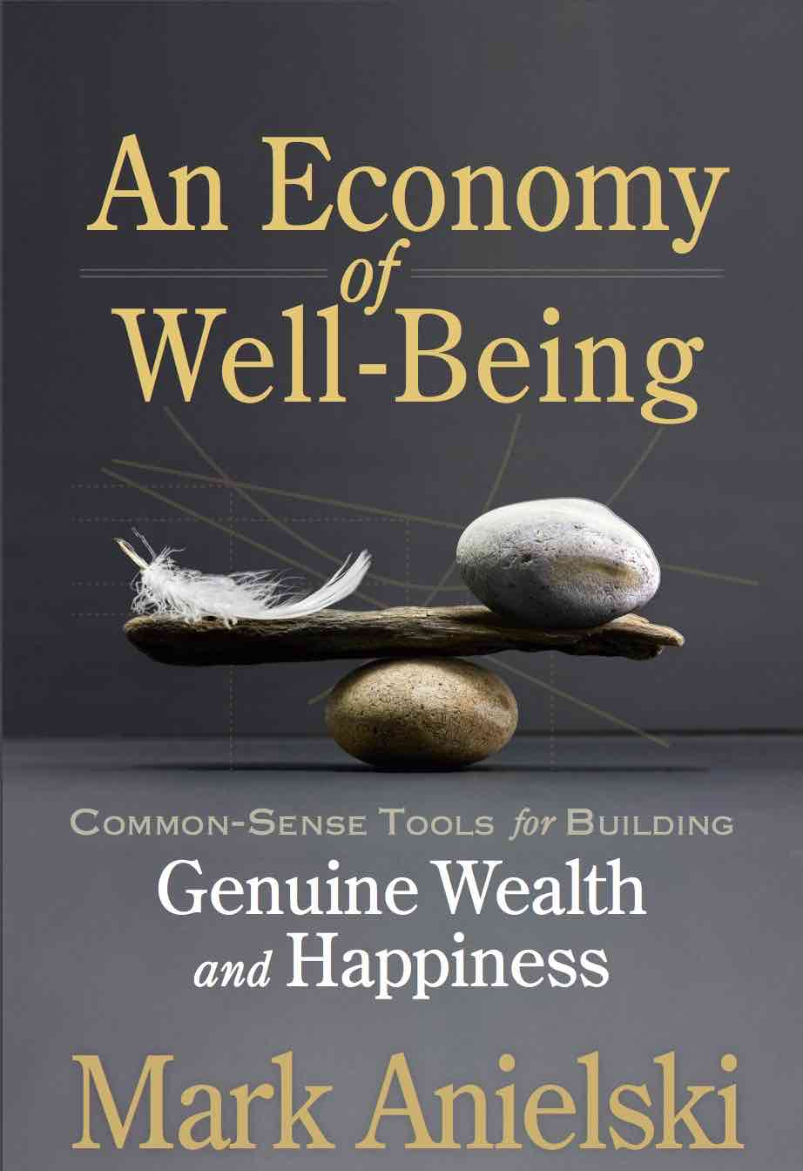

Slide 6
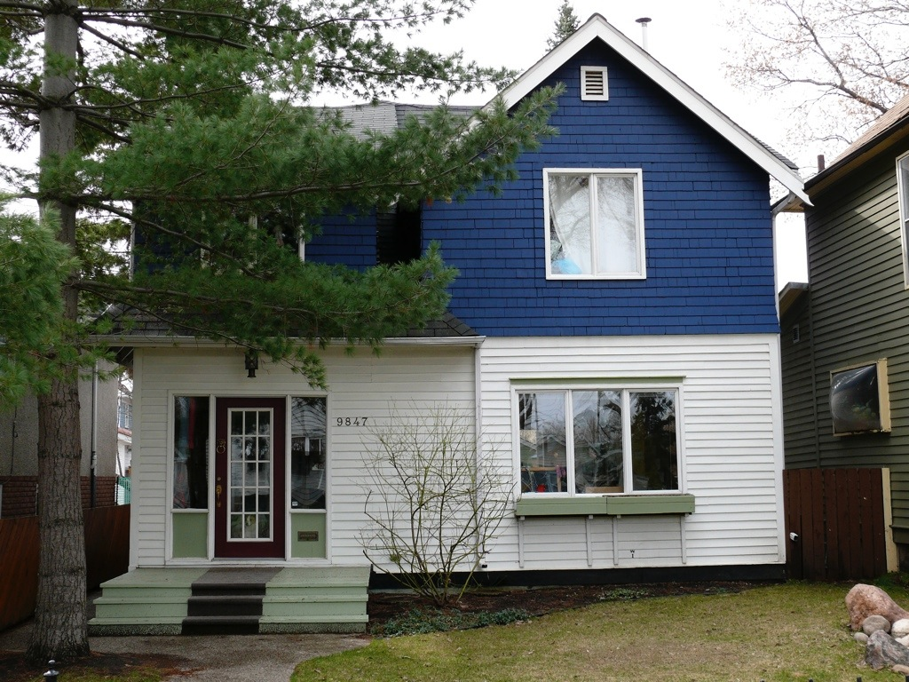
A renaissance in economics and business
ecology
oikos (household) logia (knowledge)
Economy
oikos (household) nomia (management)
Shuswap Lake, British Columbia

Slide 7
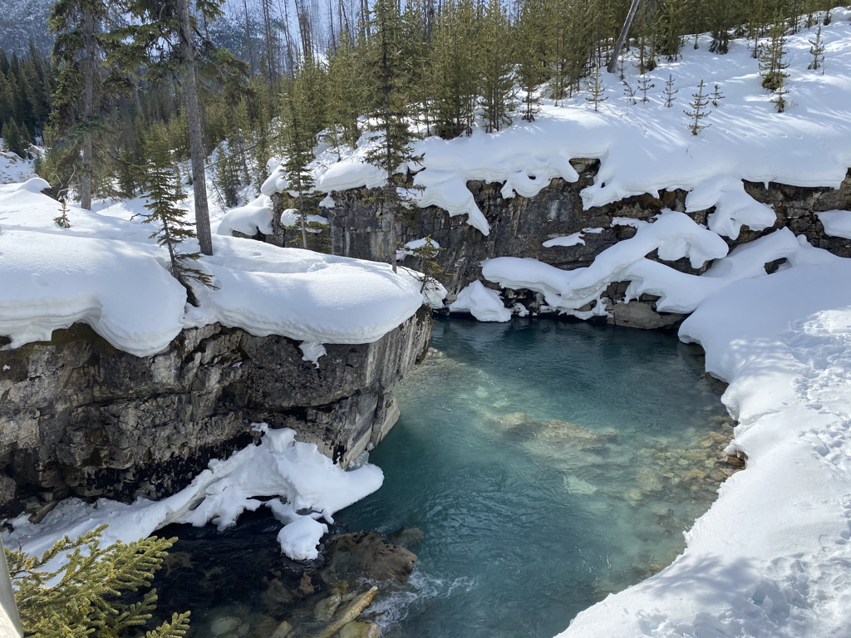
Ecology
Oikos (household) + Logia (knowledge)

Slide 8
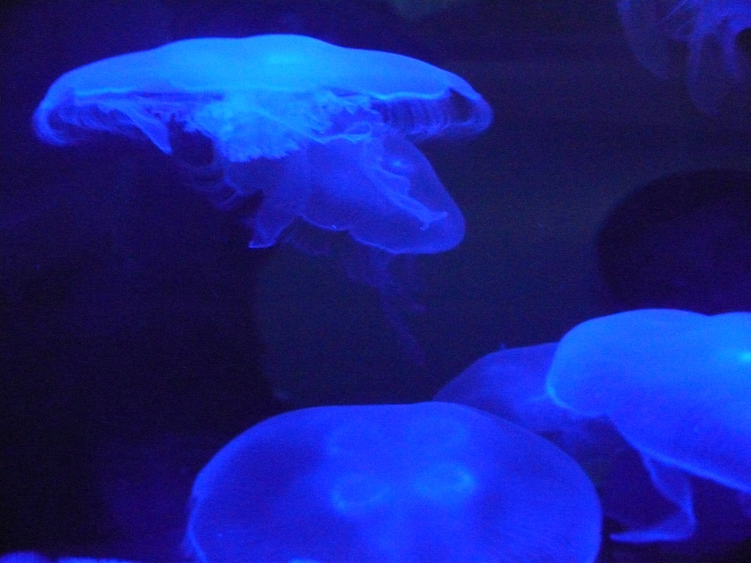
Wealth
“The conditions of well-being”

Slide 9
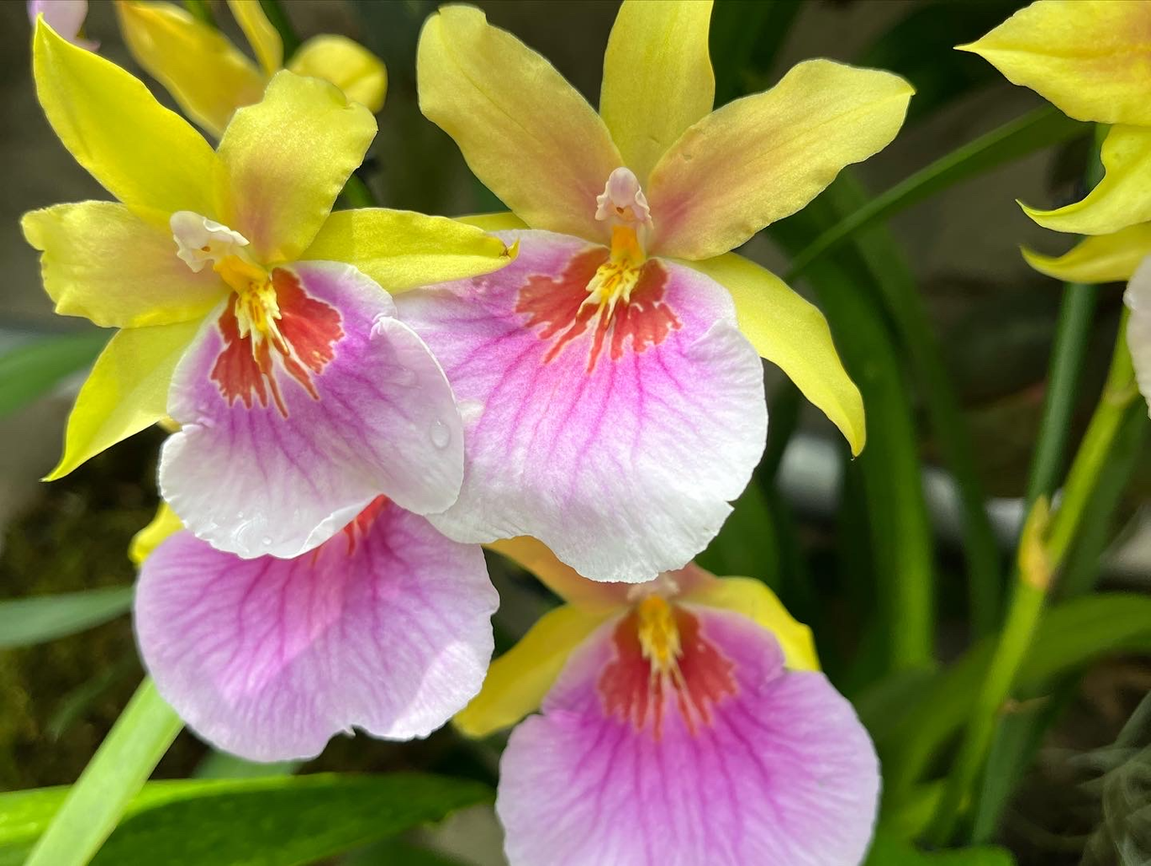
Value
(Latin:valorum)
To be worthy or strong

Slide 10
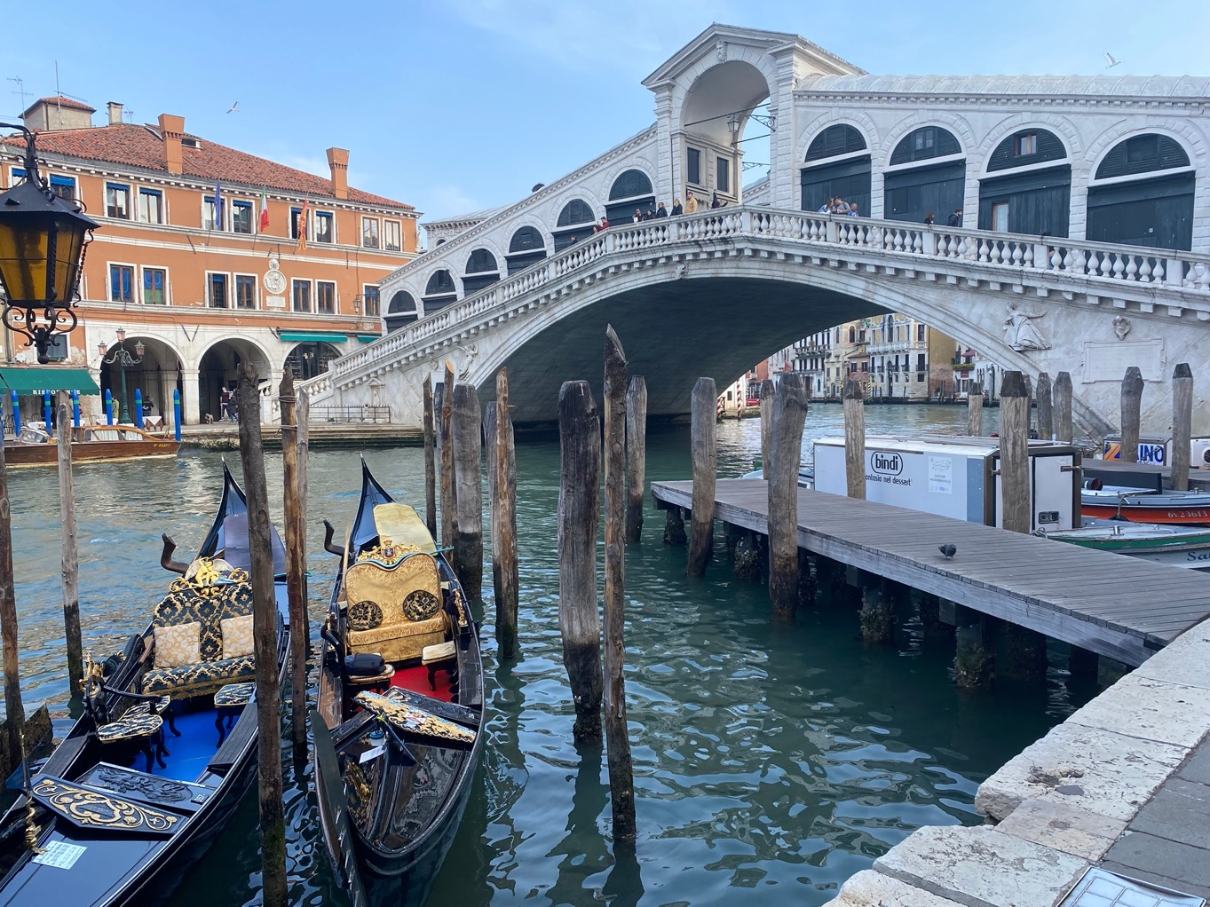
Competition
(Latin:competere)
To strive together
Venice

Slide 11

What’s wrong with how we measure progress?

Slide 12
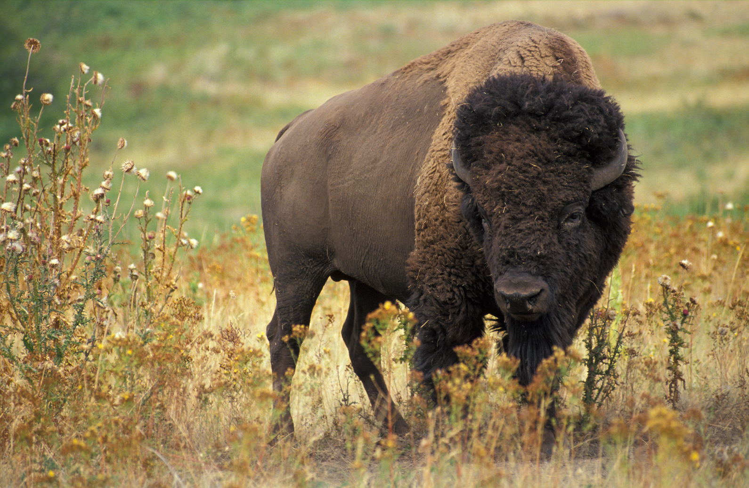
GDP is a flawed measure of progress;
Let us measure what matters to well-being

Slide 13
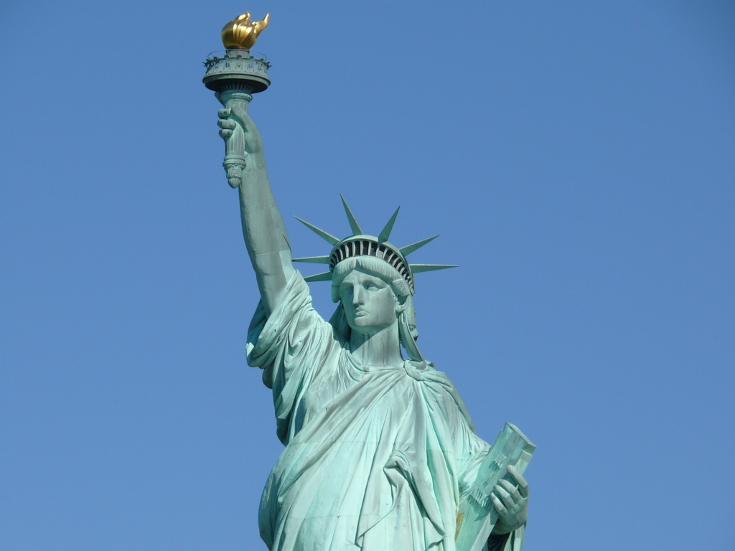
Too much and too long, we seem to have surrendered community excellence and community values in the mere accumulation of material things.
The gross national product (GNP) does not allow for the health of our children, the quality of their education, or the joy of their play...it measures everything, in short, except that which makes life worthwhile.
What’s wrong with GDP?
Robert Kennedy, 1968

Slide 14
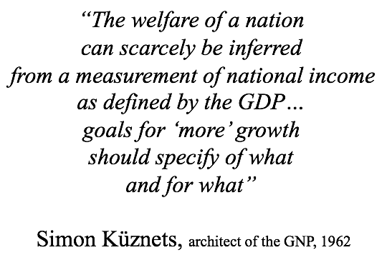
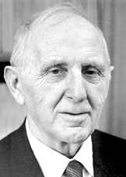
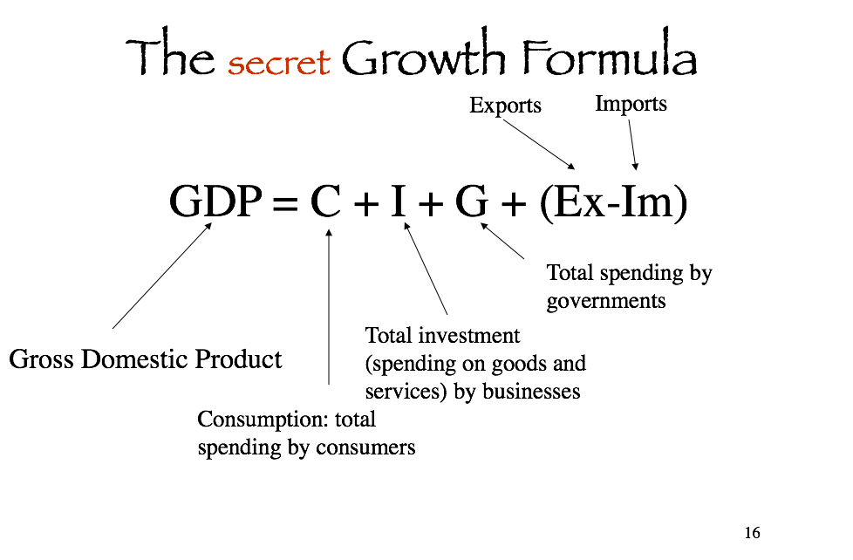

Slide 15
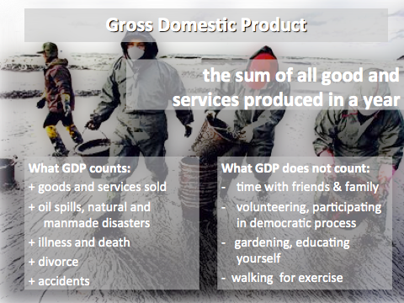

Slide 16
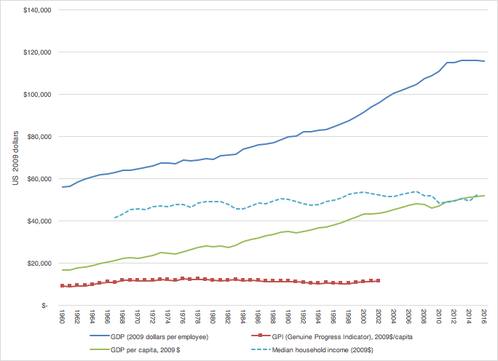
A rising tide of US GDP has not benefited the majority of Americans
US real GDP
per employed worker
US median household income
US real GDP per capita
US Genuine Progress Index
per capita

Slide 17
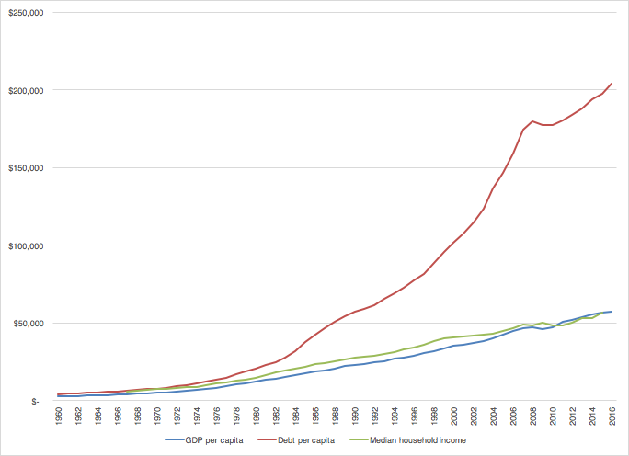
For every $1.00 of American household income, $0.44 will be spent on hidden interest charges on $91.6 trillion of outstanding debt money.
The hidden cost of debt
US total debt outstanding 2022 = $91.56 trillion
$26 trillion (government)
$19.5 trillion (business)
$18.6 trillion (household)
Debt money and the hidden impact of debt charges in the economy is the most significant missing element of the UN SDGs
Interest costs represent 20% of US GDP
US median household income
US GDP per capita

Slide 18
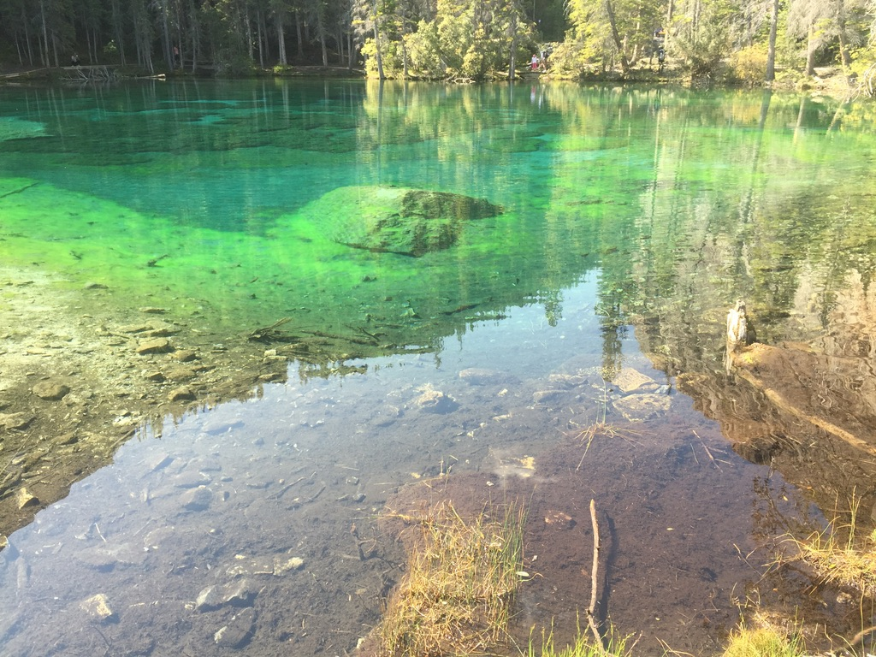
What is happiness?

Slide 19
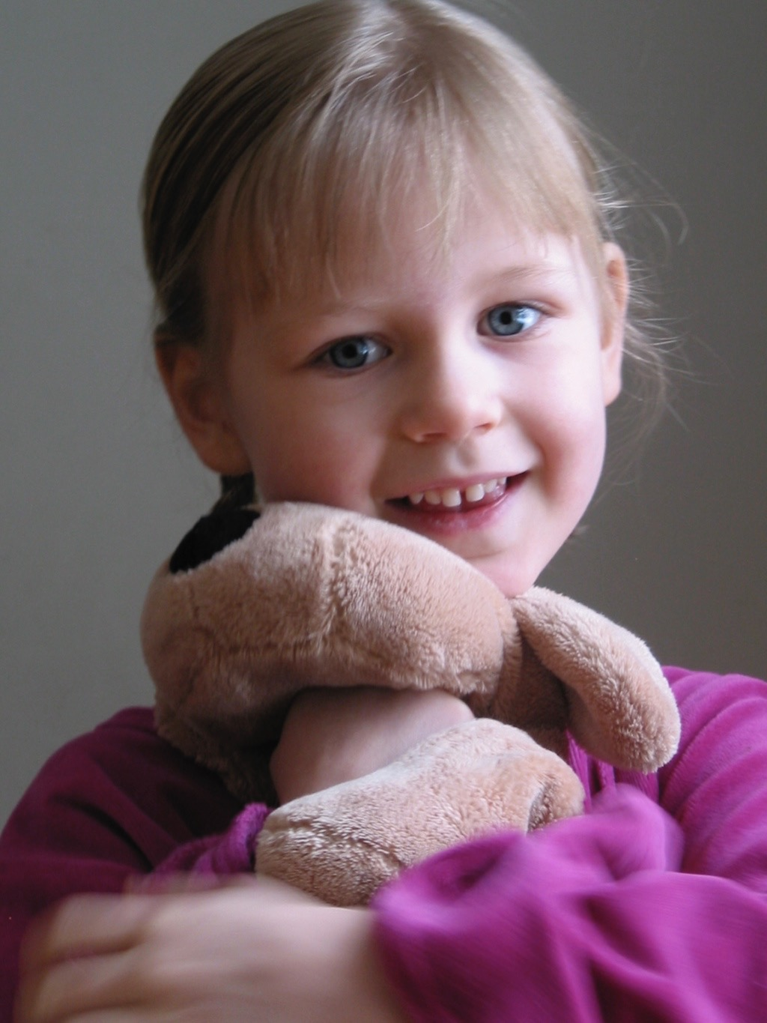
Happiness
(Greek: eudaimonia)
“well-being of spirit “
on the purpose of an economy
(based on Aristotle’s teachings)
Economics is the science that studies the component cells of the state, that is families, and their interrelationships and their conditions of existence.
He condemned, as a sin, individual efforts to achieve a continuous and unlimited increase in material wealth which modern society applaud as a quality.
A sense of well-being, resulting from achieving excellence in the fulfillment of one's functions.
-- Aristotle

Slide 20
Happiness results from a good birth, accompanied by a lifetime of good friends, good children, health, wealth and a contented old age...and virtuous activity.
(Aristotle)
A sense of well-being, resulting from achieving excellence in the fulfillment of one's functions.
-- Aristotle

Slide 21
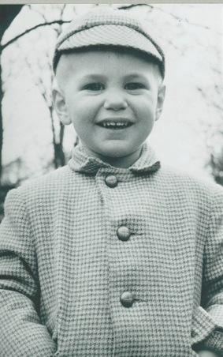
Life satisfaction can be defined as…
Being engaged in life
Being curious
Feeling life as ‘flow’
Personal development and growth
Autonomy
Fulfilling your potential
Having a purpose
Feeling life has meaning

Slide 22
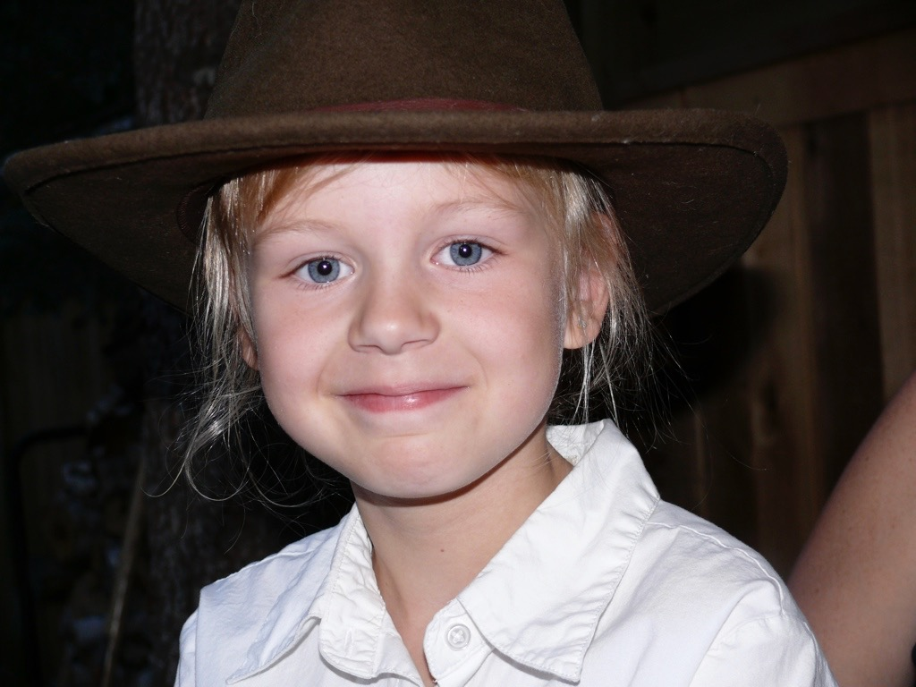
Being happy is seriously good for you and others.
Happy and fulfilled people live up to seven years longer, have stronger social networks and are more engaged in their communities.
Happiness results from a good birth, accompanied by a lifetime of good friends, good children, health, wealth and a contented old age...and virtuous activity.
(Aristotle)

Slide 23
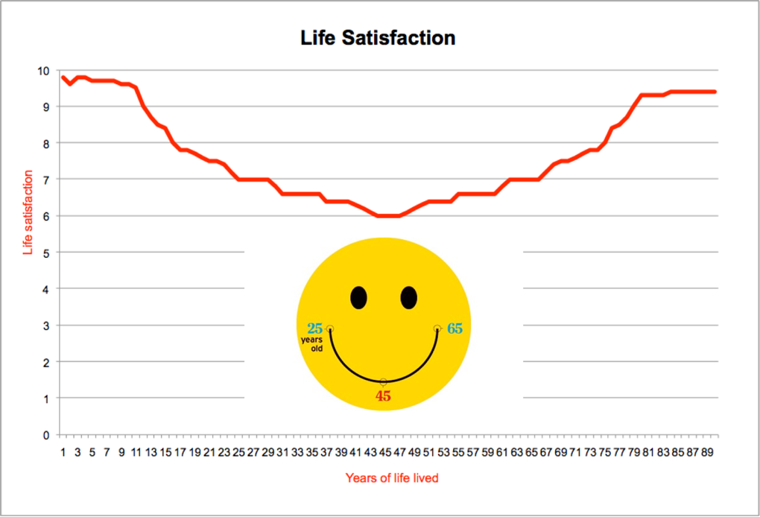
Life-satisfaction ratings are highest between birth and 12 years of age then slowly decline reaching a low point about 45-49 years of age and then improve again well into your 70s
Notes:
According to psychologists who have studied happiness, we are happiest at an early age then life satisfaction (our perceptional satisfaction with life or our happiness) begins to fall by the time we hit puberty hitting our lowest point on our happiness-life curve about 45 years of age. Happiness then improves through our senior years reaching a steady plateau at about 80 years of age. The average person in Canada will live to about 82 years of age, meaning you will have roughly 740,000 hours of time to live, sleep, work and recreate throughout a typical life time.

Slide 24
How much money is enough for sustainable happiness?

Slide 25
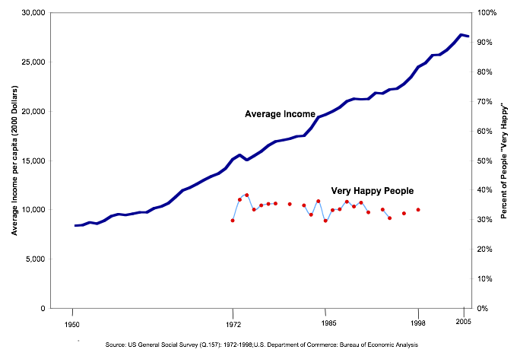
More money has not resulted in greater happiness
Life, liberty and the pursuit of happiness?
Happiness threshold: $75,000 per household
Notes:
Despite continuous growth in spending power (income) and growing consumer expenditures, our the number of Americans who say they are very happy hasn’t literally remained unchanged since the 1950s.
Why then do we continue to pursue “more economic growth”, as measured by GDP, as our primary economic mantra?

Slide 26
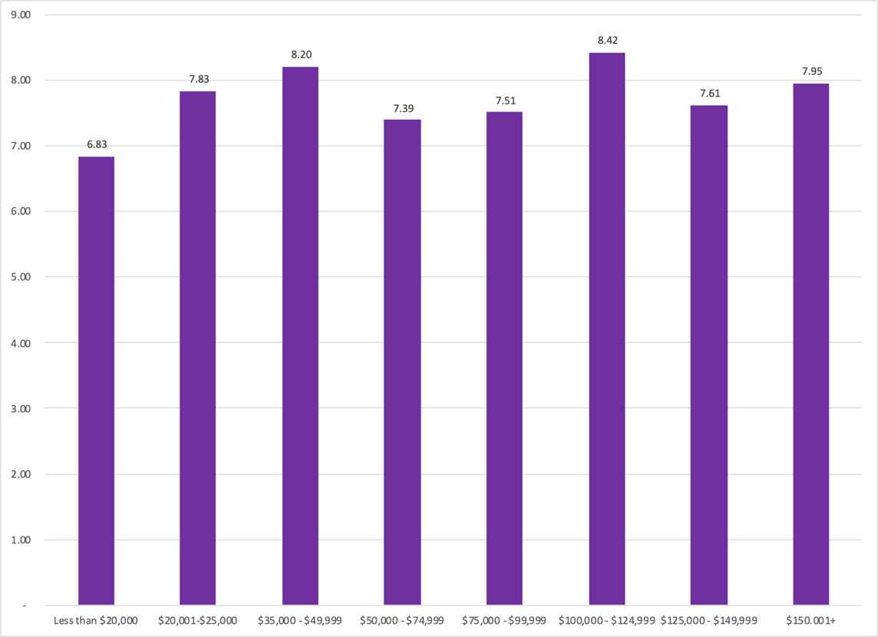
Life Satisfaction vs. Household Income
More money does not necessarily equate to more happiness
Living Wage (US$68,800)
Based on Soul Print of Well-being Survey (Global) 2019-2020 n = 680

Slide 27

Life satisfaction vs. National Income: All Nations
Life satisfaction ladder (1-10)
Gross Domestic Product (GDP) in USD per capita
Data Sources: World Happiness Report 2022 and World Bank data (GDP per capita

Slide 28

Life satisfaction vs. Ecological Footprint: All Nations
Slovenia
Ecological Footprint (gha/capita)
Life Satisfaction (1-10)
Data Sources: World Happiness Report 2022 and York University/Global Footprint Network (gha per capita), 2018

Slide 29
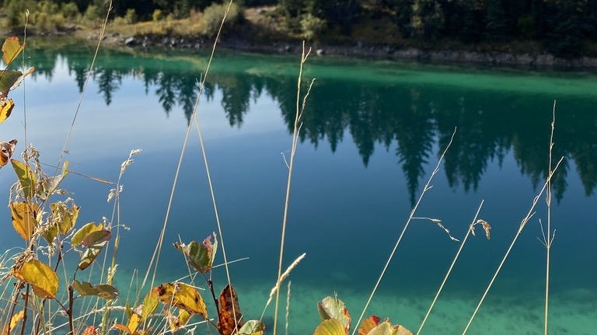
The science of well-being

Slide 30
The determinants of happiness and well-being
The Science of Happiness
Notes:
Positive Psychologist Sonja Lyubomirsky in her research over the years identified three key drivers or determinants of self-rated happiness and life satisfaction: 1) 50% is related to your genetics 2) 40% is related to your intentional activities or relationships with others (we are social creatures and the more we are in healthy relationships with others the happier we tend to be) and 3) 10% of our happiness relates to our life circumstances including income, marital status, location, education, and age (50+ year olds tend to be happiest as well as 0-12 year olds),

Slide 31
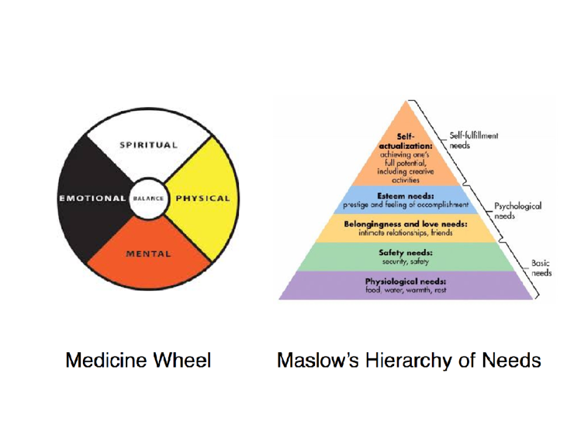
Maslow vs. Blackfoot Wisdom
The Maslow hierarchy of needs originated with the traditions of the Blackfoot Nation in Alberta, based on the teachings of the medicine wheel as the basis for understanding the human being.

Slide 32
An indigenous world view of human well-being
Mental
Physical
Spiritual
Emotional

Slide 33
The Medicine Wheel of Well-being
Spend time doing things I enjoy
Feel positive
Little stress
Ability to handle life challenges
Ability to handle day-to-day life demands
Doing things I enjoy
Enough energy in life
Un-loneliness
Little anxiety
Mental
Physical
Spiritual
Physical health
Diet and eating habits
Quality of sleep
Use of traditional medicines
Financial well-being
Income meets life needs
Economic conditions at OCN
Work happiness
Ability to develop personal skills
Balance of work time and other personal time
Satisfaction with access to sports and recreational facilities and activities
Satisfaction with access to arts and cultural opportunities
Satisfaction with access to informal education for skills
Feeling safe walking alone at night
Happiness
Life Satisfaction
Hope
Joy
Spiritual well-being
Soul peace
Emotional
Belonging to community
Trust of the community
Trust of work colleagues
Trust of local businesses
Trust of O&O
Feeling about quality of the natural environment
Interaction with the natural environment and traditional territory

Slide 34
Life’s Well-being Journey
75+
65-74
56-64
46-55
35-45
26-35
Mental
20-25
16-19
12-15
Physical
Spiritual
1-11
Emotional
Birth

Slide 35
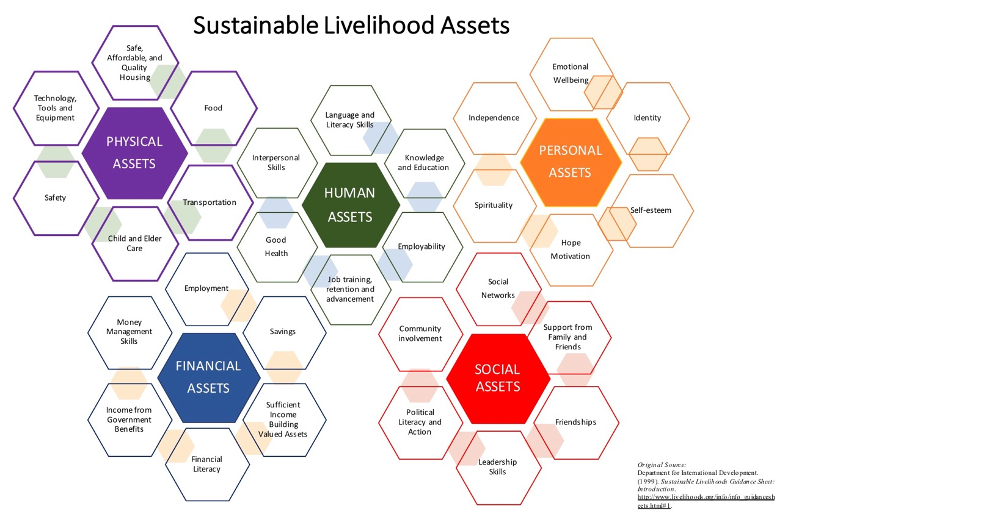
Personal assets that contribute to resilience

Slide 36
Nations are operating without a Balance Sheet

Slide 37
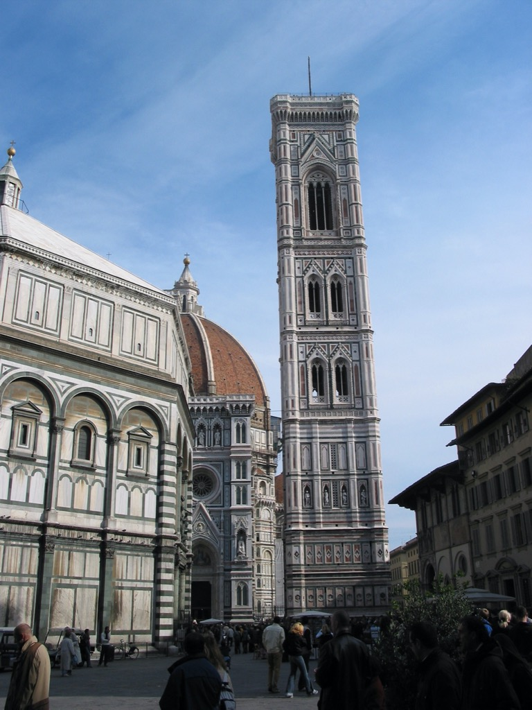
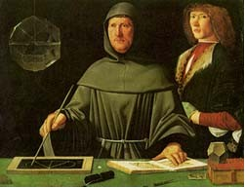
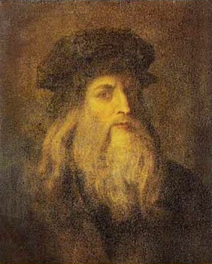
Origins of accounting
Luca Pacioli
1494
Summa de arithmetica, geometria, proportioni et proportionalita
All wealth belongs to God
There is no such thing as profit
Florence, Italy

Slide 38
Well-being-based national accounting and governance system

Slide 39
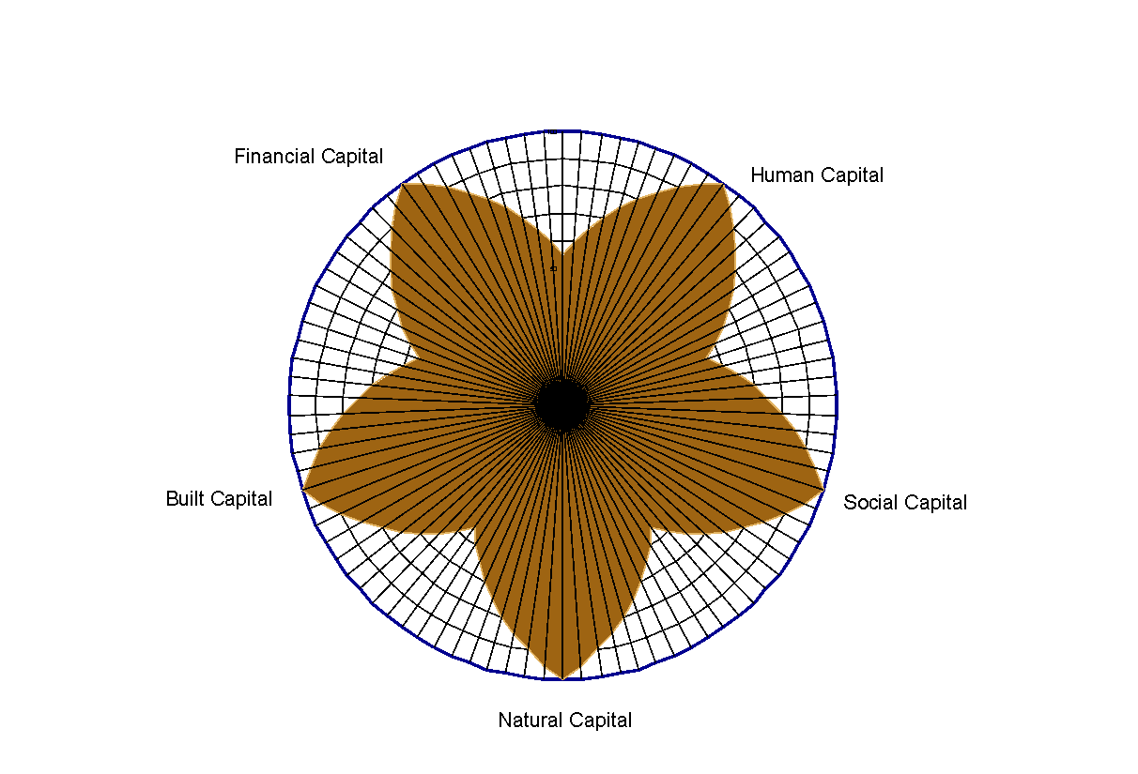
Genuine
native, natural, authentic
Wealth
the conditions of Well-being
“All wealth comes from God”
-- Fr. Luca Pacioli, father of accounting (1492)
Genuine Wealth is the foundation of
an economy of well-being
Capital
Wealth, in whatever form (money, assets), used or capable of being used to produce more wealth or contribute to a particular purpose.
Genuine Wealth is a process and practical approach to building flourishing and resilient communities of well-being where people, social relationships, cultural (traditions), natural resources, traditional use, ecosystem services, along with built (infrastructure) and financial (money) assets are managed in a harmonious manner that ensures seven-generations of well-being.

Slide 40
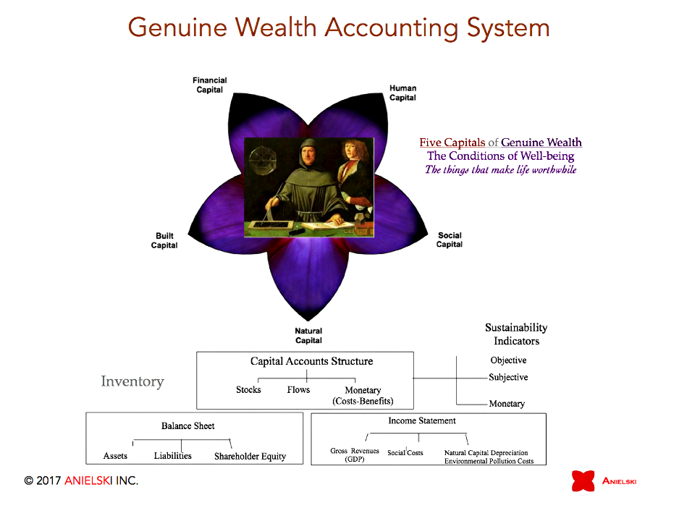
Five Capital Asset Accounts provide a integrated asset accounting of the stocks and flows of assets of a nation or community using a conventional accounting model of well-being ledgers, income statement (flows) and balance sheet).

Slide 41
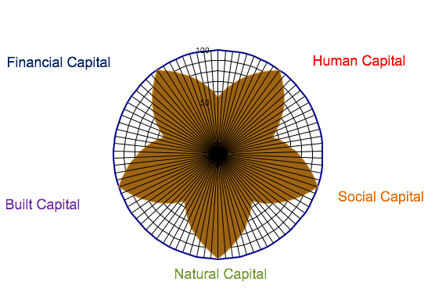
Genuine Wealth: Five Capital Assets Model
Financial assets (Money, cash, stocks, bonds, derivatives), liabilities (debt) and equity.
Individual skills, education, knowledge , capabilities, and health (mental, physical, emotional and spiritual) of individuals that make up households, organizations and communities.
The web of interpersonal connections, relationships and networks, including trust, institutional arrangements, rules, and norms that facilitate human interactions. Also, the set of values, history, traditions and behaviours which link a specific group of people together.
Infrastructure, buildings, roads, houses, factories, machinery, equipment, and manufactured goods, and intellectual property (patents, copyright) that make up the material structure of society.
The land and natural resources, including soils, forests, water, air, and other species and life forms, and the services which the earth and its atmosphere provide, including ecological systems and life-support services.
Asset:
any tangible or intangible economic resource that is capable of
being owned or controlled to produce value and that is held to have positive economic value.
A well-being baseline inventory and assessment measures the current and historical physical conditions of well-being.

Slide 42
Well-being Accounting Structure
Well-being Domains
Capital Asset Accounts

Slide 43
National and Community Well-being Accounts
Demographics
Work
Time use
Health
Physical well-being
Psychological well-being
Spiritual well-being
Family well-being
Education and Learning
Economic vitality
Living standards
Financial security
Affordable housing
Affordable and efficient government
Housing
Public and private infrastructure
Tangible assets (buildings, engineered structures)
Intangible assets (brand equity, artistic-related, contract-based)
Ethnic diversity & inclusion
Trust and sense of belonging
Community vitality and resilience
Equity and fairness
Safety and crime
Democratic engagement
Ecological footprint
Population density
Sustainable food production
Consumption and conservation
Natural environment and ecosystem health
Land (greenspace, farmland)

Slide 44
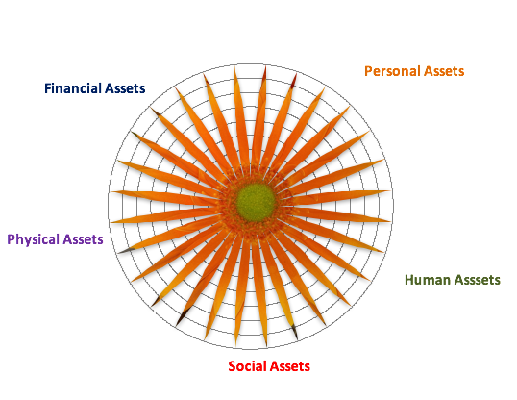
Individual and Household Five Assets of Well-being
]
Sufficient income
Available savings
Regular flows of money
Credit rating
Access to credit
Good health
Physical well-being
Emotional well-being
Spiritual well-being
Hope
Confidence
Motivation
Self-esteem
Self-perception
Child/elder care
Affordable sustainable housing
Clean affordable energy
Information
Access to financial services
Basic consumer needs
Affordable transportation
Tools and equipment
Access to green space and nature
Air and water quality
Skills
Competencies
Meaningful work
Educational attainment
Knowledge
Abilities
Employability
Earning potential
Leadership skills
Trust index
Relational capital
Cooperation
Networks, interconnectedness
Family support
Friendships
Partnership and collaboration
Political participation
Notes:
The Genuine Wealth model recognizes that sustainable livelihoods and flourishing lives of well-being requires five capital assets (human, physical, personal, social/cultural, and financial). Within each of the five personal genuine wealth asset categories are a suite of well-being indicators to assess the relative conditions of well-being of an individual or family/household. Both objective and self-rated subjective metrics are used to assess overall well-being. Each of these indicators can be scored in terms of a well-being index and aggregated into a composite well-being index for individuals and households as well as neighbourhoods and municipal-scale reporting.

Slide 45
UN 17 Sustainable Development Goals Aligned with Community 5-Assets, 8-Well-being Domains and Well-being Indicators
Objective
Well-being Indicators
Community 5-Asset Accounts
Subjective
Well-being Indicators

Slide 46
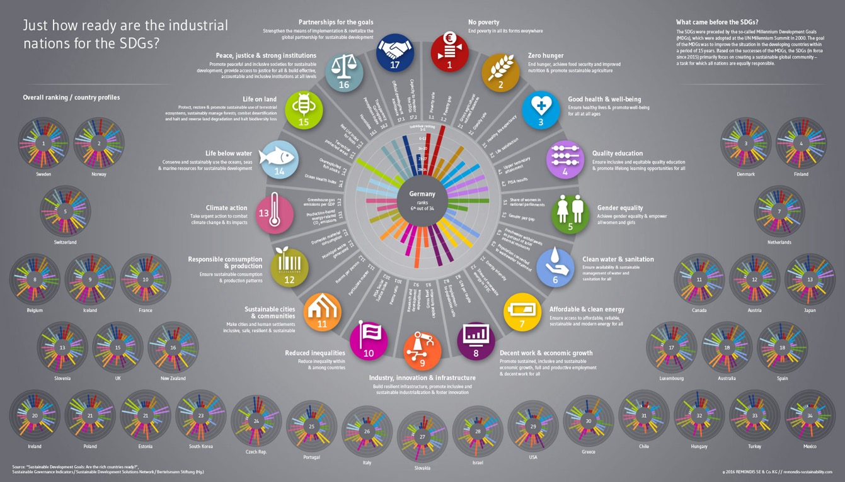
United Nations 17 SDGs

Slide 47
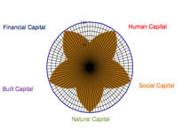
Genuine Wealth (Well-being) Governance Framework
Mission
Core Values & Traditions
Vision and Principles
Goals, Strategies, Actions
Alignment with UN SDGs
Measuring What Matters to Well-being
8 Sustainable Well-being Domains
Integrated Five-Capital Asset Accounts
Objective
Well-being Indicators
& Targets
Subjective
Well-being Indicators
& Targets
Implementation Strategies:
Sustainable Well-being Plan, Actions, Policies,
Triple-Bottom-Line Accounting
Well-being-based-Budgeting

Slide 48
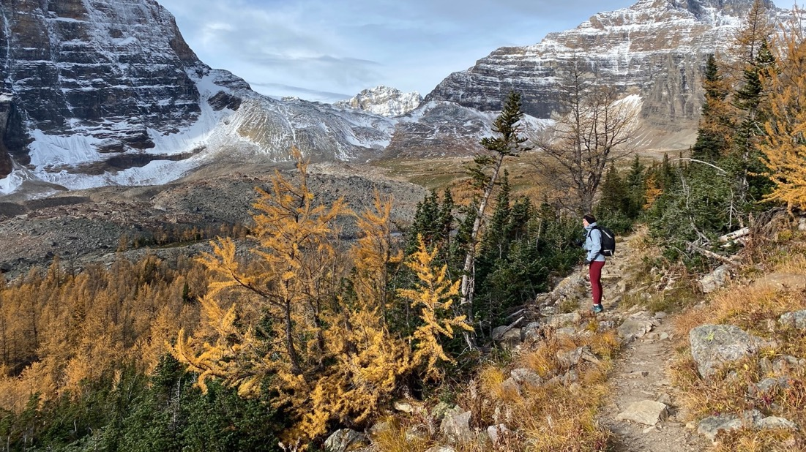
Alberta Genuine Progress Index 1961-2021

Slide 49

Alberta
Genuine Progress Indicators
51 Indicators of Well-being

Slide 50
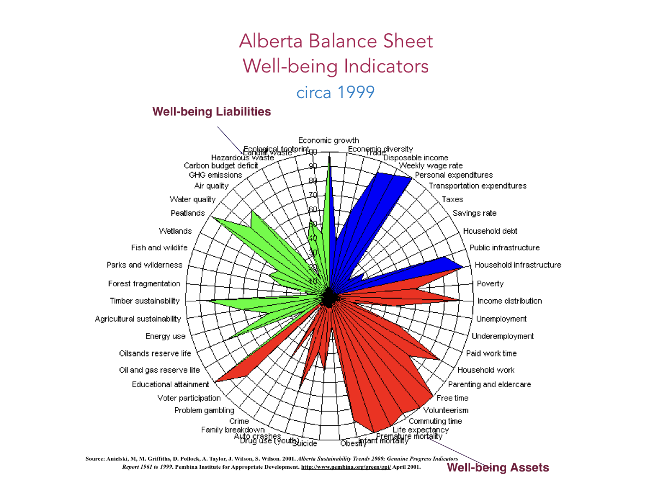

Slide 51
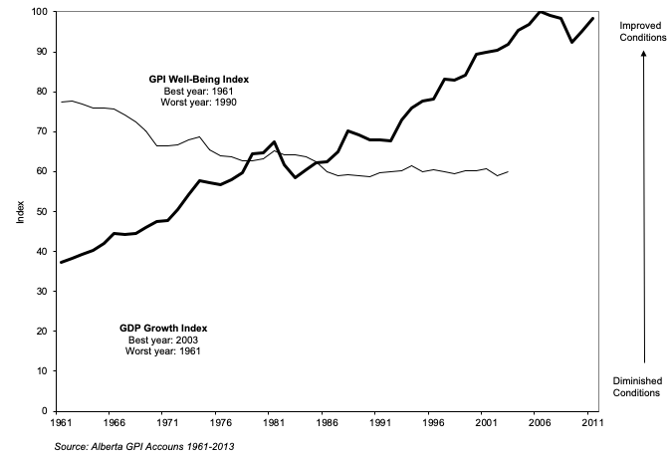
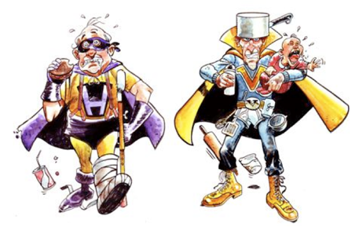
Alberta Genuine Progress Index, 1961-2012

Slide 52
Alberta Ecological Footprint vs. GDP, 1961-2003

Slide 53

Good Health and Well-being
Cancer
Source: Cancer statistics are from Statistics Canada CANSIM 103-0204; GDP is from Statistics Canada Table 384-0038 and 2016 GDP is forecast by Alberta Government

Slide 54
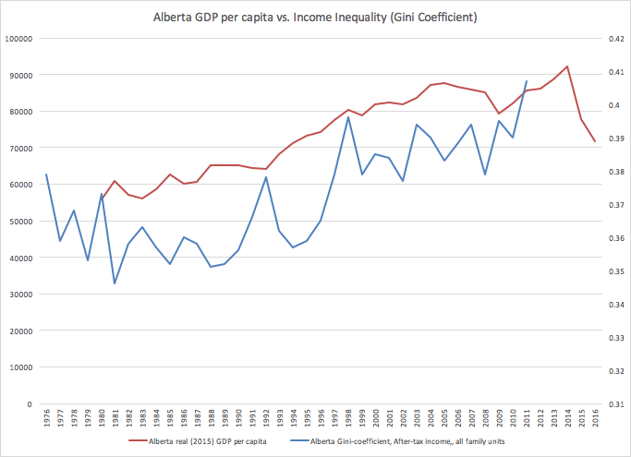
Alberta GDP and Inequality
Alberta GDP per capita
Canada
Alberta Gini Coefficient
Alberta
Source: Statistics Canada CANSIM Table 206-0031

Slide 55
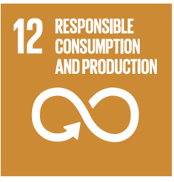
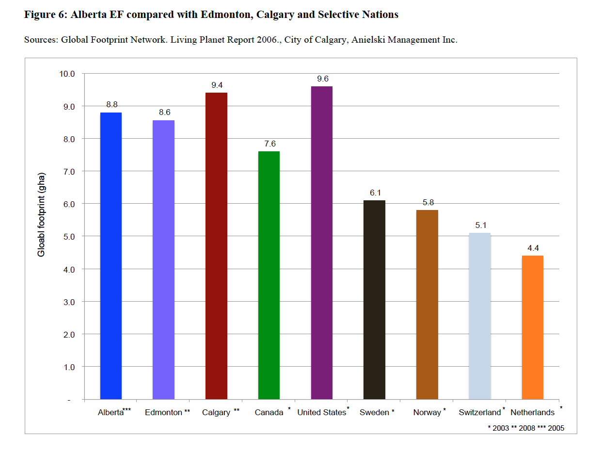
Alberta Ecological Footprint per capita
Source: Anielski Management Inc. 2011. Alberta Ecological Footprint Report Measuring the Sustainability of Alberta’s Progress
v

Slide 56
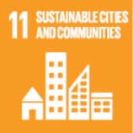
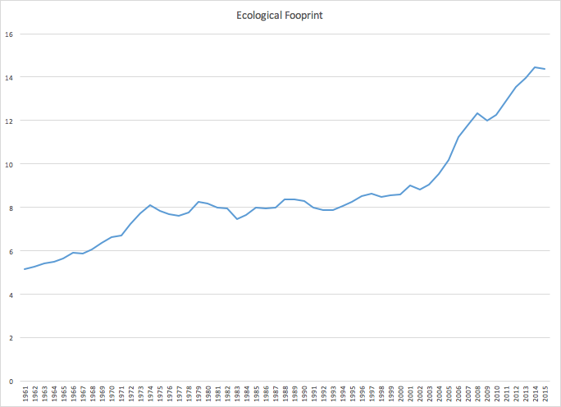
Alberta Ecological Footprint per capita
Alberta’s ecological footprint exceeds the average available global biocapacity (1.78
gha/capita) by almost 5 times.
Alberta
Alberta’s ecological footprint occupies 28.9 million hectares of land and water or the equivalent of 43.8% of Alberta’s total land base of 66 million hectares.
Source: Anielski Management Inc. 2011. Alberta Ecological Footprint Report Measuring the Sustainability of Alberta’s Progress

Slide 57

Subjective Well-being
Needs to be included

Slide 58
The Well-being Self-Assessment

Slide 59
Subjective Well-being Surveys to Track Perceptions and Feelings
Changes in well-being perceptions will be measured in annual Well-being Surveys (Census) of the citizens with customized survey questions,
Opaskwayak Cree Nation Well-being Index 2020

Slide 60

OCN Well-being Indices
Physical Well-being Index | 55.0
Physical health | 6.3
Diet and eating habits | 5.6
Quality of sleep | 6.0
Use of traditional medicine | 4.7
Financial well-being | 6.3
Income meets life needs | 5.7
Economic conditions at OCN | 6.5
Work happiness | 6.5
Ability to develop personal skills | 6.6
Balance of work time and other personal time | 6.4
Satisfaction with access to sports and recreational facilities and activities | 3.9
Satisfaction with access to arts and cultural opportunities | 3.5
Satisfaction with access to informal education for skills | 4.4
Feeling safe walking alone at night | 4.7
Scale is from 1 (worst) to 10 (best) well-being feelings
Well-being sub-indices are out of 100.0 basis points
Spiritual Well-being Index | 72.2
Happiness | 7.3
Life Satisfaction | 7.5
Hope | 7.1
Joy | 7.1
Soul peace | 7.0
Spiritual well-being | 7.2
Mental Well-being Index | 58.7
Spend time doing things I enjoy | 5.6
Feel positive | 5.8
Little stress | 4.2
Ability to handle life challenges | 5.4
Ability to handle day-to-day life demands | 7.1
Doing things I enjoy | 6.1
Enough energy in life | 5.5
Un-loneliness | 6.6
Little anxiety | 6.6
Emotional Well-being Index | 55.4
Belonging to community | 6.3
Trust of the community | 4.6
Relationship with immediate family | 7.0
Relationship with extended family | 5.8
Relationship with friends | 5.9
Relationship with neighbours | 4.4
Trust of work colleagues | 4.8
Trust of local businesses | 4.7
Trust of Chief and Council | 4.8
Feeling about quality of the natural environment | 6.7
Interaction with the natural environment and traditional territory | 5.8

Slide 61

US Genuine Progress Index 1950-2003

Slide 62

US Genuine Progress Index (GPI)

Slide 63


Slide 64

The Canadian Index of Well-being

Slide 65

the Canadian Index of Wellbeing (CIW) Eight Domains of Well-being – 64 Indicators

Slide 66

The Canadian Index of Well-being

Slide 67

Finance Canada National Quality of Life Framework

Slide 68
Bhutan Gross National Happiness Accounts
Jigme Khesar Namgyel Wangchuck
the fifth Dragon King of Bhutan
Jigmi Y. Thinley
Former Prime Minister (2008-2013)

Slide 69
Bhutan Gross National Happiness Accounts

Slide 70

City of Edmonton (Alberta) Genuine Well-being Index 1981-2008

Slide 71


Slide 72

The Genuine Well-being Index vs. GDP
City of Edmonton, 1981-2008
Source: Anielski Management Inc. 2009. The Edmonton 2008 Genuine Progress Indicator Report: The State of Economic, Social and Environmental Wellbeing for the City of Edmonton. Prepared for the City of Edmonton.

Slide 73
Edmonton Ecological Footprint tracks GDP per capita
R2 = 0.971 (highly correlated
Source: Anielski Management Inc. 2009. The Edmonton 2008 Genuine Progress Indicator Report: The State of Economic, Social and Environmental Wellbeing for the City of Edmonton. Prepared for the City of Edmonton.

Slide 74
Natural Capital Accounting and Geospatial Watershed-level Mapping

Slide 75
Natural Capital Accounts
Assets
Liabilities
Marketable Natural Capital
Greenhouse gas emissions
Land
  Arable Land
  Grassland
  Forest Land
  Wetlands
  Other Lands
Energy
  Oli, Gas, Coal
  Renewable energy capacity
Minerals
Timber
Human/Industrial Footprint
Loss of Traditional Use Values
Pollution
Solid and toxic wastes
Loss of Ecological Integrity
Unsustainable renewable resource use
Depreciation of non-renewable energy resources
Carbon
Water
Ecological Services (17+ functions)
Traditional Use
plants and berries
medicines
animals
Shareholder’s Equity
Returns on investment in natural capital assets
Distribution of natural capital benefits
6

Slide 76

Geospatial Mapping of Well-being Conditions

Slide 77

Soil Organic Carbon mapping by watershed: Canada
Prepared by Global Forest Watch Canada, 2012, based on Tarnoci.

Slide 78

Mapping Industrial/Human Footprint and Damages to Ecosystems

Slide 79

Mapping Ecological Integrity and Resilience
Potential Pipeline Utility Corridor
Moose (Gardiner) Lake

Slide 81
Agricultural Land Productivity Mapping

Slide 82

Ecosystem Service Values heat mapping

Slide 83

The Well-being Map of Ireland

Slide 84

The Practice of Well-being Economics

Slide 85


Economy of Well-being Governance Framework
Charter of Well-being
Laws, Core Values & Traditions
Love
concern for the Well-being of the other
Vision & Mission
Principles
A nation rooted in the law of love and natural laws pursues an economy of well-being by measuring what matters to the well-being of its people, in harmony with the land and with the aspiration of better lives lived by everyone.
Goals, Strategies, Actions
Measuring What Matters to Well-being
Alignment with G17
Well-being Domains
Integrated Five-Capital Asset Accounts
Objective
Well-being Indicators
& Targets
Subjective
Well-being Indicators
& Targets
Well-being Strategic Plan
Well-being-based-Budgeting

Slide 86

Five Capital Asset Accounts provide a full accounting of the stocks and flows of assets using a conventional accounting model of well-being ledgers, income statement (flows) and balance sheet). All data is geospatially coded to help determine optimum economic, social and environmental value per hectare of land use.
Geospatial inventory and mapping of all data

Slide 87




Five-Capital Assets (including cities, communities, businesses) are geospatially mapped for a nation or watershed, measured in terms of Well-being conditions and valued (market, non-market, intangible) using advanced GIS mapping protocols and heat mapping.
Land value and economic value (GDP, employment) heat map
Ecological services value heat map
Water quality and value heat map

Slide 88

Every business or enterprise is evaluated using the integrated 5-Capitals Asset Genuine Model, aligned with the Global Reporting Initiative (GRI) standards and the UN SDGs

Slide 89






Individual and Household Wealth/Well-being
Accounts that track the well-being conditions, both qualitative and perceptional well-being
Social & Cultural Assets
Financial Assets
]
Trust index
Relational capital
Cooperation
Networks, interconnectedness
Family support
Friendships
Partnership and collaboration
Political participation
Sufficient income
Available savings
Regular flows of money
Credit rating
Access to credit
Human Assets
Personal Assets
Skills
Competencies
Meaningful work
Educational attainment
Knowledge
Abilities
Employability
Earning potential
Leadership skills
Good health
Physical well-being
Emotional well-being
Spiritual well-being
Hope
Confidence
Motivation
Self-esteem
Self-perception
Physical Assets
Child/elder care
Affordable sustainable housing
Clean affordable energy
Information
Access to financial services
Basic consumer needs
Affordable transportation
Tools and equipment
Access to green space and nature
Air and water quality
All data encrypted on a digital ‘ark’ digital wallet, immutable and holy; connected to your scrolls
Notes:
The Genuine Wealth model recognizes that sustainable livelihoods and flourishing lives of well-being requires five capital assets (human, physical, personal, social/cultural, and financial). Within each of the five personal genuine wealth asset categories are a suite of well-being indicators to assess the relative conditions of well-being of an individual or family/household. Both objective and self-rated subjective metrics are used to assess overall well-being. Each of these indicators can be scored in terms of a well-being index and aggregated into a composite well-being index for individuals and households as well as neighbourhoods and municipal-scale reporting.

Slide 90
Measuring Perceptional Well-being
Feelings
Individual well-being profiles

Slide 91
Individual well-being profiles
The results of individual and household well-being profiles are aggregated into a community or national-level Well-being Index
aggregated to community
well-being index
profile

Slide 92

Circular Economy: Restorative Economics

Slide 93


Circular Economy: Reslience
Mapping the inter-harmonious-relationships amongst the
assets of the nation

Slide 94

Life Cycle Value Analysis
Circular
Economy
The Genuine Wealth Accounting model uses a life-cycle full-cost accounting model to determine the overall impact of an enterprise on employees, the community and the natural environment. Using Life-Cycle-Value Analysis (LCVA).
The Genuine Wealth model assesses the relationships, values and impacts of the five assets of an enterprise.
For each enterprise, a Well-being relational map is developed to account for the relative impacts an enterprise has on its employees, the community-at-large and the natural environment.

Slide 95


Doughnut Economics: Kate Raworth

Slide 96




















Ibrahim Abouleish
Notes:
Seminal models of integral economy – inspirations for Integral Green Slovenia.
From Part I:
„The next phase of the IGS movement is dominated by Integral Economics, elaborating four integral economic paths and searching for Slovenian integral practices, studying them and presenting them to a wider public in an integral manner, also aligning them with seminal global integral models.“
96

Slide 97

Integral Worlds Model: Lessem and Schieffer

Slide 98
An indigenous world view of human well-being
Wahkotowin
“all my relations”

Slide 99

Well-being-based Decision Making

Slide 100

Strategic Well-being Asset Management
Operating Model
Human Capital
Well-being baseline
Inventory and Assessment
Social Capital
Community Asset Balance Sheet
Community Strategic Asset Management Plan
Sustainable Community Wellbeing Governance Model
Built Capital
Assets formalized to GAAP
Accounting Standards
Natural Capital
Financial Capital
Well-being-based Evidence Decision Making

Slide 101

Capital Region Housing Corp.
Well-being Impact Analysis of Affordable Housing Program (2018)
Household Impact Domains
Happiness and Hope
Health and Wellness
Financial well-being
Work-Life Balance
Belonging, Trust, Relationships
Safety and Inclusion
Life is better
We need affordable housing
Access to Services and
personal development
Over 9,000
Low-income Edmonton
households
served
Satisfaction with CRHC programs
Well-being Impacts of
Affordable Housing Program
Living Wage
Mission: We improve the well-being of children and families in our communities through a continuum of quality housing options, supports, and partnerships.
Income taxes to
Government
Well-being ROI
50 Well-being Impact Indicators
using a household well-being impact survey

Slide 102

Measuring and Mapping the Well-being across Ireland
Conducted during Covid April 2021

Slide 103
The Well-being Self-Assessment

Slide 104
The Well-being Check-up for Ireland

Slide 105
The Well-being Map of Ireland

Slide 106
Slovenia Well-being Profile

Slide 107




Slovenia Development Strategy 2030

Slide 108




Policy and Legislation in Slovenia
and several other policy and legislative documents for each of the 12 strategic goals in SDS 2030, among them: Slovenia`s National Strategy for Transition from Coal of Slovenian Coal Regions in Accordance with Just Transition Principles:
"Slovenia’s opportunities for adopting a well-being economy approach" implies that the EU framework has to be considered, maybe even as a starting point.

Slide 109



Commission priorities for 2019-2024 (political guidelines)
https://ec.europa.eu/info/strategy/priorities-2019-2024_en
8th Environmental Action Programme:
Elements of the Green Deal:
“… by 2050 at the latest,
people live well,
within the planetary boundaries
in a well-being economy …”

Slide 110

Six Key Performance Indicators
Slovenia Development Strategy 2030

Slide 111

12 Quality of Life Goals
Slovenia Development Strategy 2030

Slide 112

Is Slovenia Living within Planetary Boundaries?

Slide 113
OECD BETTER LIFE INDEX: SLOVENIA
How’s Life?
Slovenia performs well across a number of well-being dimensions relative to other countries in the Better Life Index. Slovenia outperforms the average in , education, safety and social connections. It underperforms average in income and life satisfaction. These assessments are based on available selected data.
Money, while it cannot buy happiness, is an important means to achieving higher living standards. In Slovenia, the average household net-adjusted disposable income per capita is USD $25,250 a year, less than the OECD average of USD $30,490 a year.
In terms of employment, about 71% of people aged 15 to 64 in Slovenia have a paid job, above the OECD employment average of 66%. Some 74% of men are in paid work, compared with 68% of women. In Slovenia, 6% of employees work very long hours in paid work, below the OECD average of 10%, with 8% of men working very long hours in paid work compared with 3% of women.
Good education and skills are important requisites for finding a job. In Slovenia, 90% of adults aged 25-64 have completed upper secondary education, higher than the OECD average of 79%. However, completion varies between men and women, as 91% of men have successfully completed high school compared with 89% of women.
In terms of the quality of the education system, the average student scored 504 in reading literacy, maths and science in the OECD's Programme for International Student Assessment (PISA). This score is higher than the OECD average of 488. On average in Slovenia, girls outperformed boys by 17 points, well above the average OECD gap of 5 points.
In terms of health, life expectancy at birth in Slovenia is around 82 years, one year higher than the OECD average of 81 years. Life expectancy for women is 85 years, compared with 79 for men. The level of atmospheric PM2.5 – tiny air pollutant particles small enough to enter and cause damage to the lungs – is 17 micrograms per cubic meter, above the OECD average of 14 micrograms per cubic meter. In Slovenia, 93% of people say they are satisfied with the quality of their water, higher than the OECD average of 84%.
Concerning the public sphere, there is a strong sense of community and moderate levels of civic participation in Slovenia, where 95% of people believe that they know someone they could rely on in time of need, more than the OECD average of 91%. Voter turnout, a measure of citizens' participation in the political process, was 53% during recent elections, lower than the OECD average of 69%. Social and economic status can affect voting rates; voter turnout for the top 20% of the population is an estimated 62% and for the bottom 20% it is an estimated 51%.
When asked to rate their general satisfaction with life on a scale from 0 to 10, Slovenians gave it a 6.5 grade on average, lower than the OECD average of 6.7; ranked 24th of 41 OECD nations.

Slide 114


Legatum Prosperity Index: SLOVENIA
The Legatum Prosperity Index is an annual ranking developed by the Legatum Institute, an independent educational charity founded and part-funded by the private investment firm Legatum. The ranking is based on a variety of factors including wealth, economic growth, education, health, personal well-being, and quality of life.
    Economic Sub Index: Slovenia ranked 34th in the world
      The Economy sub-index measures countries; performances in four areas that are essential to promoting prosperity: macroeconomic policies, economic satisfaction and expectations, foundation for growth, and financial sector efficiency.
    Entrepreneurship and Opportunity Sub-index: Slovenia ranked 21st in the world; Denmark and Sweden were #1 and 2, with Finland, UK, Norway, Ireland following thereafter.
      The Entrepreneurship & Opportunity sub-index measures countries‚Äô performances in three areas: entrepreneurial environment, innovative activity, and access to opportunity.
    Health Index: Slovenia ranked #13 overall, with Switzerland (#3), Norway (#4), Germany (#6). France (#7), and Austria (#8), Slovenia ranked ahead of Denmark, Italy, the UK and Spain
      The Health sub-index measures countries‚performances in three areas: basic health outcomes, health infrastructure and preventative care, and physical and mental health satisfaction.
    Personal Freedom Index: Slovenia ranked #22 in the world; Canada was #1, Norway #2, Sweden #5 and Denmark #6)
      The Personal Freedom sub-index measures countries‚ performances in two areas: individual freedom and social tolerance.
    Personal Security Index: Slovenia ranked #9 in the world with Iceland, Norway, Finland, Ireland and Singapore ranked in the top 5. Slovenia ranked ahead of Austria, Switzerland, the Netherlands and Germany
      he Safety and Security sub-index measures countries‚ performances in two areas: national security and personal safety.
    Social Capital Index: Slovenia ranked #34 with Norway and Denmark in #1 and 2 positions.
      The Social Capital sub-index measures countries‚ performances in two areas: social cohesion and engagement, as well as community and family networks
    Well-rested?: Slovenia ranked 61st in the world (Malaysians, Singaporeans, Paraguayans are most well rested) In Europe the Austrians are the most well-rested ranked 34th in the world, followed by the Spanish and Portuguese

Slide 115

Quality of Life
Legatum Prosperity Index
satisfaction with life on a scale from 0 to 10, Slovenians gave it a 6.5 grade on average, lower than the OECD average of 6.7; ranked 24th of 41 OECD nations
Interpersonal trust: Slovenia ranked 44th in the world.
Source: The Legatum Prosperity Index

Slide 116
Satisfaction with Life is Improving

Slide 117




Agency
Financial Capital: Economic Well-being
Economic vitality
Living standards (income, living wages)
Ecological Footprint
Financial security; Living Wages
Affordable housing
Affordable-efficient government
Perceived value for public services
High productivity (GDP/labourer)
Source: OECD; (Numbers in parentheses refer to the OECD average)
…but GDP nor labour productivity is a comprehensive measure of overall economic well-being

Slide 118

Legatum Prosperity Indices Ranking
Economic Index
Entrepreneurship and Opportunity Index
Ranked in the Prosperity Index | Country | Economy Sub-Index Scores
1 | Norway | 3.09
2 | Switzerland | 2.99
3 | Netherlands | 2.92
4 | Denmark | 2.87
5 | Canada | 2.65
6 | Singapore | 2.60
7 | Sweden | 2.54
8 | Australia | 2.52
9 | Finland | 2.46
10 | Hong Kong | 2.33
11 | Japan | 2.30
12 | Austria | 2.28
13 | Germany | 2.23
14 | United States | 2.01
15 | South Korea | 1.97
16 | Belgium | 1.95
17 | New Zealand | 1.94
18 | United Kingdom | 1.84
19 | France | 1.83
20 | Kuwait | 1.81
21 | Malaysia | 1.78
22 | Ireland | 1.71
23 | Thailand | 1.69
24 | China | 1.65
25 | Taiwan | 1.57
26 | Czech Republic | 1.56
27 | Israel | 1.51
28 | Saudi Arabia | 1.45
29 | Italy | 1.37
30 | United Arab Emirates | 1.32
31 | Mexico | 1.25
32 | Spain | 1.19
33 | Brazil | 1.19
34 | Slovenia | 1.12
Ranked in the Prosperity Index | Country | Entrepreneurship and Opportunity Sub-Index Scores
1 | Denmark | 3.70
2 | Sweden | 3.60
3 | United States | 3.45
4 | Finland | 3.41
5 | United Kingdom | 3.31
6 | Norway | 3.24
7 | Ireland | 3.20
8 | Singapore | 3.18
9 | Iceland | 3.18
10 | Canada | 3.16
11 | Switzerland | 3.14
12 | Netherlands | 3.08
13 | Australia | 3.05
14 | New Zealand | 2.92
15 | Germany | 2.80
16 | Austria | 2.53
17 | Hong Kong | 2.37
18 | South Korea | 2.32
19 | Japan | 2.20
20 | France | 2.14
21 | Belgium | 2.05
22 | Taiwan | 2.01
23 | Estonia | 1.91
24 | United Arab Emirates | 1.87
25 | Israel | 1.81
26 | Slovenia | 1.67
The Economy sub-index measures countries; performances in four areas that are essential to promoting prosperity: macroeconomic policies, economic satisfaction and expectations, foundation for growth, and financial sector efficiency.
The Entrepreneurship & Opportunity sub-index measures countries performances in three areas: entrepreneurial environment, innovative activity, and access to opportunity.
Source: The Legatum Prosperity Index, 2017

Slide 119
GDP per capita (and income) alone explains 56% of the (EF) consumption per capita *
*
https://medium.com/@pedro.hf86/the-uncomfortable-relation-between-ecological-footprint-and-human-development-401d24b69499

Slide 120

Slovenia

Slide 121

Slovenia Ecological Footprint
Biocapacity Deficit = 3.02 gha/capita
Ecological Footprint = 5.37 gha/capita
GDP per capita alone explains 56% of the (EF) consumption per capita
61.5% of Slovenia’s Ecological Footprint is from Energy Use
Slovenia’s goal is to reduce its carbon footprint by 20% by 2030. Can it by phasing out coal?

Slide 122
Ecological Footprints: European Countries, 2018
European Nations | Built-up Land | Carbon | Cropland | Fishing Grounds | Forest Products | Grazing Land | Total | Biocapactiy | Biocapacity (Deficit)/Surplus
Austria | 0.131 | 3.936 | 0.752 | 0.056 | 0.919 | 0.269 | 6.064 | 3.07 | (2.99)
Belgium | 0.134 | 4.564 | 1.100 | 0.095 | 0.564 | 0.409 | 6.866 | 1.19 | (5.68)
Bulgaria | 0.172 | 2.064 | 0.707 | 0.037 | 0.462 | 0.179 | 3.621 | 2.86 | (0.76)
Croatia | 0.078 | 2.276 | 0.622 | 0.078 | 0.648 | 0.179 | 3.881 | 2.80 | (1.08)
Czech Republic | 0.123 | 3.494 | 0.656 | 0.039 | 1.076 | 0.330 | 5.718 | 2.46 | (3.26)
Denmark | 0.158 | 3.450 | 0.702 | 0.812 | 1.061 | 0.469 | 6.653 | 4.78 | (1.87)
Finland | 0.097 | 4.075 | 0.717 | 0.207 | 1.161 | 0.188 | 6.443 | 13.44 | 7.00
France | 0.151 | 2.508 | 0.791 | 0.217 | 0.509 | 0.244 | 4.421 | 3.11 | (1.31)
Germany | 0.129 | 3.042 | 0.693 | 0.044 | 0.578 | 0.188 | 4.672 | 2.27 | (2.40)
Greece | 0.050 | 2.565 | 0.703 | 0.101 | 0.303 | 0.377 | 4.099 | 1.61 | (2.49)
Hungary | 0.179 | 2.404 | 0.741 | 0.025 | 0.440 | 0.077 | 3.866 | 2.17 | (1.70)
Iceland |  |  |  |  |  |  | 12.700 | 4.40 | (8.30)
Ireland | 0.077 | 3.166 | 0.939 | 0.150 | 0.594 | 0.324 | 5.251 | 3.73 | (1.52)
Italy | 0.042 | 2.619 | 0.766 | 0.135 | 0.467 | 0.282 | 4.311 | 1.08 | (3.23)
Luxembourg | 0.085 | 9.696 | 0.843 | 0.137 | 1.589 | 0.601 | 12.950 | 1.68 | (11.27)
Netherlands | 0.070 | 3.654 | 1.044 | 0.002 | 0.342 | 0.580 | 5.692 | 1.17 | (4.52)
Norway | 0.027 | 2.498 | 0.829 | 1.152 | 0.886 | 0.277 | 5.669 | 8.18 | 2.51
Poland | 0.102 | 3.017 | 0.644 | 0.070 | 0.899 | 0.023 | 4.755 | 2.08 | (2.67)
Portugal | 0.028 | 2.573 | 0.832 | 0.358 | 0.408 | 0.352 | 4.552 | 1.51 | (3.04)
Serbia | 0.079 | 1.678 | 0.752 | 0.032 | 0.494 | 0.036 | 3.071 | 1.25 | (0.36)
Slovakia | 0.118 | 2.904 | 0.591 | 0.042 | 0.893 | 0.183 | 4.731 | 2.71 | (2.38)
Slovenia | 0.083 | 3.303 | 0.620 | 0.049 | 1.119 | 0.193 | 5.366 | 2.35 | (3.02)
Spain | 0.065 | 2.386 | 1.132 | 0.349 | 0.298 | 0.161 | 4.391 | 1.25 | (3.14)
Sweden | 0.072 | 3.318 | 0.663 | 0.118 | 1.721 | 0.384 | 6.276 | 10.62 | 4.34
Switzerland | 0.051 | 3.116 | 0.589 | 0.066 | 0.336 | 0.191 | 4.348 | 1.30 | (3.05)
United Kingdom | 0.126 | 2.572 | 0.699 | 0.084 | 0.443 | 0.255 | 4.179 | 0.56 | (3.62)
Average | 0.097 | 3.235 | 0.765 | 0.178 | 0.728 | 0.270 | 5.555 | 3.17 | (2.22)
Slovenia as % of average | 85.1% | 102.1% | 81.0% | 27.7% | 153.7% | 71.3% | 96.6% | 73.1% | 131.1%
Source: National Ecological Footprint Data, York University, Canada, 2018 https://footprint.info.yorku.ca/data/
Slovenia’s EF was ranked 16th lowest in Europe

Slide 123

Ranking of European Nations |  | Total Ecological Footprint (gha/capita) | Carbon Footprint (gha/capita)
1 | Serbia | 3.07 | 1.68
2 | Bulgaria | 3.62 | 2.06
3 | Hungary | 3.87 | 2.40
4 | Croatia | 3.88 | 2.28
5 | Greece | 4.10 | 2.57
6 | United Kingdom | 4.18 | 2.57
7 | Italy | 4.31 | 2.62
8 | Switzerland | 4.35 | 3.12
9 | Spain | 4.39 | 2.39
10 | France | 4.42 | 2.51
11 | Portugal | 4.55 | 2.57
12 | Germany | 4.67 | 3.04
13 | Slovakia | 4.73 | 2.90
14 | Poland | 4.75 | 3.02
15 | Ireland | 5.25 | 3.17
16 | Slovenia | 5.37 | 3.30
17 | Norway | 5.67 | 2.50
18 | Netherlands | 5.69 | 3.65
19 | Czech Republic | 5.72 | 3.49
20 | Austria | 6.06 | 3.94
21 | Sweden | 6.28 | 3.32
22 | Finland | 6.44 | 4.07
23 | Denmark | 6.65 | 3.45
24 | Belgium | 6.87 | 4.56
25 | Iceland | 12.70
26 | Luxembourg | 12.95 | 9.70
Average |  | 5.56 | 3.24
Can Europeans live within the average biocapacity of 3.17 gha/ha?; this would require a carbon footprint reduction by at least 2.38 gha/capita, down to 0.85 gha/capita (similar to Albania with a carbon footprint of 0.853 gha/capita)
Carbon footprint remains at 58.2% of total Ecological Footprint
Europe’s average EF exceeds biocapacity (3.17gha/capita) by 2.38 gha/capita

Slide 124
Forests are the largest natural asset in all regions. The southern regions of Jugovzhodna Slovenija and Primorsko-notranjska are proportionally the richest in forest biocapacity and have the highest biocapacity per hectare. Pomurska and Podravska in the north, by contrast, have higher proportions of croplands and the lowest biocapacity per hectare.
Three categories of household consumption make up three quarters of household consumption for all regions: transportation (25-26%); housing, water, electricity, gas and other fuels (26-27%); and food and non-alcoholic beverages (21-23%).

Slide 125
Happiness Planet Index, Life Expectancy, and Ecological Footprint
HPI rank | Country | Population (thousands) | Life Expectancy (years) | Life Satisfaction (Wellbeing) (0-10) | Ecological Footprint (g ha) | Happiness Planet Index
53 | Slovenia | 2,079 | 81.3 | 6.67 | 5.05 | 47.9
European Nations ranked
4 | Switzerland | 8,591 | 83.8 | 7.69 | 4.14 | 60.1
14 | United Kingdom | 67,530 | 81.3 | 7.16 | 3.95 | 56.0
18 | Netherlands | 17,097 | 82.3 | 7.43 | 4.59 | 54.9
29 | Germany | 83,517 | 81.3 | 7.04 | 4.44 | 52.7
30 | Spain | 46,737 | 83.6 | 6.46 | 4.14 | 52.3
31 | France | 65,130 | 82.7 | 6.69 | 4.41 | 51.8
33 | Finland | 5,532 | 81.9 | 7.78 | 5.76 | 51.3
35 | Ireland | 4,882 | 82.3 | 7.25 | 5.20 | 51.1
38 | Norway | 5,379 | 82.4 | 7.44 | 5.51 | 50.9
40 | Italy | 60,550 | 83.5 | 6.45 | 4.45 | 50.7
41 | Sweden | 10,036 | 82.8 | 7.40 | 5.61 | 50.5
45 | Cyprus | 1,199 | 81.0 | 6.14 | 3.97 | 49.4
47 | Greece | 10,473 | 82.2 | 5.95 | 4.04 | 48.8
52 | Iceland | 339 | 83.0 | 7.53 | 6.46 | 48.0
53 | Slovenia | 2,079 | 81.3 | 6.67 | 5.05 | 47.9
58 | Czech Republic | 10,689 | 79.4 | 6.97 | 5.40 | 46.8
59 | Austria | 8,955 | 81.5 | 7.20 | 6.05 | 46.8
61 | Slovakia | 5,457 | 77.5 | 6.24 | 4.22 | 46.6
63 | Portugal | 10,226 | 82.0 | 6.10 | 4.78 | 46.3
65 | Croatia | 4,130 | 78.5 | 5.63 | 3.64 | 46.2
69 | Hungary | 9,685 | 76.9 | 6.00 | 4.07 | 45.4
70 | Denmark | 5,772 | 80.9 | 7.69 | 7.05 | 45.3
74 | Poland | 37,888 | 78.7 | 6.24 | 4.77 | 45.0
85 | Malta | 440 | 82.5 | 6.73 | 6.50 | 43.5
92 | Belgium | 11,539 | 81.6 | 6.77 | 6.69 | 42.5
106 | Bulgaria | 7,000 | 75.0 | 5.11 | 3.83 | 40.1
143 | Luxembourg | 616 | 82.3 | 7.40 | 12.59 | 31.7
Source:
https://happyplanetindex.org/countries/

Slide 126
Agency
Human Capital
Demographics
Work
Time use
Health
Physical well-being
Psychological well-being
Spiritual well-being
Family well-being
Education and Learning
 | Well-being Indicator | Slovenia’s Global Ranking
Mental Health | Emotional wellbeing | 81
 | Depressive disorders | 39
 | Suicide | 138
Physical Health | Physical pain | 9
 | Health problems | 64
 | Communicable diseases | 28
 | Non-communicable diseases | 16
 | Raised blood pressure | 155
Longevity | Maternal mortality | 27
 | Under 5 mortality | 2
 | 5-14 mortality | 11
 | 15-60 mortality | 33
 | Life expectancy at 60 | 34
 | Well-being Indicator | Slovenia’s Global Ranking
Protection from Harm | Death and injury from road traffic accidents | 44
 | Death and injury from forces of nature | 64
 | Unintentional death and injury | 140
 | Occupational mortality | 35
Behavioural Risk Factors | Obesity | 82
 | Smoking | 102
 | Substance use disorders | 138
 | Well-being Indicators | Slovenia’s Global Ranking
Pre-Primary Education | Pre-primary enrolment (net) | 25
Primary Education | Primary enrolment | 21
 | Primary completion | 74
 | Primary education quality | 24
Secondary Education | Secondary school enrolment | 18
 | Lower-secondary completion | 42
 | Access to quality education | 3
 | Secondary education quality | 12
Tertiary Education | Tertiary enrolment | 27
 | Tertiary completion | 22
 | Average quality of higher education institutions | 63
 | Skillset of university graduates | 54
 | Quality of vocational training | 62
Adult Skills | Adult literacy | 33
 | Education level of adult population | 14
 | Women's average years in school | 29
 | Education inequality | 3
 | Digital skills among population | 37
Care Systems | Healthcare coverage | 1
 | Health facilities | 24
 | Health practitioners and staff | 32
 | Births attended by skilled health staff | 29
 | Tuberculosis treatment coverage | 15
 | Antiretroviral HIV therapy | 99
 | Satisfaction with healthcare | 13
Source: The Legatum Prosperity Index, 2021

Slide 127
Agency
Human Capital
Demographics
Work
Time use
Health
Physical well-being
Psychological well-being
Spiritual well-being
Family well-being
Education and Learning
Ranked by Nation | Country | Health Sub-Index Scores
1 | United States | 3.10
2 | Iceland | 2.75
3 | Switzerland | 2.73
4 | Norway | 2.72
5 | Japan | 2.67
6 | Germany | 2.60
7 | France | 2.48
8 | Austria | 2.42
9 | Sweden | 2.36
10 | Finland | 2.30
11 | Canada | 2.30
12 | Belgium | 2.25
13 | Netherlands | 2.23
14 | Ireland | 2.22
15 | Australia | 2.16
16 | Slovenia | 2.02
17 | Denmark | 1.91
18 | Italy | 1.89
19 | New Zealand | 1.84
20 | United Kingdom | 1.78
The Legatum Health Index
The Health sub-index measures countries performances in three areas: basic health outcomes, health infrastructure and preventative care, and physical and mental health satisfaction.
Source: The Legatum Prosperity Index, 2017

Slide 128
Agency
Human Capital
Ranked in the Prosperity Index | Country | Personal Freedom Sub-Index Scores
1 | Canada | 3.79
2 | Norway | 3.66
3 | New Zealand | 3.61
4 | Australia | 3.60
5 | Sweden | 3.58
6 | Denmark | 3.44
7 | Ireland | 3.05
8 | Iceland | 3.03
1 | United States | 2.96
2 | Belgium | 2.93
3 | Uruguay | 2.87
4 | Finland | 2.84
5 | Netherlands | 2.83
6 | Germany | 2.63
7 | United Kingdom | 2.57
8 | Hong Kong | 2.43
9 | France | 2.39
10 | Switzerland | 2.36
11 | Spain | 2.36
12 | Costa Rica | 2.20
13 | Botswana | 1.87
14 | Slovenia | 1.79
15 | Austria | 1.51
16 | Portugal | 1.32
17 | Brazil | 1.30
18 | Italy | 1.23
19 | Chile | 1.23
20 | Taiwan | 1.13
The Legatum
Personal Freedom Index
The Personal Freedom sub-index measures countries‚ performances in two areas: individual freedom and social tolerance.
Source: The Legatum Prosperity Index, 2017

Slide 129
Agency
Social Capital
Ethnic diversity & inclusion
Trust and sense of belonging
Community vitality and resilience
Equity and fairness
Safety and crime
Democratic engagement
Crime and Safety
Agency
Social Tolerance
Well-being Indicator | Global Ranking
Intentional homicides | 10
Dispute settlement through violence | 26
Safety walking alone at night | 6
Physical security of women | 11
Property stolen | 30
Business costs of crime and violence | 16
Business costs of organised crime | 30
Well-being Indicator | Global Ranking
Personal autonomy and individual rights | 23
Due process and rights | 26
Freedom of movement | 1
Women's agency | 30
Freedom from arbitrary interference with privacy | 31
Freedom from forced labour | 45
Government response to slavery | 24
Satisfaction with freedom | 4
Well-being Indicator | Global Ranking
Perceived tolerance of ethnic minorities | 72
Perceived tolerance of LGBT individuals | 43
Perceived tolerance of immigrants | 159
Social Networks
Respect | 14
Opportunity to make friends | 2
Helped another household | 33
Absence of Legal Discrimination
Interpersonal Trust
Freedom of Assembly and Speech
Right to associate and organise | 1
Guarantee of assembly and association | 32
Autonomy from the state | 93
Press freedom from government censorship | 22
Press freedom from physical repression | 35
Freedom of opinion and expression | 37
Government media censorship | 121
Alternative sources of information | 67
Political diversity of media perspectives | 82
Equal treatment and absence of discrimination | 24
Non-discriminatory civil justice | 13
Freedom from hiring and workplace discrimination | 15
LGBT rights | 30
Protection of women's workplace, education and family rights | 12
Freedom of belief and religion | 48
Government religious intimidation and hostility | 66
Generalised interpersonal trust | 44
Helped a stranger | 159
Institutional Trust
Confidence in local police | 15
Public trust in politicians | 113
Confidence in financial institutions and banks | 80
Confidence in judicial system and courts | 116
Confidence in national government | 110
Confidence in military | 91
Source: The Legatum Prosperity Index, 2019

Slide 130



Agency
Social Capital
Ethnic diversity & inclusion
Trust and sense of belonging
Community vitality and resilience
Equity and fairness
Safety and crime
Democratic engagement
Society Indicators (OECD)
Source: OECD; (Numbers in parentheses refer to the OECD average)

Slide 131
Agency
Social Capital
Ethnic diversity & inclusion
Trust and sense of belonging
Community vitality and resilience
Equity and fairness
Safety and crime
Democratic engagement
Ranked in the Prosperity Index | Country | Safety and Security Sub-Index Scores
1 | Iceland | 3.94
2 | Norway | 3.84
3 | Finland | 3.64
4 | Ireland | 3.60
5 | Singapore | 3.44
6 | Denmark | 3.20
7 | New Zealand | 3.05
8 | Sweden | 3.04
9 | Slovenia | 2.94
10 | Taiwan | 2.93
11 | Japan | 2.93
12 | Switzerland | 2.83
13 | Australia | 2.79
14 | Hong Kong | 2.70
15 | Canada | 2.63
16 | Austria | 2.63
17 | Portugal | 2.57
18 | Netherlands | 2.34
19 | Belgium | 2.21
20 | Germany | 2.15
The Legatum
Safety & Security
Index
The Safety and Security sub-index measures countries‚ performances in two areas: national security and personal safety.
Source: The Legatum Prosperity Index., 2017

Slide 132
Agency
Social Capital
Ethnic diversity & inclusion
Trust and sense of belonging
Community vitality and resilience
Equity and fairness
Safety and crime
Democratic engagement
Ranked in the Prosperity Index | Country | Safety and Security Sub-Index Scores
1 | Norway | 4.47
2 | Denmark | 4.16
3 | New Zealand | 4.03
4 | Australia | 3.73
5 | Netherlands | 3.64
6 | Switzerland | 3.60
7 | Finland | 3.42
8 | Canada | 3.28
9 | United Kingdom | 3.04
10 | Ireland | 2.86
11 | Sweden | 2.84
12 | United States | 2.76
13 | Morocco | 2.53
14 | Iceland | 2.50
15 | Austria | 2.45
16 | Germany | 1.97
17 | Israel | 1.78
18 | Saudi Arabia | 1.53
19 | Belgium | 1.51
20 | Thailand | 1.44
The Legatum
Social Capital
Index
The Social Capital sub-index measures countries performances in two areas: social cohesion and engagement, as well as community and family networks.
37 | Slovenia | 0.29
Source: The Legatum Prosperity Index., 2017

Slide 133

Natural Capital
Ecosystem Health Indicators
(Canadian index of wellbeing; adaptation for Slovenia needed)

Slide 134

Agency
Natural Capital
Ecological footprint
Population density
Sustainable food production
Consumption and conservation
Natural environment and ecosystem health
Land (greenspace, forests, wetlands farmland)
 | Well-being Indicator | Slovenia’s Global Ranking
Emissions | CO2 emissions | 108
 | SO2 emissions | 42
 | NOx emissions | 29
 | Black carbon emissions | 82
 | Methane emissions | 32
Exposure to Air Pollution | Exposure to fine particulate matter | 114
 | Health impact of air pollution | 30
 | Satisfaction with air quality | 48
Forest, Land and Soil | Forest area | 15
 | Flood occurrence | 138
 | Sustainable nitrogen management | 61
Freshwater | Renewable water resources | 46
 | Wastewater treatment | 15
 | Freshwater withdrawal | 70
 | Satisfaction with water quality | 7
About 1.2 million ha of forests, i.e. 0.6 ha per citizen, cover 58.2% of Slovenia's surface. The growing stock of Slovenian forests amounts to 338 million cubic meters. Of this, 46.5% is coniferous and 53.5% deciduous growing stock.
Preservation Efforts | Terrestrial protected areas | 2
 | Long term management of forest areas | 14
 | Protection for biodiverse areas | 24
 | Pesticide regulation | 18
 | Satisfaction with preservation efforts | 33
Source: The Legatum Prosperity Index
Ecological Footprint = 5.37 gha/capita

Slide 135
Agency
Natural Capital
Ecological footprint
Population density
Sustainable food production
Consumption and conservation
Natural environment and ecosystem health
Land (greenspace, forests, wetlands farmland)
Energy Balance (TJ), Slovenia | 2021 (Tj)
Solid fuels | 39,630
Crude oil | -
Petroleum products | 82,132
Natural Gas | 32,450
Nuclear energy | 62,247
Hydro energy | 16,963
Geotherm., solar, etc. | 4,673
Renewable resources and waste | 30,114
Electricity | (974)
The heat | -
Energy resources-TOTA | 267,235
Energy balance (TJ) by: SUPPLY AND CONSUMPTION, ENERGY SOURCE, YEAR
Source: The Legatum Prosperity Index

Slide 136


Forest Lands
Since 1875, when forests covered only 36 % of the Slovenian territory, forest cover has increased to 58.5 % in the year 2009 and rests stable today at 58,0 %.
Third highest level of forest cover in Europe

Slide 137


Agency
Natural Capital
Ecological footprint
Population density
Sustainable food production
Consumption and conservation
Natural environment and ecosystem health
Land (greenspace, forests, wetlands farmland)
Source: OECD

Slide 138

Resilience = Flourish

Slide 139

We need new measures of progress that measure our happiness, joy and well-being.
Life is really simple, but we insist on making it complicated.
Confucius

Slide 140


