Slide 1
Water Framework Directive and Floods Directive latest news
Eionet freshwater workshop
Copenhagen, 19-20 June 2017
Joaquim Capitão
Policy Officer
DG Environment – Unit C.1

Slide 2
Contents
Status of adoption and reporting of 2nd RBMPs and 1st FRMPs in Member States
Timeline for assessment of 2nd RBMPs and 1st FRMPs
Scope of the assessment
Evaluation of EU water policy including the Water Framework Directive and Floods Directive
Next reporting
Implementation support initiatives

Slide 3
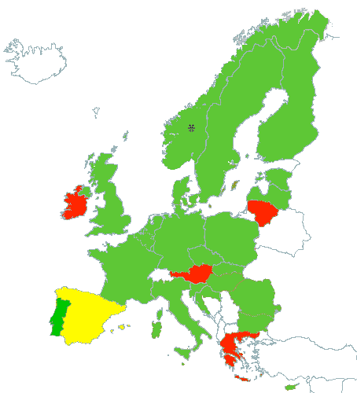
Status of adoption of 2nd RBMPs in Member States
Pending:
AT, EL, ES (Canary islands), IE
LT (adopted but not reported)
GREEN - all second River Basin Management Plans adopted
YELLOW - part of the second River Basin Management Plans adopted
RED - second River Basin Management Plans not yet adopted or reported to EC
Updated 12th June 2017

Slide 4
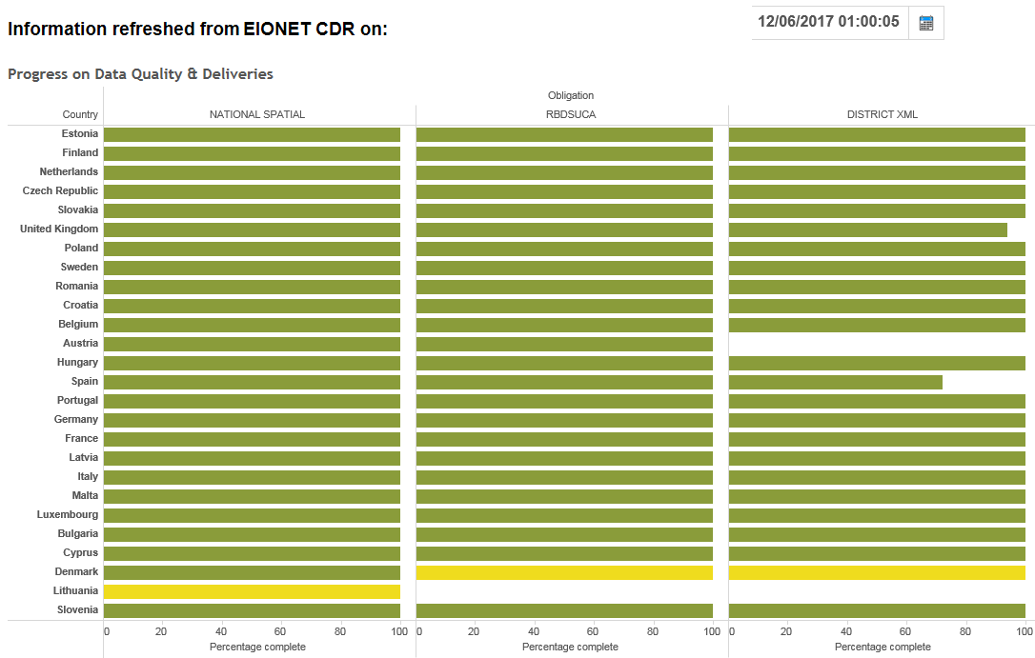
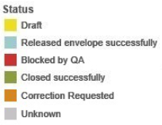
Status of reporting of
2nd RBMPs into WISE
Pending:
DK, LT,
UK (Gibraltar)
(+ Plans not yet adopted)
Updated 12th June 2017

Slide 5
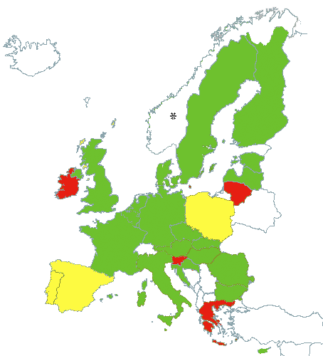
Status of adoption of 1st FRMPs in Member States
GREEN - all second River Basin Management Plans adopted
YELLOW - part of the second River Basin Management Plans adopted
RED - second River Basin Management Plans not yet adopted or reported to EC
Updated 12th June 2017

Slide 6
Overall timeline for the assessment
Member States reports
  Legal obligation: March 2016
  Delays in adoption and reporting of plans into WISE
  Deadline for inclusion in EC implementation report: 31 May 2017
EC Implementation report for WFD and FD
  Legal obligation: end 2018
  Intention: early 2018, as an early input to the evaluation process.

Slide 7
Scope of the assessment
Second RBMPs
  country specific assessments
  assessment at EU level (overview)
First FRMPs
  country specific assessments
  assessment at EU level (overview)
International coordination in water resources and flood management

Slide 8
Assessment of 2nd RBMPs
Main guiding questions:
Status of implementation of WFD requirements?
Compliant implementation?
Progress made since the 1st cycle?
Follow-up of COM's previous recommendations?
+
Identification of good practices
Recommendations for the future steps

Slide 9
Assessment of 1st FRMPs
Main guiding questions:
Status of implementation of FD requirements?
Compliant implementation?
+
Identification of good practices
Identification of weaknesses
Recommendations

Slide 10
Evaluation and review of EU water policy
Drinking Water Directive (2016)
Urban Waste Water Treatment Directive (tbc)
Water Framework Directive (2019)
    Environmental Quality Standards (Priority Substances) Directive
    Groundwater Directive
    Directive Laying Down Technical Specifications for Chemical Analysis and Monitoring of Water Status (QA/QC Directive)
Floods Directive (2019)
Bathing Water Directive (2020)

Slide 11
Preparation for the WFD evaluation
Deliverables / process
WFD/FD Implementation Report (2018)
Public consultation (2018)
Evaluation report (2019)

Slide 12
Estimated timetable
RBMP1
Reporting
measures
RBMP2
Reporting
measures
RBMP3
Reporting
measures
RBMP4
…
RBMP
2009
2015
2021
2027
Blueprint 2012
first RBMP
March 2015
full first cycle
Early 2018
second RBMP
COM reports
2019
Evaluation
Report
2019 WFD review
Evaluation
4Q 2019
New COM takes office
Autumn 2018
Water
Conference
This timetable is tentative and has not yet been formally validated by the European Commission

Slide 13
Next reporting
Intermediate reporting on implementation of the WFD Programmes of Measures (December 2018)
3rd RBMPs (March 2022)
  Watch list (December 2017)
  Supplementary monitoring programme and preliminary programme of measures for new substances in the 2013 EQS Directive (December 2018)
Preliminary Flood Risk Analysis (March 2019)
Flood Hazard and Risk Maps (March 2020)
Flood Risk Management Plans (March 2022)

Slide 14
Implementation support initiatives
Enforcement strategy (infringements)
  Common Implementation Strategy WP 2016-2018
  Water Taskforce ENV-AGRI (AGRIFISH Council May 2017)
Water reuse standards (late 2017)
Pharmaceuticals in the environment (roadmap public)
Investment instruments
European Innovation Partnership on Water
Launch of the European New Urban Water Agenda 2030 (2017)
Ad-hoc Strategic Group (established January 2017)

Slide 15
Thank you for your attention http://water.europa.eu/policy joaquim.capitao@ec.europa.eu

