Slide 1
Stéphane Isoard
Water and Marine – Head of Group
Stephane.Isoard@eea.europa.eu
Freshwater EIONET Workshop
19-20 June 2017, EEA, Copenhagen
Setting the scene: the EEA Freshwater activities

Slide 2
Objectives of the EIONET workshop
To provide member countries an update of the activities of the past year and an outlook on the next years
To seek feedback from member countries on main EEA products, activities and plans
Ensure an active role and participation of member countries in EEA’s activities, in connection with its key mandate of supporting and inform policy development and implementation and specifically the following tasks:
  Assessments supporting the implementation and development of EU policies
  Data flows/reporting, data management
  Information sharing and indicators
  Networking
To kick-start the consultation process of member countries on EEA’s State of Water draft report, planned for publication early 2018 (official consultation of EIONET network will take place later in 2017)

Slide 3
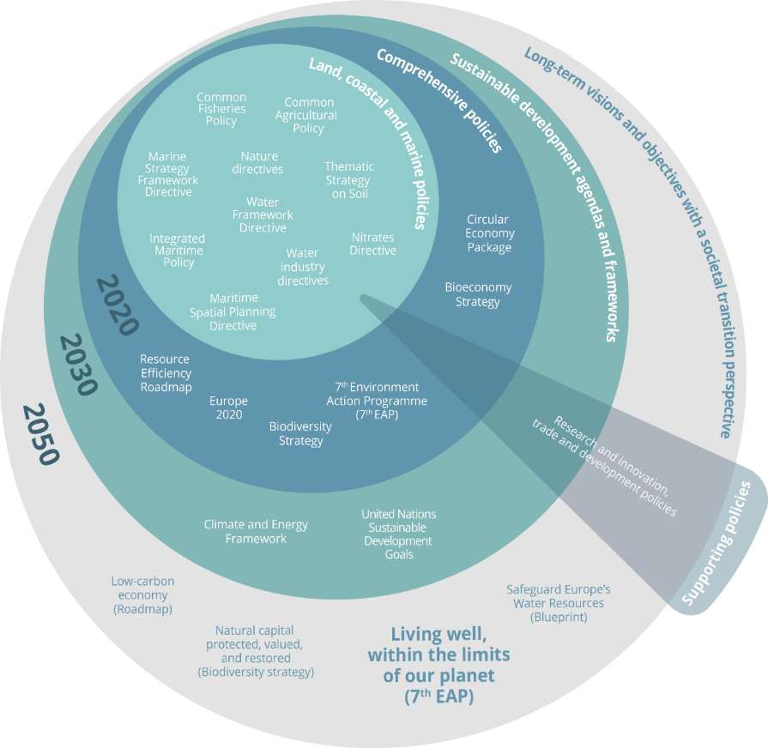

EEA Water and Marine group - Main EU policies and initiatives
  7th EAP (Priority Objectives 1, 2, 3)
  2020 EU Biodiversity Strategy (Target 2/Action 5)
  Nature Directives
  WFD
  FD
  Water Industry Directives
  Nitrates D
  WS&D strategy
  MSFD
  IMP/MSP
  CFP

Slide 4
EEA Water and Marine group
Mandate: To support and inform policy development and implementation
Generic tasks across the Water and Marine tasks:
  Assessments supporting the implementation and development of EU policies
  Data flows/reporting, data management
  Information sharing and indicators
  Networking
Resources:
EEA ICT and data management colleagues
European Topic Centre on Inland, Coastal and Marine waters (ETC/ICM; http://icm.eionet.europa.eu)
EIONET network of EEA member and collaborating countries (NFPs, NRCs)
Collaborating partners (Regional Sea Conventions, ICES)

Slide 5


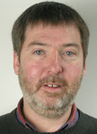


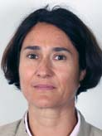


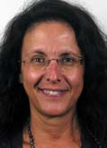


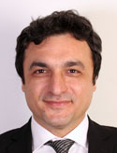



EEA Water and Marine group – Human resources
Water
Regional cooperation
Caroline
Water industries and pollution
Water accounts
Néry
Data management
Peter
Water assessments
Trine
Freshwater assessments and floods
Nihat Cécile Michael
Regional cooperation – EN I South and East
Water quantity and accounts – Marine environment - ICT & Data
Marine
Ana
WISE-Marine and regional cooperation
Eva
Marine assessments
Irene
Marine Data and reporting
Johnny
Marine assessments
Mustafa
Regional cooperation (Black Sea)
Nikolaj
Ocean governance, Arctic
Marine assessments
Freshwater
Stéphane
Head of Group
Charlotta
Secretarial support

Slide 6
Upcoming changes in the strategic and policy context
Priorities and opportunities
2017 - 2018 - 2019:
  Evaluation of the EEA (2017-2018)
  Monitoring and Reporting - Fitness Check (2017-2019)
  Potential revision of EEA Regulation
  New European Topic Centre on Inland, Coastal and Marine Waters (ETC/ICM) (1st Jan 2019)
  European Elections / New European Parliament and new European Commission (2019)
2020
  End of EEA’s Multi-Annual Work-Programme
  End of European MFF (Multi-Annual Financial Framework)
  Horizon of a series of EU legislations, policies and initiatives, and EEA core business:
    7th EAP
    2020 Biodiversity Strategy
    EEA’s State of the Environment and Outlook report (SOER2020)
Given the level of uncertainty and constraints on human and financial resources (EEA’s flat or decreasing budget; staff cuts), it is important to develop realistic and robust planning (e.g. roadmaps).

Slide 7
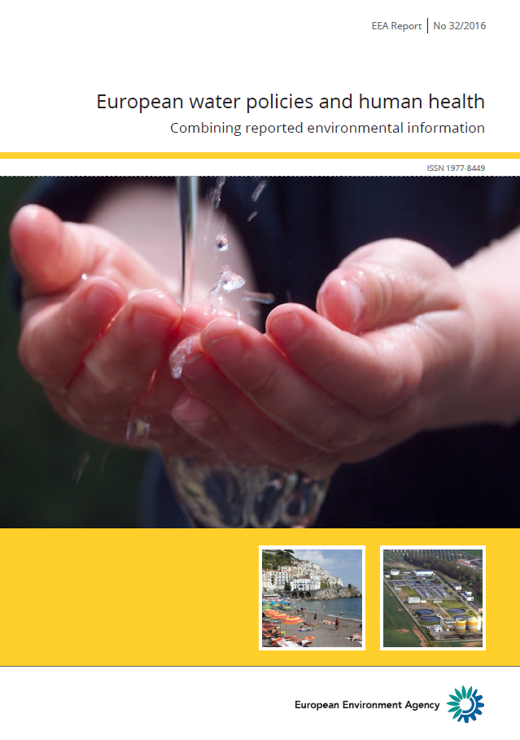
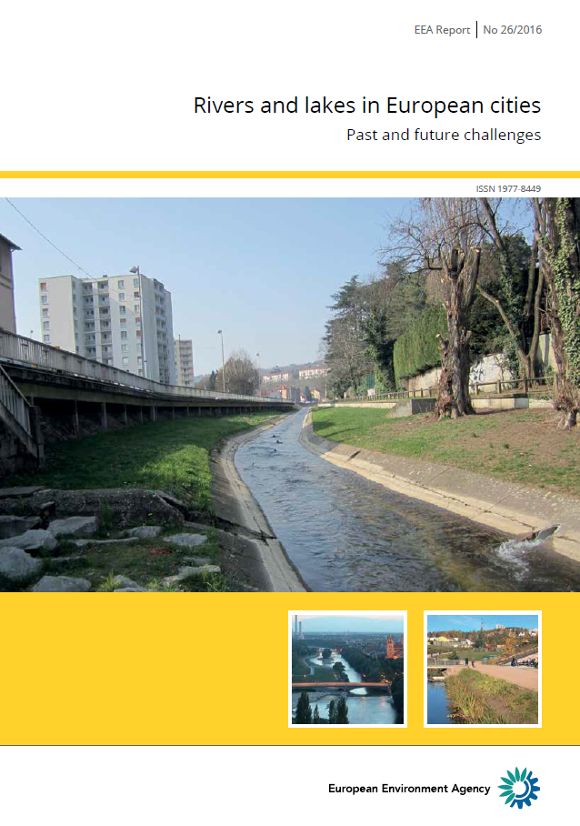
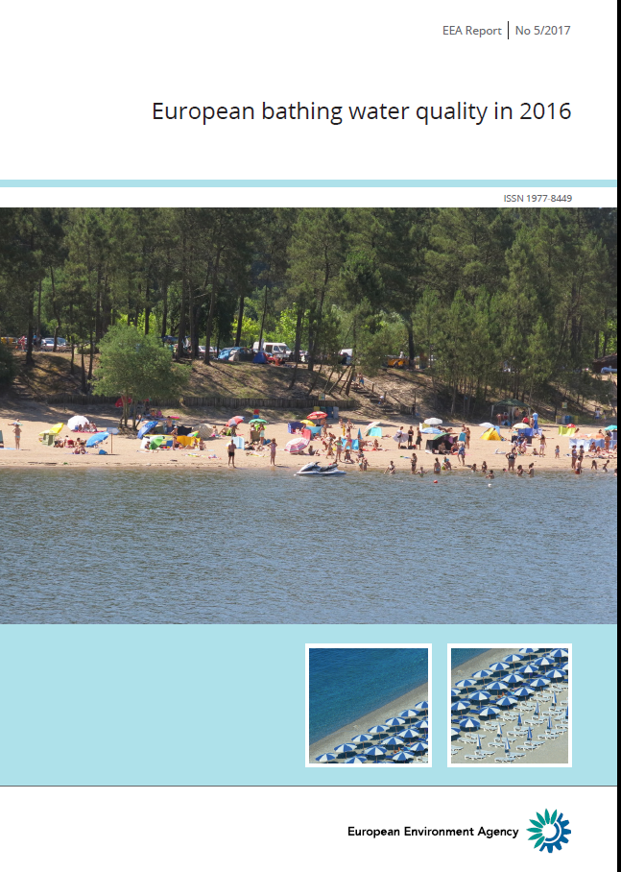
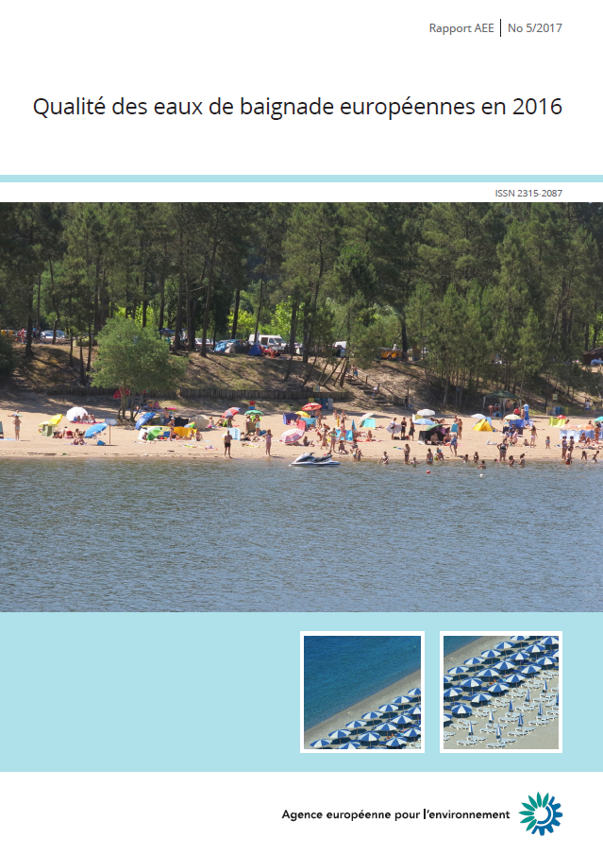

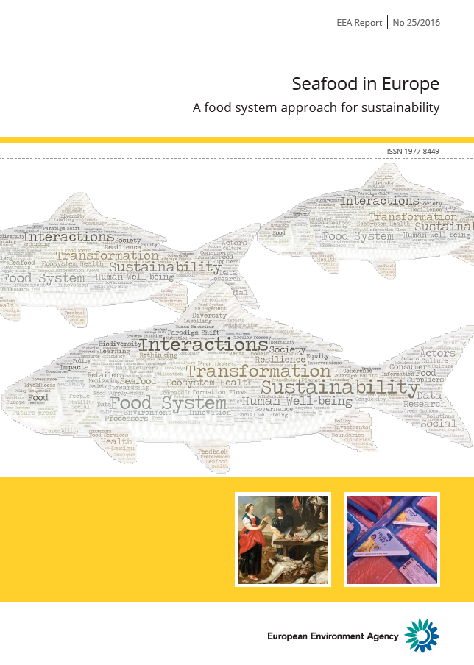
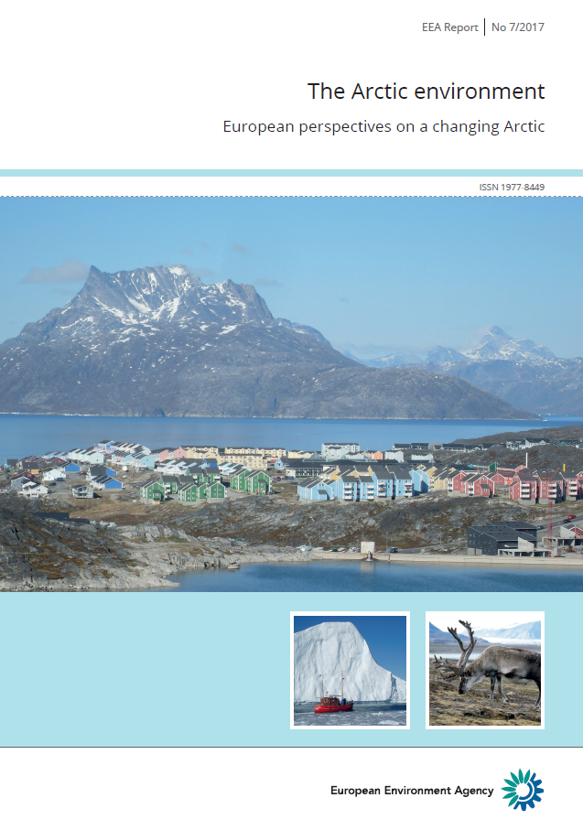
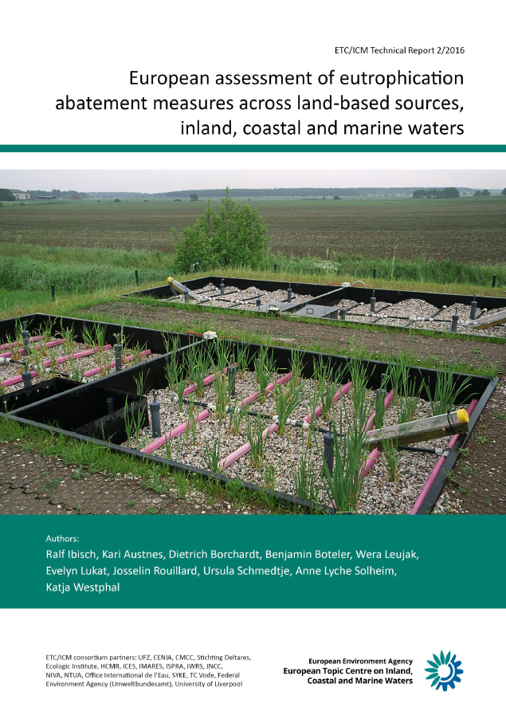
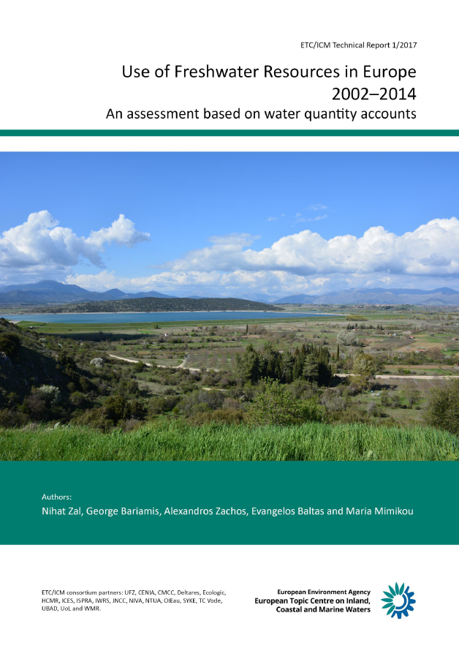
The EEA, a knowledge provider - Recent reports
Assessments supporting the implementation and development of EU policies
ETC/ICM Technical Reports (http://icm.eionet.europa.eu/)

Slide 8
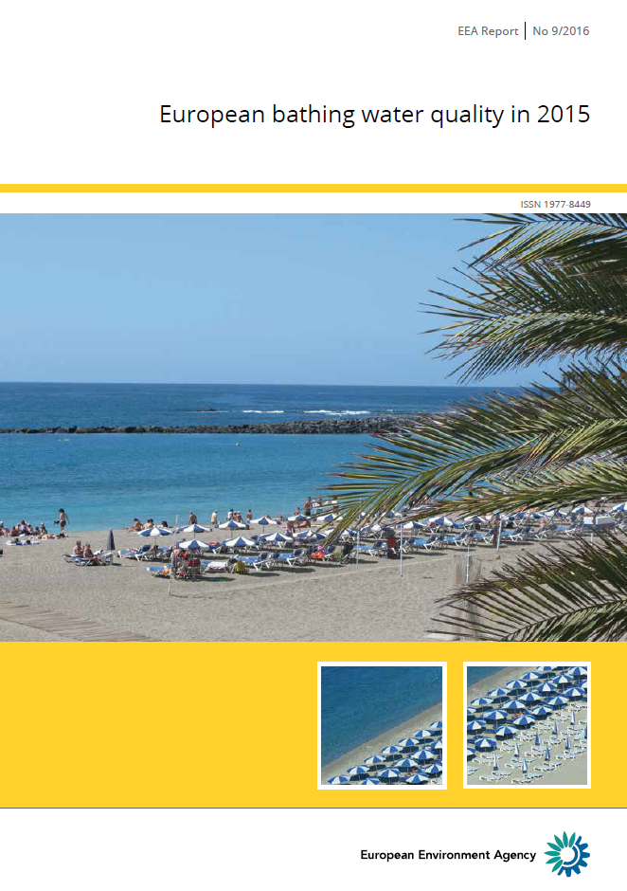
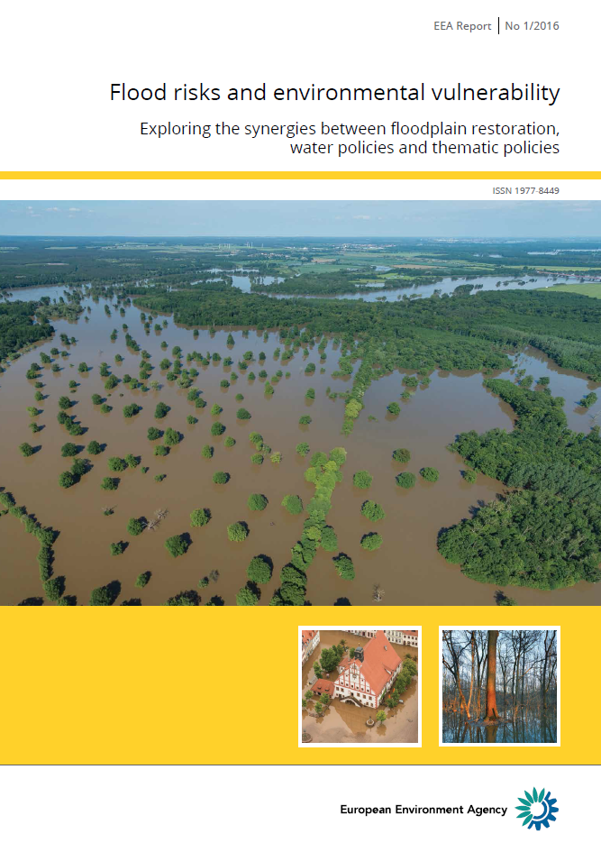

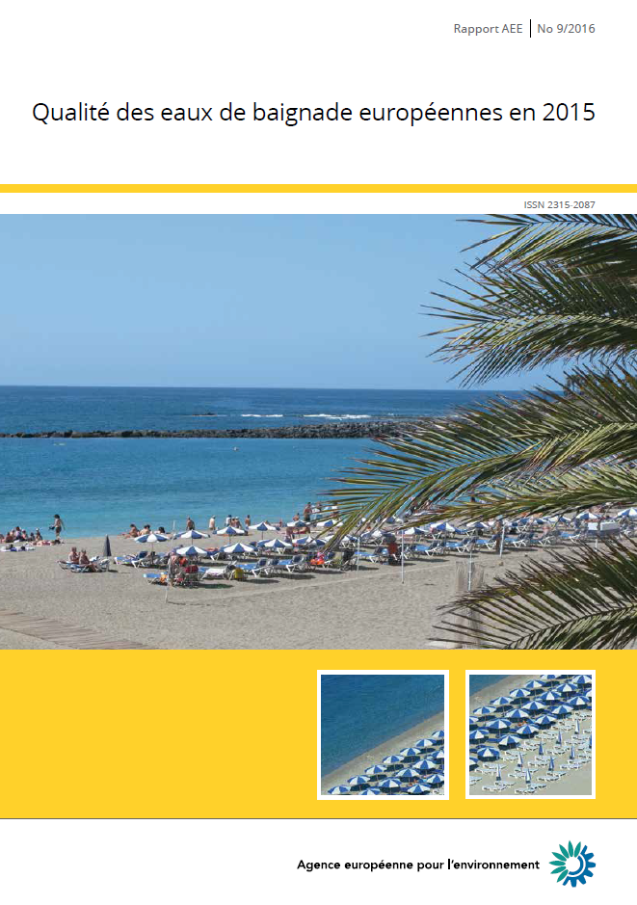
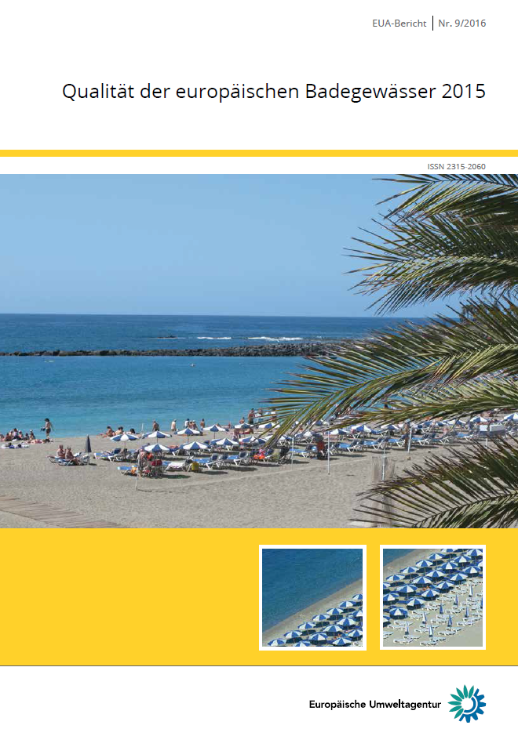
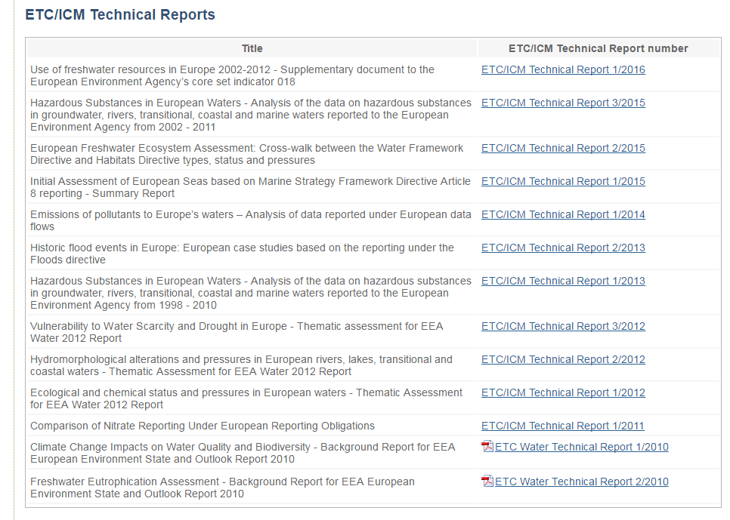

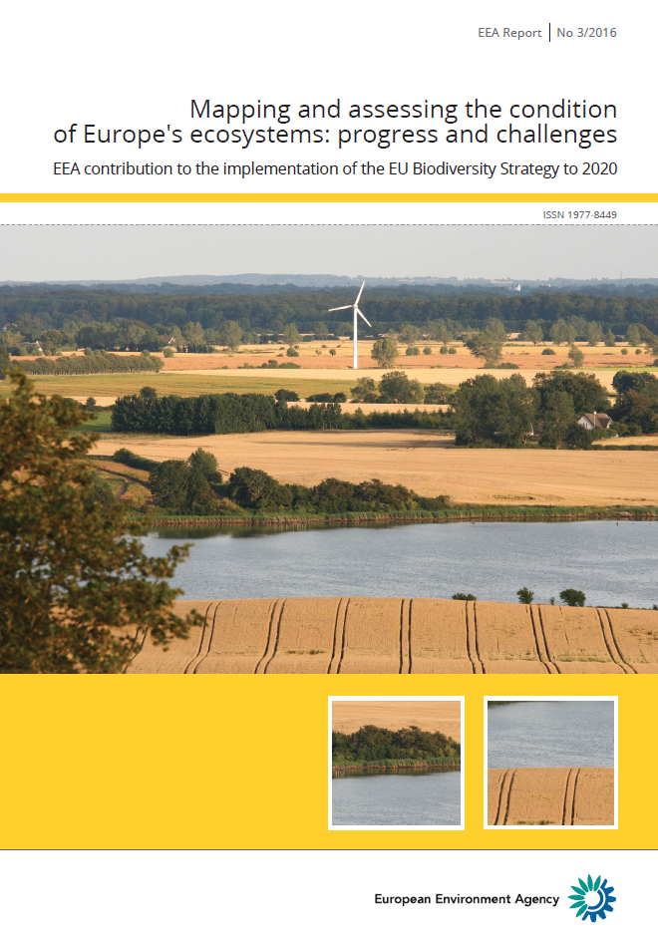
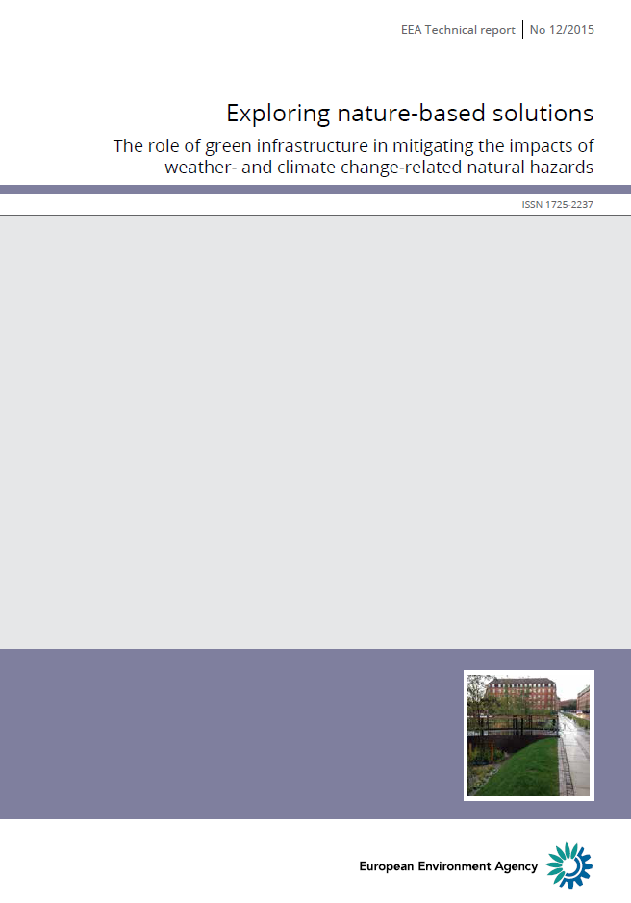
The EEA, a knowledge provider - Recent reports (2016 update)
Assessments supporting the implementation and development of EU policies
Contributions

Slide 9
Data flows/reporting, Information sharing and indicators, Networking
Data flows/reporting, data management
  Support water data reporting under EU Directives: Water Framework D., Urban Waste Water Treatment D. and Bathing Water D.
  Support to the common implementation strategy under WFD and FD.
  2016 WISE-SoE 1, 3, 4, 5 data calls (voluntary reporting)
  Support towards more coherent reporting for WFD and SoE.
Information sharing and indicators
  Water information for Europe (WISE) maintenance and developments in relation to EIONET core data flows and reporting. Water Data Centre.
  Updated core set of indicators on water (e.g. Water Exploitation Index (WEI+), Agricultural water resource efficiency, Oxygen-consuming substances in rivers, Nutrients in freshwater, Urban waste water treatment, Bathing water quality)
Networking
  WFD Common Implementation Strategy (CIS) Working Groups (DIS, floods, chemical)
  UWWTD Working Group
  BWD Working Group
  ESTAT (e.g. OECD/ESTAT Joint Questionnaire)
  JRC (e.g. water quantity)
  EIONET Workshop

Slide 10
The 2016 WISE SoE water data calls
The WISE SoE 2016 Data call covers WISE 1, 3, 4 and 5:
  WISE SoE 1: Emissions to water
  WISE SoE 3: Water quantity
  WISE SoE 4: Water quality in rivers, lakes and groundwater
  WISE SoE 5: Spatial data
From 1st November 2016 to 28 February 2017 – A longer reporting time period to reduce the load on Reportnet due to concomitant reporting exercises and deadlines (e.g. Air Quality (Art. 6, 7, 13, 14; including plans and measures) due by 31 December). To improve the stability and availability of the Reportnet systems, EEA may request, if necessary, that WISE SoE deliveries be interrupted or significantly reduced in December.
The Announcement Letter sent by EEA to:
  Eionet PCPs and NRCs for Water quality and ecological status
  Eionet PCPs and NRCs for Water emissions
  Eionet PCPs and NRCs Water Quantity
    Cc: Eionet National Focal Points; Eionet PCPs and NRCs for Marine, coastal and maritime
The European datasets from previous submissions will be available at the EEA Water Data Centre.
As communicated on 20th June, the SoE 2016 data request for transitional, coastal and marine waters (TCM) will take place in 2017. The next data calls for freshwater and marine are planned for October 2017.

Slide 11
WISE SoE - 2016 Data call
Please note that the EEA, in accordance with its data policy, publishes all data reported by countries, aggregated and disaggregated.
Planned use of WISE SoE data calls:
  The European datasets from previous submissions will be available at the EEA Water Data Centre.
  Freshwater quality indicators: Nutrients in freshwater (CSI 020), Oxygen consuming substances in rivers - biochemical oxygen demand (BOD) (CSI 019). Emission intensity of the domestic sector in Europe (WREI02)
  Freshwater quantity indicators: Use of freshwater resources (CSI 018), Crop water intensity of agriculture (WREI 04)
  WISE interactive maps providing European overviews.
  Marine indicators (based on TCM): Nutrients in TCM waters (MAR 005 / CSI 021), Chlorophyll in TCM waters (MAR 006 / CSI 023), Hazardous substances in marine organisms (MAR 001 / CSI 049).
  Assessments (see the Freshwater and Marine Roadmaps 2016-2022)
  Support to 2020 Biodiversity Strategy (Target 2 / Action 5: MAES), KIP-INCA

Slide 12
Looking forward: upcoming activities to strengthen the water knowledge
Assessments supporting the implementation and development of EU policies
  State of Water (2018)
  European bathing water quality in 2017 (2018)
  Chemicals in Europe’s surface waters (2018)
  Emissions to water (2017; ETC Technical Report)
  EEA Briefing - Water management in Europe: the relative merits of price and non-price approaches to water conservation (2017)
  Green Infrastructure and Flood Management - Promoting cost-efficient flood risk reduction via green infrastructure solutions (2017; format to be decided)
Data flows/reporting, data management
  Support on water data reporting under Directives (Water Framework D., Urban Waste Water Treatment D., Bathing Water D., and Floods D.).
  Water quantity database consolidated.
  WISE-SoE data calls (October 2017).
Information sharing and indicators
  Water information for Europe (WISE) maintenance and developments in relation to EIONET core data flows and reporting. Water Data Centre.
  Updated core set of indicators on water
Networking
  Common Implementation Strategy (CIS) Working Groups
  Eionet Workshops

Slide 13
Looking forward: WISE SoE - 2017 Water & Marine Data calls
The WISE SoE 2017 Data call covers WISE 1, 2, 3, 4, 5 and 6:
  WISE SoE 1: Emissions to water
  WISE SoE 2: Biology in transitional and coastal waters
  WISE SoE 3: Water quantity
  WISE SoE 4: Water quality in rivers, lakes and groundwater
  WISE SoE 5: Spatial data
  WISE SoE 6: Water quality in transitional, coastal and marine waters
From 1st October 2017 to 31 December2017
If necessary, a longer reporting time period may be put in place to reduce the load on Reportnet due to concomitant reporting exercises and deadlines (e.g. Air Quality (Art. 6, 7, 13, 14; including plans and measures) due by 31 December). To improve the stability and availability of the Reportnet systems, EEA may request, if necessary, that WISE SoE deliveries be interrupted or significantly reduced in December.
The Announcement Letter will be sent by EEA to:
  Eionet PCPs and NRCs for Water quality and ecological status
  Eionet PCPs and NRCs for Water emissions
  Eionet PCPs and NRCs Water Quantity
  Eionet PCPs and NRCs for Marine, coastal and maritime
    Cc: Eionet National Focal Points
The European datasets from previous submissions will be available at the EEA Water Data Centre.

Slide 14
WISE SoE - 2017 Data call
The WISE-3, WISE-4 and WISE-5 data collection models are identical to the ones used since the 2015 Data Call.
The WISE-1 data collection model is identical to the one used since the 2015 Data Call, but now includes riverine input loads and direct discharges to the sea
The WISE-2 has been revised during 2015 and 2016 and streamlined with the biology data-model in WISE-4
The WISE-6 data collection model is the new model for water quality in transitional, coastal and marine waters (former WISE-TCM), which has been revised during 2015 and 2016 and streamlined with the water quality data-model in WISE-4
Please try to deliver your data early in the data collection period.
Final feedback will be provided on any released envelope during the reporting period (and not after the end of the data collection period). Envelopes released after the end of the data collection period (31 December 2017) will only be harvested and processed as part of the 2018 data call.
Please use the Reporting Obligations Database (ROD) to locate the relevant information about:
  WISE SoE - Emissions (WISE-1)
  WISE SoE - Water Quantity (WISE-3)
  WISE SoE - Water Quality (WISE-4)
  WISE SoE - Spatial Data (WISE-5)
Reporting process - Guidance documents available at:
  WISE SoE - Emissions (WISE-1)
  WISE SoE - Water Quantity (WISE-3)
  WISE SoE - Water Quality (WISE-4)
  WISE SoE - Spatial Data (WISE-5)
Data files should be uploaded to the Central Data Repository (CDR). The following formats are accepted: Microsoft EXCEL files (XLS or XLSX); XML files; Shapefiles and GML files (WISE-5 only).

Slide 15

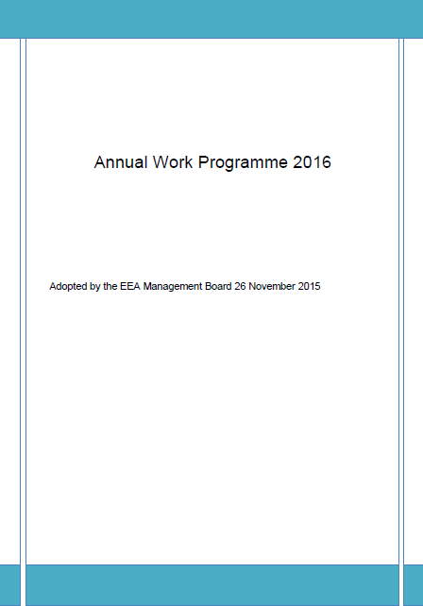
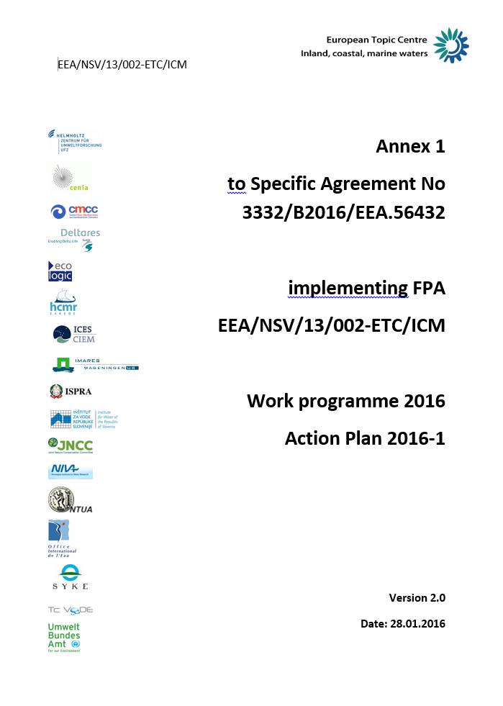

EEA Freshwater Roadmap 2016-2022
Policy developments
Analytical and assessment methods
Availability of data and information

Slide 16
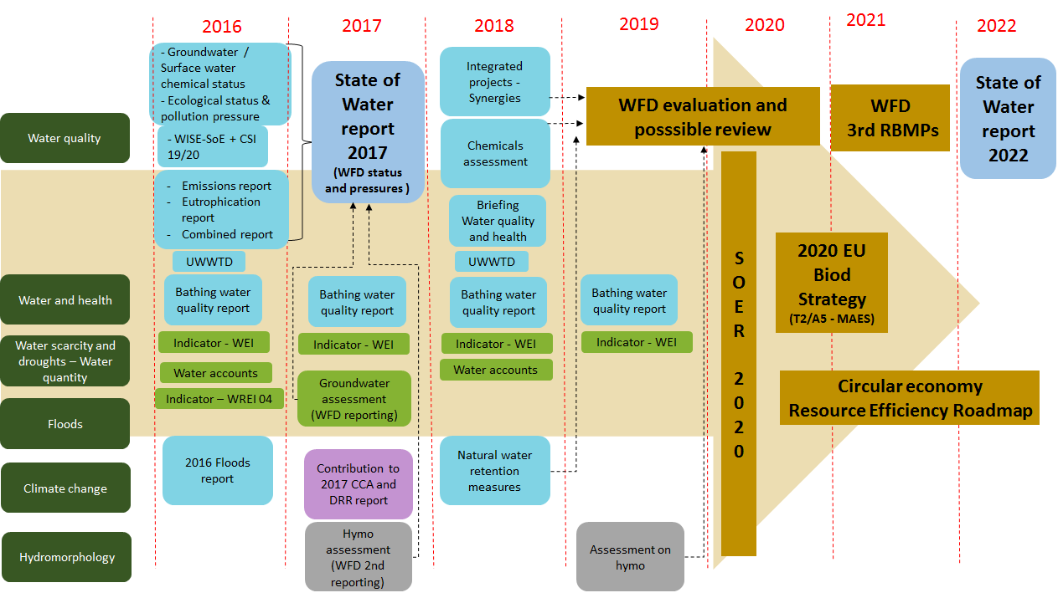
Water knowledge - EEA freshwater Roadmap to support EU policy implementation

Slide 17

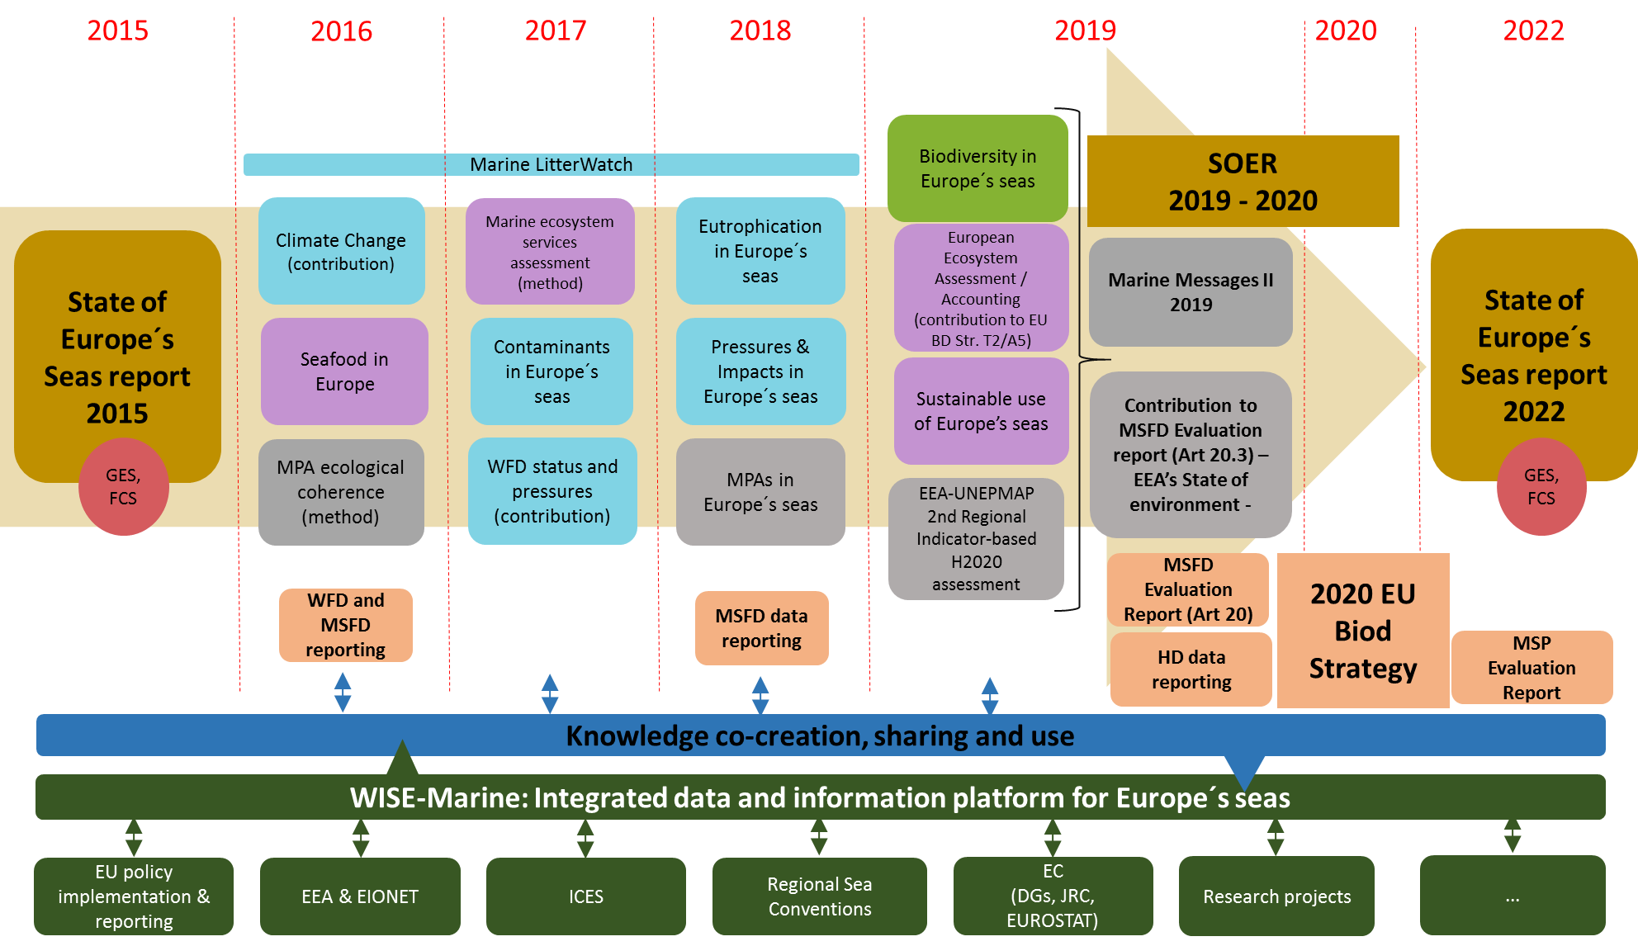
Marine knowledge - EEA marine Roadmap to support EU policy implementation

Slide 18
Stéphane Isoard
Water and Marine – Head of Group
Stephane.Isoard@eea.europa.eu
Sign up to receive EEA news, reports
and alerts on your areas of interest at
http://eea-subscriptions.eu/subscribe
Thank you for your attention

