Slide 1
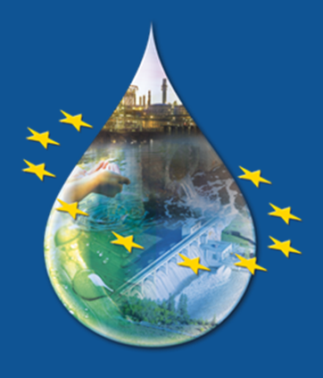
Highlights on Water Industry Directives
Bathing Water Directive
Urban Waste Water Treatment Directive
Drinking Water Directive
Eionet freshwater workshop
Copenhagen, 19-20 June 2017
European Commission
Directorate General for Environment
Unit C.2 - Marine Environment & Water Industry
Maja Feder
Notes:
x

Slide 2
Reporting obligations under Water Industry Directives
Annual reporting under Bathing Water Directive 2017 report on Bathing Water Quality , 2016 data, published on 23 May 2017
Bi-annual reporting under Urban Waste Water Treatment Directive- COM Report on the basis of the 2014 data, to be published in autumn
Triennial reporting under Drinking Water Directive- the Synthesis Report on the Quality of Drinking Water in the Union, 2011-2013 data, published on 20/10/2016

Slide 3
Data and information flow
Using EEA CDR for all three WI directives
QA/QC on Reportnet
Data processing and compliance calculation:
  BWD: EEA/ETC
  DWD: EEA/ETC – in the past, but discontinued
  UWWTD: Commission contractor
Data in EEA database and on mapviewer

Slide 4
Water Industry Directives – state of play
DWD: on-going revision
UWWTD: evaluation planned for near future, pending internal discussions
BWD: review by 2020 (art. 14)

Slide 5
On-going revision of the the Drinking Water Directive - 98/83/EC
Start accelerated by the ECI "Right2Water"
Consultation of public and stakeholders done throughout process
Steps:
  REFIT Evaluation - finished SWD(2016)428 final
  Impact Assessment – ongoing; internal scrutiny
  Legal proposal Commission – scheduled end 2017
www.safe2drink.eu
Negotiation with Council and EP - 2018-2019

Slide 6
Six main areas covered in the Impact Assessment
updating the list and limit values of parameters;
promoting Risk-Based Assessment (RBA) for addressing drinking water pollution risks;
proposing EU harmonized standards for materials and products in contact with drinking water;
ensuring SMART information to drinking water consumers; more efficient reporting provisions
providing access to drinking water to all EU inhabitants
leakages
Meeting with Regulatory Scrutiny Board on 21 June 2017

Slide 7
Evaluation of the Urban Waste Water Treatment Directive 91/271/EEC (UWWTD) – (1)
No specific review clause in the Directive.
Directive in force for over 25 years – context has changed!
new pressures on the environment
depletion of the availability of key resources
impacts of climate change
socio-economic situations
scientific and technological progress
increased societal demands for "cleaner waters"
increasing importance of tourism

Slide 8
Evaluation of the Urban Waste Water Treatment Directive 91/271/EEC (UWWTD) – (2)
Need for an evaluation confirmed also by:
the practical follow-up of implementation
the European Court of Auditors
The evaluation will assess the effectiveness, coherence, efficiency, relevance, and EU added value of the Directive.
It might serve as a basis for an impact assessment if a revision of the Directive is found appropriate

Slide 9
Review of the Bathing Water Directive - 2006/7/EC (BWD)
Steps undertaken so far:
WHO recommandations to scientific, analytical and epidemiological developments relevant to the parametres for bathing water quality in the Bathing water Directive; results expected by June 2018
Assessment of Member States' Compliance with the Bathing Water Directive

Slide 10
The SIIF
(Structured Implementation and Information Framework) website
Created to enhance the reporting process and the generation of information for policy makers, interested parties and the general public
Applying geospatial approach
Helping Member States to implement:
  INSPIRE directive - 2007/2/EC
  Urban Waste Water Treatment Directive – 91/271/EEC
  Public Access to Environmental Information directive - 2003/4/EC

Slide 11
The SIIF
Provides free user-friendly access to detailed information on:
  24 000 urban waste water agglomerations >2000 p.e.
  25 000 urban waste water treatment plants
  25 000 discharge points
  hundreds of sensitive areas
  compliance of each agglomeration and treatment plant, treatment in place and pressures on the environment

Slide 12
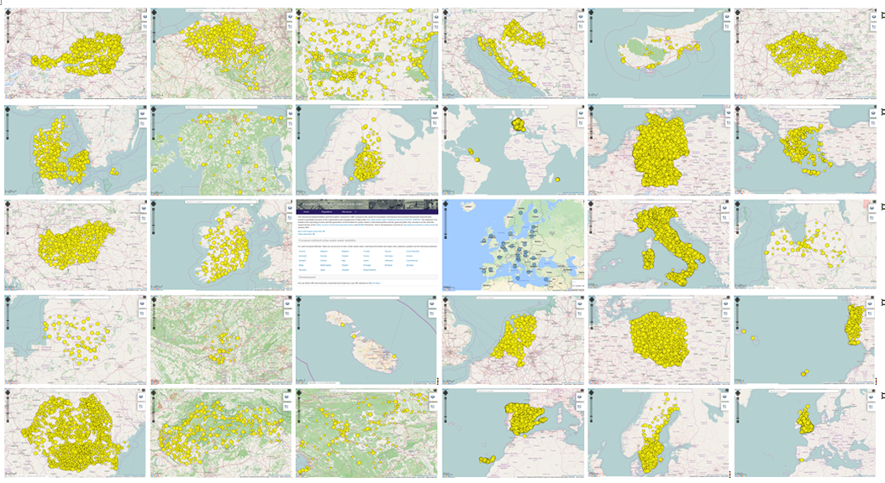
One European urban waste water platform connected to 28 EC urban waste water websites including reporting information from 2012 and 2014
(Websites available since March 2017)

Slide 13
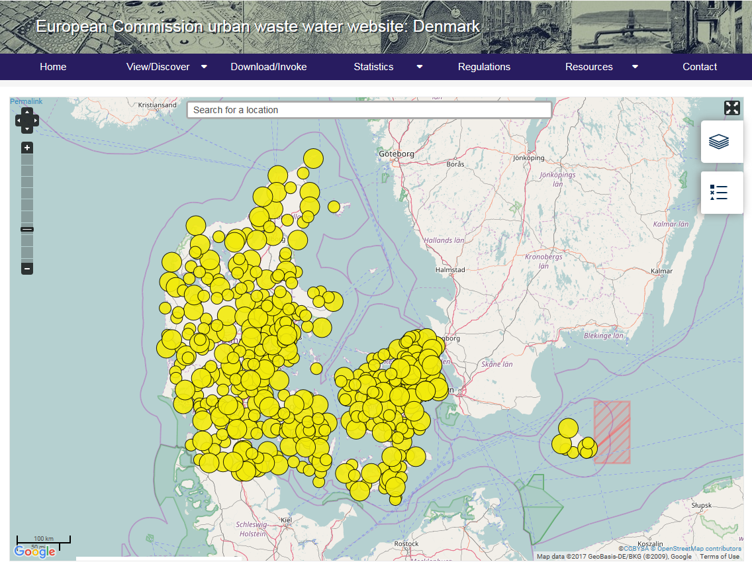

Slide 14
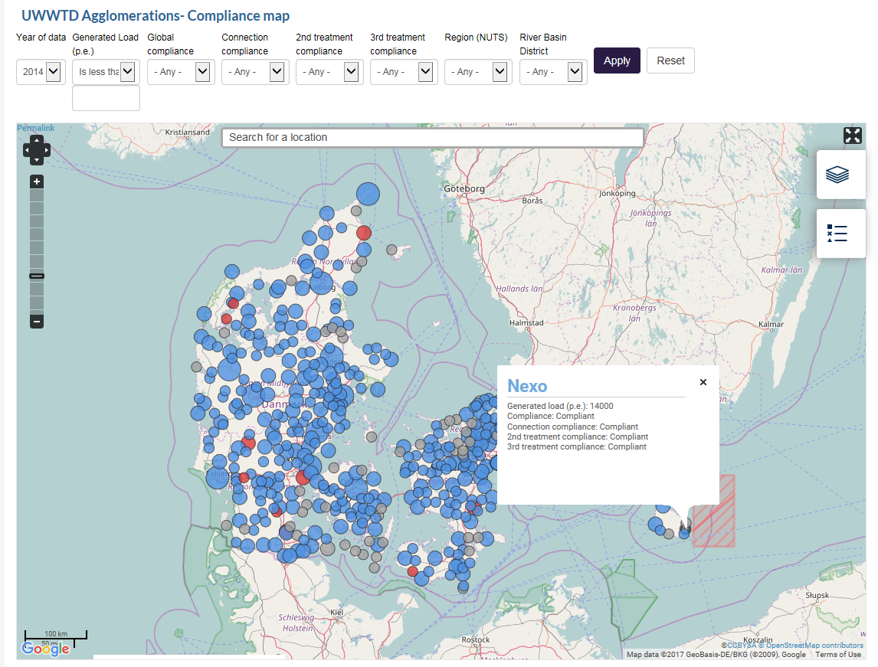

Slide 15
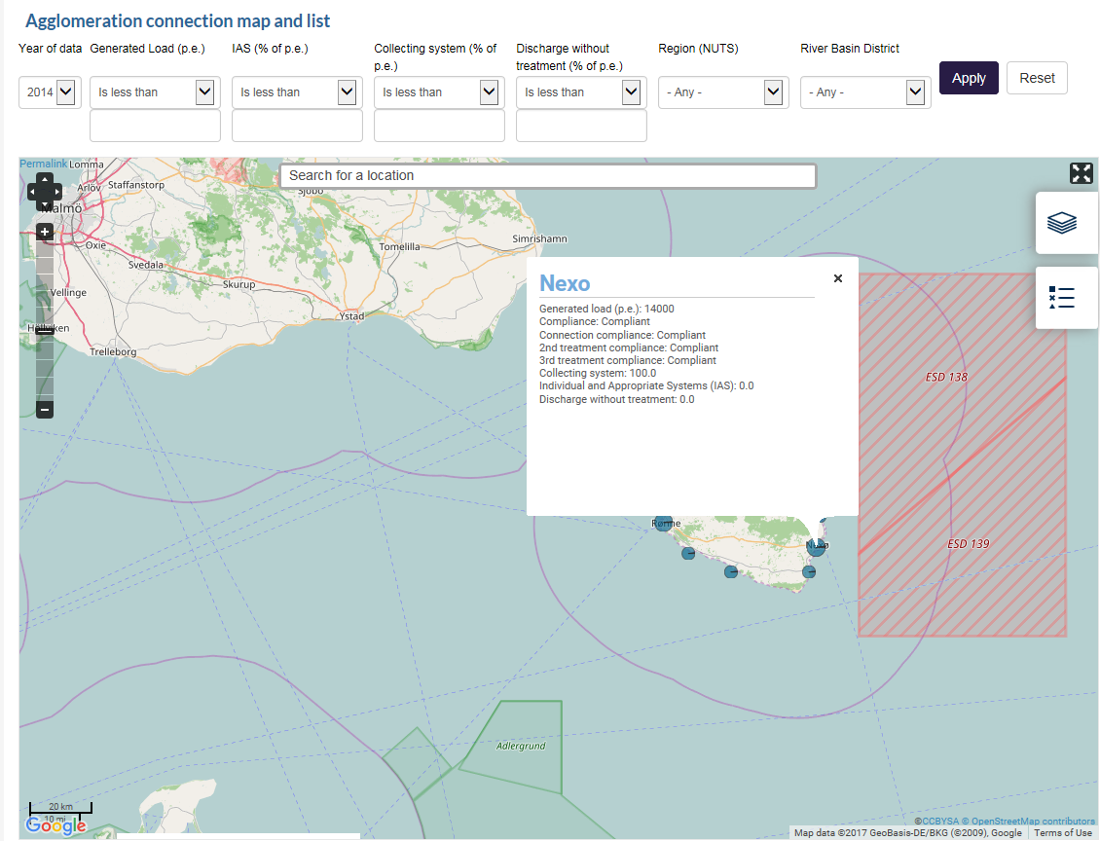

Slide 16
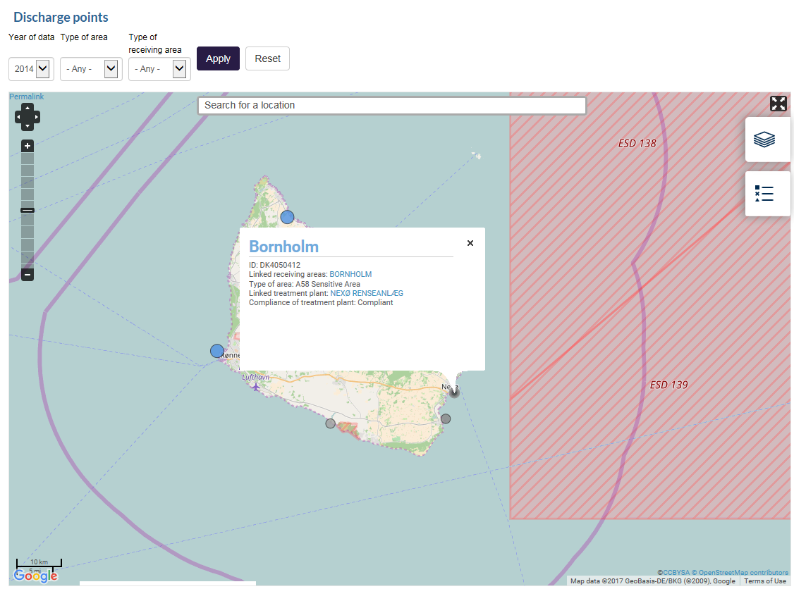

Slide 17
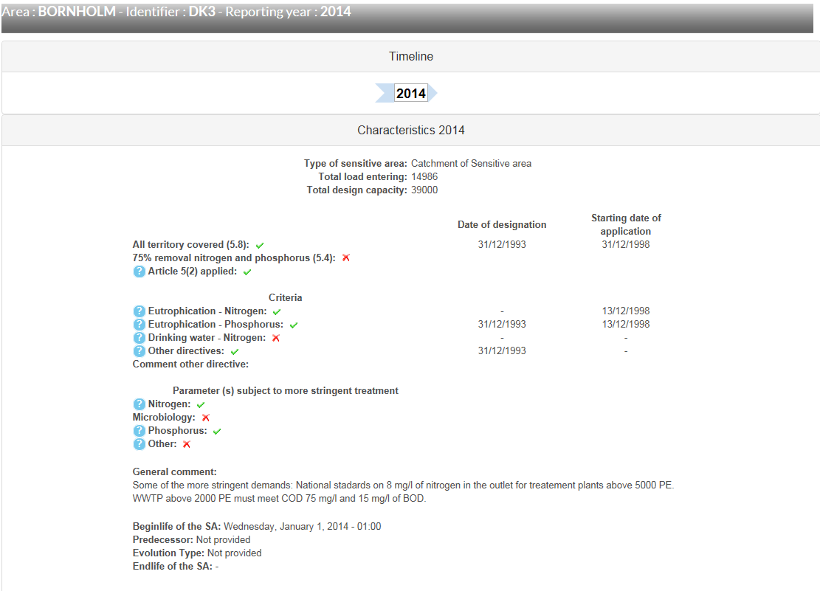

Slide 18
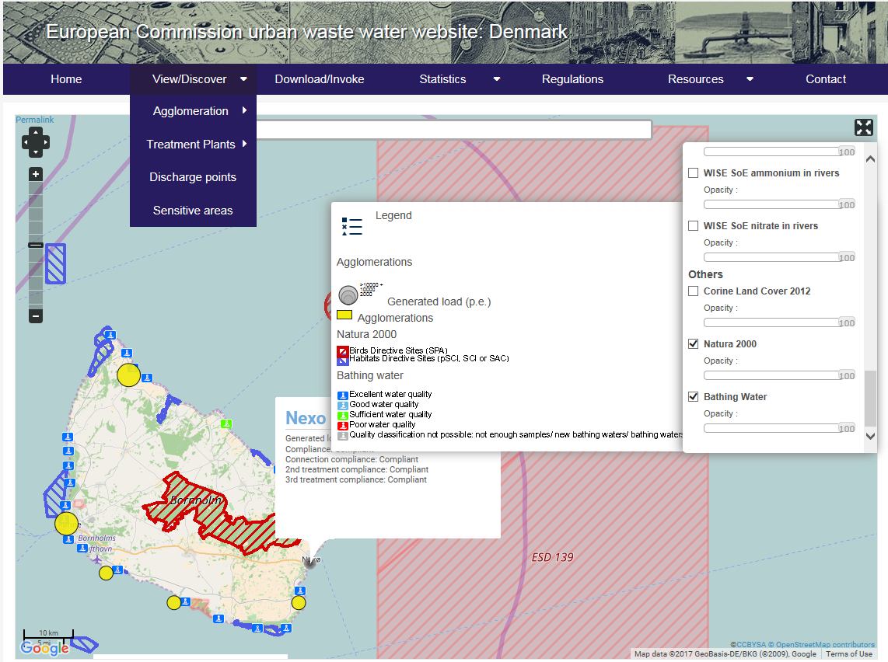

Slide 19
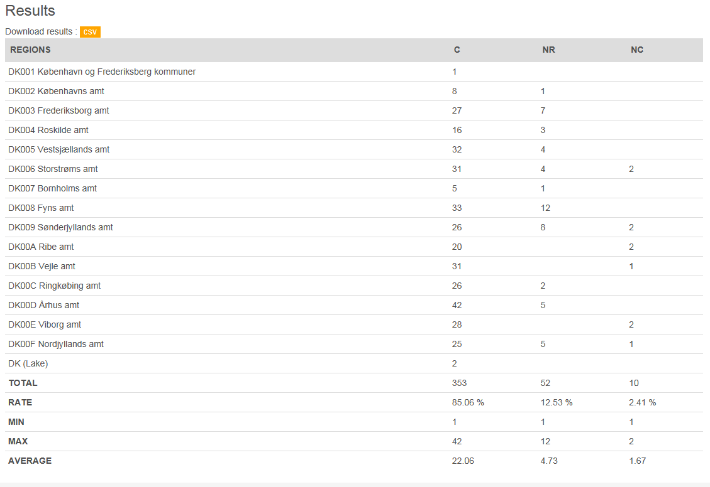
Statistics
Aglomerations/Compliance/2014/regions(NUTS)

Slide 20
Upcoming products on UWWTD implementation:
• The Commission Report, due after summer
• The SIIF website with access to full information about individual objects, and national and EU-level information
• The EEA viewer, with selected information about individual objects and EU-level information

Slide 21
Conclusions
DG ENV relies on your work/data in its work on
  Policy implementation follow-up
  Evaluation processes

Slide 22
Further information
EU Commission water homepage:
http://ec.europa.eu/environment/water/
BWD:
http://ec.europa.eu/environment/water/water-bathing/index_en.html
UWWTD:
http://ec.europa.eu/environment/water/water-urbanwaste/index_en.html
DWD:
http://ec.europa.eu/environment/water/water-drink/index_en.html

Slide 23

Thank you for your attention

