Slide 1


EEAs assessments of the status of
Europe’s waters
EIONET NRC Freshwater meeting
19-20 June 2017
Peter Kristensen
European Environment Agency (EEA)

Slide 2
Introduction to EEA State of Water assessment 2018
Why, what, for who and when
2018 is the year in which the European Commission published its report on “Implementation of WFD and the review of the 2nd River Basin Management Plans (RBMPs)” and start the process of reviewing the Water Framework Directive. To accompany and inform this process, the EEA has long planned a report of ”State of European waters”
The report aims to present results on:
What is the status of European waters?
Which pressures is causing less than good status;
What progress has been achieved in the 1st River Basin Management cycle (2009-2015)?
The target audience is EU institutions (EP, COM, JRC); countries (national, River Basin District administrations working with WFD and other water policy implementation); International River Basin and Regional Sea Conventions; water experts and scientists; and general public.
EEA will in addition to WFD results try to include results from non-WFD countries.

Slide 3
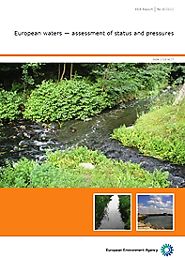
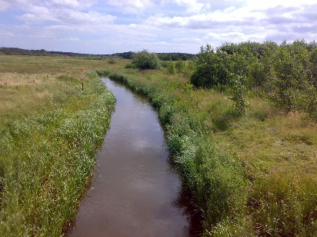
EEA’s 2018 State of Water Assessment (report/portal)
The first EEA report was published in 2012, the second is planned for March 2018.
Overview of status (quantitative, chemical and ecological), pressures and impacts
Change in status and pressures from 1st to 2nd RBMPs
Relationship between pressure and status (what is causing less than good status) –pressures-driving force relationship.
Effect of measures (implemented during the 1st RBMP period from 2010-2015).
Other information on status of European water including results from non-WFD countries
European waters – status and pressures
2018 State of water assessment
Notes:
State of water (SoW) assessment should quantify and identify the current state of, and impacts on, water environment, how these are changing in time and if the measures that are taken at different levels prove effective.

Slide 4
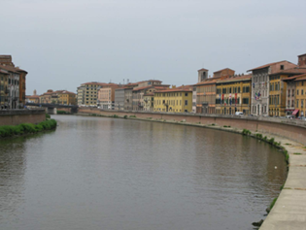
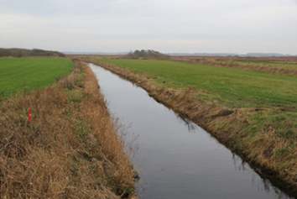
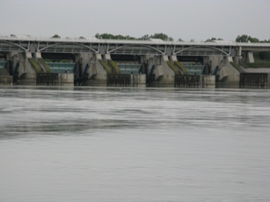
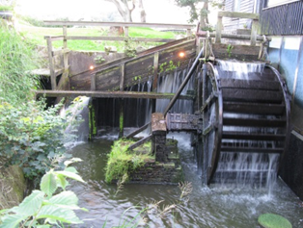
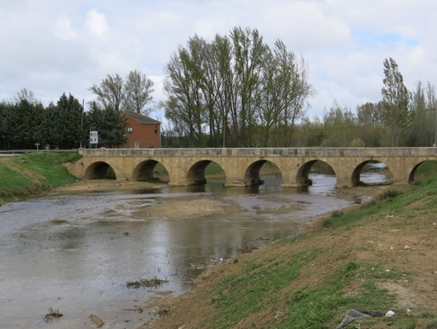
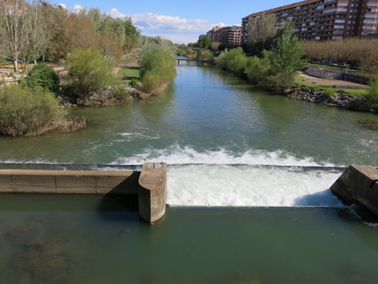
EEA State of Water assessment 2018

Slide 5

Source: MARS project (Managing Aquatic ecosystems and water resources under multiple stress) - http://mars-project.eu/

Slide 6
Overall outline of the state of water report
Introduction
Ecological status and pressures
Chemical status of surface waters
Chemical status of groundwater
Groundwater quantitative status
Overall status, integrated assessment and outlook (examples of measures, implemented during 1st RBMP period (2010-2015), other water policies and sector activities, emerging issues)

Slide 7
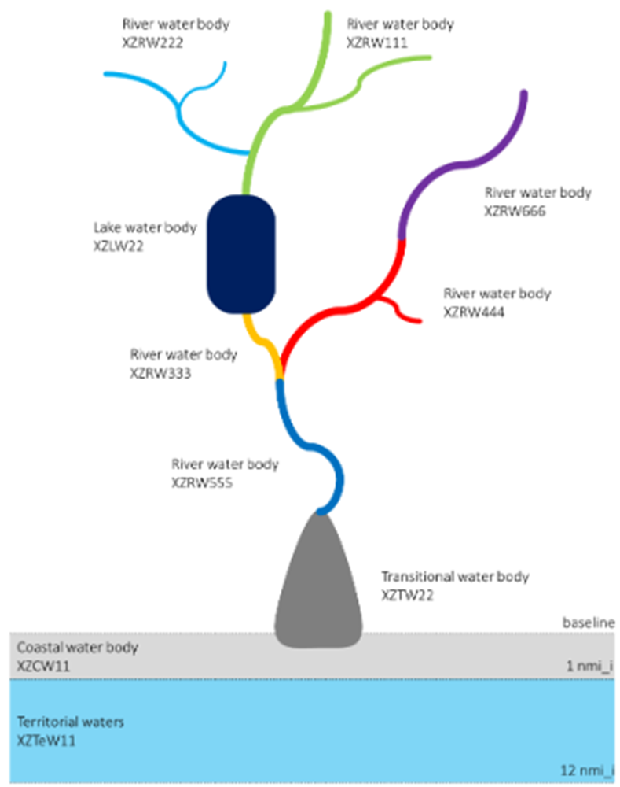
Data sources and methodology used
Reporting May 2017– 20 Member States – 125 RBDs
(Germany, Luxembourg and Malta (are now in WFD database, but not used in diagrams); data not yet available from Austria, Denmark, Greece, Ireland, Lithuania, Norway)
63 000 river water bodies 936 000 km – average length 15 km
16 125 lake water bodies – 2/3 from Sweden and Finland - avg area 4.9 km²
772 transitional water bodies (avg area 18.4 km²)
2632 coastal water bodies (avg area 94 km²)
32 territorial waters
11 700 Groundwater bodies (3.9 million km²)
Preliminary results – 20 MS – May 2017

Slide 8
General storyline for the status chapters
What is the status? – Details on status.
Comparison between results from 1st and 2nd RBMP period
What is causing not achieving good status (e.g. significant pressures, pollutants causing failure etc.)
Which significant pressures are causing failure?
What is the status of water bodies?
Good
?
Less than good
Which pollutants or quality elements are failing?
Change in status or pressures
1st and 2nd RBMP period

Slide 9
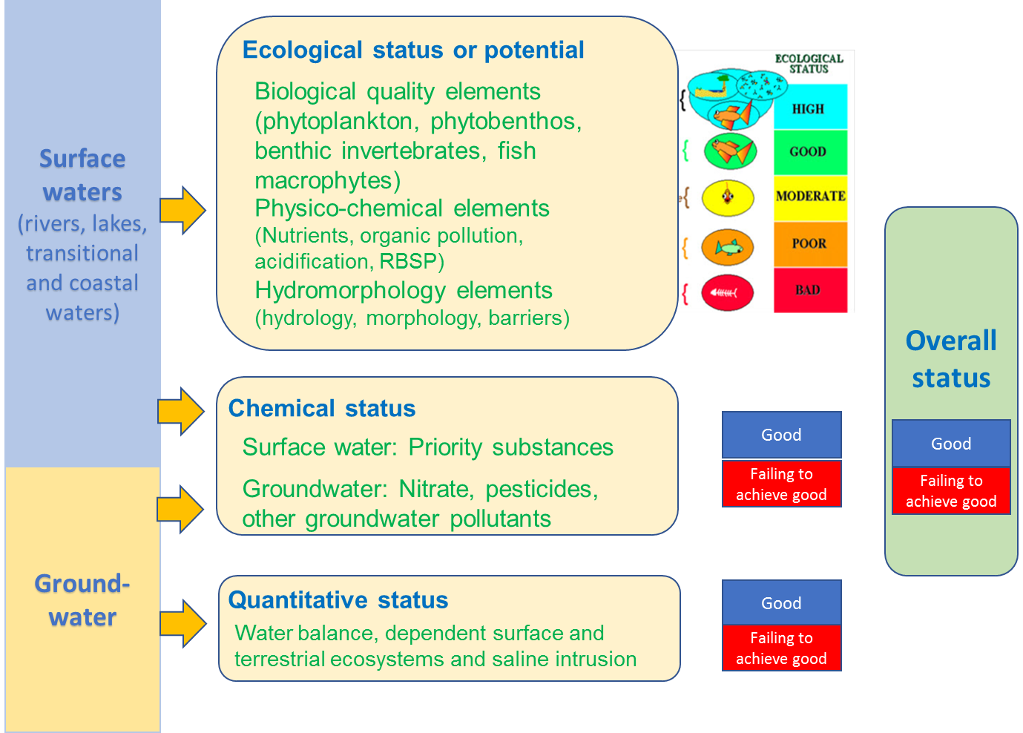
The report will cover all status (ecological, chemical and quantitative) and details (Quality Elements, Priority substances etc.)

Slide 10
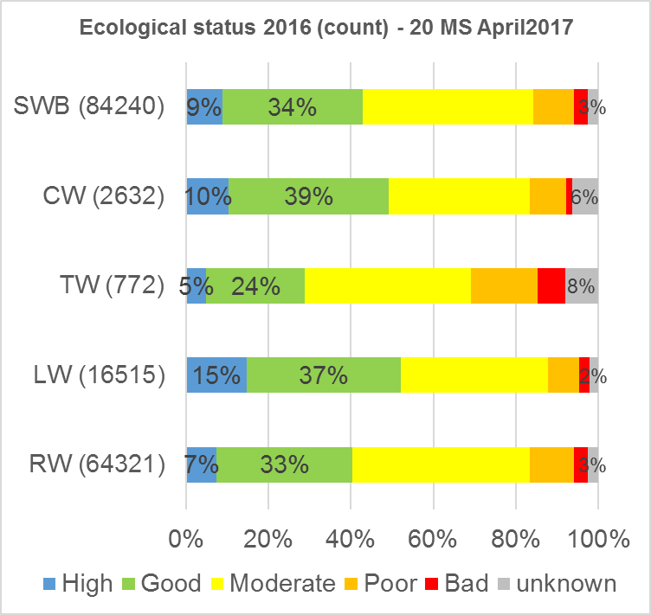
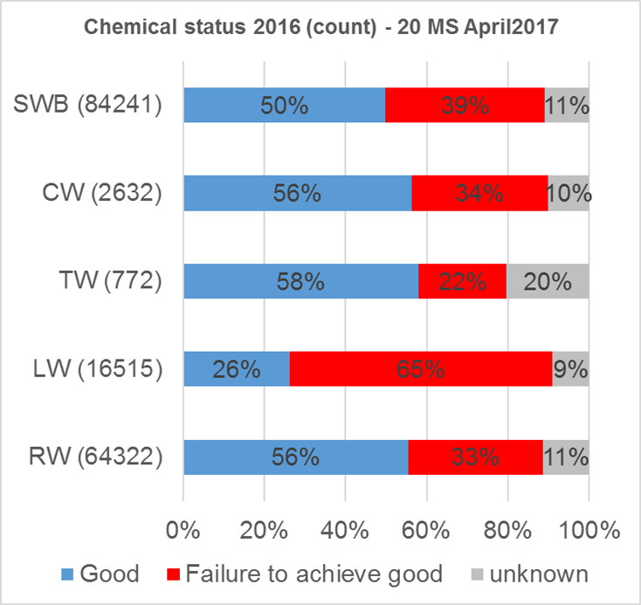
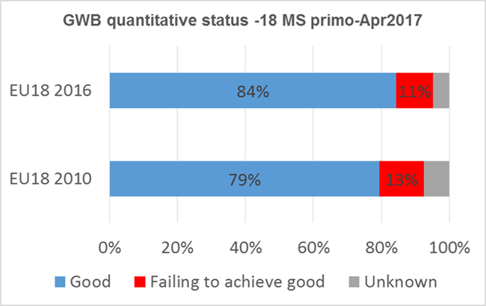
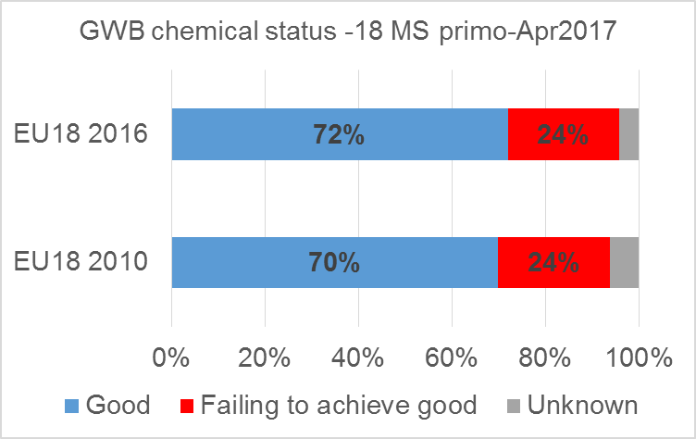
Status (ecological, chemical and quantitative)

Slide 11
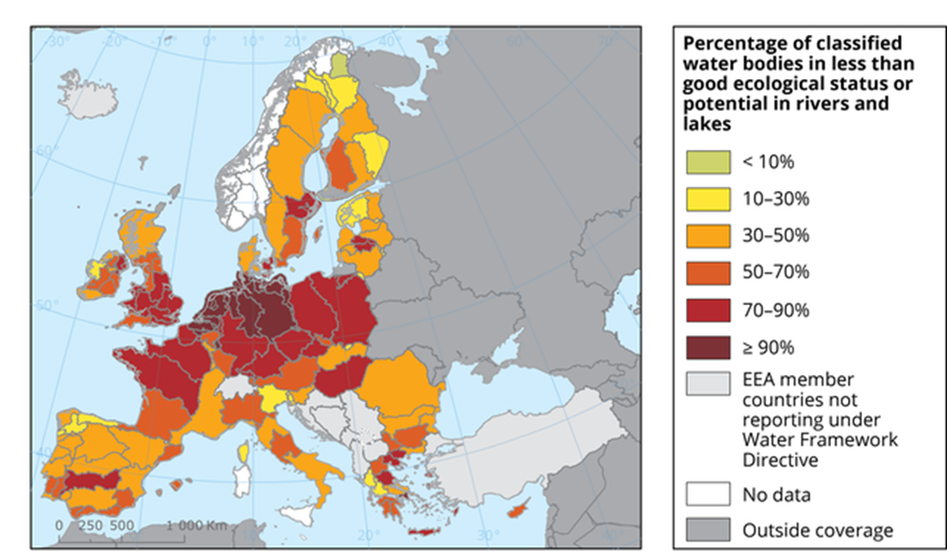
Status and pressures by River Basin Districts
Ecological status of rivers and lakes (2012 results)
Map to be updated
Source: https://www.eea.europa.eu/data-and-maps/figures/proportion-of-classified-surface-water-3

Slide 12
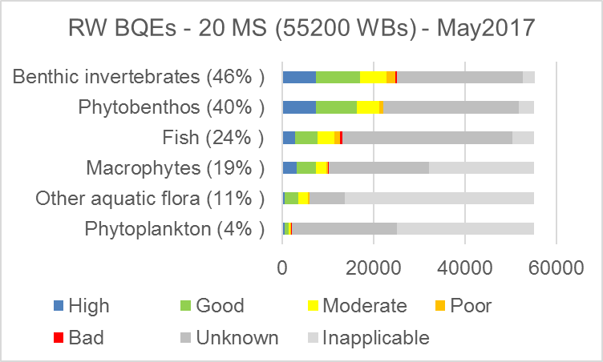
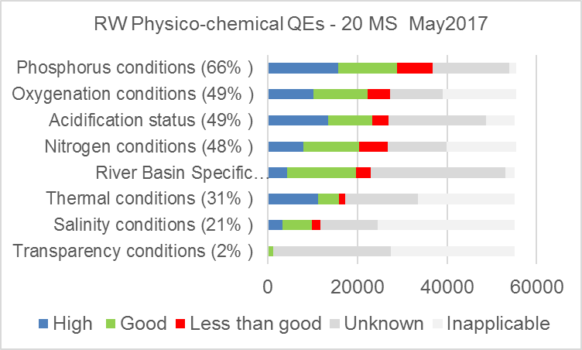
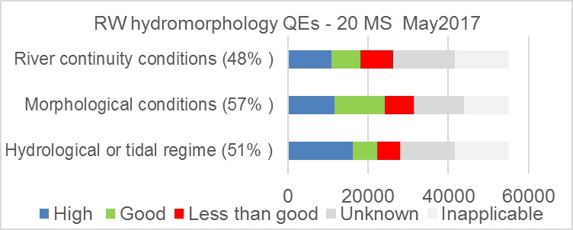
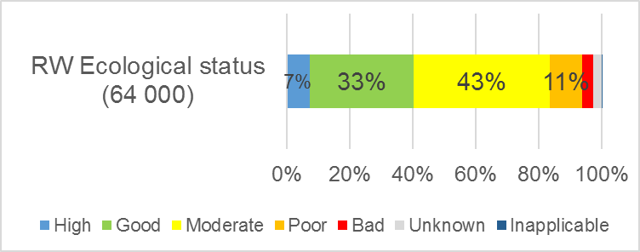
Details on status - ecological status by quality elements
River water bodies – ecological status by quality elements
Percentages high/good (H/G) of known QE status
68 % H/G status
83 % H/G status
75 % H/G status
Preliminary results – 20 MS – May 2017

Slide 13
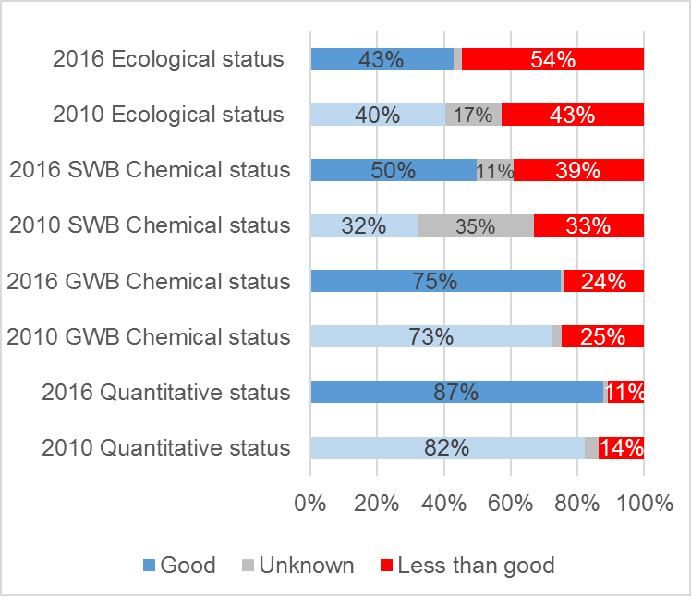
Comparison of status in 1st and 2nd RBMP period
The diagram illustrate
A marked reduction in unknowns from 1st to 2nd RBMPs
There are an increase in the proportion of water bodies in Good and Less than Good status.
Preliminary results – 18-20 MS – May2017

Slide 14
General storyline for the status chapters
What is the status? – Details on status.
Comparison between results from 1st and 2nd RBMP period
What is causing not achieving good status (e.g. significant pressures, pollutants causing failure etc.)
Which significant pressures are causing failure?
What is the status of water bodies?
Good
?
Less than good
Which pollutants or quality elements are failing?
Change in status or pressures
1st and 2nd RBMP period

Slide 15
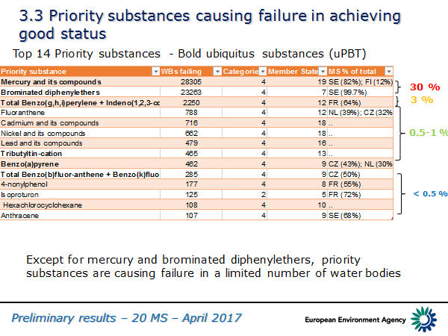
Pollutants causing failure
The report will provide and overview of the pollutants causing failure to achieve good status

Slide 16
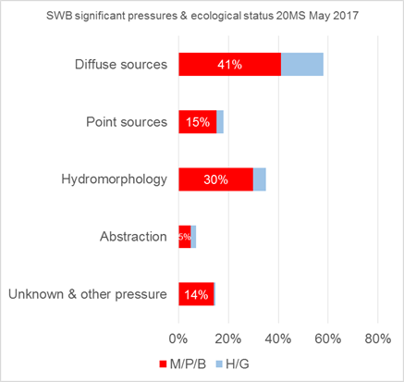
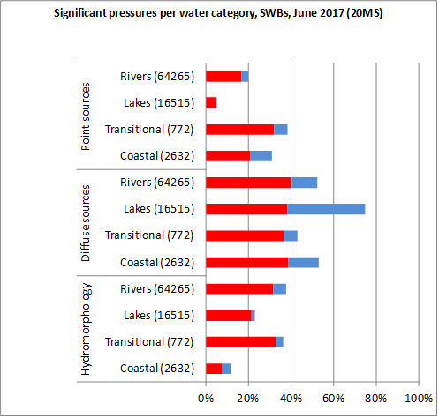
Pressures causing not achieving good ecological status
Pressures – relevant for ecological status - proportion of surface WBs affected by pressure
Preliminary results – 20 MS – May2017

Slide 17
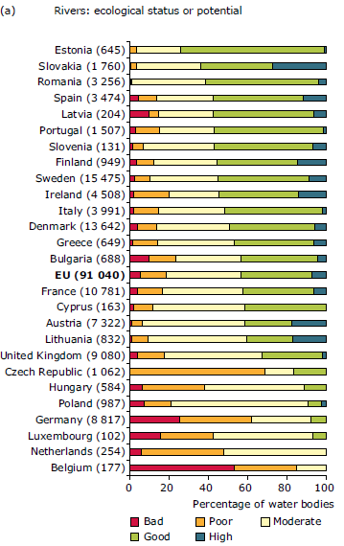
Comparison of status and pressures by country
Diagram from 2012 water assessment River ecolological status by Member States
After EEAs 2012 State of water assessment, countries have raised concerns on the diagrams illustrate Member State comparison/ranking of Member State results on status.
EEA understands this concern and wants to consult with countries on different approaches to illustrate results on status and quality elements.

Slide 18
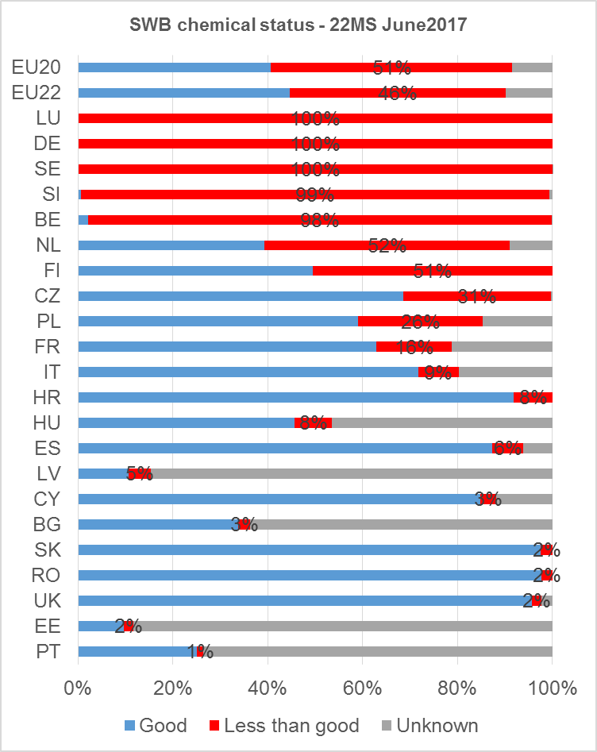
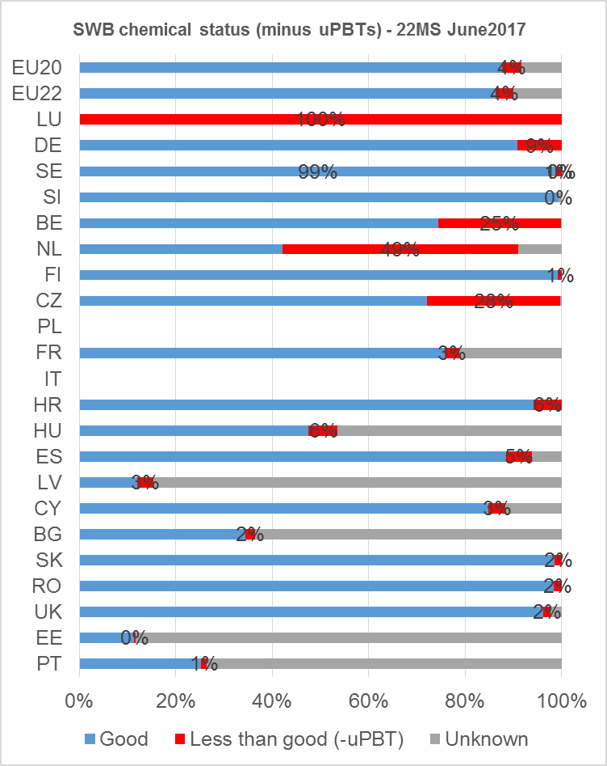

Comparison of status and pressures by country
Chemical status – surface water bodies
Chemical status with uPBTs
Chemical status without uPBTs
Preliminary results – 22 MS – June2017

Slide 19
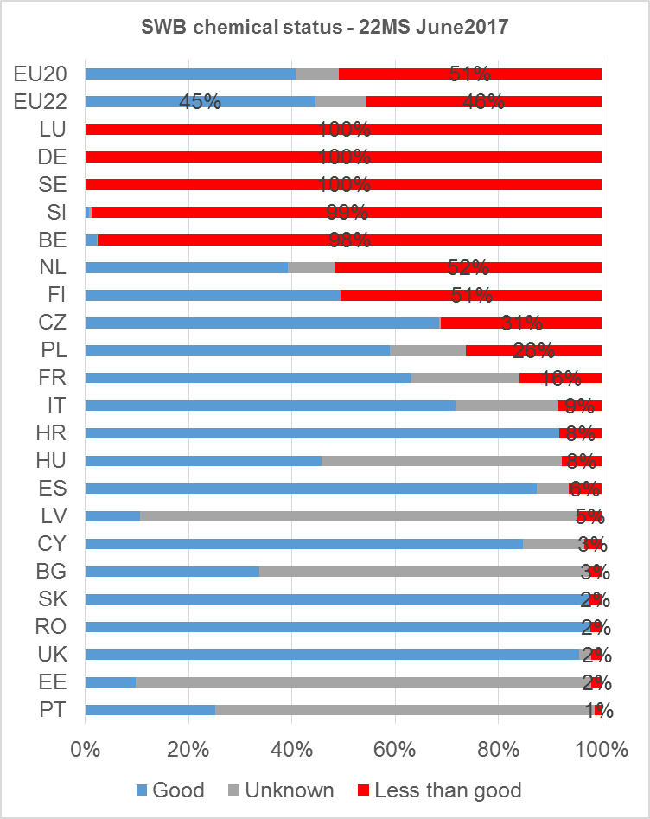
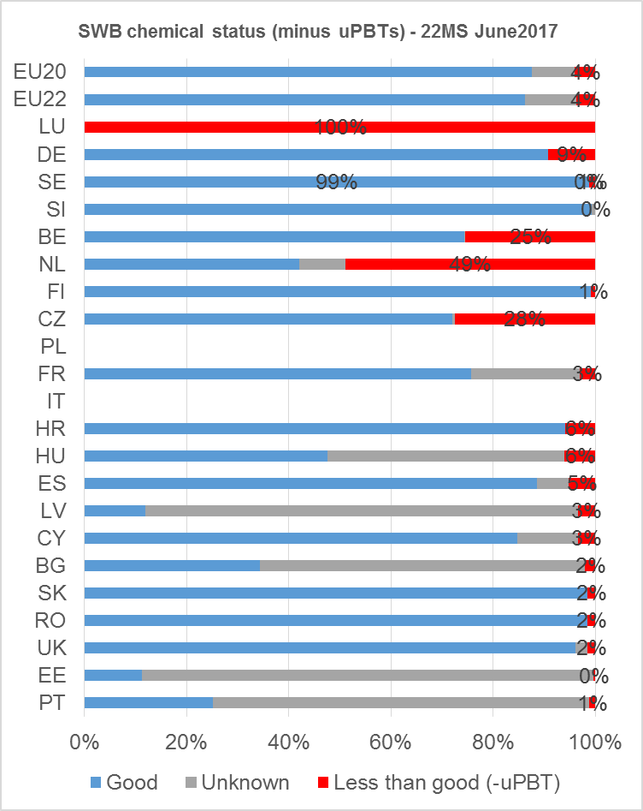
Comparison of status and pressures by country
Chemical status – surface water bodies
Chemical status with uPBTs
Chemical status without uPBTs
Preliminary results – 22 MS – June2017

Slide 20
EEA State of water report 2018, next steps
June-September EEA to develop an advanced draft of the report
October 2017: consultation of draft report: Eionet & CIS (WG-DIS and other WGs)
November-December 2017: last update of diagrams and textual content based on consultation.
Winter/spring 2018: Final production of report and publication.

Slide 21
Breakout sessions
Two groups and two topics: (1) ecological status and pressures – integrated assessment; (2) chemical and quantitative status and pressures.
Each topic will be discussed twice, once with each group. Two hours are available on day 1 (16-18), and two hours on day 2 (9-11).
Each session
EEA presentation(s) showing key points
Tour de table of responses to EEA background document/key points
Structured discussion
  Priorities – Have we identified the main points which should be reported in the Europe’s State of Water assessment?
  Accuracy – Please sense check the results and conclusions with your knowledge of RBMP reporting
  Alternatives and gaps – Other ways to present the information, other relevant information, etc.

Slide 22

Thank you
Your comments and
inputs are highly appreciated.
eea.europa.eu

