Slide 1


EEAs assessments of the status of
Europe’s waters
Ecological status and pressures
EIONET NRC Freshwater meeting
19-20 June 2017
Peter Kristensen
European Environment Agency (EEA)

Slide 2
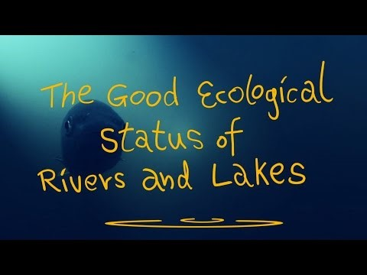
Source: MARS project (Managing Aquatic ecosystems and water resources under multiple stress) - http://mars-project.eu/

Slide 3
Chapter 2: Ecological status and pressures
2.1 Introduction
2.2 Ecological status in 2nd RBMPs
2.3 Status by quality elements
2.4 Pressures causing not achieving good ecological status
2.5 Change in ecological status between 1st and 2nd RBMP
Expected content of the chapter
The chapter will update the European overview of ecological status or potential. The overview of ecological status will related to population density and agricultural area and presented for broad water types.
The chapter will also focus on the status by quality elements in particular biological quality elements.
Results on the pressures causing failure to achieve good ecological status will be presented.
Results on ecological status and quality elements from the 1st to 2nd RBMP period will be compared.

Slide 4
General storyline for the status chapters
What is the status
What is causing not achieving good status (e.g. significant pressures, pollutants causing failure etc.)
Comparison between results from 1st and 2nd RBMP period
Which significant pressures are causing failure?
What is the status of water bodies?
Good
?
Less than good
Which pollutants or quality elements are failing?
Change in status or pressures

Slide 5
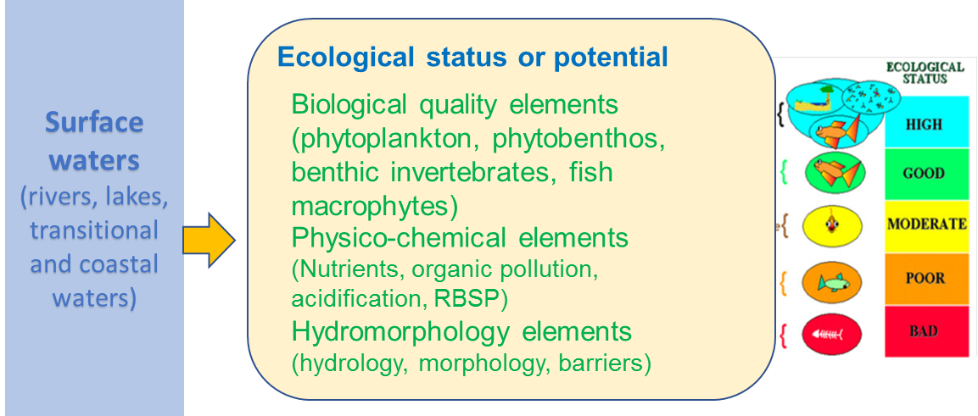
2.1 Introduction
Ecological status and potential
One-out all out principle,
Notes:
The WFD defines 'good ecological status' in terms of a healthy ecosystem based upon classification of the biological quality elements (phytoplankton,
phytobenthos, benthic fauna, macrophytes and fish) and supporting hydromorphological, physico‑chemical quality elements and non-priority
pollutants.
Water bodies are classified by assessment systems developed for the different water categories (river, lake, transitional and coastal waters) and the
different natural type characteristics within each water category.
Ecological status/potential is recorded on the scale of high, good, moderate, poor or bad. 'High' denotes largely undisturbed conditions, and
the other classes represent increasing deviation from this natural condition.
The ecological status classification for the water body is determined using the worst scoring quality element (also known as the 'one out, all out' principle).

Slide 6
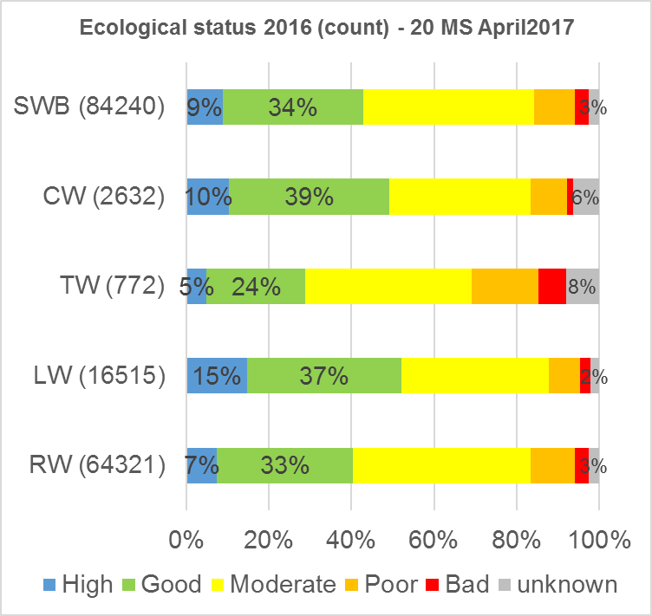
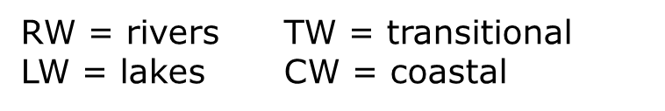
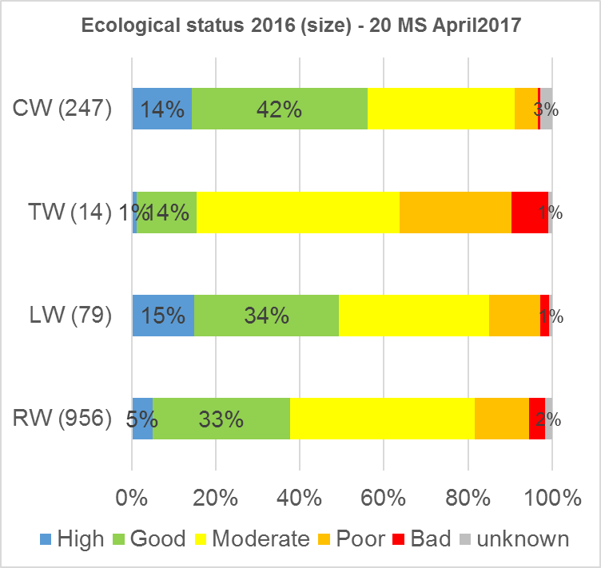
2.2 Ecological status in 2nd RBMPs
Ecological status – by count of water bodies (left) – by size (right)
Preliminary results – 20 MSs – May 2017

Slide 7
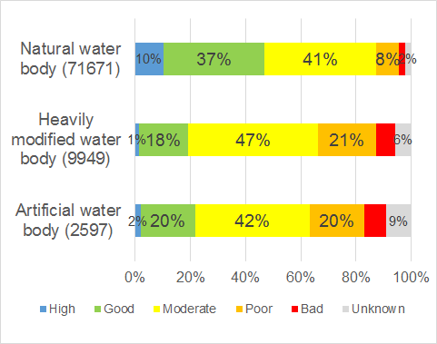
Ecological status and potential by natural, heavily modified and artificial water bodies
Preliminary results – 20 MSs – May 2017

Slide 8
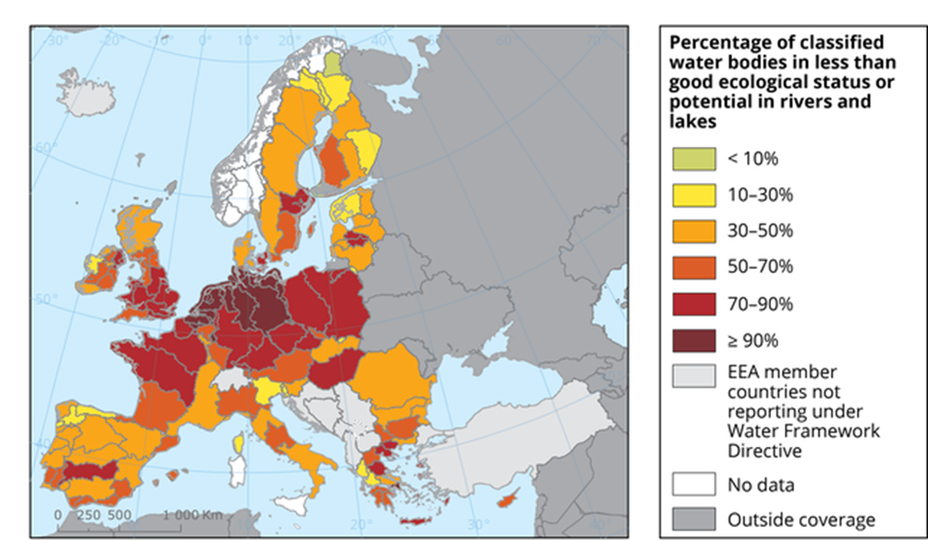
Ecological status of rivers and lakes by River Basin Districts (2012 results)
Map to be updated
Source: https://www.eea.europa.eu/data-and-maps/figures/proportion-of-classified-surface-water-3

Slide 9
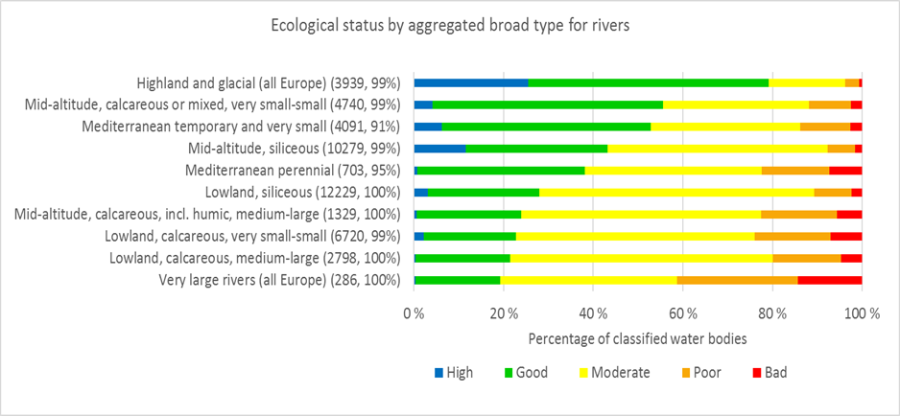
Ecological status and potential by aggregated broad types
Example of river broad types (similar results is available for lakes)
The ecological status for river water bodies and lake water bodies aggregated to major broad types is best for highland rivers and lakes with 80-90% of classified water bodies in good or better ecological status.
Mid-altitude small calcareous rivers, mid-altitude siliceous rivers and Mediterranean rivers have 40-55% of their water bodies in good or better ecological status.
The lowland rivers and large rivers have only 20-30% of their water bodies in good or better status.
Preliminary results – 20 MSs – June 2017

Slide 10
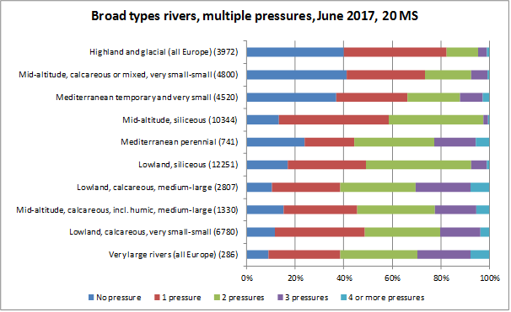
Multiple pressures on SWB per broad types for rivers and lakes. Percentages are based on the num-ber of water bodies in each broad types.
Highland and glacial rivers which have typically a high proportion of water bodies meeting good status are also those with the least number of water bodies with more than one significant pressure. In contrast, a large proportion of water bodies in very large rivers does not meet good ecological status and are under multiple pressures.

Slide 11
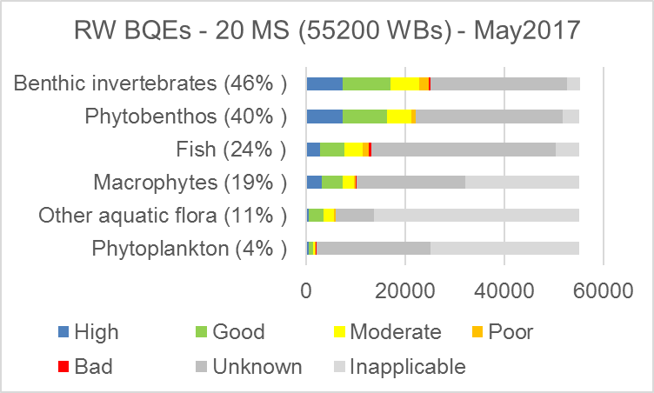
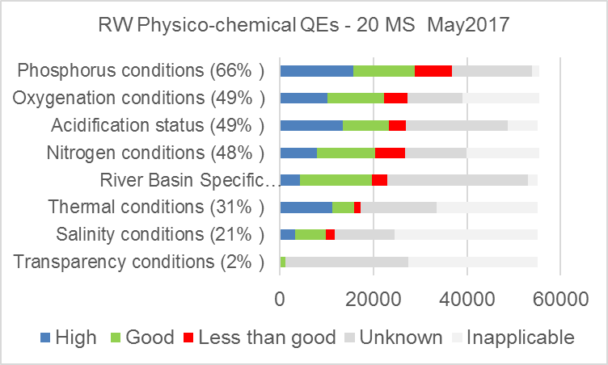
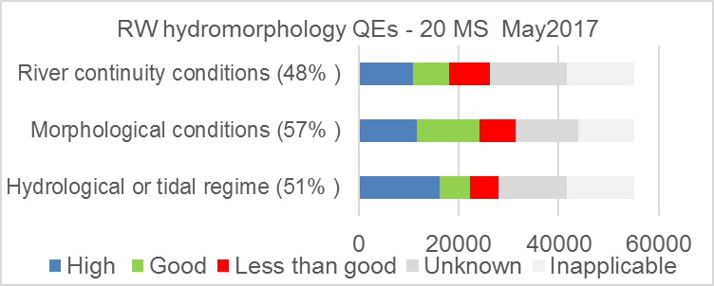
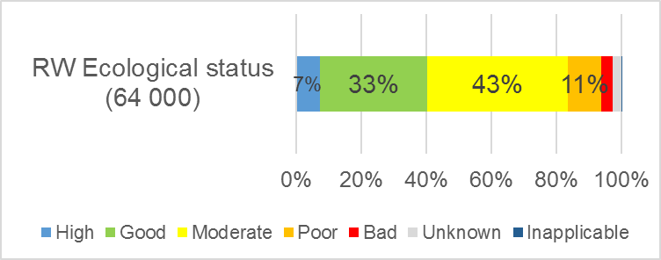
2.3 Status by quality elements
River water bodies – ecological status by quality elements
Percentages high/good (H/G) of known QE status
68 % H/G status
83 % H/G status
75 % H/G status
Preliminary results – 20 MS – May 2017

Slide 12
Quality element status compared to overall ecological status
Preliminary results – 20 MS – June 2017

Slide 13
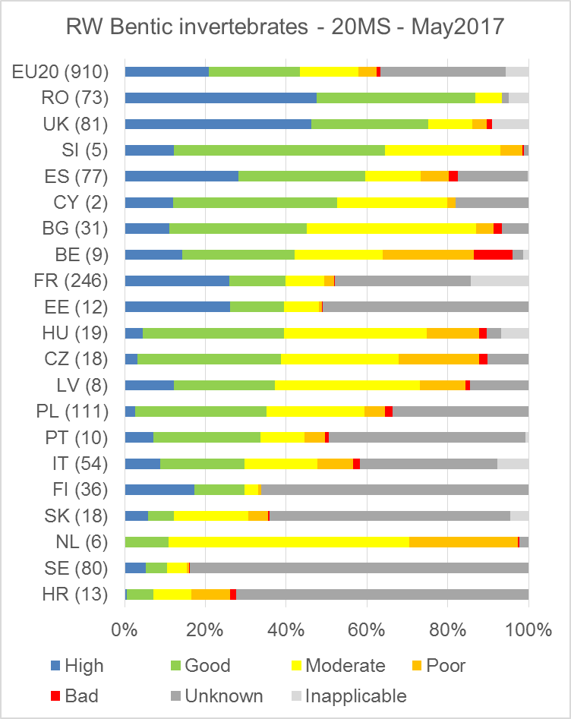
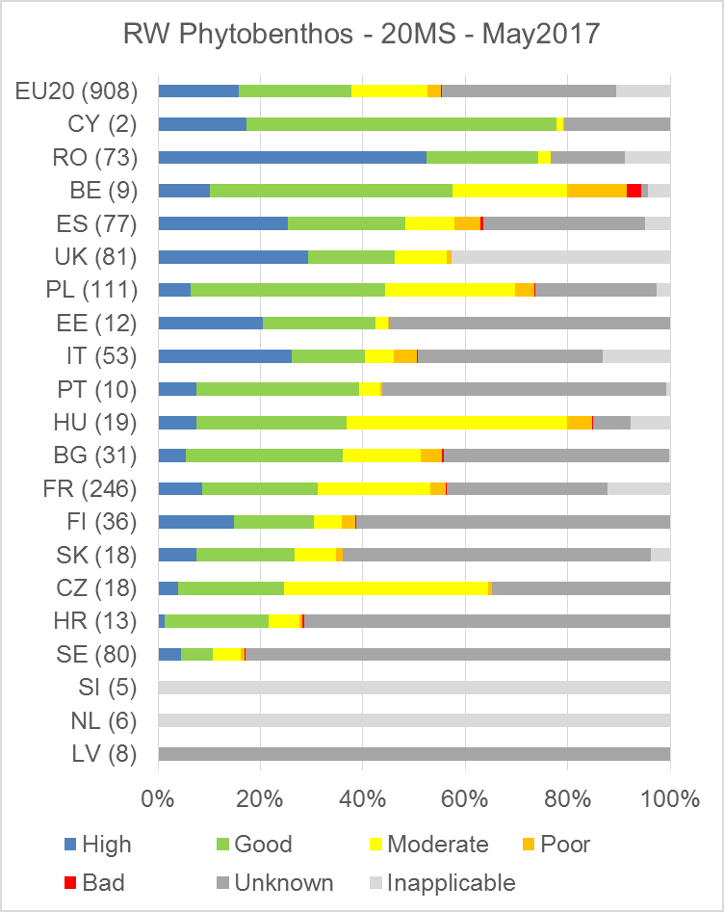
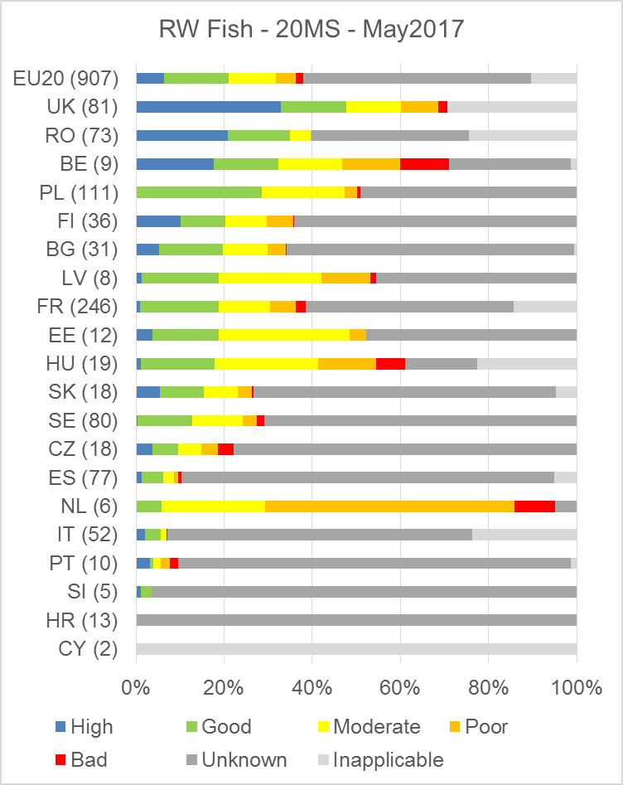
Comparison of Member States ecological status by different BQEs – river water bodies
All three diagrams are ranked by proportion in high/good status
Benthic invertebrates
Phytobenthos
Fish
Preliminary results – 20 MS – May 2017

Slide 14
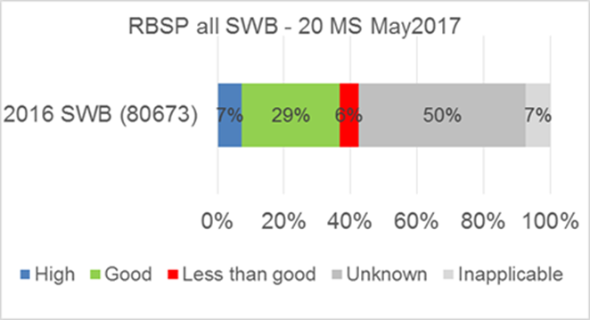
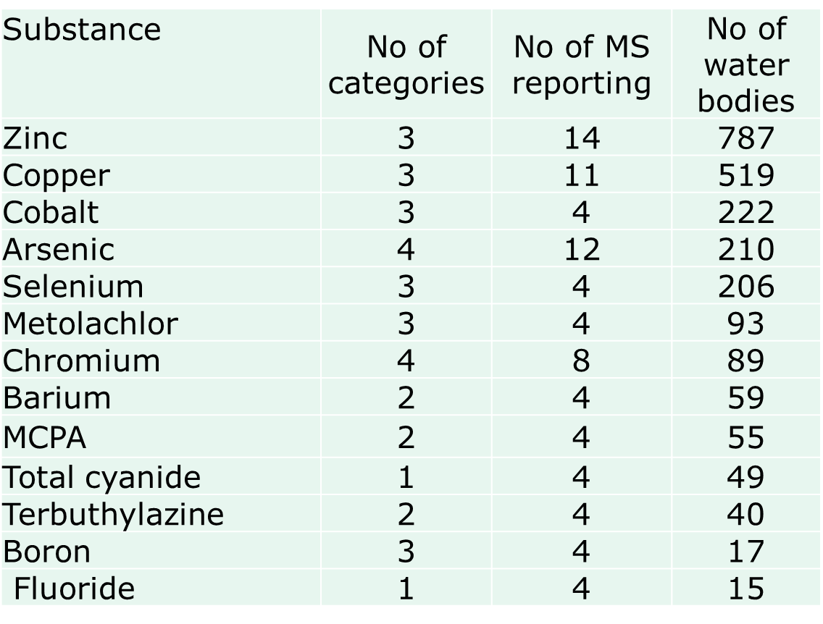
River Basin Specific Pollutants (RBSPs) – preliminary results
At EU level, 6% water bodies not achieving good status owing to RBSPs.
Where there was failure, most (>80%) owed to one or two substances.
Most widely reported failing RBSPs are metals and pesticides.

Slide 15
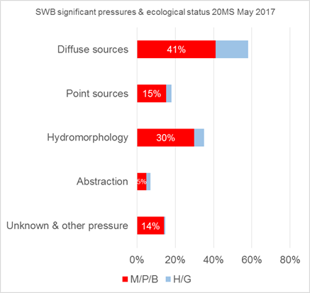
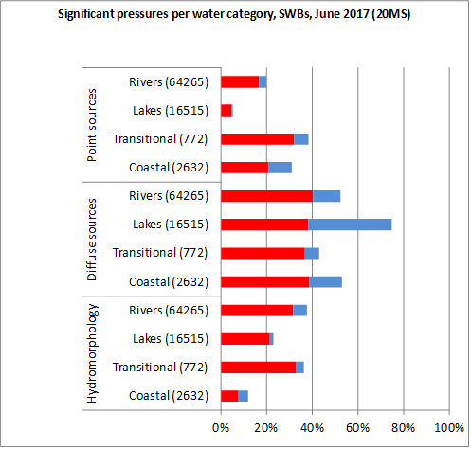
2.4 Pressures causing not achieving good ecological status
Pressures – relevant for ecological status - proportion of surface WBs affected by pressure
Preliminary results – 20 MS – May2017

Slide 16
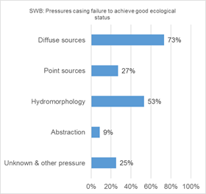
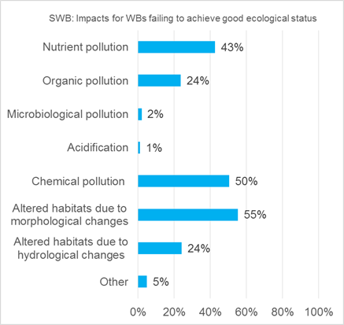
Overview of pressures causing failure to achieve good ecological status
Main significant pressures
Main impacts
Diffuse pollution, hydromorphological and point pollution sources are the main significant pressures of surface water bodies in less than good ecological status.
Altered habitats (morphological and hydrological change), chemical and nutrient pollution are the main impacts on surface water bodies in less than good ecological status

Slide 17
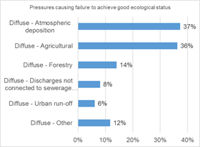
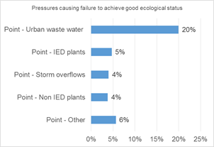
Detailed diffuse and point pollution pressures – proportion of water bodies in less than good ecological status affected by the pressures
Diffuse source pressures
Point source pressures

Slide 18
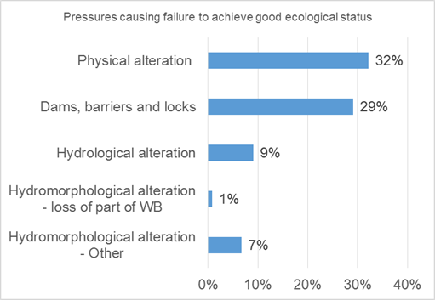
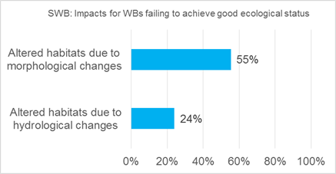
Detailed hydromorphological pressures and impacts
Proportion of water bodies in less than good ecological status affected by the hydromorphological pressures
Hydromorphological pressures
Hydromorphological impacts

Slide 19
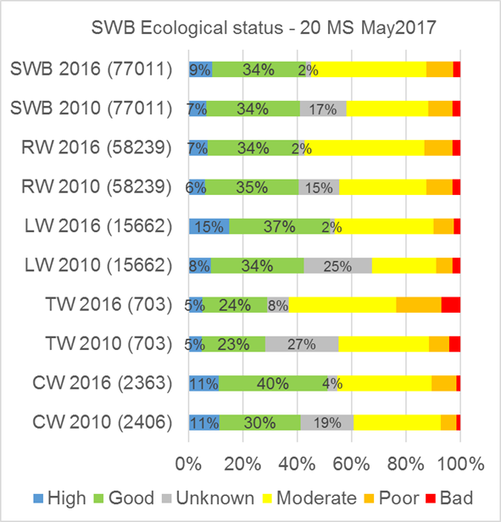
2.5 Change in ecological status between 1st and 2nd RBMP
Minor change in overall ecological status per water category
Preliminary results – 20 MS – May 2017

Slide 20
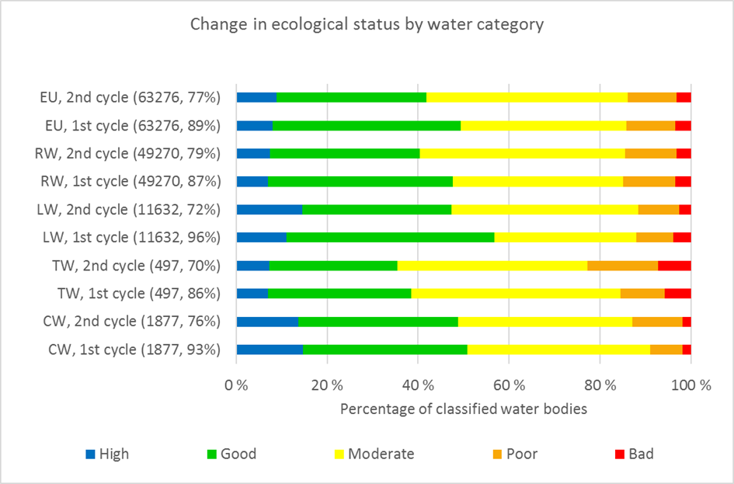
Change in ecological status between 1st and 2nd RBMP (same as previous diagram without unknowns)
The ecological status or potential of Europe’s waters has not improved since the 1st cycle of RBMPs. At EU-level, the proportion of classified water bodies in high or good status has decreased from 49% in 2010 to 42% in 2016.
If Swedish results are excluded, the deterioration from the 1st to the 2nd cycle becomes less (from 46% to 44% in high or good status).
The reason for the deterioration can be more sensitive assessment methods and more quality elements.
Preliminary results – 20 MS – June 2017

Slide 21
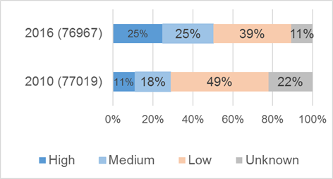
Improved confidence in ecological status assessment
According to the reporting guidance Member States should for each water body report the ecological assessment confidence.
The confidence level is divided into four classes with the following general guidance
Unknown ecological status
Low = no monitoring data;
Medium = supporting QE data and/or limited data on one BQE;
High = good data for at least one BQE and the most relevant supporting QE.
Preliminary results – 20 MS – May 2017

Slide 22
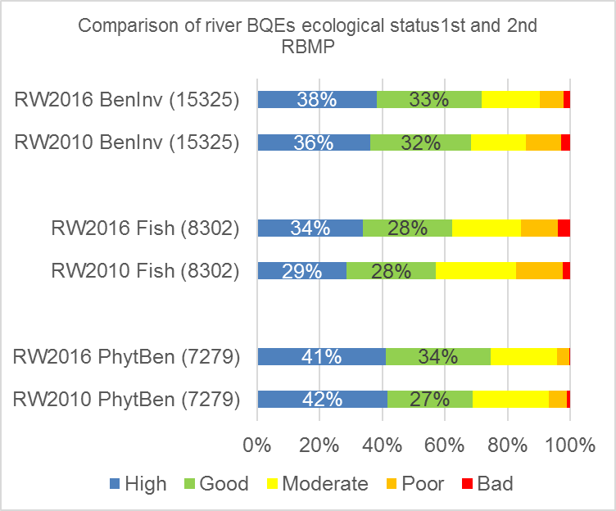
Comparison of river BQEs ecolological status 1st and 2nd RBMP period
+3%
+5%
+6%
Preliminary results – 20 MSs – June 2017

Slide 23
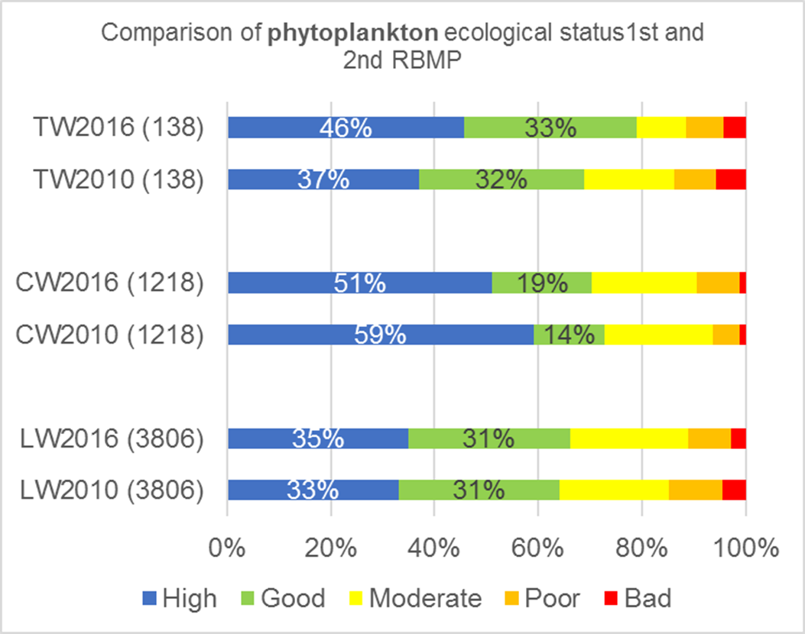
Comparison of phytoplankton ecolological status 1st and 2nd RBMP period
+10%
-3%
+2%
Preliminary results – 20 MSs – June 2017

Slide 24
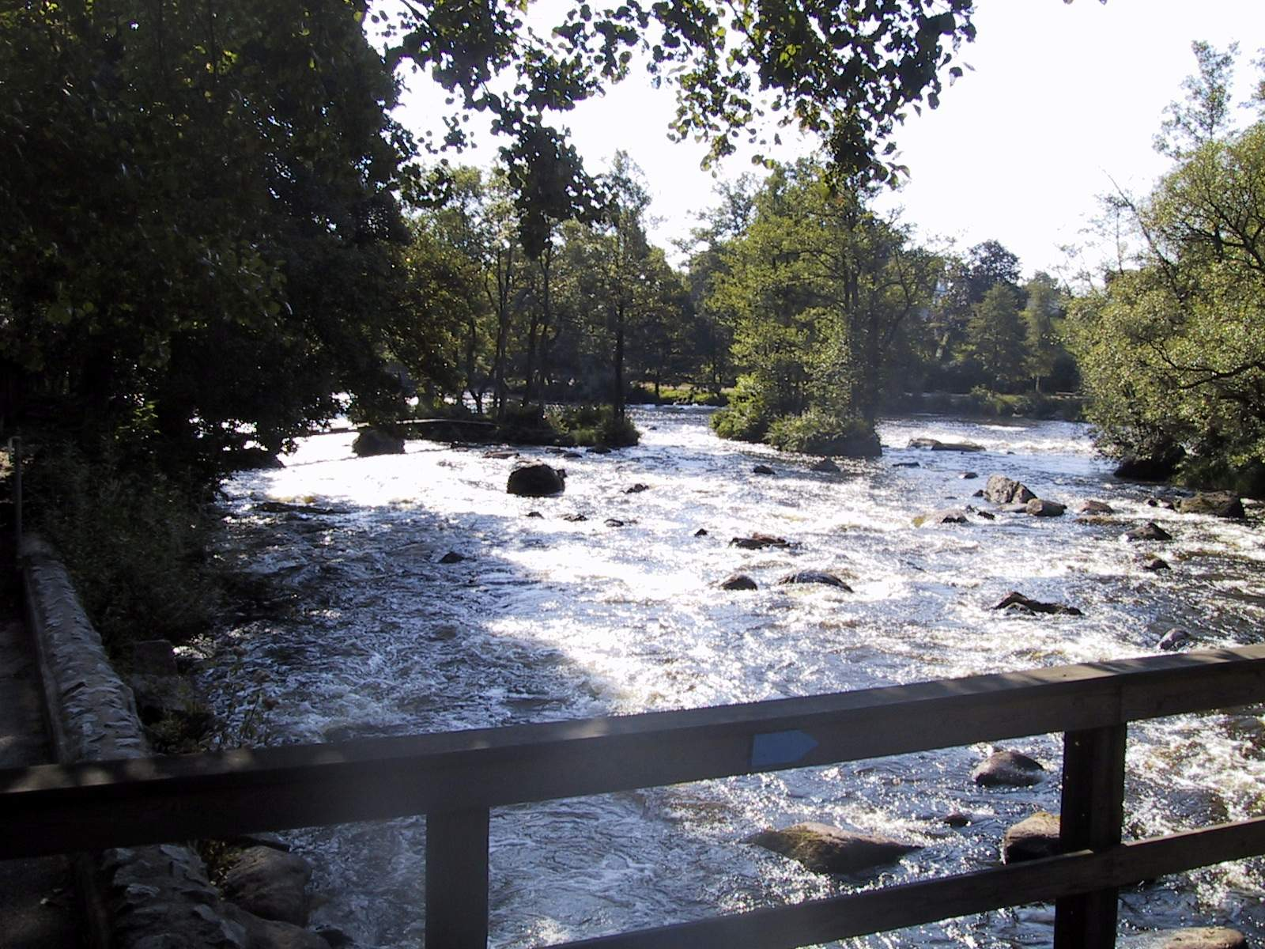
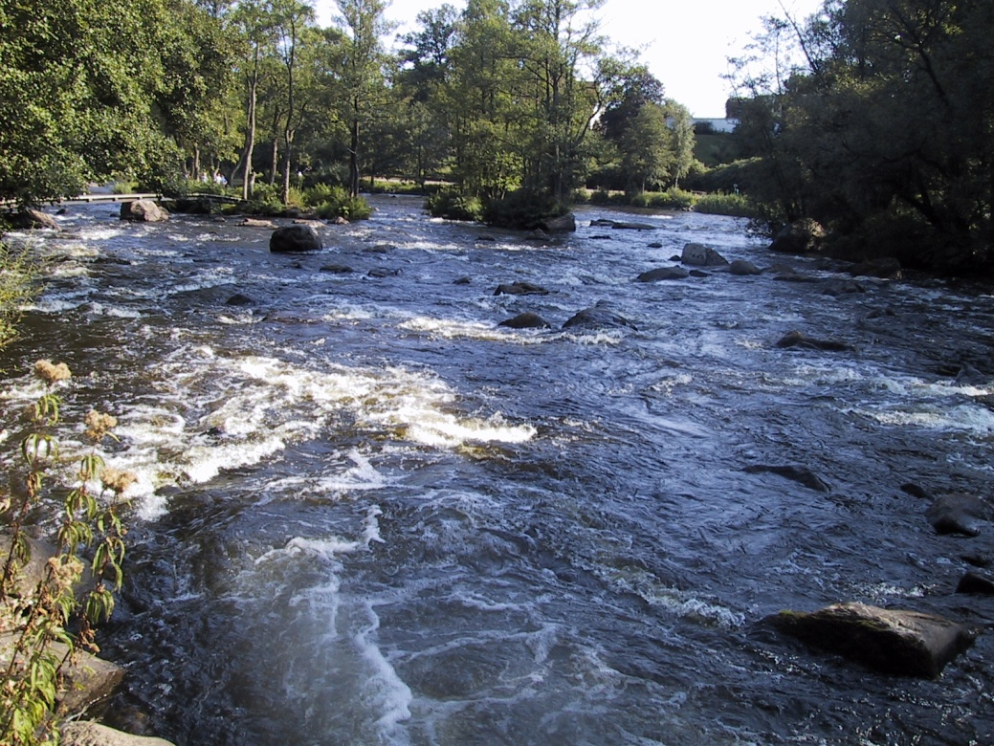
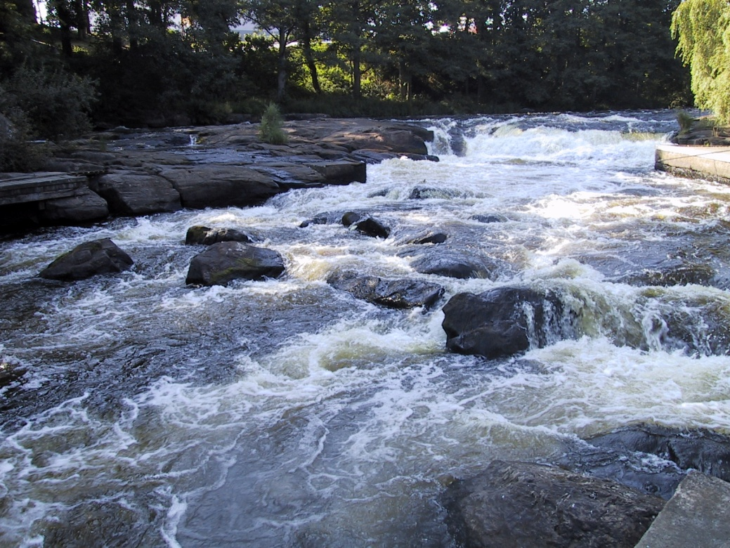
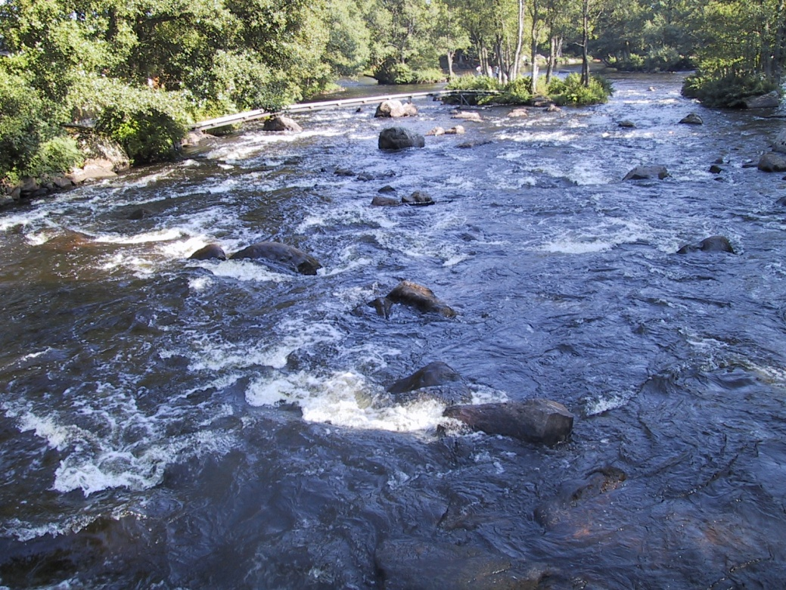

Slide 25
Workshop themes
Priorities – Have we identified the main points which should be reported in the Europe’s State of Water assessment?
Accuracy – Please sense check the results and conclusions with your knowledge of RBMP reporting
Alternatives and gaps – Other ways to present the information, other relevant information, etc.

Slide 26
Ecological Status of surface waters – priorities, accuracy and alternatives

Slide 27
Pressures causing not achieving good ecological status – priorities, accuracy and alternatives

Slide 28
Changes btw first and second river basin management plan – accuracy and alternatives

Slide 29
Gaps and improvements to ecological status presentation

Slide 30
6. Overall status, integrated assessment and outlook
This chapter is less developed as the results are not available yet
6.1 Overall status (ecological, chemical and quantitative)
6.2 Pressures causing not achieving good status and impacts.
6.3 Measures implemented during 1st RBMP period.
6.4 Integrated assessment of status, pressures and sectors.
6.5 Outlook – what will the status be in 2021, 2027 and beyond.
Expected content of the chapter
The chapter will an overview of status (ecological, chemical and quantitative) including an assessment of change of the underlying causes of limited change from 1st to 2nd RBMP period.
An overview of the pressures causing failure to achieve good status will be provided. This overview will also focus on the main sectors and activities causing failure.
We aim to provide an overview of the measures implemented during the 1st RBMP period (the good messages).
We aim to include an integrated assessment of other water policies and sector activities. This may also cover relevant emerging issues.

Slide 31
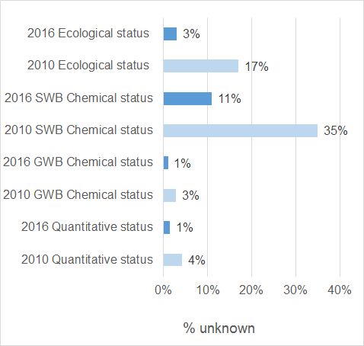
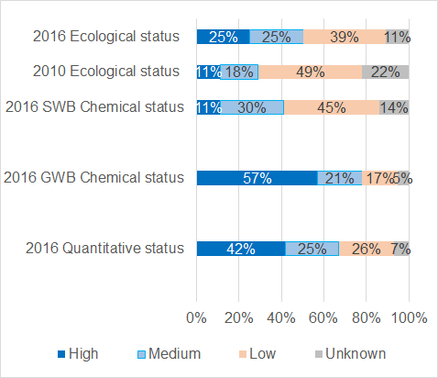
6.1 Overall status
Less unknowns, higher confidence in status assessments, more monitoring and stricter standards
% unknowns
confidence in status assessments
The proportion of water bodies with unknown status decreased from 1st to 2nd RBMP period. The confidence in the status assessments have also improved.
Preliminary results – 20 MS – May 2017

Slide 32
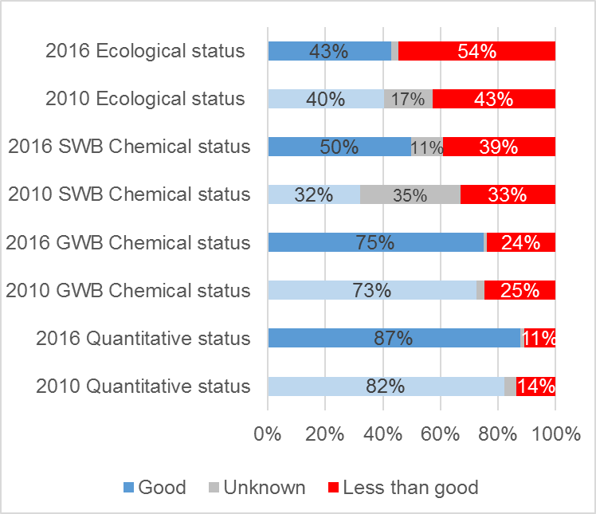
Overall status (ecological, chemical and quantitative)
In the 2nd RBMPs only 43% of surface water bodies were in high or good ecological status or potential compared to 40 % in the 1st RBMPs. There was also a marked increase in the proportion of water bodies of water bodies in less than good ecological status.
In the 1st RBMPs less than one third of the surface water bodies were in good chemical status, in the 2nd RBMPs half of the surface water bodies had good chemical status but also 39 % failed to achieve good status.
There was a slight improvement in groundwater chemical status and quantitative status from 1st to 2nd RBMP period.
Preliminary results – 20 MS – May 2017

Slide 33
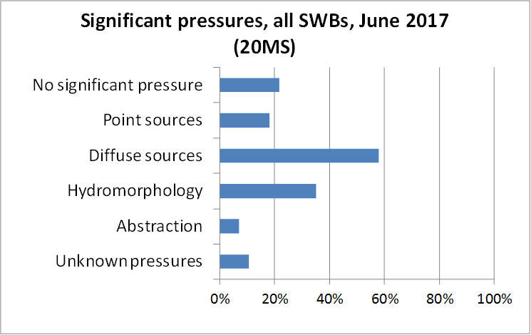
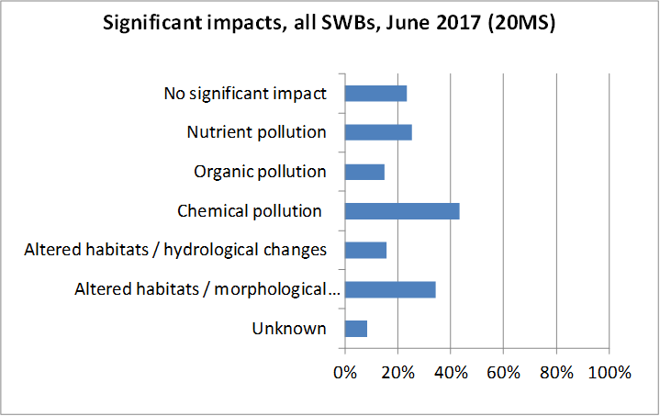
6.2 Pressures causing not achieving good status and impacts.
Overview of significant pressures and impacts affecting surface water bodies
Diffuse pollution (58% of SWBs) and hydromorphological pressures (35% of SWBs) are the main significant pressures on surface water bodies, followed by point sources (18% of SWBs) and abstraction (7% of SWBs).
The main significant impacts on SWBs are chemical pollution (43% of SWBs), followed by altered habitats due to morphological changes (34% of SWBs) and nutrient pollution (25% of SWBs).
Preliminary results – 20 MS – June 2017

Slide 34
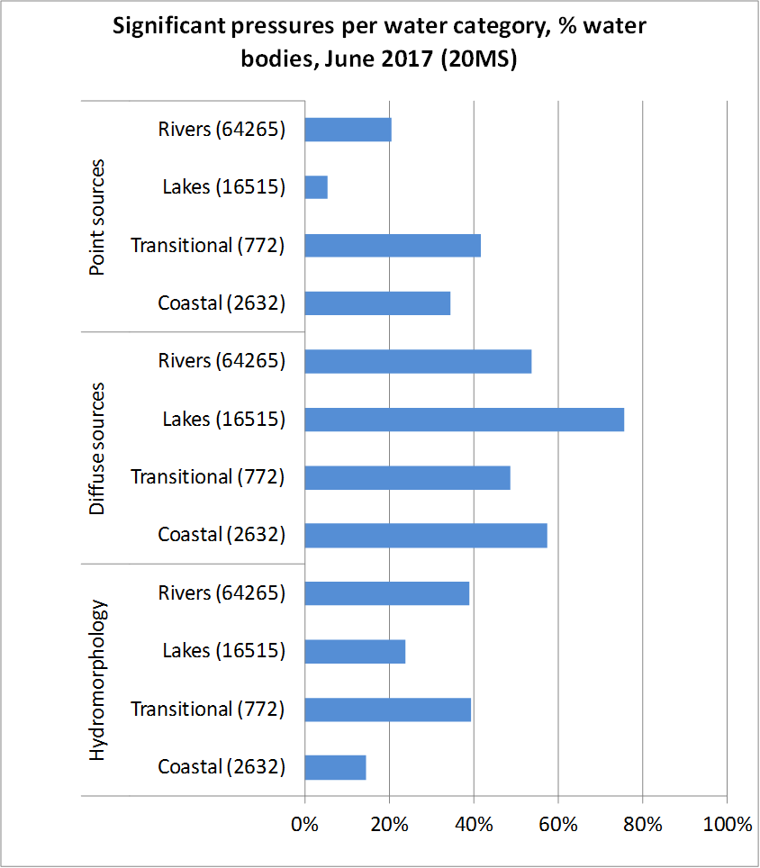
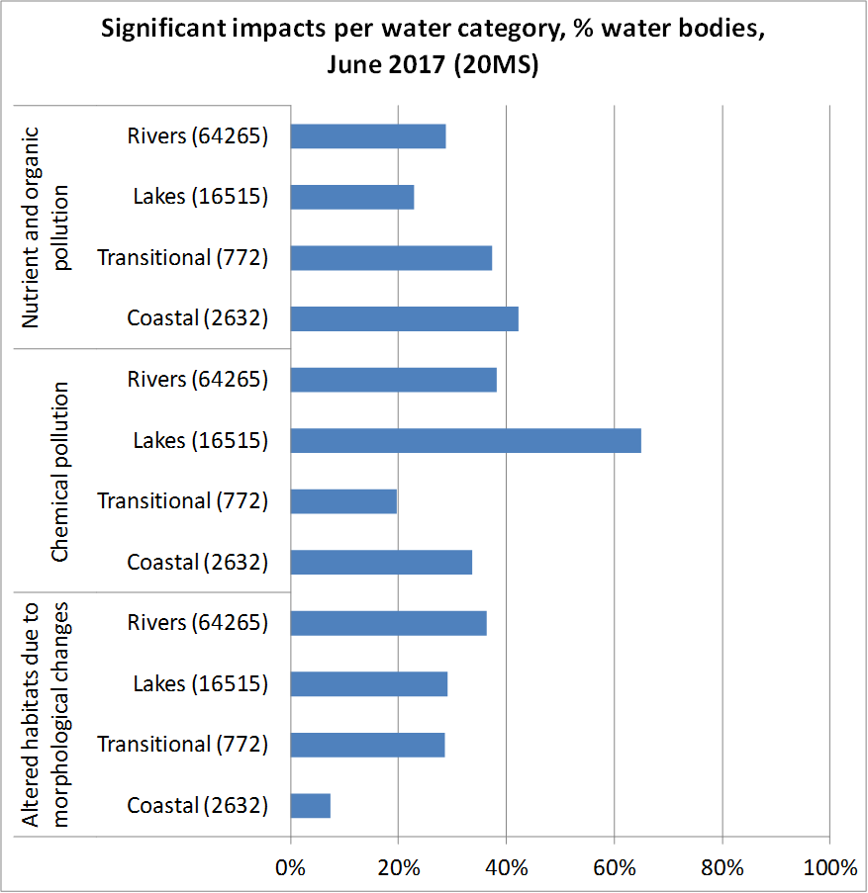
Overview of main significant pressures and impacts affecting the surface water body categories – Similar results is available for groundwater
The majority of lakes (ca. 80% of lakes) are affected by diffuse pollution, but this is also the main pressure in rivers, transitional and coastal water bodies which are affected to a similar extent (ca. 50-60% of water bodies in each category).
Hydromorphological pressures are more significant in rivers and transitional water bodies (affecting ca. 40% each). Point pollution pressures are present to a larger extent in transitional and coastal waters (affecting ca. 40 and 30% respectively).
•Chemical pollution affects the majority of lakes (ca. 60% of lakes) and is the main impact in rivers (ca. 40%), while nutrient and organic pollution are the main impacts in transitional and coastal waters (ca. 40%). Altered habitats due to hydromorphological changes affect a similar proportion of rivers, lakes and transitional waters (ca. 30%)
Preliminary results – 20 MS – June 2017

Slide 35
6.3 Measures implemented during 1st RBMP period.
This section is less developed and results are not available yet
Examples of measures implemented during 1st RBMP period (2010-2015) (Key Types of Measures (KTMs))
Pollution measures
KTM1 – Construction or upgrades of wastewater treatment plants.
KTM16 – Upgrades or improvements of industrial wastewater treatment plants (including farms).
KTM2 – Reduce nutrient pollution from agriculture.
KTM21 – Measures to prevent or control the input of pollution from urban areas, transport and built infrastructure
KTM22 – Measures to prevent or control the input of pollution from forestry.
KTM25 – Measures to counteract acidification.
Water abstraction
KTM8 – Water efficiency, technical measures for irrigation, industry, energy and households
KTM9 – Water pricing policy measures for the implementation of the recovery of cost of water services from households
Chemical measures
KTM15 – Measures for the phasing-out of emissions, discharges and losses of Priority Hazardous Substances or for the reduction of emissions, discharges and losses of Priority Substances.
KTM3 – Reduce pesticides pollution from agriculture.
KTM4 – Remediation of contaminated sites (historical pollution including sediments, groundwater, soil).
Hydromorphological measures
KTM5 – Improving longitudinal continuity (e.g. establishing fish passes, demolishing old dams)
KTM6 – Improving hydromorphological conditions of water bodies other than longitudinal continuity
KTM7 – Improvements in flow regime and/or establishment of ecological flows
Other measures
KTM18 – Measures to prevent or control the adverse impacts of invasive alien species and introduced diseases
KTM24 – Adaptation to climate change

Slide 36
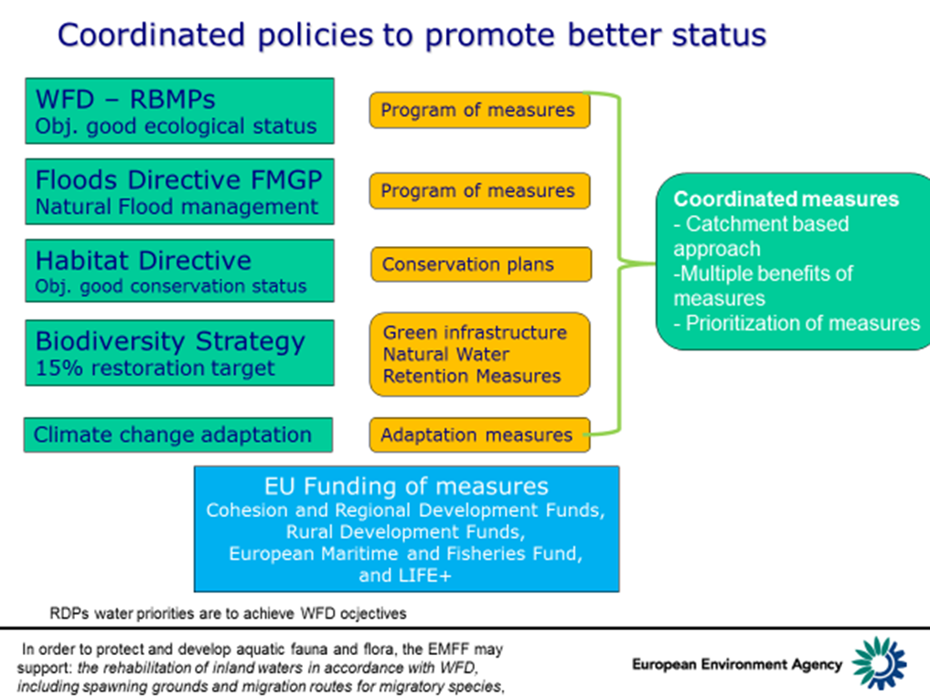
6.4 Integrated assessment of status, pressures and sectors.
This section is less developed as the results are not available yet
The section will consider other water policies and sector activities and relevant emerging issues.

Slide 37
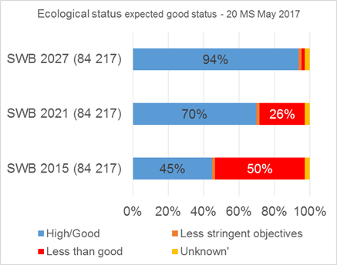
6.5 Outlook – what will the status be in 2021, 2027 and beyond.
2021 & 2027 status based on Member States expected to be good
This section is less developed as the results are not available yet
Member States have for water bodies failing to achieve good status (in 2015) indicated in the reporting the expected time (2021, 2027 or beyond 2027) to achieve good status:
The results of the achievement year of good ecological status is summarized in the diagram.
The results are probably optimistic and it is uncertain if they will be included.
Should EEA include graphs like this?
?
Preliminary results – 20 MS – May 2017

Slide 38
Can we achieve good status with the current measures?
GAP to achive good status
Supplementary measures
Business as usual
‘what is in place and/or in the pipeline already’ and
‘what is feasible

Slide 39
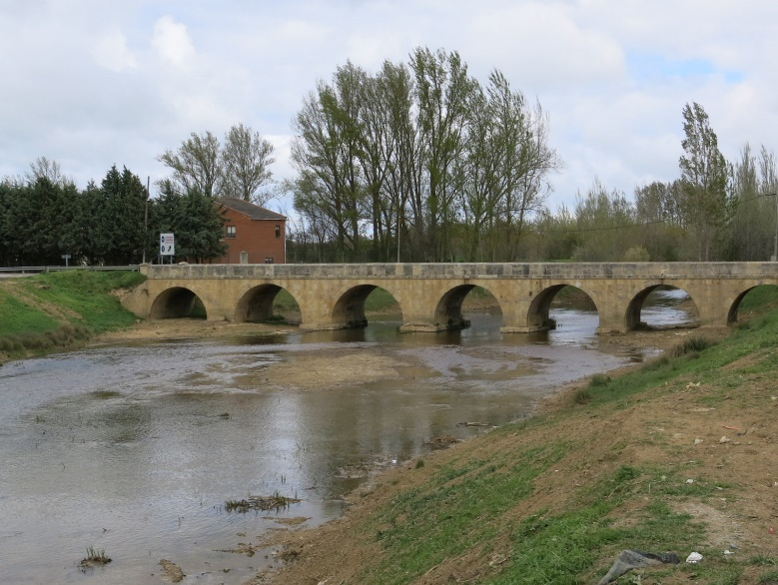
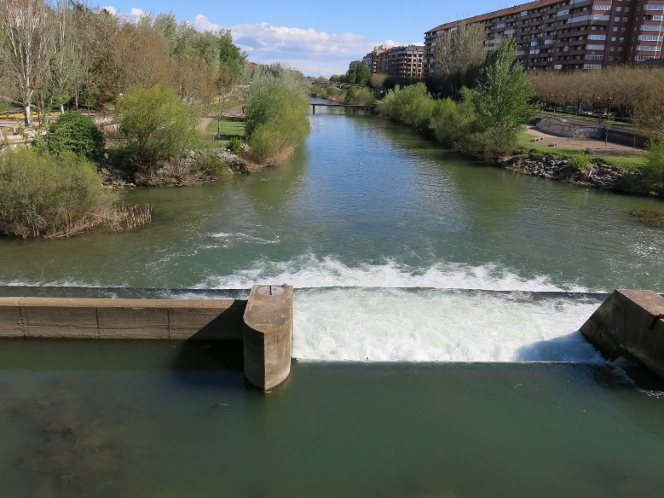
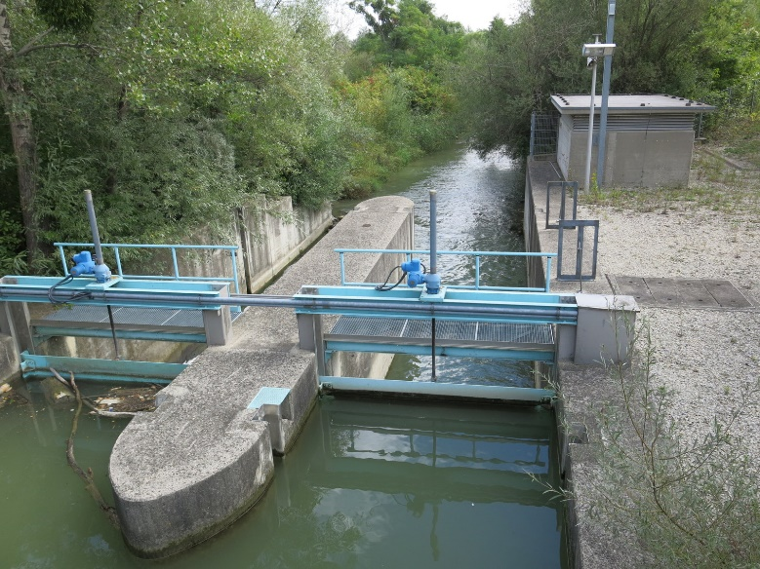
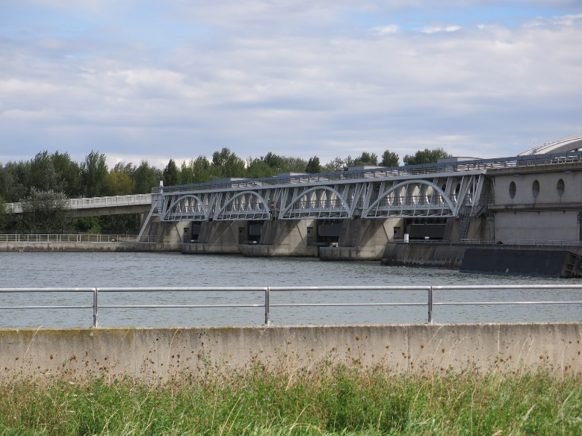

Slide 40
Inputs to chapter 6

Slide 41
Main conclusions of SoW (based on ws discussions)

Slide 42
Confidence

Slide 43
Status outlook

Slide 44
Conclusions on key activities or pressures

Slide 45
Conclusions on what is needed to improve status

Slide 46

Thank you
Your comments and
inputs are highly appreciated.
eea.europa.eu

