Slide 1
Nihat Zal
EIONET Freshwater Meeting
19-20 June 2017
Copenhagen
Groundwater quantitative status – breakout presentation

Slide 2
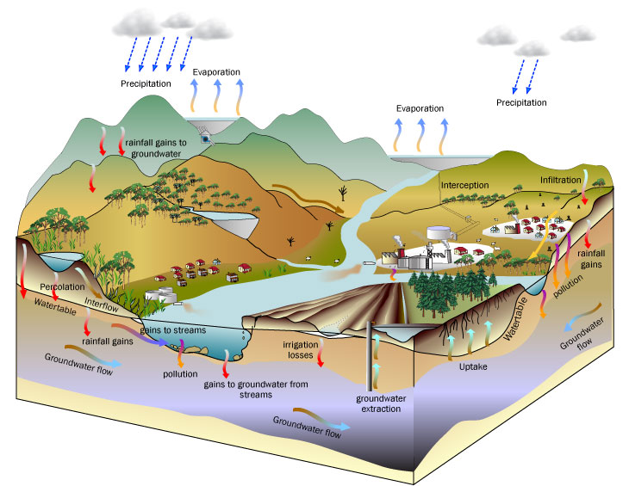
Hydrological cycle and water balance in groundwater
Hydrological cycle is a very complex process and effected by a number of antropogenic interventions which can only be measured once their impacts would be visible
soer.justice.tas.gov.au

Slide 3
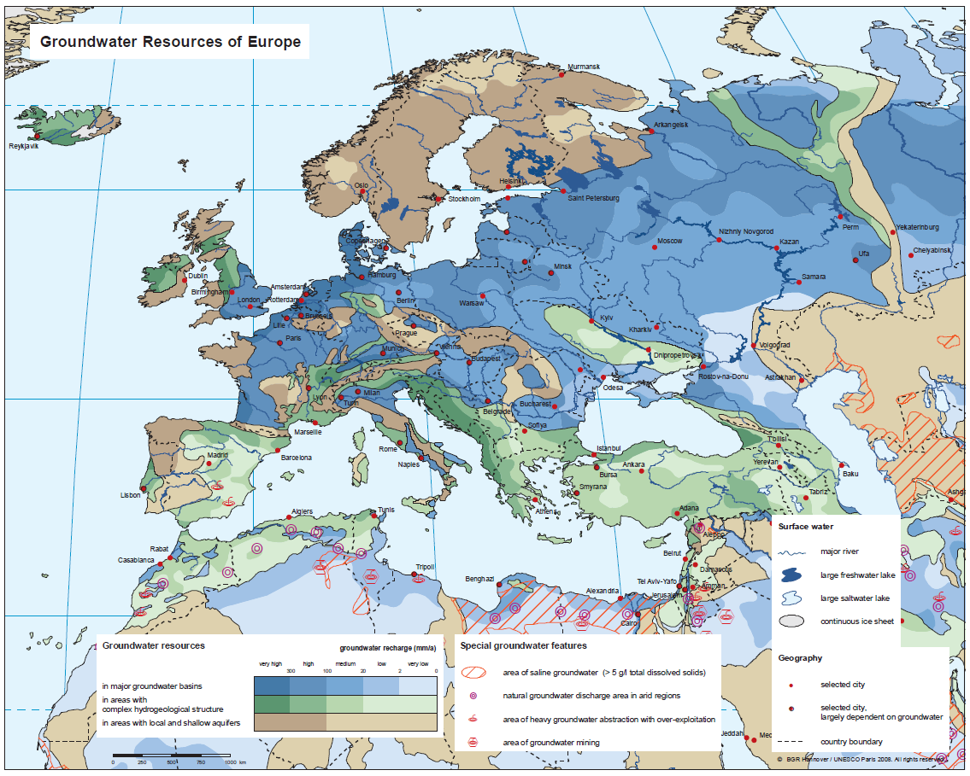
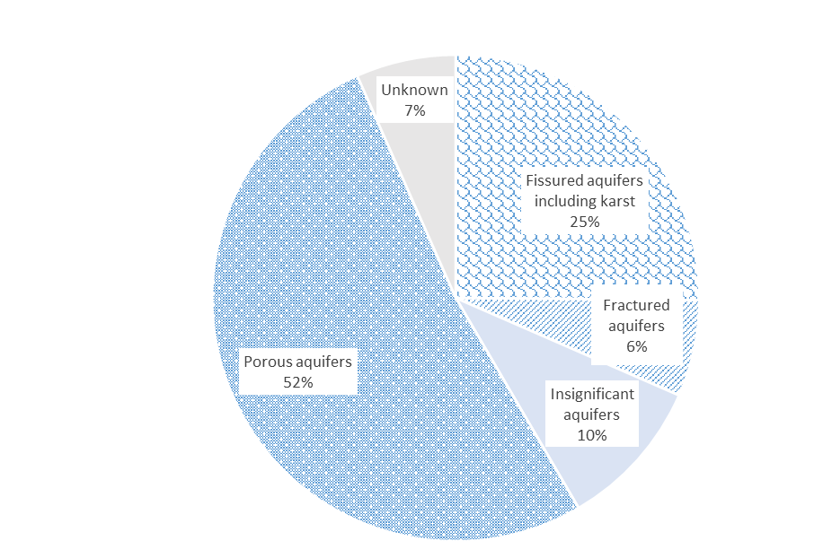
Northern Europe with shallow aquifers
Southern Europe marked with very complex tectonic and hydrological structures
Western and Eastern Europe with large groundwater basins
Data from22 MS – June 2017
www.bgr.bund.de

Slide 4
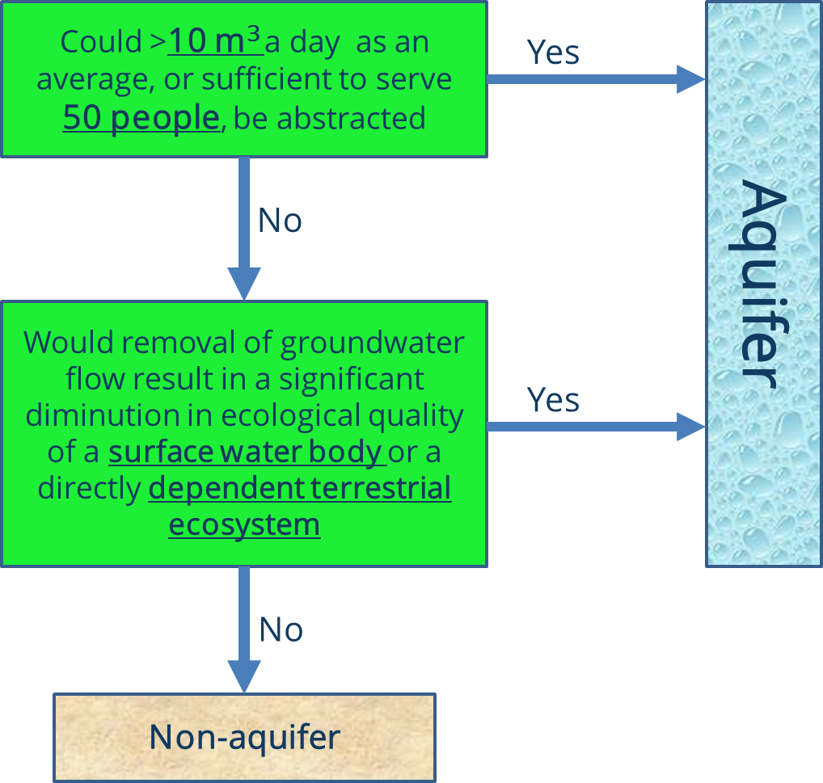
Definition of groundwater aquifers
This has to be reason for failure
www.bgr.bund.de

Slide 5
This has to be reason for failure
www.bgr.bund.de

Slide 6
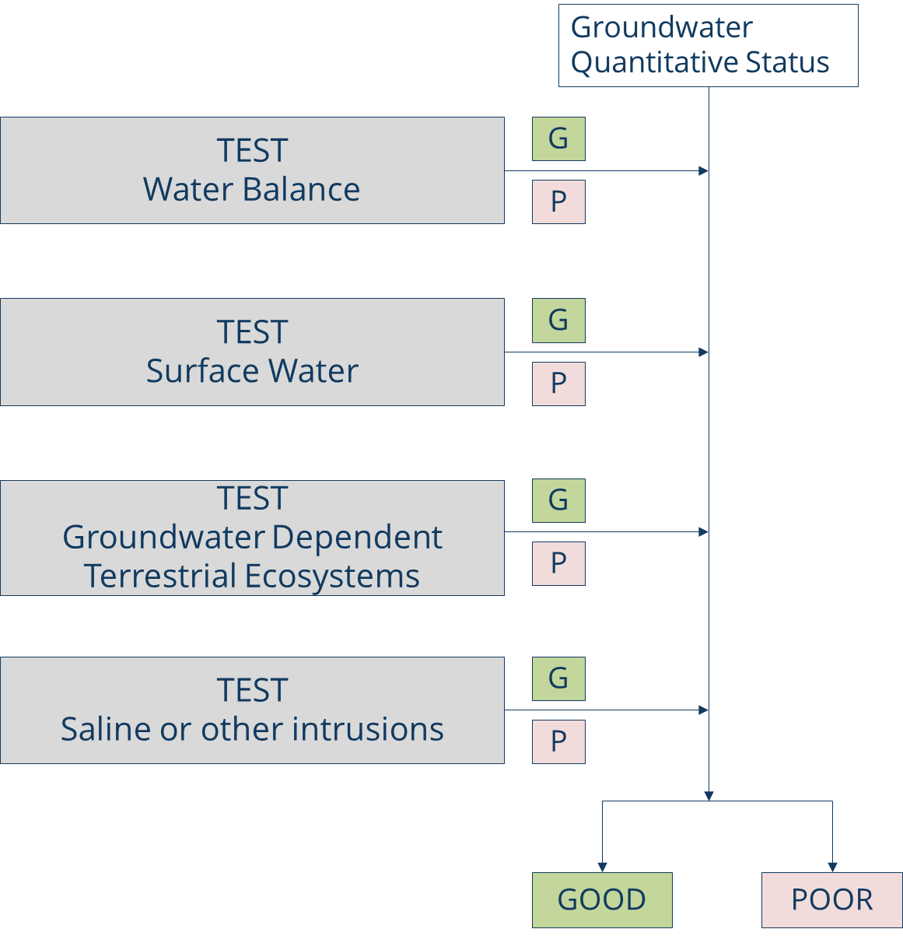
Classification test for assessing GW quantitative status
WFD Article 4 - Protect, enhance and restore all bodies of
groundwater, ensure a balance between abstraction and
recharge of groundwater, with the aim of achieving good
groundwater status

Slide 7
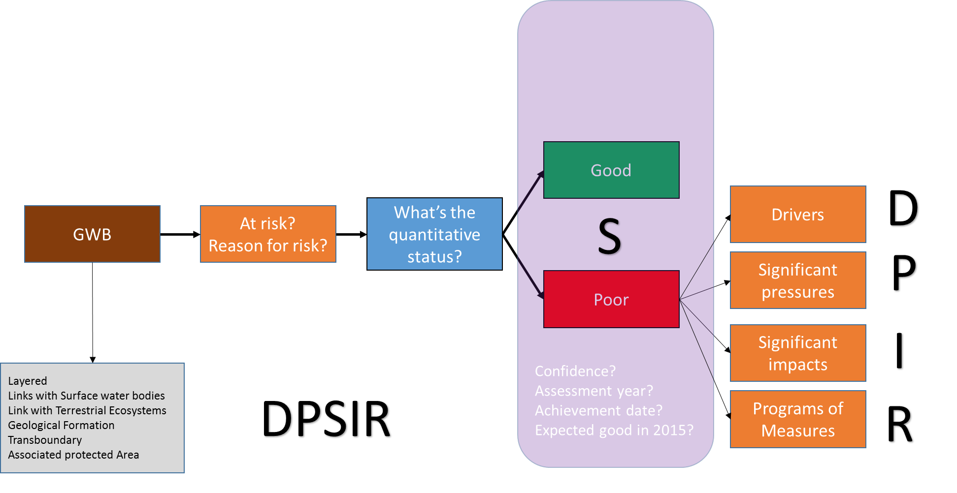
Classification test for assessing GW quantitative status
WFD Assessment Framework for groundwater quantitative status
Source: Bariamis and Baltas, 2016 -NTUA
Quantitative reason for failure
At quantitative risk?
Environmental objective risk?
Reason for quantitative risk?

Slide 8
Very small achievement in the GW QS status between 2010 and 2016.
Descreasing mainly in unknown status.
Rate of improvement between 2010 and 2016 is around 20%

Slide 9
Confidence level is around 64%

Slide 10
Croatia, Estonia, Luxembourg, Latvia, Netherlands and Romania have reported all GWBs in good quantitative status

Slide 12
All MS have shown improvements with the GW QS except Hungary and Germany with a tiny deterioriation

Slide 13
Main pressures (9% of GWB area in poor quantitative status) causing failure of good quantitative in 12 MS

Slide 14
Main pressures (12% of GWB area in poor quantitative status) causing failure of good quantitative in 22 MS

Slide 15
Quantifying the pressures
Water abstraction by sources
Water abstraction by sectors

Slide 16
Agriculture and public water supply continue to be main significant pressures over the GW resources
Water abstraction from GWs at the MS level

Slide 19
Key messages
In 2016, 86 % of the groundwater bodies in the 22 MS are in good quantitative status. This means a 3% increase in reaching the objectives in total and 20% improvement in poor status from 2010.
The main pressures exerted on the quantitative status of groundwater bodies are water abstractions, artificial recharge, antropogenic pressures as well as physical and hydrological alterations.
Agriculture is still the main pressure on renewable water resources. A positive development is that water abstraction decreased by around 7 % between 2002 and 2014.
Over exploitation from GW resources have caused water table lowering around 64 % GWBs that having poor status. Saline intrusion is mainly concerned in Finland, Bulgaria, United Kingdom and Slovakia while dependent terrestrial ecosystems have been affected in the United Kingdom, Hungary, Spain and Italy

