Slide 1
Jiří KVAPIL | 20.6.2017 | EIONET FW Workshop
WISE SoE data flows
flashback and outlooks

Slide 2
Contents
WISE SoE dataflows introduction – as it is now
WISE SoE reporting 2016 overview – processes and data
Changes in WISE SoE dataflows for future data calls
WISE SoE reporting 2017 – timing and preparations

Slide 3
WISE SoE dataflows introduction – status 2016
WISE-1: Emissions
WISE-3: Water quantity
WISE-4: Water quality (+ Watchlist)
WISE-5: Spatial data
Biology in TC waters
TCM waters quality

Slide 4
Revision of data models
Freshwater
  Updated reporting guidance http://cdr.eionet.europa.eu/help/WISE_SoE/wise4/WISE_SoE_ReportnetGuidance_v1.4_2016-10-06.pdf
TCM
  Consultation with NRCs -> document on revision https://forum.eionet.europa.eu/nrc-marine-coastal-and-maritime/library/2017-activities/webinar-revision-wise-soe-tcm-dataflows/revision-process-wise-soe-tcm-dataflows

Slide 5
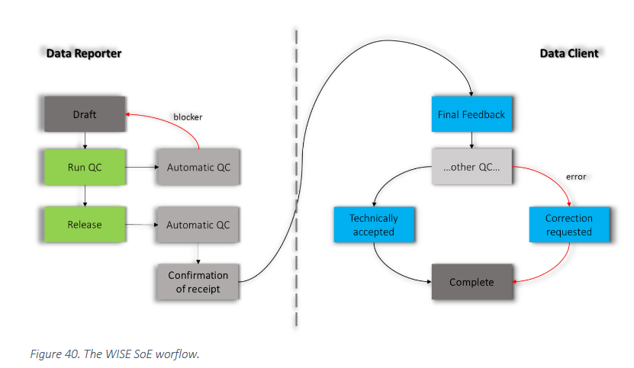
WISE SoE reporting workflow 2016
Already fully automated in FW area, TCM in 2017
Image source: WISE SoE Reporting Guidance

Slide 6
WISE SoE reporting 2016 – data products availability
Processing of legacy data (i.e. prior to 2014) first
  Quality assurance of legacy spatial (WISE-5) data
  Import of legacy content data (WISE-4)
  Only once finalized, inclusion of 2015 and 2016 data can happen
Waterbase 2016 available in summer
  All other derived products available then (maps, indicators,…)

Slide 7
WISE SoE reporting 2016 – non EU countries
 | WISE-1 | WISE-3 | WISE-4 | WISE-5
AL |  |  | X
BA
CH | X | X | X | X
IS | X | X | x | X
LI
ME |  |  | X
MK | X | X | X
NO | X | X | X | X
RS |  | X | X
TR |  | X | X | X (monitoring sites)
XK | X |  | X

Slide 8
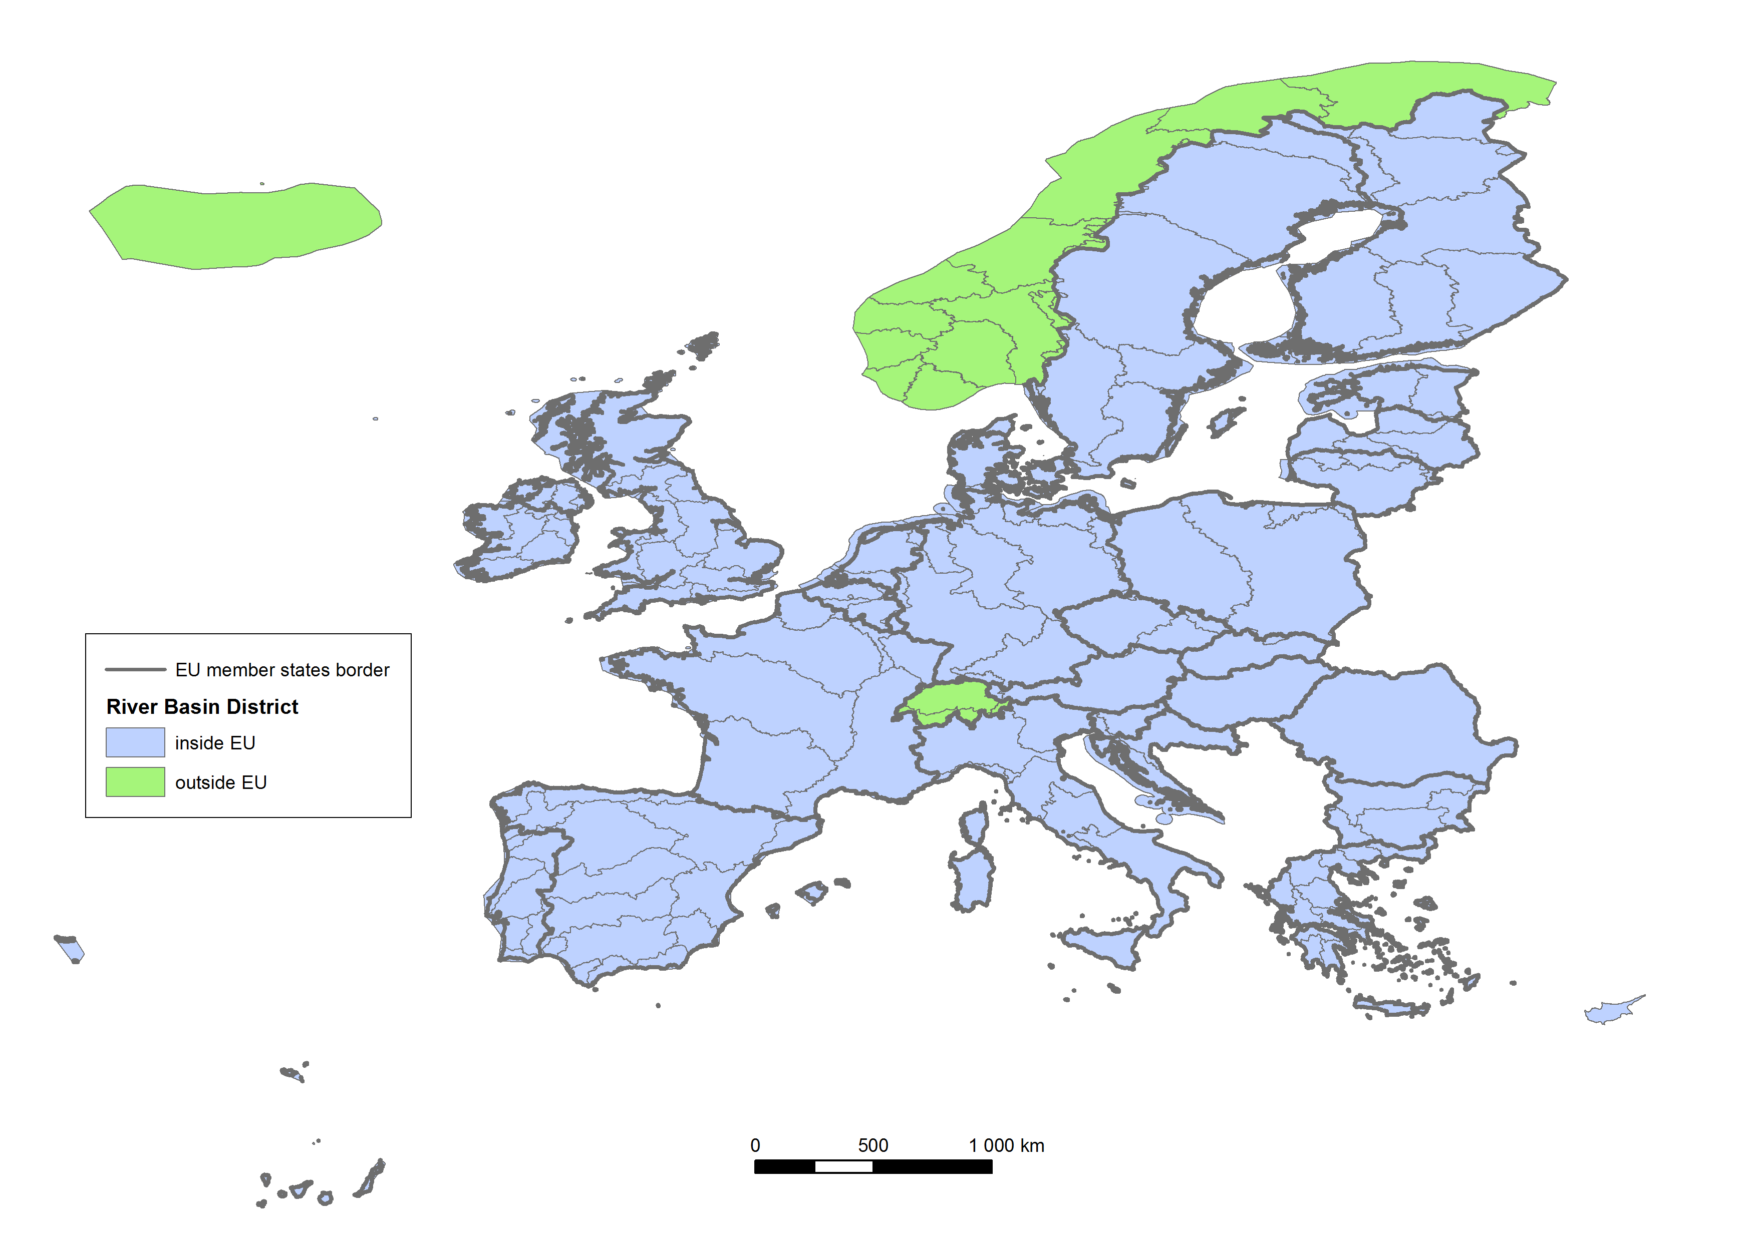
River basin districts (RBD) overview

Slide 9
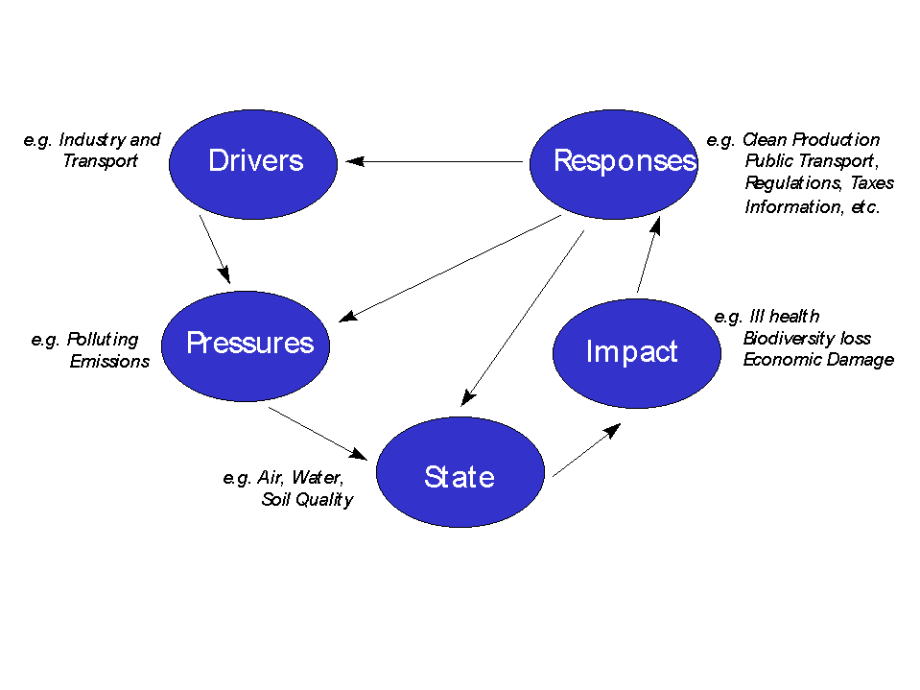
WISE SoE dataflows updates 2015 – 2017/2018
Update of paradigm
  Move from environment (FW vs. TCM) division to domains (emissions, biology, etc.) division
  Holistic approach
  Reflection of DPSIR model
  Improved assessment
Slight adjustments of data models
Move of several topics among dataflows

Slide 10
WISE SoE data flows evolution diagram – 2015
FRESHWATER
TCM
WISE-1
Emissions
WISE-TCM
WISE-3
Quantity
Biology in TC waters
WISE-4
Quality
WISE-5
Spatial

Slide 11
WISE SoE data flows evolution diagram – 2016 update
FRESHWATER
TCM
X
WISE-1
Emissions
Riverine inputs, direct discharges
WISE-TCM
WISE-3
Quantity
Biology in TC waters
WISE-2
Biology
Nutrients,
Hazardous
substances
Stations
Stations
WISE-4
Quality
WISE-6
Water Quality TCM
WISE-5
Spatial

Slide 12
WISE SoE data flows evolution diagram – 2017 status
FRESHWATER
TCM
WISE-1
Emissions
WISE-3
Quantity
WISE-2
Biology
Biology – 2018 (plan)
WISE-4
Quality
WISE-6
Water Quality TCM
WISE-5
Spatial

Slide 13
WISE SoE data call 2017
Data call 2017 opens on 1.10.2017
Reporting of WISE-1,2,3,4,6
WISE-5 is continuous reporting (whenever an update is available-> report)
Helpdesk will be available as usually
  wisesoe.helpdesk@eionet.europa.eu

Slide 14
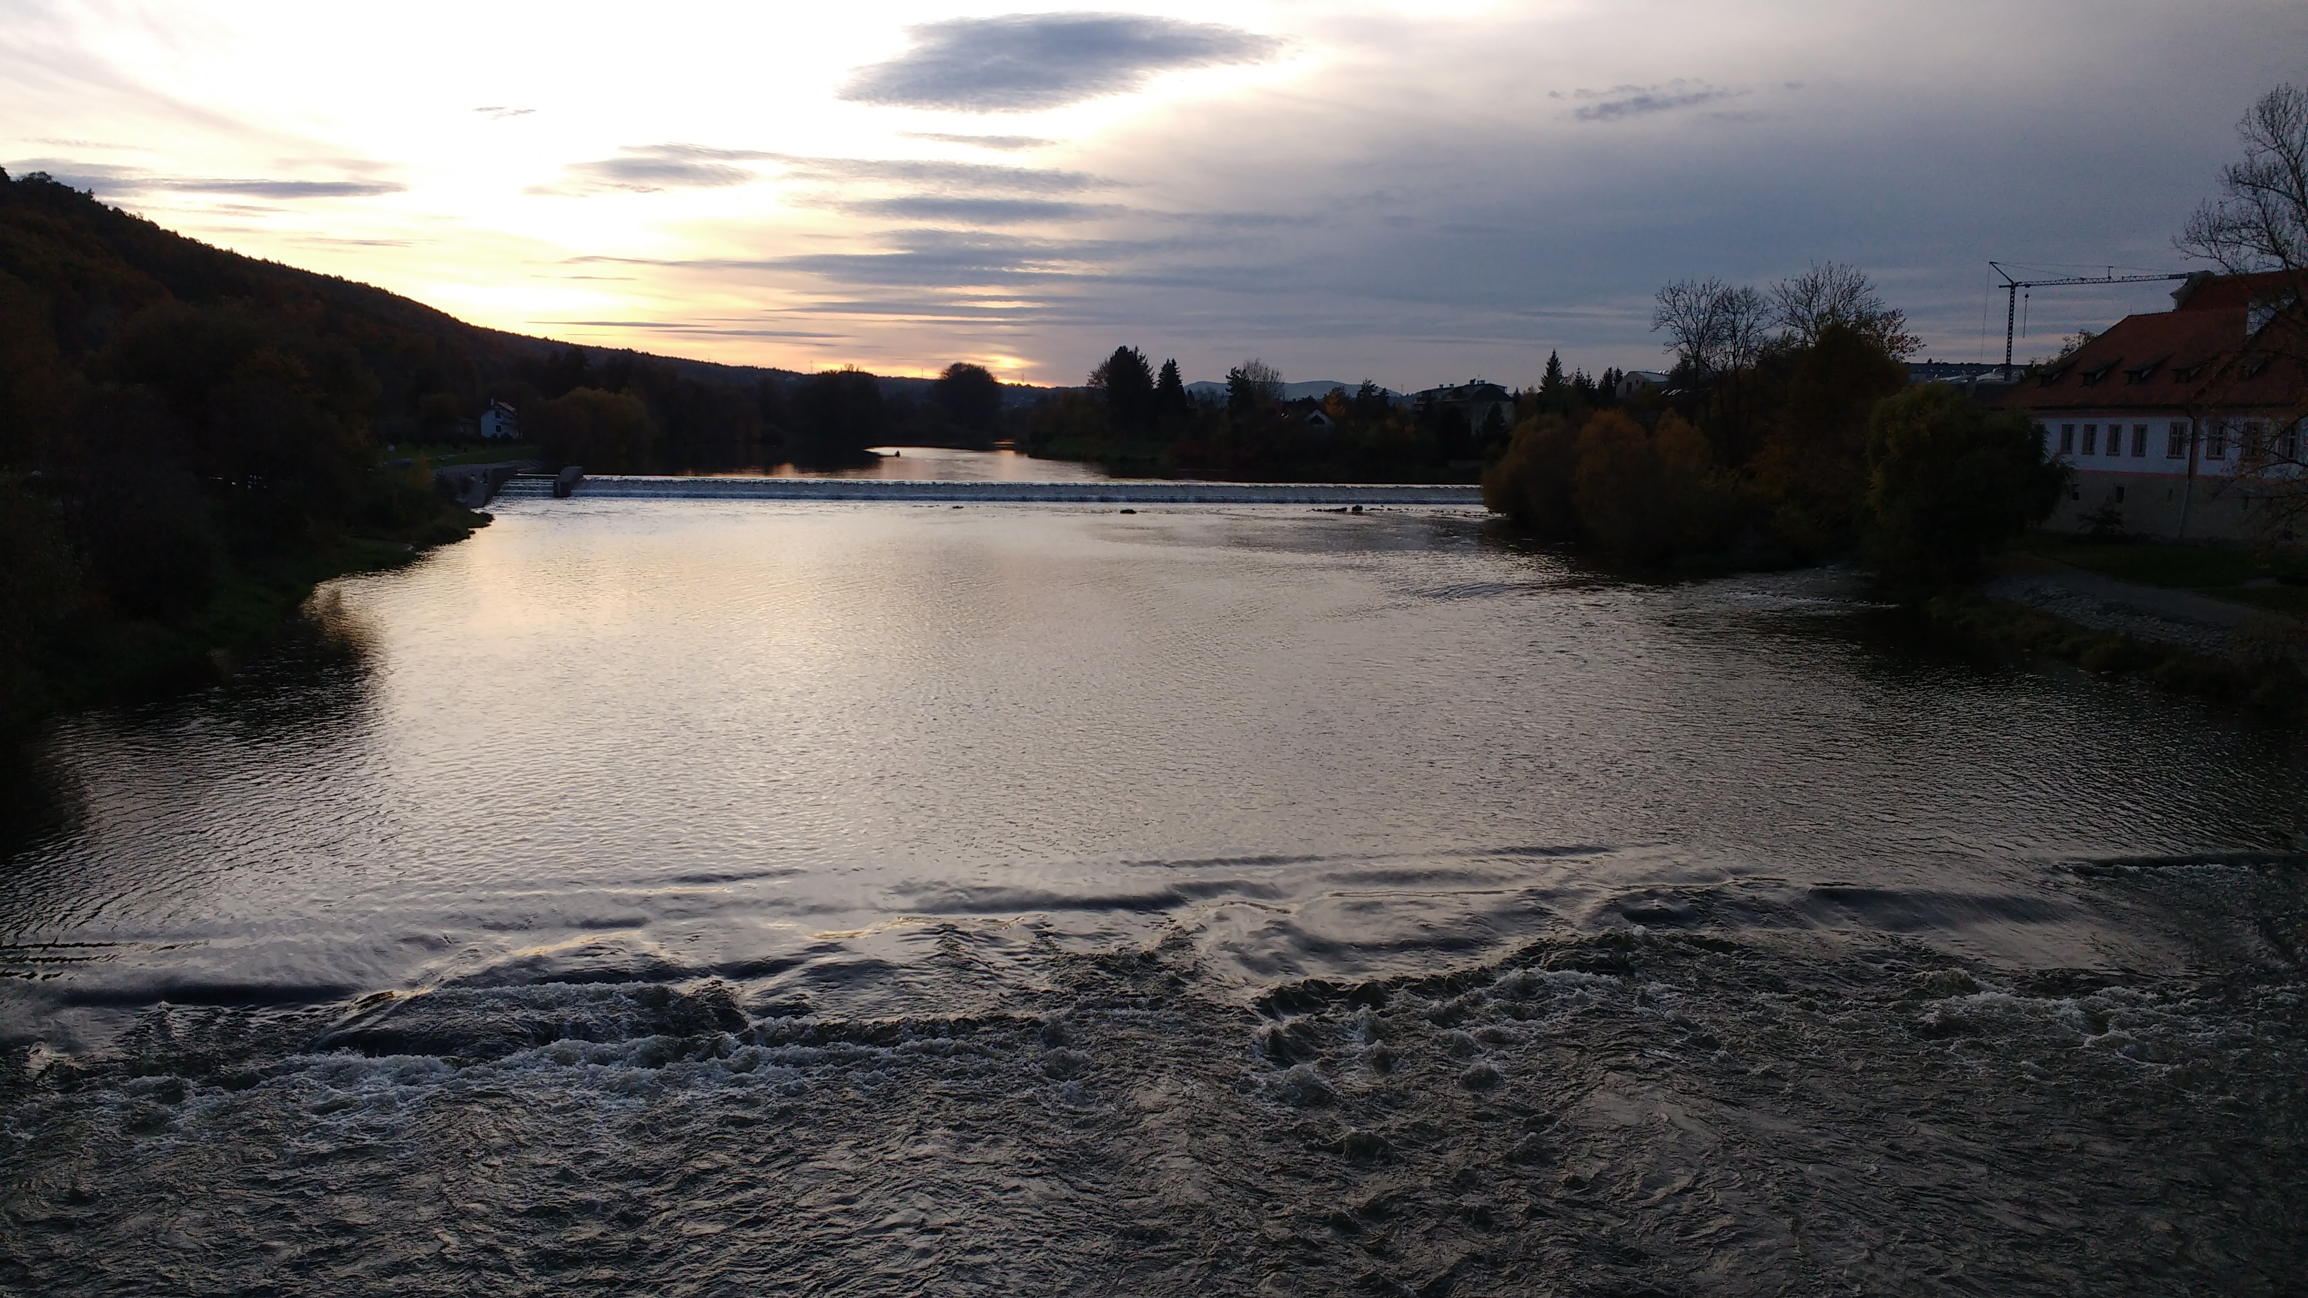
Thank you!

