Slide 1
Forward looking information in environment assessments and cooperation with the EEA
Anita Pirc Velkavrh
Strategic futures, EEA
Slovenian EIONET network meeting, 2 October 2013, ARSO

Slide 2
Aims of the presentation
Present overview of use of forward‘looking information in EEA SOER and introduce and describe some dilemas and contraversies that exist in this area of work
Present what is NRC for Forward‘looking information doing in this area

Slide 3
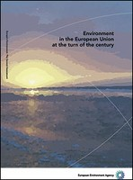
SOER 1999
Dedicated chapter on societal developments and use of resources, economic developments.
Approach: A suite of (linked) models to explore a coherent baseline.
Time-horizon: 10 to 20 years (depending on issue)

Slide 4
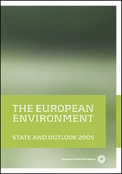
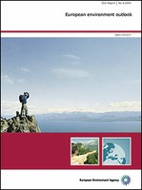
SOER 2005
Forward-looking information ‘sporadically’ embedded in the integrated assessment (‘Part A’)
Complemented by a dedicated sub-report ‘European Environment Outlook 2005’
Approach: Coherent assumptions across themes - Baseline scenario - assumptions (EU CAFE) - Alternative (policy) scenarios by theme
Time-Horizon: 2020/2030 (& 2100 for climate)
Focus issues: Socio-economic trends, GHG, waste, water resources, agriculture, air quality

Slide 5



SOER 2010
Forward-looking information embedded in all parts (at least that was the ambition)
Dedicated publication on long-term trends (‘Part A’)
Approach:
Making use of existing outlooks and projections (i.e. no new coherent set of assumptions)
Explorative long term assessment
Time-horizon: depends on issue; 2020/2030 for most thematic assessments, 2050 for global megatrends

Slide 6
Why thinking about future?
Why doing forward looking environment assesment?

Slide 7

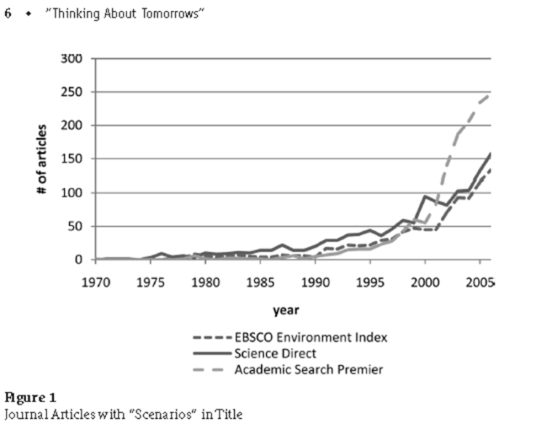
becouse we don‘t know the future
We all think about the future every day
… there are no future facts
“Life can only be understood backwards; but it must be lived forwards.”
Søren Kierkegaard
there is increasing interest and need
because of increasing dynamic,
changes and complexity

Slide 8
..becouse we need to
Europe and the world face challenges of great complexity, uncertainty and dynamism and if society is going to adapt to a more sustainable path policymakers need to understand these challenges and their long-term implications better.
“For future success in almost any area, we have to incorporate future effects into our current decision policy making.” (Commissioner Potočnik)
New thinking
“The world we have made, as a result of thinking we have done thus far, creates problems we can not solve at the same level of thinking at which we created them.” (Einstein)
Preparedness

Slide 9
Why is dealing with future difficult?

Slide 10
1 Because we think: I KNOW!!!!
“No woman in my time will be prime minister.“ Margaret Thatcher (quote in 1969)
2 - Because we’re ignorant:
“Wisdom is to know, that you do not know” (Socrates)
3 - Because we cannot predict the future:
“ Prediction is very difficult, specially of the
future” Niels Bohr (1885 – 1962)
Notes:
"It will be years --not in my time-- before a woman will become Prime Minister." --Margaret Thatcher, October 26th, 1969.
She became Prime Minister of the United Kingdom only 10 years after saying that, holding her chair from 1979 to 1990. But she wasn’t all that wrong since she is the only woman to have held this post. Maybe she should have added the word “again.” Read more at http://www.oddee.com/item_96635.aspx#dwZfu1pRjCYiMW0h.99

Slide 12
...becouse we live in different worlds
World of futurists
Scientific rationality
Exploring uncertainty
Long term orientation
Integrated perspective
Focussed on one study
World of policymakers
Political rationality
Searching for certainty
Short term orientation
Sector perspective
Confronted with many studies, advices etc.

Slide 13
....Becouse we need to deal with uncertainty
Policy making needs to uphold long term sustainability goals with suitable approaches and precautionary actions
Zureck and Henrichs, 2007

Slide 14
What can future assessments offer?

Slide 15
What can forward-looking assessments provide
Frame policies by identifying priority, warning signals and emerging issues
reflecting on different options for the future
identify driving forces and uncertainties
Check whether and how targets can be met, their relevance
Develop robust measures and precautionary actions
Analyse cause-effect relationships
Anticipate possible surprises, discontinuities, shocks
Facilitate short and long-term thinking in a structured way

Slide 16
How to deal with future?

Slide 17
Zureck and Henrichs, 2007

Slide 18
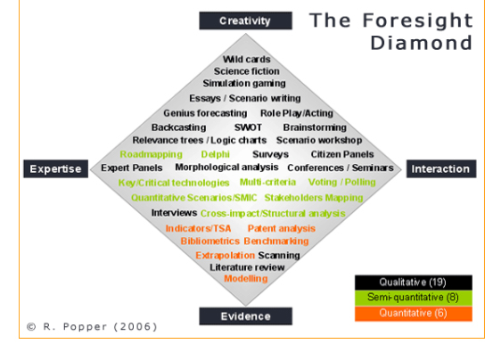
No perfect method exists

Slide 19
Scenarios : Forecast

Slide 20
The danger of forecasting is…
… you get it wrong!
Single/point forecast
SCENARIOS
Range
of
uncertainties
Today
Trends
Timing
“It is better to be vaguely right than exactly wrong.”

Slide 21
Scenarios ≠ Strategy ≠ Visions

Slide 22
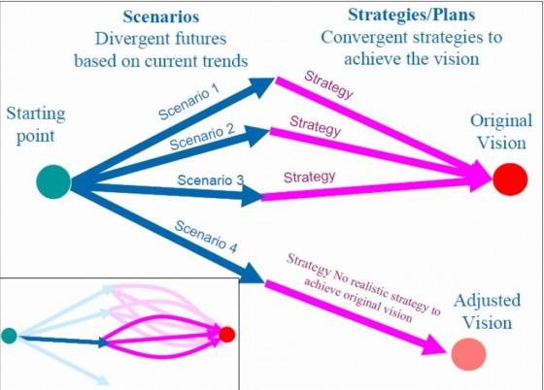
Scenarios used to challenge management thinking
input
Forward-looking assessment
Policy making

Slide 23
EEA forward-looking assessment and cooperation with countries

Slide 24
Conlusions on how to improve usefulness of future studies
Develop more targeted, sound and socio-economy integrated forward-looking environmental assessments at appropriate geographical scale
Include future perspective routinely in the regular environment reporting system
Strenthen national and regional leadership in producing forward looking assessments to support relevant policy processes
Strengthen institutional capacity at all scales to perform forward looking assessments
The Pan-European Environment: Glimpses into an uncertain future, EEA 2007
Review assessment approaches to improve monitoring and analyses of future changes and their uncertainties
Revise approaches and institutional arrangements to embed a long-term perspective into policy planning and decision-making
Reflect on future policy changes to take better account of global to European interlinkages and better align European policies with environment polices
SOER 2010, Assessment of global megatrends
Notes:
1. By fostering well-designed and sound
forward‑looking assessments that integrate
societal, technological, environmental, economic
and demographic issues
2. By adapting existing information systems to
regularly capture data on emerging issues, and
by including more forward-looking perspectives
and projections in national environmental
reporting.
3. By encouraging the active involvement of regional
and national institutions in the development of
forward-looking studies.
4. By increasing the expertise and resources available
to build and carry out forward-looking studies
— both at supra-national and national levels.

Slide 25
TRANSITIONS on megatrends level
EEA objective
To measure, monitor and report on long term trends and sustainability transitions.
Specifically:
to support transition pathways to the future with forward-looking assessments;
to reflect on global megatrends;
to facilitate the inclusion of environmental considerations into discussions of societal transition and governance models.
Country level
GMTs Impacts to countries, little possibilites to influence, need to adapt, but need to know the driving forces.
Use of sound and adequate Forward-looking methdologies
Distance to target anlyses
Setting national LT objectives
Deal with uncertainties
Inclusion of forward‘looking in SoE assessmen
Notes:
Policy context
Europe and the world face challenges of great complexity, uncertainty and dynamism and if society is going to adapt to a more sustainable path policymakers need to understand these challenges and their long-term implications better. Strengthening institutional capacity significantly at all levels of governance and performing relevant, credible and scientifically sound forward-looking assessments are essential in this regard.
Europe is bound to the rest of the world through numerous systems — environmental, economic, social, political, others — enabling a two-way flow of materials and ideas. Europe contributes to global environmental pressures and accelerating feedbacks through its dependence on fossil fuels, raw materials and other imports. Conversely, transformations elsewhere increasingly affect Europe; both directly as in the case of environmental change or indirectly through, for example, intensified socio-economic pressures.
Many of these changes are interlinked and likely to unfold over decades. They can significantly affect Europe's resilience in the long term, but can also offer unique opportunities for action. But effective measures require new ways of thinking and innovation beyond existing policy targets, as well as better information and better understanding of a highly complex and evolving situation.
The most relevant policy European frameworks are those with a time horizon beyond 2020, i.e., the broader EU mid- term (2020/2030) and long term (2050) policy targets and ambitions - and, in particular, the transition towards a resource-efficient, low-carbon economy/society in which key sectors are transformed, natural capital is protected and enhanced, and the health and well-being of citizens is safeguarded.
Global agendas such as Rio+20, the United Nations Framework Convention on Climate Change and the Convention on Biological Diversity have similar objectives and time horizon.

Slide 26
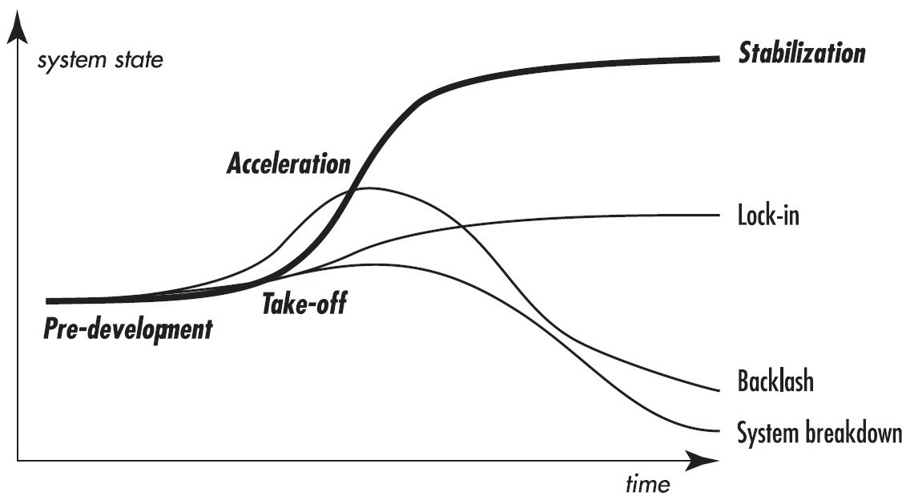

transition to a sustainable future
change
3 levels:
Makro: megatrends
Dominant: socio‘technical regimes
Micro: innovations, novelties
Notes:
These are crucial times for Europe:
When the European Parliament launched its awareness and information campaign in the run-up to the 2014 European elections 10 September, they stated:
„These are turbulent times in the history of Europe. The crisis has made citizens aware that Europe touches the heart of their living conditions. They have understood more than ever that European countries are interdependent, and what is happening in another EU member state fully affects everyone's future prospects.
The logo with the baseline ACT.REACT.IMPACT. stresses that EU voters can exercise their power, through the ballot box, to determine the future shape of Europe.
European citizen rate Environmental and climate concerns not as high as in the past (Eurobarometer 2013, environment: rank 9, climate: rank 11 of most concerning topics for Europeans). But as with overcoming the economic crisis we will have the choise: are we able to prepare a system transition leading towards stabilization of our ecosystems?
The overall aim with EEAs work in the coming 5 years is to step up the contribution of environment policy to the transition towards a resource-efficient, low-carbon economy in which natural capital is protected and enhanced, and the health and well-being of citizens is safeguarded. They are also the basis for EU involvement in global and wider European activities, which increasingly are framed in a 2050 perspective.
Picture: EP president Martin Schulz presenting 2014 EP election campaign on 10 September 2013

Slide 27
EEA structures
EEA: Strategic futures group
NRC for forward-looking information and scenarios

Slide 28
NRC for Forward-looking information and scenarios
NRC for Forward-looking information and scenarios (FLIS) was established in 2009
2 annual meetings per year
Expert meetings (around 3 per year)
Coordination group for NRC FLIS
Art 5 projects 2011 (60000 EUR) and 2012 (80000 EUR)
NRC FLIS is not reporting and data flows, but rather deals with methodologies, capcity building and specidfic future isseus (emerging issues, uncertainties, wild cards, horizon scanning...)

Slide 29
NRC FLIS –terms of references
NRC | Expertise | Skills | Policy processes to be supported | Input and contributions from the NRC
FLIS | Forward-looking techniques and approaches; Scenarios Projections Strategising Impacts assessment Early warnings | Sustainable development Environment (components and driving forces, sectors integration) Stakeholder involvement Policy Assessment Impact assessment Information system | Scenarios development, uncertainties Tailoring forward-looking approaches and methods on the European to country level, including terminology discussions Strategic futures: Support to strategy building , how policies interact, drawing information from different sources in a new context Decision making under risk, uncertainty, complexity, ignorance Global to national links in scenarios | Review and commenting of forward-looking reports and indicators Support from the country site to FLIS development on-site management of information Providing good countries practices and exchange of information Participate in capacity building exercises s appropriate (as provider of practice or receiver) Act as stakeholder and arrange within countries stakeholder involvement if necessary Participation on meetings, workshops, working groups (two EIONET meetings per year) Coordinate activities between different institutions in the countries (normally is this area very dispersed and it doesn’t link to normal SOE institutional set-up)

Slide 30
EIONET – FLIS Vision
Strategic foresight will be successfully implemented in regular Environmental reporting of EEA and in the agencies in the EIONET
Forward looking information from strategic foresight will be robust, based on past evidence and best understanding of system functionality, transparent and using up-to-date methodologies
NRC FLIS network provides a wide range of knowledge, skills and methodological experiences and actively shares them among EIONET members and interested bodies in the EU and its wider context worldwide.
Coordination group NRC FLIS. May 2013

Slide 31
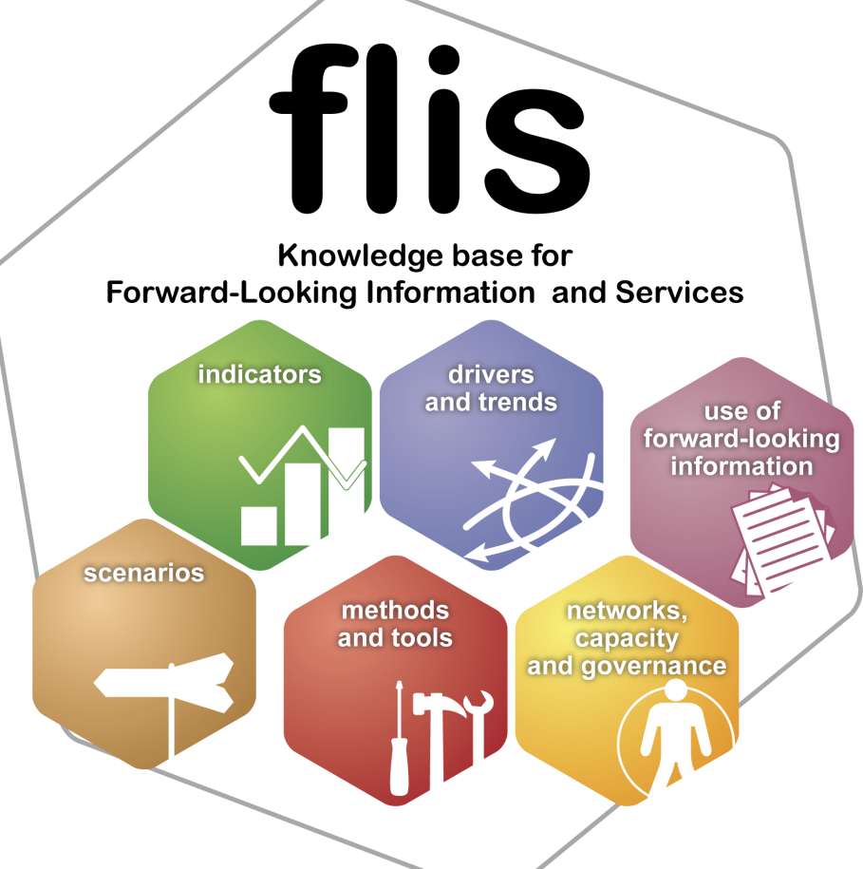
Information about the future itself
Capacity building
Practice of studying the future

Slide 32


FLIServices
To improve:
accessibility and transparency of forward-looking information for users; experts and non-experts
management, sharing and use of information
sharing of expert knowledge widely (cooperation and communication)
to reinforce institutional capacity in the EEA and member countries;
An Information Service is this part of an Information system that serves data/knowledge/information to customers and collects it from its contributors, to manage and store it by optionally using administrators.
“service,” reflects the process of doing something
beneficial for and in conjunction with some entity

Slide 33

Thank you.

Slide 34
Scenarios and modelling in policy cycle
Problem
signalled
Problem
recognised
Measures
taken
Problem
controlled
Outlooks - Projections
Scenarios
Public awareness / Policy attention

Slide 35
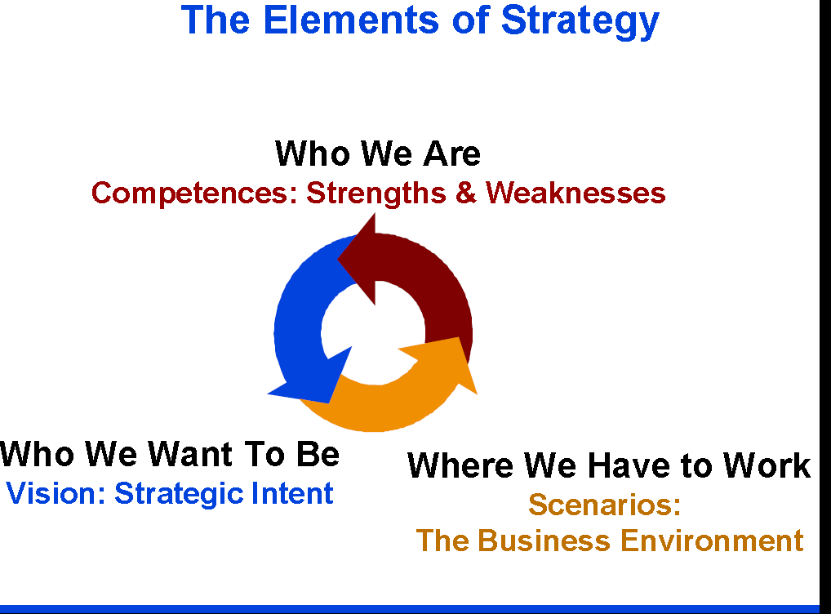

Slide 36
MAWP 2014-2018: TRANSITIONS
Objective
To measure, monitor and report on long term trends and sustainability transitions.
Specifically:
to support transition pathways to the future with forward-looking assessments;
to reflect on global megatrends;
to facilitate the inclusion of environmental considerations into discussions of societal transition and governance models.

