Slide 1
Climate change impacts and adaptation (data, models and platforms)
Blaz Kurnik
EEA

Slide 2
Climate Impacts and Adaptation
- Climate change impacts and vulnerability report
- Urban Adaptation report
Copernicus Climate Change Service
Climate-ADAPT

Slide 3
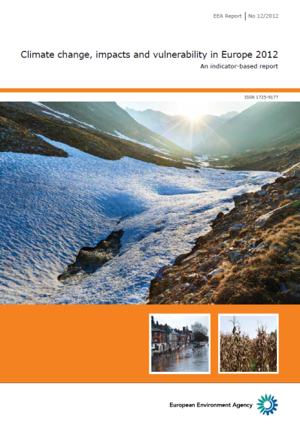
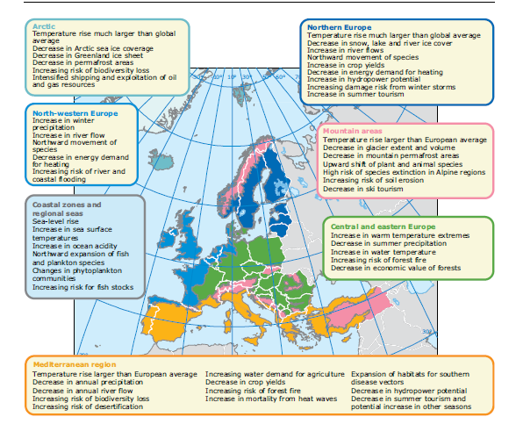
Climate Change impacts in Europe

Slide 4
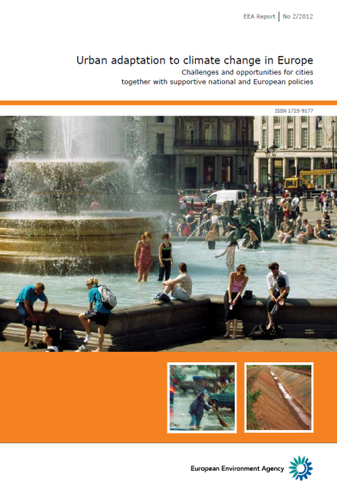
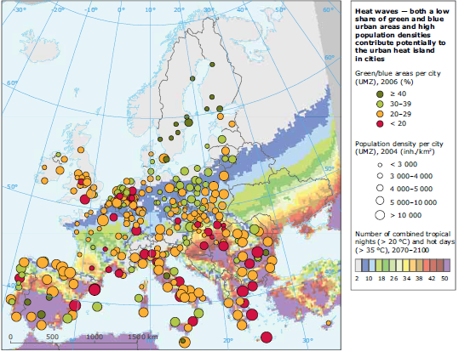
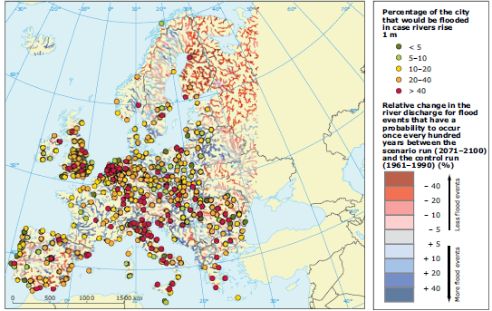
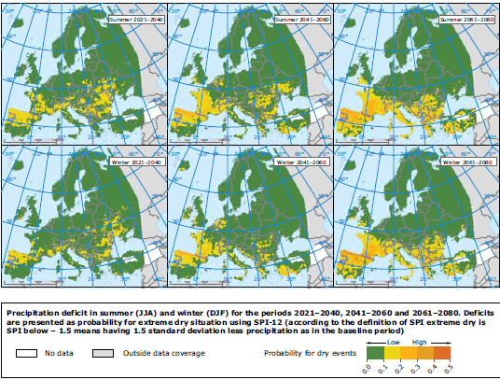
Urban Adaptation and Climate change
Urban Adaptation to climate change in Europe
Climate change - assessing risks to cities and towns in Europe
Planning urban adaptation
Multi-level governance
Examples:
Heat waves River floods Droughts

Slide 5
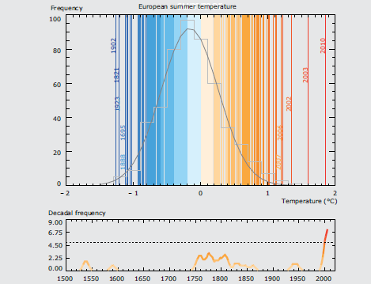
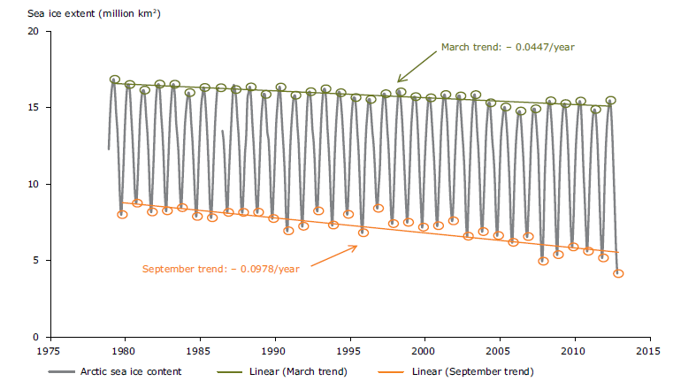
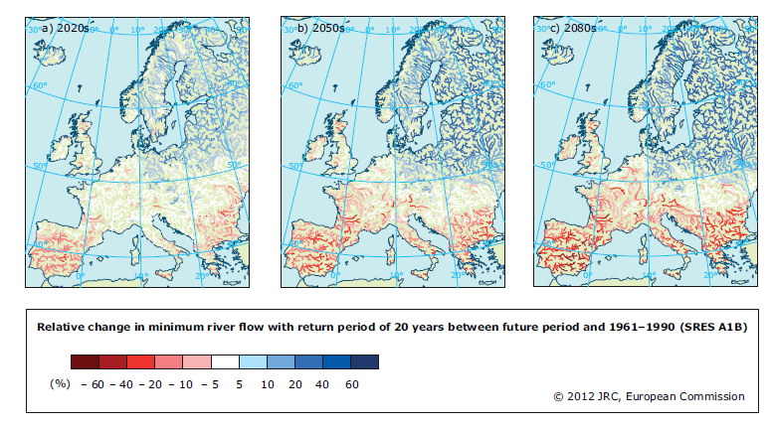
Climate indicators
Key messages:
Climate change is occurring globally and in Europe
Observed climate change has already led to a wide range of impacts
Climate change can increase existing vulnerabilities and deepen socio-economic imbalances in Europe
Damage costs from natural disasters have increased
The causes of the most costly climate impacts are projected to differ strongly across Europe
On-going and planned monitoring and research at national and European level can improve assessments

Slide 6
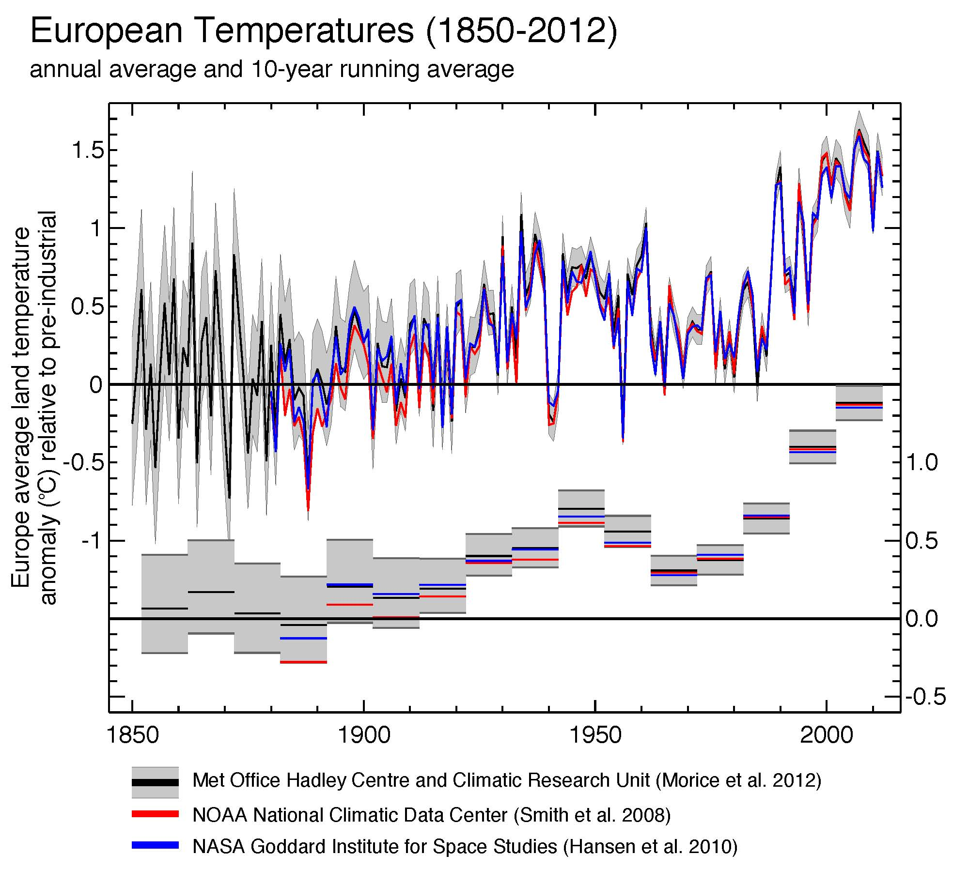
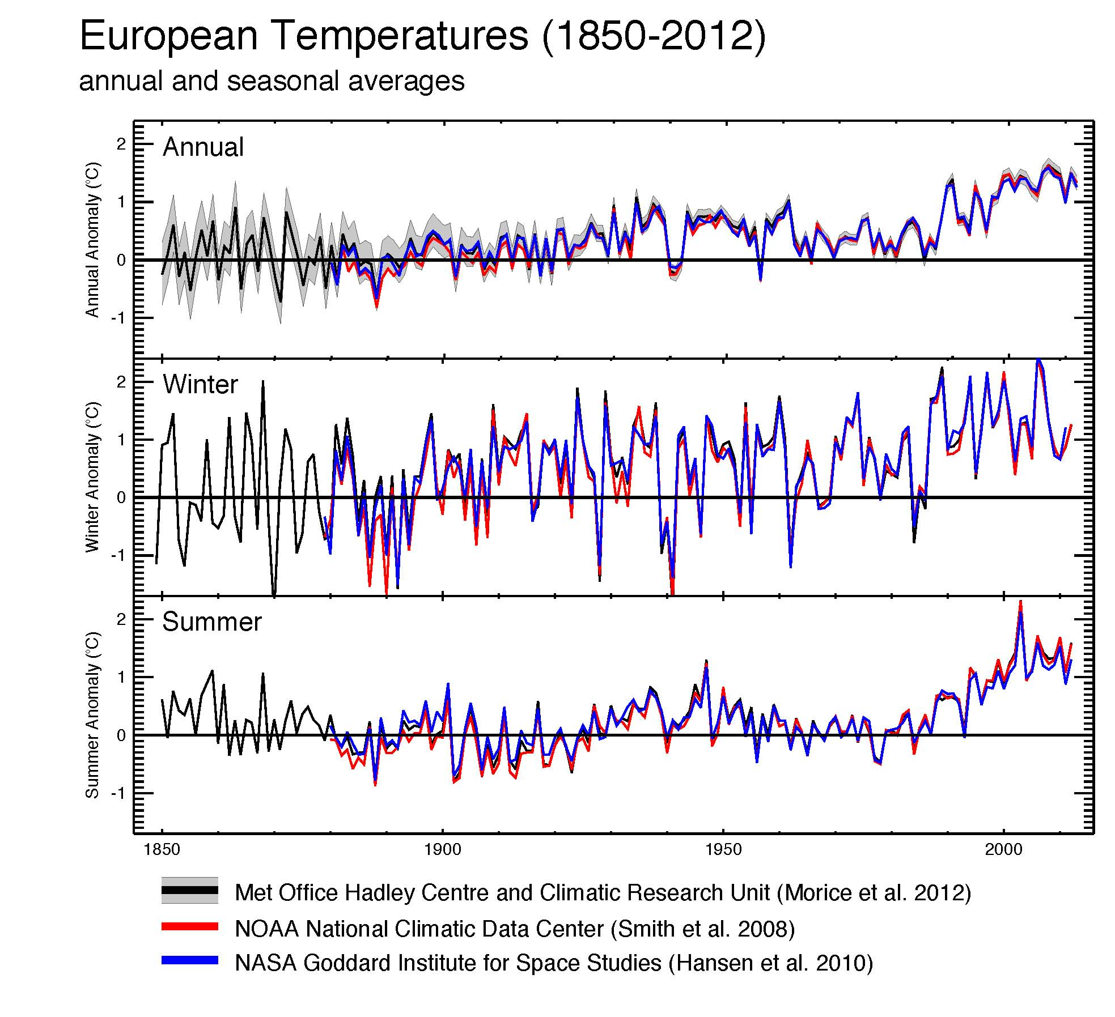
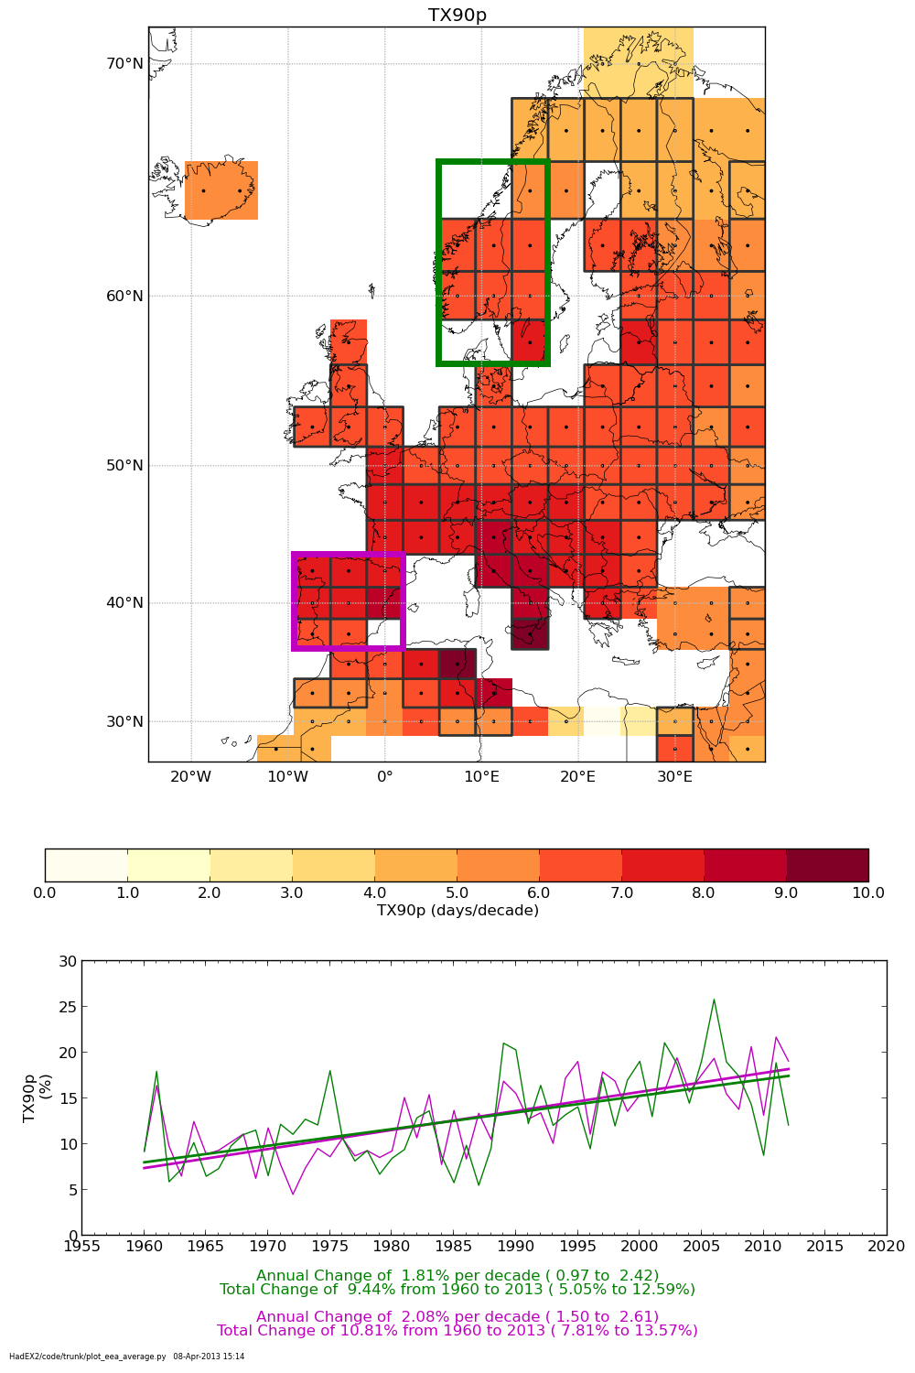
Climate Indicators
Regular assessments of climate changes:
regular update
assessment/methodology/data/figures
Using various data providers
From past trends to future projections

Slide 7
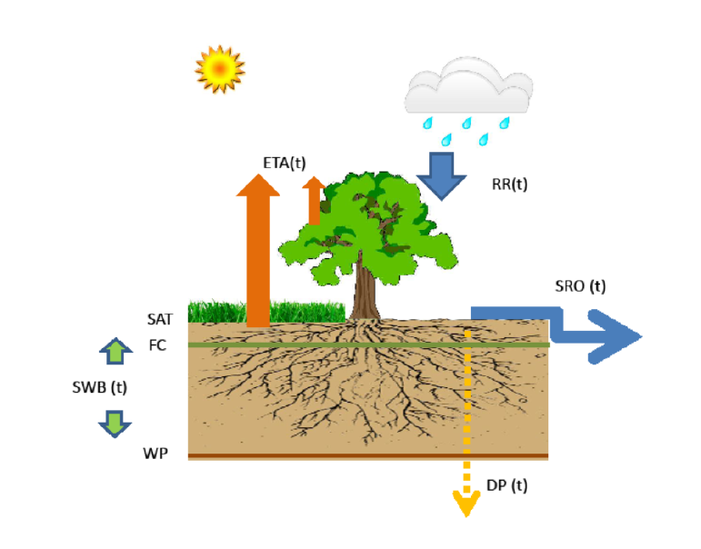
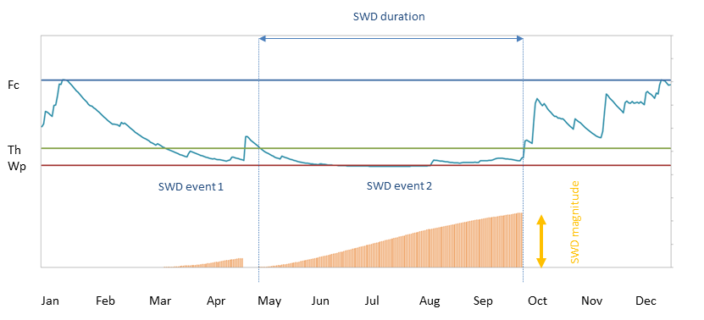
Soil water balance modelling

Slide 8
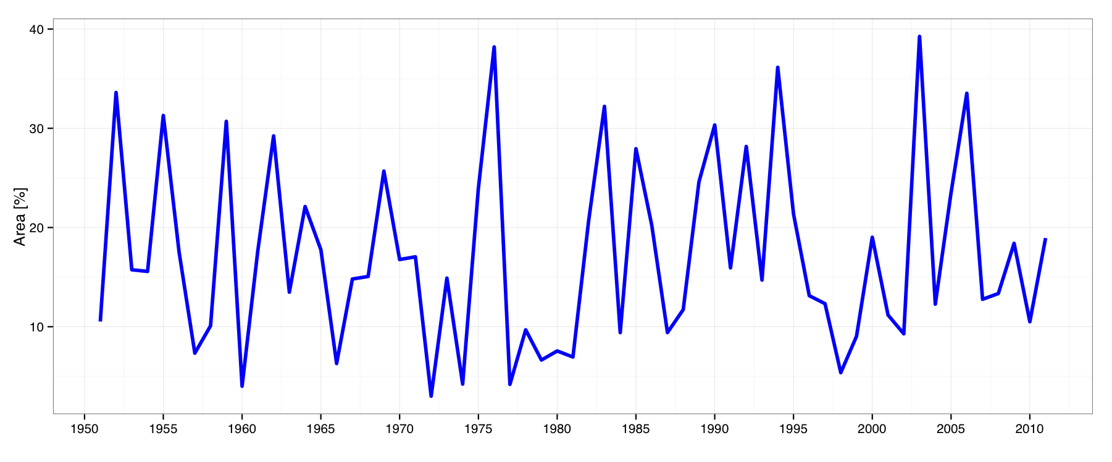
Share of dryness in Europe

Slide 9
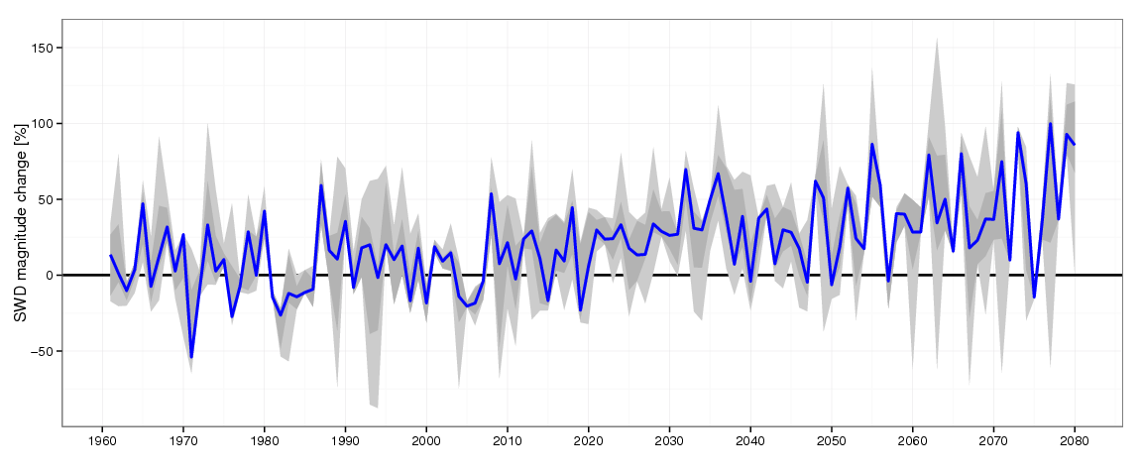
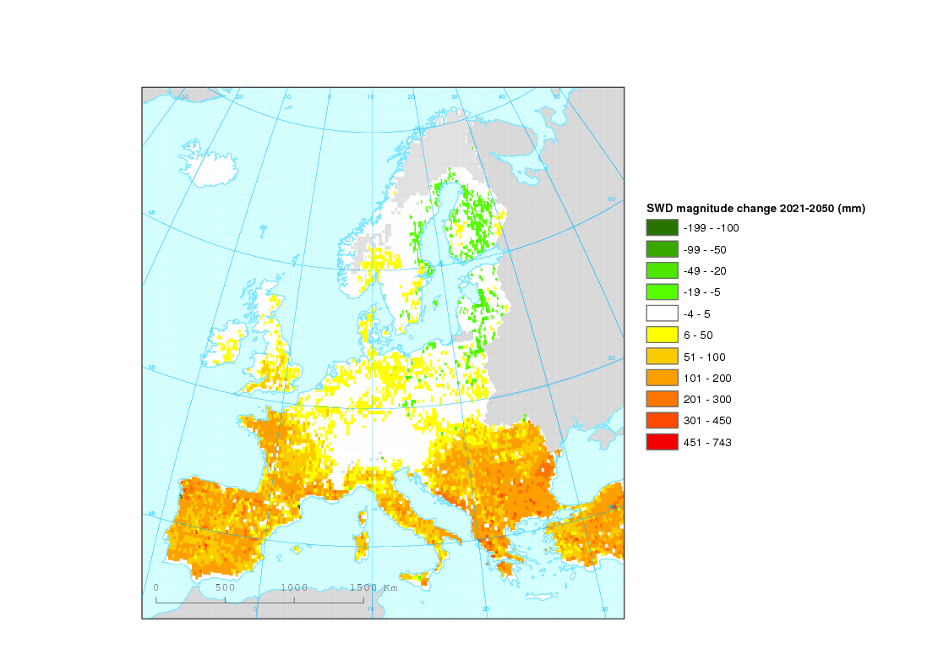
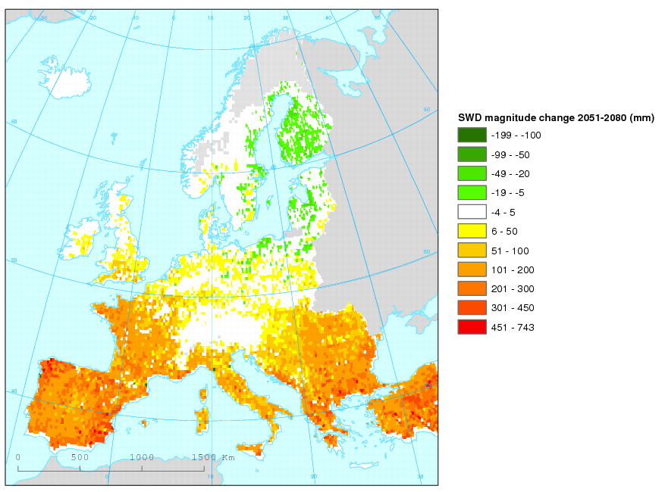
Soil water deficit

Slide 10
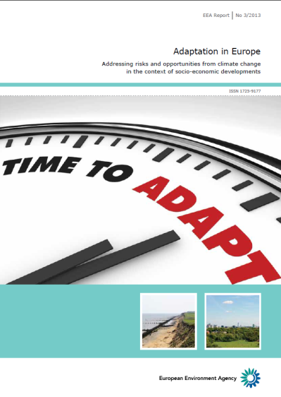
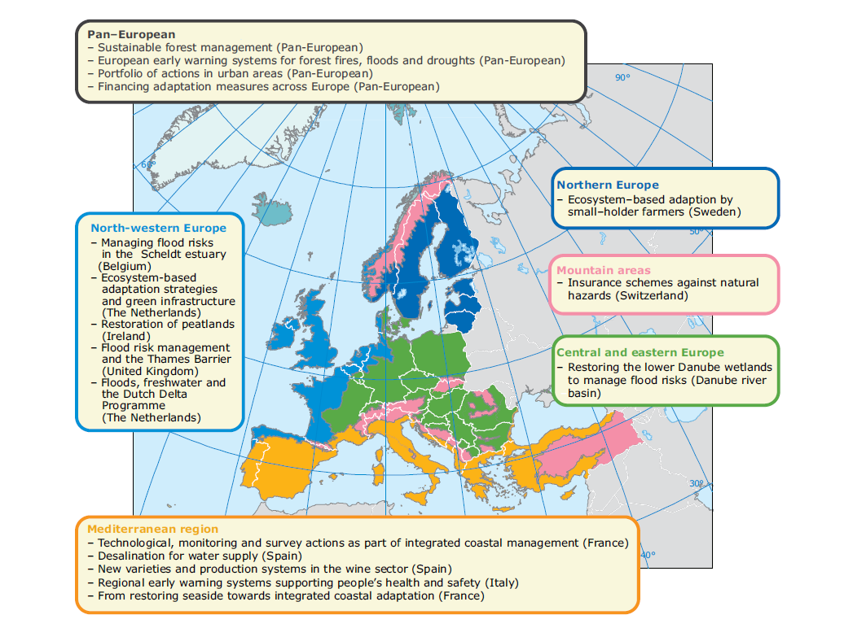
Adaptation
Adaptation examples in Europe
Adaptation actions:
green: ecosystem
grey: technology/monitoring/managing
soft: education, information
combined

Slide 11

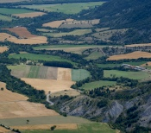
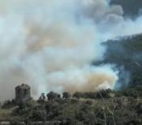


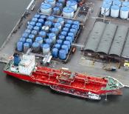
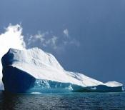
Land
Monitoring
Security
Climate
Change
Emergency
Management
Atmosphere
Monitoring
Marine
Monitoring
Operational phase
Pre-operational
phase
Pre-operational/development
phase
Coordination:
Global: JRC
European
&case studies
EEA
Coordination:
TBD
for EFAS:
JRC+ECMWF+
others
Building on:
MACC-II
(ECMWF)
Building on:
MyOcean2
(CNES)
Building on:
Various
EC FP7 projects
Building on:
Various
EC FP6/7
projects

Slide 12
Copernicus Climate Change Service
Aim:
The service will provide access to several climate indicators (e.g. temperature increase, sea level rise, ice sheet melting, warming up of the ocean) and climate indices (e.g. based on records of temperature, precipitation, drought event) for both the identified climate drivers and the expected climate impacts
Building blocks:
FP6:
e.g: ENSEMBLES
FP7 2009 call:
EURO4M
CARBONES
MONARCH-A
FP7 2012 call
CHARME
Core-Climax
FP7 2013 call:
Under negotiations

Slide 13
Climate adaptation platform
One-stop shop
Information platform
Communication platform

Slide 14
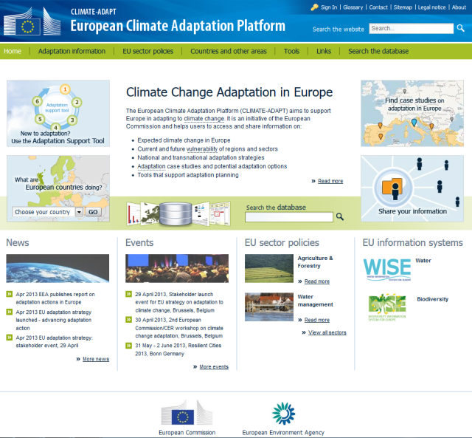
Climate-ADAPT platform
Reports
Publications
Guidance documents
National
Transnational
Urban
Policy makers
End users
Expert users or contributors
Information portals
Tools
Case studies
Indicators
Datasets
Maps and graphs
Past to future 1850 - 2100

Slide 15
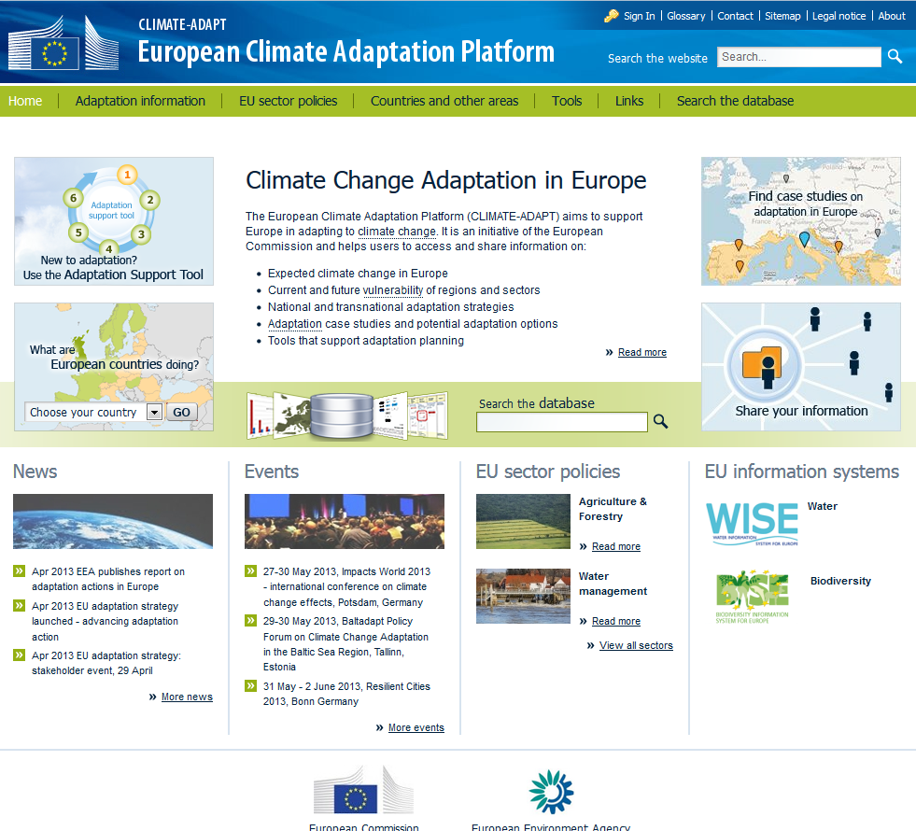
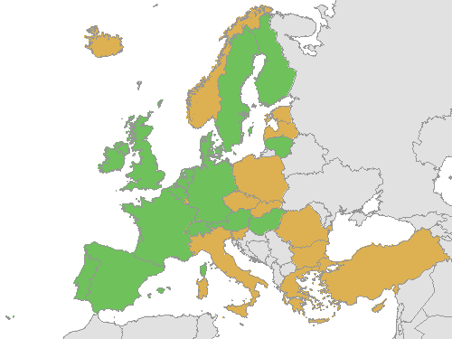

Country profiles

Slide 16
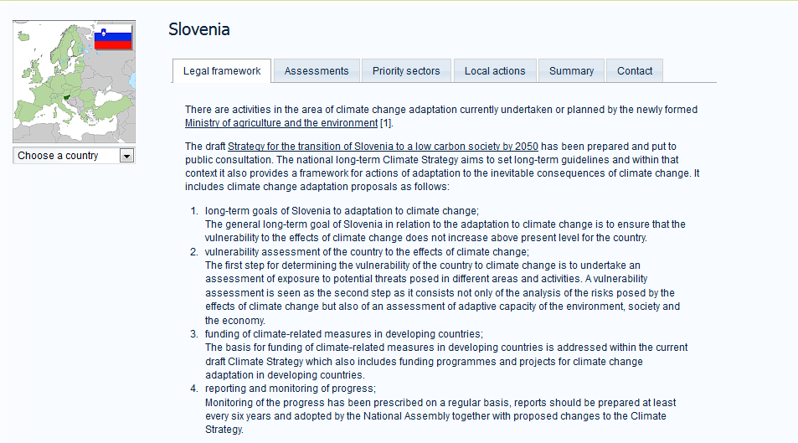
Country profiles - Slovenia

