Slide 1
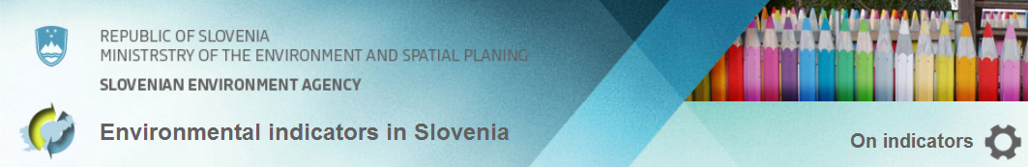
System of
Environmental indicators in Slovenia
and state of the environment reporting
http://kazalci.arso.gov.si/
Introduction
Indicator model
Network
Applicability in SOE
  SENSE
Slovenian Environment Agency
Urška Kušar, urska.kusar@gov.si
EIONET-SI & EEA meeting, 2.10.2013

Slide 2

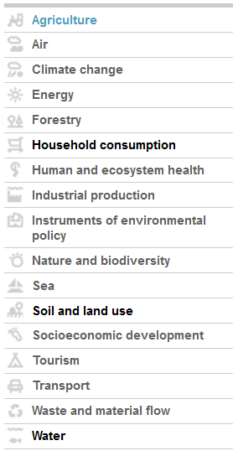
Environmental Indicators in Slovenia
17 chapters, 181 indicators
Published:
since 2004
http://kazalci.arso.gov.si/
printed v. 2002, 2003, 2005
Institution:
Ministry of Agriculture and Environment
Slovenian Environment Agency -
International Cooperation Service (3-5 editors)
+ 20 institutions, 100 experts
Legal basis:
Environmental Protection Act
(report and indicators)

Slide 3
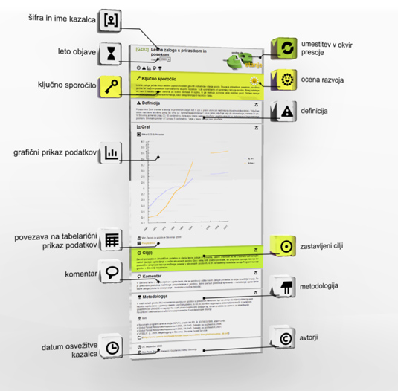
Indicator
An environmental indicator is a measure, generally quantitative, that can be used to illustrate and communicate complex environmental phenomena simply, including trends and progress over time — and thus helps provide
insight into the state of the environment (EEA, 2005).

Slide 4
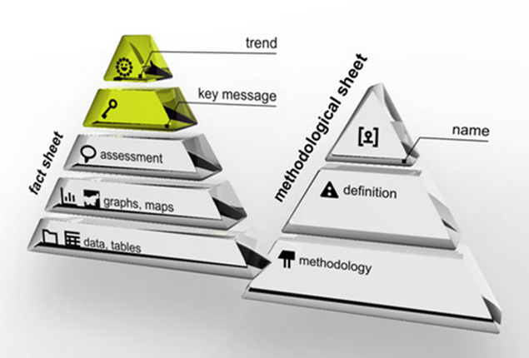
Indicator model
layers – “multi-functional”
different level of details, for different audiences
POLICY GOAL
general public
experts

Slide 5

Source database:
Data administrator:
Data acquisition date for this indicator:
Methodology and frequency of data collection:
Data processing methodology:
Information concerning data quality:
( 1 to 3 assessment mark, comments )
Advantages and disadvantages of this indicator
  relevance,
  accuracy,
  completeness over time,
  completeness over space,
explaining
uncertainties

Slide 6

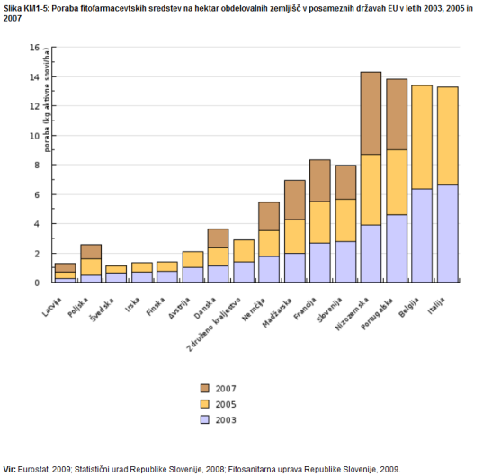
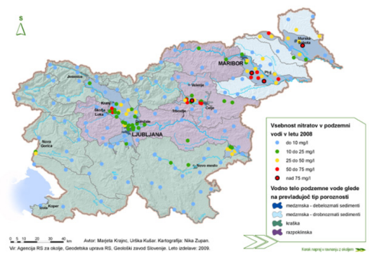
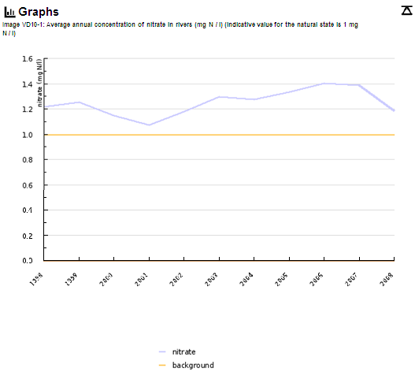
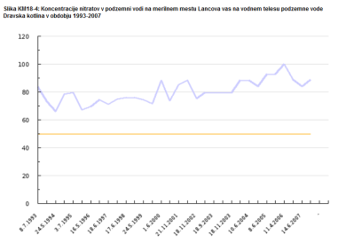

POLICY GOAL – NATIONAL LEVEL
POLICY GOAL – INTERNATIONAL LEVEL
TREND
STATE
BENCHMARKING
TIME
SPACE
HOT SPOTS
8

Slide 7
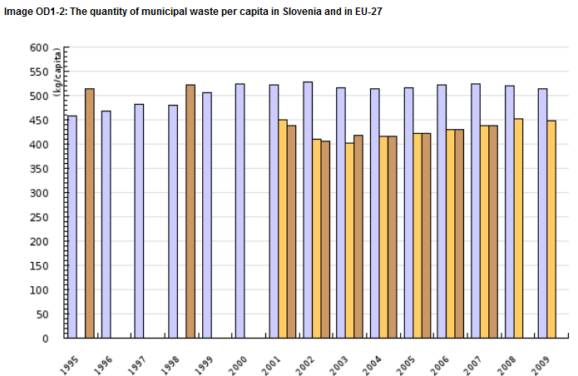

dealing with
data inconsistency
in graphics

Slide 8
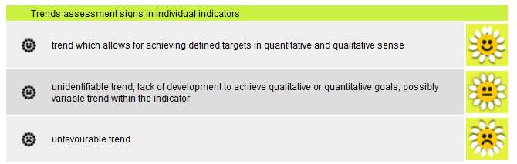
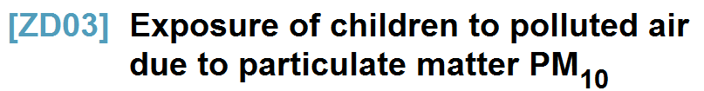
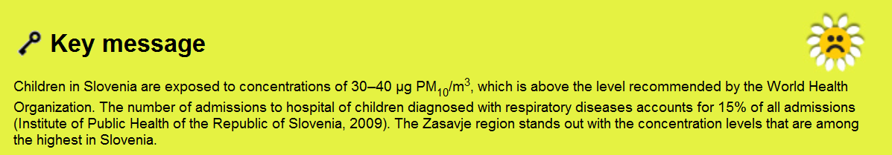
Trend assessment
& key message

Slide 9
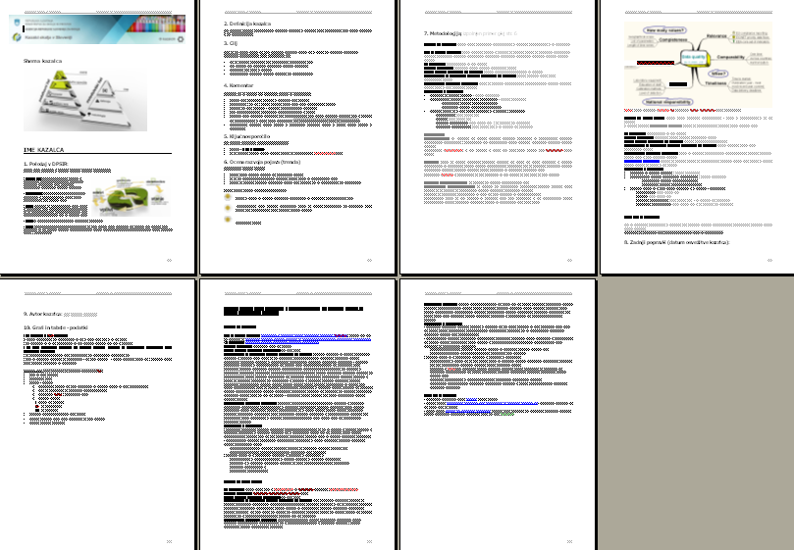
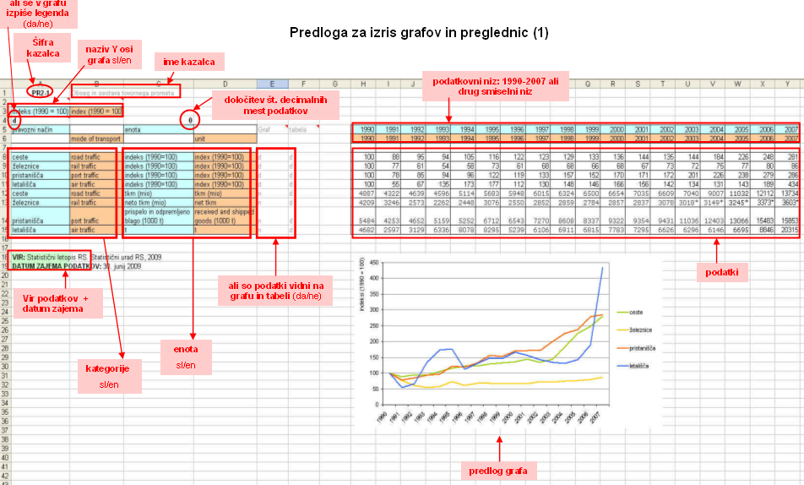
Templates
Word template for texts
Excel template for data

Slide 10
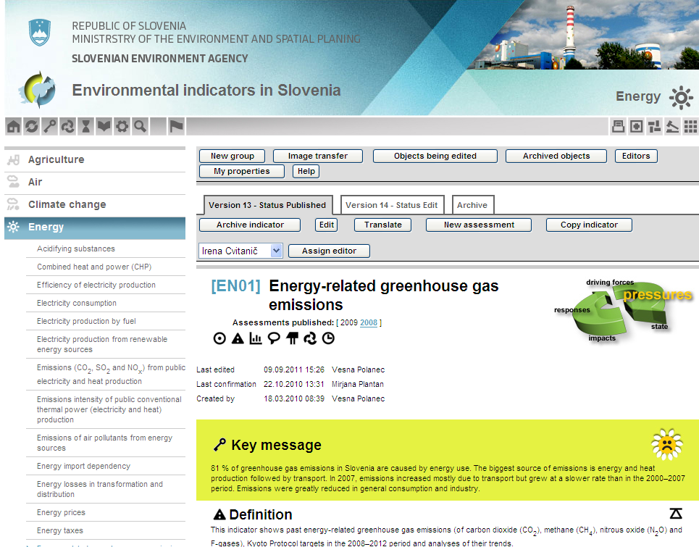
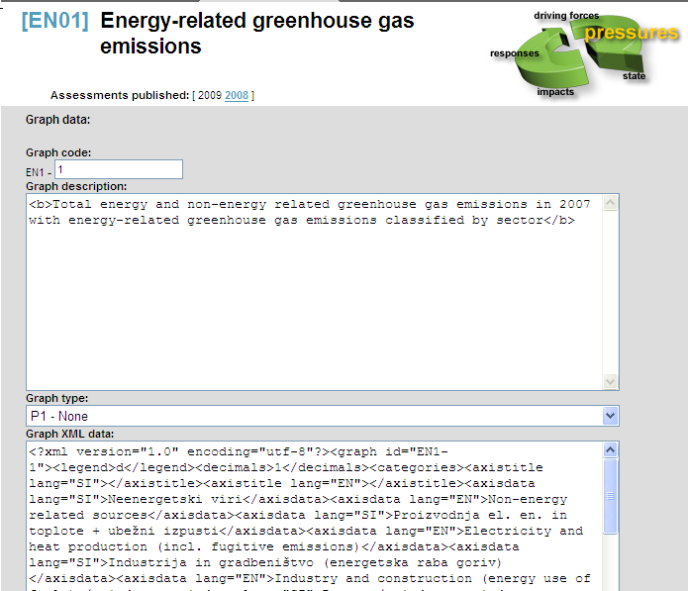
WEB application “KOS-2”
WEB application “KOS-2” for managing and browsing the content
built on Zope and PostgreSQL
XML descriptions used for transferring graphs and tables from Excel
bilingual: Slovene and English
administration form
“input” form – graph:

Slide 11
Indicator model
+
multi-functional structure of indicators
  for different groups of users
  for different proposes (overview for reports, questionnaires, …)
improved clarity and transparency of certain environment-related information
explanation of uncertainties in the data, methodology and interpretation
easy to manage web-publishing
-
only on general (state) level and annual data
not automatic – extra work and subjectivity of authors
not fully compliant structure with international indicator models (metadata,…)

Slide 12
Integrated Environmental Indicators Network
and EIONET-SI (EEA):
authors (100), institutions (20), data sources (around 80) and knowledge
Slovenian Environment Agency
Ministry of Agriculture and Environment
Statistical Office of the Republic of Slovenia
Agricultural Institute of Slovenia
National Institute of Public Health of the Republic of Slovenia
Jožef Stefan Institute
Marine Biology Station,
Forestry Institute of Slovenia
Institute of Macroeconomic Analysis and Development
Urban Planning Institute of the Republic of Slovenia
National Institute of Biology
Morigenos (NGO)
Biotechnical Faculty - Department of Biology
Biotechnical Faculty - Forestry department
Slovenia Forest Service
DOPPS (NGO)
ERICO (business)
Slovenian Academy of Science - Anton Melik Geographical Institute
Institute of Waters of the Republic of Slovenia
Faculty of Arts, Department of Geography
EIONET nominations:
NFP, PCPs
NRCs
Thematic editors

Slide 13
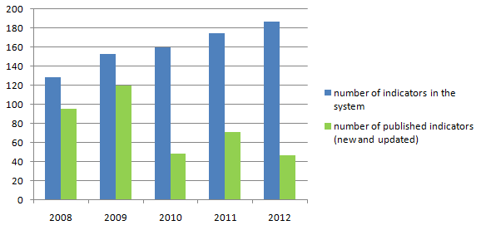
Indicator system management
EDITOR
(EIONET PCP)
AUTHOR
Selection of indicators
Review of definition and methodology
Review of indicators
Thematic working group of authors

Slide 14
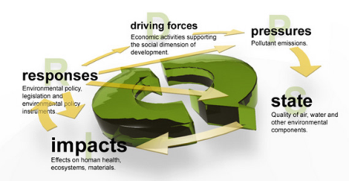
Selection of indicators
NATIONAL PRIORITIES (National Environmental Action Plan)
      streamlinening of international sets of indicators
CSI (Core Set of Indicators, EEA)
AEI (Agri-Environmental Indicators, IRENA, EEA and EUROSTAT)
EERM (Indicators of environmental integration of the energy sector, EEA)
TERM (Transport and Environment reporting mechanism, Eurostat, DGs, EEA)
SEBI 2010 (Streamlining European 2010 Biodiversity Indicators, EEA)
CLIM (EEA)
ENHIS (Environment and health Information System, WHO)
KEI, CEI (Key- and Core environmental Indicators, OECD)
SDI (Sustainable Development Indicators, Eurostat)
SI (Structoral Indicators, Eurostat)
ISD (Indicators of Sustainable Development)
EPI (Environmental Pressure Indicators, Eurostat and DG Env)

Slide 15

Selection of indicators
 | AIR | WATER | BIOSPHERE& SOIL & LAND | NON ENERGY RESOURCES | ENERGY SOURCES
AGRICULTURE
ENERGY PRODUCTION
INDUSTRIAL PRODUCTION
TRANSPORT
COMMERCE AND SERVICES
HUMAN HEALTH AND WELLBEING

Slide 16
Indicator system management
+
network of experts
multi - institutional,
cross - sectorial
framework as a “tool” for cooperation
expert cooperation
knowledge and awareness raising in institutions (sectors)

Slide 17
Indicator system management
-
issue of “official status” and ownership of the data/information
difficulties with management of many different forms of co-working (agreements, contracts, exchange of information and services,…)
“missing links”
balance between stability and adaptability (“core set” of indicators vs. emerging themes)
only partly translated in English
not enough promotion (live presentation of results, printed editions,..)
resources!

Slide 18
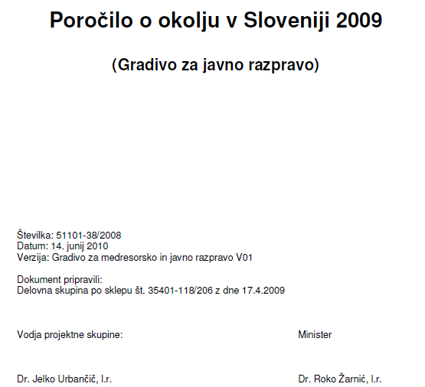
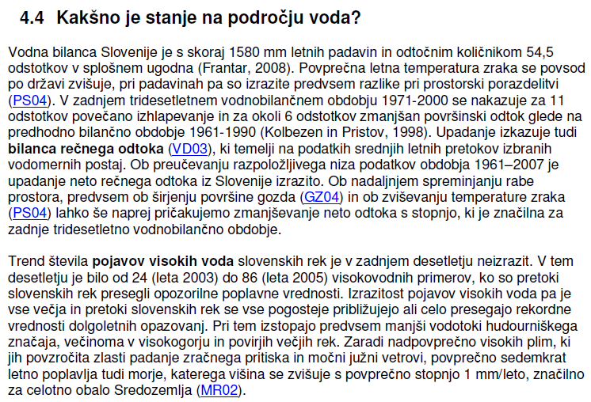
Use of KOS indicators
in national SOE report 2009
Indicators -
facts and figures

Slide 19
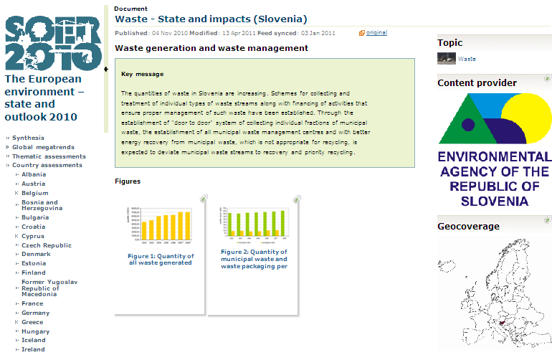
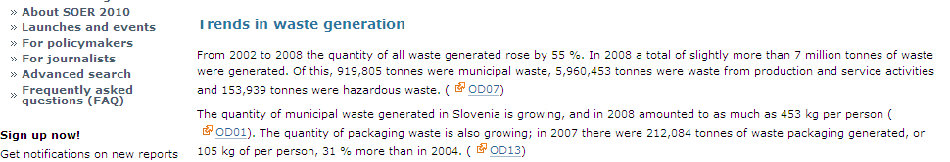
Use of KOS indicators
in SOER 2010 (country assessment)
SENSE -1:
Working with EEA on
web-based approaches for sharing texts and graphics
(RDF feeds)

Slide 20
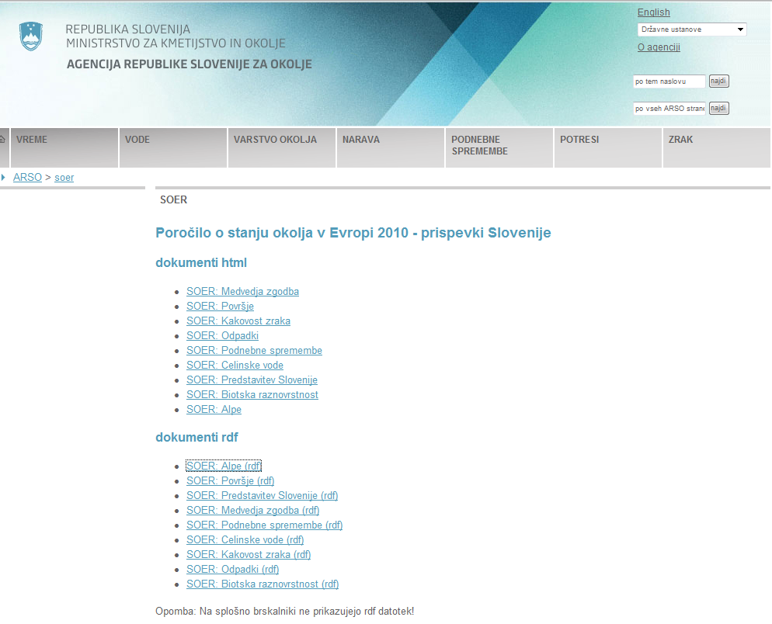
Use of KOS indicators
in SOER 2010 (country assessment)
SENSE -1:
Working with EEA on
web-based approaches for sharing texts and graphics
(RDF feeds)

Slide 21
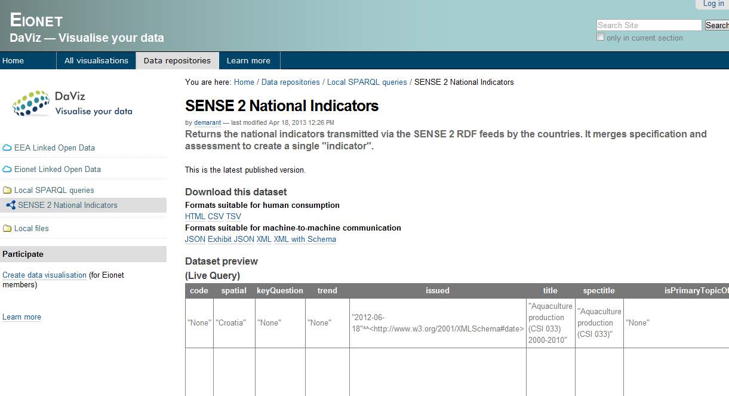
Use of KOS indicators
in state of the environment reporting
SENSE 2:
Sharing environmental indicators in Eionet with Linked Data principles
- indicator mapping (7 of 9)
- RDF feeds (manually)

Slide 22
Use of KOS indicators
in other reports
Environmental Performance Review – Slovenia (OECD)
Development Report (Institute for Macroeconomics and Development)
Measuring of Well-being in Slovenia (government’s project)
National Energy Programme
Rural Development Programme
National Strategy on Health and Environment (“Parma Strategy”)
Mirror to the Government (NGO’s)
Resource efficiency – Country profile (EIONET - EEA)
Strategic Environmental Assessment
  National Energy Programme
  Rural Development Programme
etc.

Slide 23
Forward
Updates of indicators
Update of sets
  Environment and health
  Green economy / resource efficiency
Integration of forward looking information
Development of KOS application
Connection with KPV (Catalogue of data sources) and
Atlas of the environment (GIS viewer)
Printed version
Communication and usability testing

Slide 24

Indicators are very useful tool for communicating with the general and expert publics and for supporting decision making.
Comments welcome!
urska.kusar@gov.si

