Slide 1
Work for ETC ICM
Prepared by Dr. Monika Peterlin
Institute for water of the Republic of Slovenia
EIONET NRC MEETING, Ljubljana,
2.-3.October, 2013

Slide 2
Content
Organisation of ETC ICM
Content of work

Slide 3
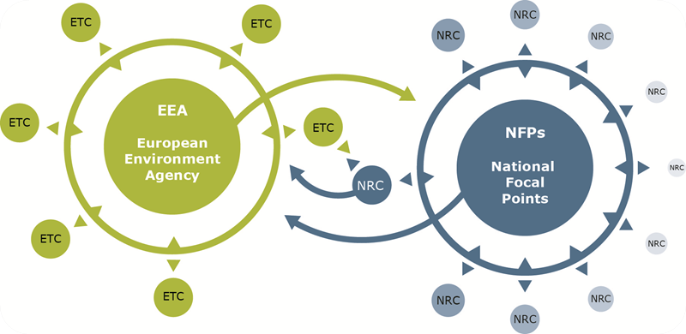
EEA regular dataflow: Eionet and the WISE SoE dataflow
The core objective of the EEA is to produce European, pan-European and regional thematic and integrated assessments.
Eionet
Timely, nationally validated, high-quality data & expertise

Slide 4
- 1 consortium
- 21 partners
- from 14 countries
DE, CZ, NL, DK, EL, ES, IT, UK, NO, FR, FI, SI, AT, HU
- Lead Partner: CENIA
- Fresh water team lead: NIVA
- Marine team lead: IWRS (M. Peterlin)
- ETC-ICM 2014-2018 – new contract
Partners 2011-2013
BGR
CENIA
Deltares
DHI
Ecologic
HCMR
ICES
IFREMER
Indra
INGV
IMARES
IWRS
JNCC
NERC-CEH
NIVA
NTUA
SAHFOS
SYKE
SZIU
TC Vode
UBA
ETC ICM 2011-2013

Slide 5
Work planning and work division
3 teams:
Marine team
Fresh water team
Data team
Yearly work planning: Implementation Plan (2013)
IWRS tasks related to marine:
Marine and maritime data
Marine and Maritime Indicators and Assessments
IWRS tasks related to fresh water:
Inland water data centre – WISE and data flows
WISE infrastructure and systems – SEIS implementation
Inland water indicators and assessments

Slide 6
IWRS Tasks 2013 (MT)
1.5.1. Marine and maritime data
1.5.1.a Support to MSFD implementation and development of WISE Marine
- MSFD data visualisation in WISE Marine
1.5.1.d WISE SoE data flows
- Update of WISE SoE and priority data flows on TCM needed for CSIs
- Support for indicators and data reports
- 2013 reference databases
1.5.1.e Implementation of a marine litter watch (IWRS lead)
- Coordination
- Pilot case studies for the EoE Watch on marine litter
- Support the TSG Marine Litter 2013 beach litter activities
1.5.1.f Bathing water reporting and visualisation – coastal part

Slide 7
IWRS Tasks 2013 (MT)
1.5.2. Marine assessments and indicators
1.5.2.b 2014 Marine Baseline Assessment (IWRS & JNCC lead)
- Coordination
- Data extraction from MSFD database
- Static maps based on MSFD database
- Filled MSFD output content reports
- Proposal for MSFD regional and European level assessment
- EEA/ETC Workshop on first analysis for milestone 1-3, May 2013
- Marine team meeting
1.5.2.d Assessment of marine protected areas
- Spatial statistics on marine protected areas
- Spatial statistics on national designated marine sites
6.0.10.b Networking with Eionet
- NFP/Eionet meetings

Slide 8
IWRS Tasks 2013 (FW)
1.4.1 Freshwater data centre – WISE
1.4.1.a WISE SOE data flows and visualisation (maintenance and development of new datasets)
- Update of WISE interactive maps
1.4.1.b WISE Water Directives data flows (maintenance and development of new datasets, streamlining European level water reporting)
- ROD
- Update of EEA water web pages
1.4.1.c Bathing water reporting and visualisation – freshwater part
1.4.3. Freshwater indicators and assessments

Slide 9
IWRS staff 2013
Fresh waters – 1
Marine waters – 4
Time used for the ETC work depends on the task, varies 10-80% per person in 2013;
Requirements vary from year to year

Slide 10
Products
Reports:
Bathing waters report (yearly)
Environmental state and outlook report 2010
Water report (2012)
MSFD Data report (2013)
Marine Baseline Assessment (2014)
Other:
Wise maps
Indicators (yearly)

Slide 11
Experience from ETC work
Requires discipline and long term planning;
Many deadlines, needs good work organization;
Many opportunities to learn and gather new experience;
Exchange of knowledge with experts on EU level;
Intensive learning process for junior staff, language skills improvement;
Opportunity to participate in shaping policy and work on products with high international visibility;
Networking
Contribution to work on national level:
Improvement of competence;
Exchange of experience and knowledge with many experts from different fields and different countries;
Discuss ideas and approaches with colleges from other countries on regular basis;
Improved technical knowledge…..

Slide 12
Thank you for your attention

