Slide 1
The European environment – state and outlook 2020
SOER 2020
Anita Pirc Velkavrh
Head of Foresight and Sustainability group
Integrated assessment programme
EEA
5.7.2017, Ljubljana
Notes:
You have received the SOER 2020 Project plan as a background information.
I will present the logic of the SOER structure and some aspects of the project plan, especially those planned for 2017.

Slide 2
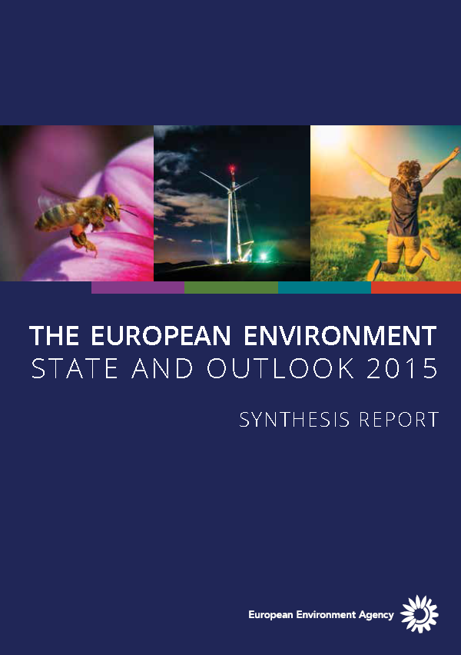
Environmental acquis, 7th EAP
Europe 2020 strategy
Env. acquis, 7th EAP, SDGs
Circular, low-carbon economy transition
2016
2017
2018
SOER 2020
From mainly problem-focused knowledge
To more solutions-oriented knowledge
Notes:
V preteklih SOER porocilih smo izdatno ana;lizirali okoljske problem in jih ocenili v zvezi z Evropskimi programi. Zelo smo vplivali na zadnji 7EAP.
V prihodnjem porocilu bomo analizo problemov in okoljskih politik nadgradili z analizo moznosti in potreb za tranzicjo k dolgorocnim ciljem v Evropi. Porocilo 2015 je zakjucilo da je Visija 7EAP do 2050 neuresnicljiva ce ne spremenimo korenito delovanje osnovnih sistemov v drzavi, hrana, energija, promet, urbani. Posvetili se bomo isaknju moznih resitev, ki jih lahko predlagamo politikam za dosego dolgorocnih ciljev EAP in SDG.

Slide 3
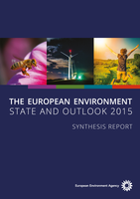
SOER 2020 assessment logic
Fisheries & acquaculture
Forestry
Agriculture
PEOPLE
Energy
Human health &
well-being
Transport
7EAP
Industry
Biodiversity & nature
Chemicals & health
Freshwater
Marine
Land & soil
Climate change
Air pollution
Waste & resources
ENVIRONMENT
ECONOMY
Sectors
Natural
capital
Resource efficiency
Themes*
Context
Policy context
SOER2015
Integrated assesments from a thematic perspective
Environmental acquis
Integrated assessments from a cross-cutting perspective
Sectors, 7th EAP objectives, summary assessment
2030 perspective
aquis
Notes:
Na osnovi izsledkov porocila 2015 in zahtev 7EAP bomo pristopili k analizi klasicnih tematskih podrocij-8: biodiverziteta, voda, morja, tla, klimatske spremembe, odaptki in ucnikovita raba virov, kemikalije, hrup in zdravje. To bomo nadgradili z anlizo sektorjev kako se okoljski vidiki upostevajo in pojavljajo v sektorskih politikah (energetika,kmetijstvo, promet, gozdarstvo, ribistvo itd).
V sintezi bomo ocenili vlogo in dosezge na podrocju okolja (zavarovani naravni capital), ekonomije (ucinkovita raba virov) in bv zvezi z ljudmi-zdravje in well being. Analize bodo opremljne z kazalci in izgledi do 2030, podalga bo okoljski aquis.

Slide 4
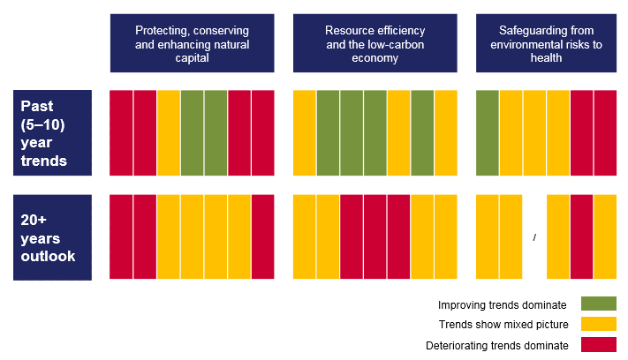
The long-term outlook is not as positive as recent trends suggest
Living well within the planet’s ecological limits in 2050 requires foundamental transitions in systems of production and consumptions (e.g. energy, mobility, food)
(SOER 2015)
EU policy agendas for long term transitions
Low – carbon economy
Worsening long term trends
Bio-economy, Blue economy
Circular economy
Notes:
Pricakujemo da bodo tematske anlize pokazale podobno sliko kot 2015, nezasciten naravni capital, narascajoci problem v zvezi z zdravjem in wellbeing, in nekaterimi naravnimi viri (morja, tla..) Leta 2015 smo tudi ugotovili da dogorocni trendi niso tako pozitivni ceprav so v kratkem roku pozitivni ali neutralni. (glej spodnjo vrstico na piano table,kjer se rumena prelevi v rdeco). Vzrok so globalni trendi in kompleksnost problemov.
Piano table: kolone so
Trendi za zascito naravnegag kapitala
2.ucinkovita raba naravnih virov
3.zdravje in wellbeing
Vrstice so
1. kratkorocni trendi
2. dogorocni trendi.
Vizija 7 EAP ni uresnicljica v sedanjih okvirih in trendih.
Na osnovi the kazalcev so politike ze pristopile k prestrukturiranju: dobili smo Low-carbon economy politico, politico za krozno gospodarstvo in v rpedlogih in ocenah so bio ekonomija in modra ekonomija.
Zatomoramo v drugem delu anliz pristopiti in razviti se druge analize, ki niso bile prej tako prisotne v nashi porocilih.
---------------

Slide 5
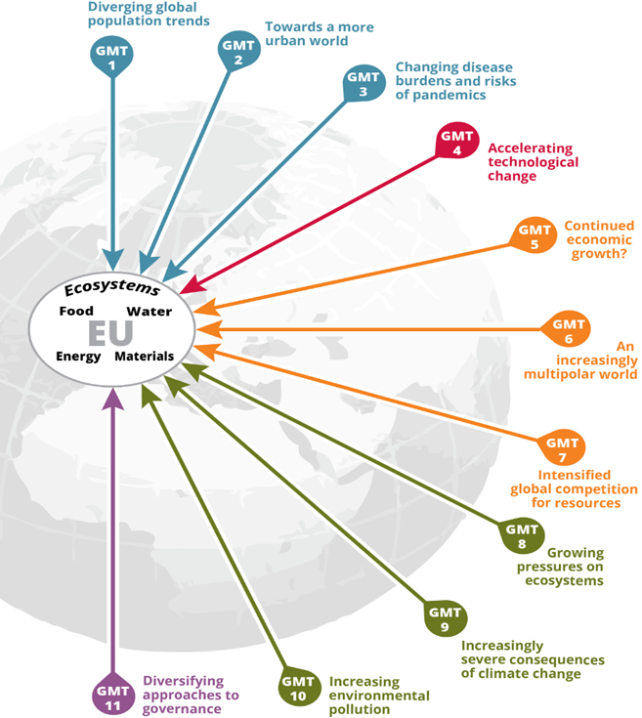
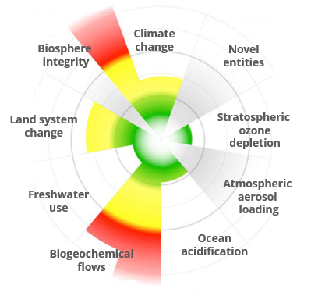
(Produkcijsko potrošniški sistemi )
Global
&
European
ecosystems
Food system
Energy system
Food
Transport
Mobility system
Fiscal
Human well-being
Housing system
Finance
Housing
Energy
Context: Europe’s sustainability goals and long-term challenges
Global megatrends
Planetary boundaries
Integrated assessment of priority production-consumption systems
Resource flows and impacts
Actors and economic dimensions
Systemic characteristics
Integrated assessment for transitions towards sustainability
Interactions of systems and GMTs
Resource nexus
Governance
Knowledge for transitions
Context: Europe’s sustainability goals and long-term challenges
Global megatrends
Planetary boundaries
2050 perspective
7EAP, LCE, CE, SDGs
Notes:
Analizirali bomo osnovne druzbene sisteme (energetski, prometni, zivilski, urbani) in njihovo vplivena naravne vire v medsebojni povezavi. To bo pokazalo na neizbezne compromise,ki jih bomo morali preuciti in ponuditi politiki. Analizirali jih bomo tudi v odnosu do finanacnih in fiskalnih sitemov. (sredina slike)
Te analize bomo morali postaviti v tesne povezave z globalnimi trendi in ekoloskimi omejitvami planeta,saj je Evropski vpliv v drugih delih sveta precejsni ( outsoursing of industry, uvoz materialov etc.) (leva stran slike).
Koncno bomo morali napraviti ocene kaj topomeni za uresnicitev nizko ogljicne politike, kroznega gospodarstva, SDG in 7 EAP. Kaksne tranzicije so potrebne,v akterih sistemih, kje so najvecji problem. Podali bomo tudi primere drzav o dobrih praksah izvedbe tranzicij.
Kajti te koncne ocene vplivajo na well being celotne druzbe. (desna stran)

Slide 6
SOER 2020 planning: overall timeline and milestones
2016
2017
2018
2019
2020
ROADMAP & INFORMATION MAPPING
METHODOLOGIES, LEARNING & PARTNERSHIPS
ASSESSMENTS IN PARTNERSHIP
1ST PUBLICATION &
STAKEHOLDERS
2ND PUBLICATION &
DISSEMINATION
Definition, organisation and preparation
Produce Parts 1 and 2
Produce Synthesis
Outreach
December: agree SOER 2020 Project plan
Map knowledge development for 2017–2019
Scope analytical methods and EEA-Eionet learning needs
Develop prototypes for Parts 1 and 2
Identify knowledge needs, develop building blocks
Formalise partnerships and networking
Implement staff learning and capacity-building with Eionet
Develop Communication Plan
Approve Implementation Plan
Continued work on building blocks, partnerships, networking
Draft Parts 1 and 2 and internal review
Annotated outline for the Synthesis
Parts 1 and 2 for external stakeholder consultation
Mid-year: publish Parts 1 and 2 in English
Events and outreach
Engage MS, EU, global stakeholders in discussing Parts 1 and 2
Draft the Synthesis
Short EEA stakeholder consultation on draft Synthesis
Translation of the Synthesis
Mid-year: publish Synthesis in all languages
2020–2021: Events and outreach
EU Presidency
Romania-Finland
EU Presidency
Croatia-Germany
Notes:
Planiramo objaviti te analize v letu 2019. potem bomo vkljucili deleznike z njihovimi perspektivami na ocenjene probleme in v letu 2020 objavili sintezo ki vkljucuje vse perspektive delznikov.

Slide 7
Thank you

Slide 8
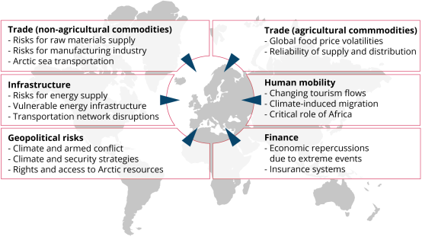
European vulnerability to climate change impacts that occur outside Europe
Notes:
Lead author(s): Tobias Lung (EEA) Contributing author(s): Lisa Eichler (Triple-E), Hans-Martin Füssel (EEA) Key messages
• Several recent studies have suggested that climate change will have much stronger negative impacts on the global economy than previously assumed, with poor countries being disproportionally affected.
• In a highly interconnected and globalised world, Europe is susceptible to spill-over effects from climate change impacts occurring outside the European territory through various pathways. Past extreme events, such as the Russian heat wave in 2010, have had negative economic consequences for Europe (here understood as the EEA member and cooperating countries).
• Six major pathways have been identified from the available literature: trade of agricultural commodities, trade of non-agricultural commodities, infrastructure and transport, geopolitics and security risks, human migration, and finance. Many of these pathways affect the value chains of European products, which are increasingly complex.
• The strongest evidence for Europe’s sensitivity to cross-border impacts exists for economic effects through climate-caused global price volatilities; for transportation networks such as ports; and for changes in the Arctic environment, such as new shipping routes. The Mediterranean area has been identified as the most vulnerable to shocks in the flow of agricultural commodities, while small, open and highly developed European economies are regarded as particularly vulnerable to shocks in the flow of non-agricultural commodities.
• An increasing body of recent literature suggests that unprecedented climatic changes in North African regions, such as the Sahel and Maghreb, as well as in the Middle East will increase the strategic importance of these regions for Europe, with respect both to potential climate-induced human migration flows and to geopolitical and security considerations.
• European vulnerability to cross-border effects is expected to increase in the coming decades, although quantitative projections are not yet available.

