Slide 1
Global megatrends as drivers of future change
Anita Pirc Velkavrh, Head of Foresight and sustainability
10 April 2018, Workshop on global megatrends impacts on Slovenia

Slide 2
Presentation overview
The need for systemic approach in integrated environment assessment
EEA SOER 2020 response
GMTs impacts at national level
To secure long term policy outcomes
Drivers of future change analysis
Systemic perspectives
Case studies - input to SOER 2020 and national SoE reports
NRC FLIS (Forward-looking information and services)
To support sustainable development

Slide 3
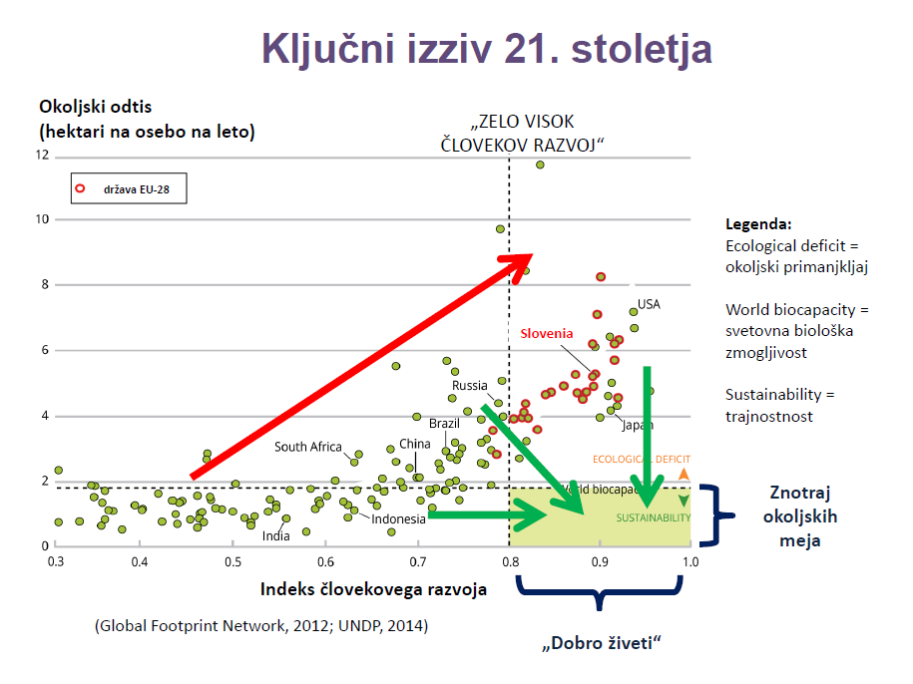
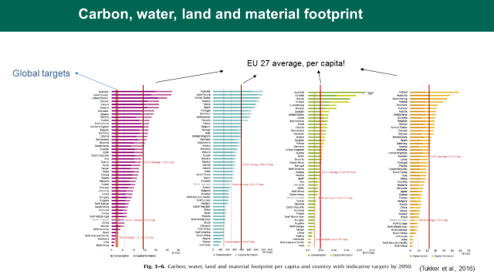

Slide 4
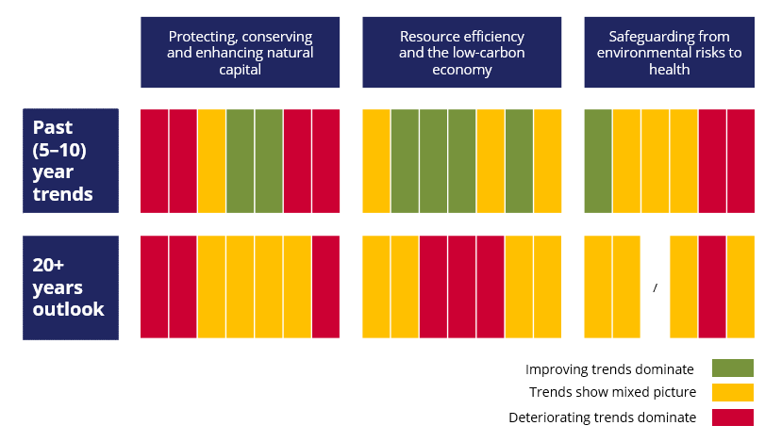
  SOER 2015: The long-term outlook is not as positive
  as recent trends suggest, because of:
    Interdependences with global developments
    2. Systemic characteristics of environmental challenges
  Living well within the planet’s ecological limits in 2050
  will require fundamental transitions in systems of production and consumption (e.g. socio-technical systems: energy, mobility, food) that are the root cause
  of environmental and climate pressures.
Notes:
Other conclusions from summary of trends in 2015 (we call it many times piano table) indicated that long term is not so positive as the recent trends may imply,
this is because of
Changing global context ( major factors being competition for resources, pressures from outside the Europe-GMTs and planetary boundaries conditions)
2. And the systemic characteristics of environmental challenges , which are characterised by Complexity and uncertainties, Interdependencies within and across systems, Lock-ins, feedbacks, trade-offs.
In conclusions, the long term objective of EU 2050 vision (Living well within the ecological limits in 2050 ) is not achievable unless we transform fundamental societal systems: energy, transport, food and material use systems, were identified as key as they are the root cause of environmental and climate pressures.
For some of those aspects initial analyses were presented in 2015 and need to be followed in 2020.
Those and related conclusions was a bases starting point for structuring the SOER 2020.

Slide 5
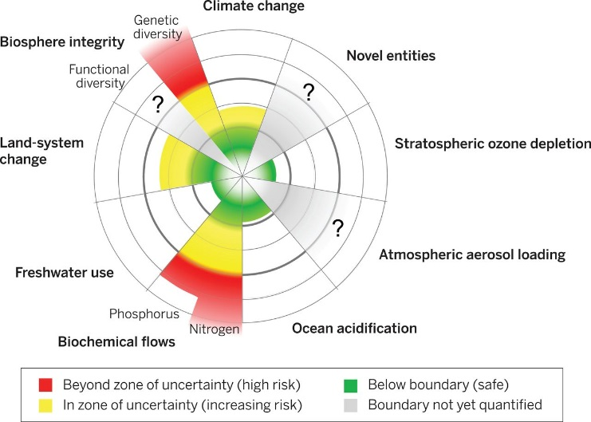

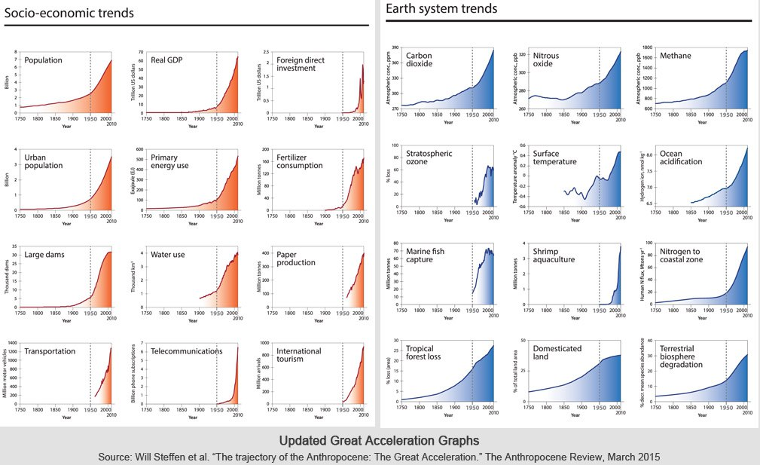
  The Anthropocene: Global megatrends and planetary boundaries necessitate urgent action
Limits of the planet
Globalisation
Drivers of change
EUROPEAN LEVEL
Great acceleration

Slide 6

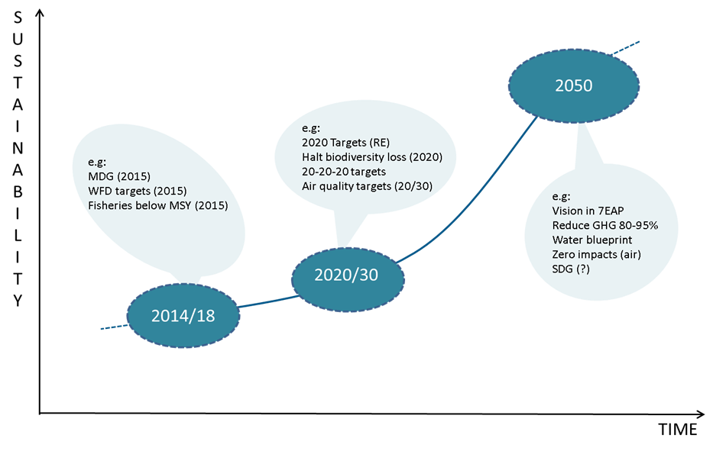
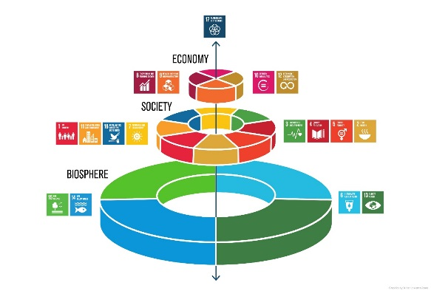
Long term objectives are increasingly embedded in EU policies
Low–carbon economy
Waste targets2030 (CE)
Bio-economy Blue economy
Circular economy
Source: EEA Multi-Annual Work Programme 2014 to 2018
Notes:
6
Forward looking is about uncertainties
Controversial policy dossiers
Disagreement about how the future “should” develop (normative)
Contesting problem frames
Doubts about quality of data and analysis
How to add value and clarity to the user?

Slide 7
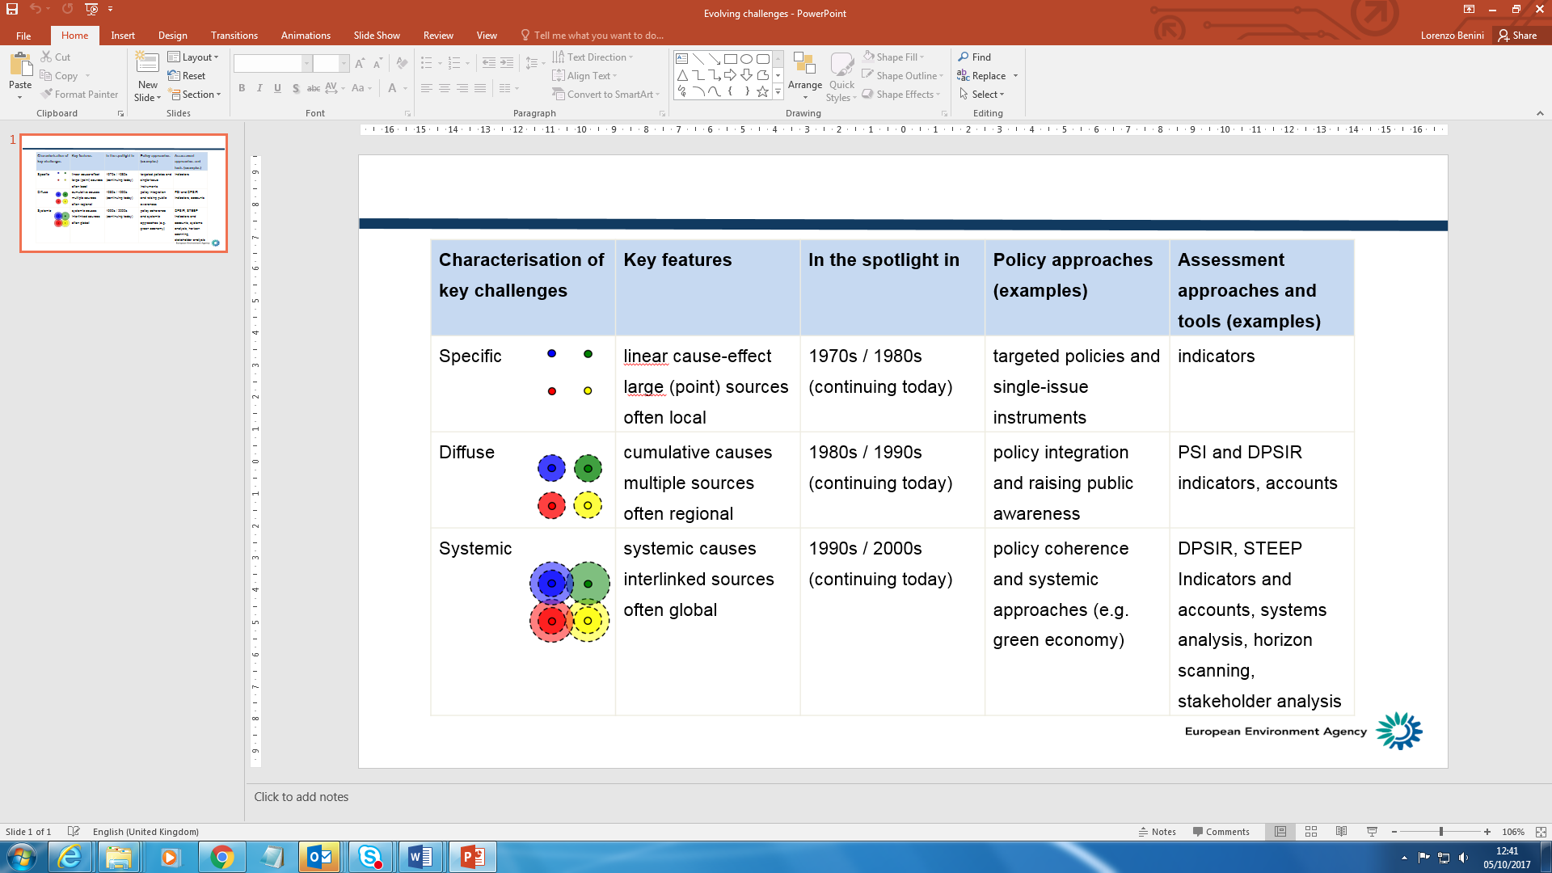
Changing nature of environmental and social challenges

Slide 8
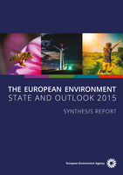
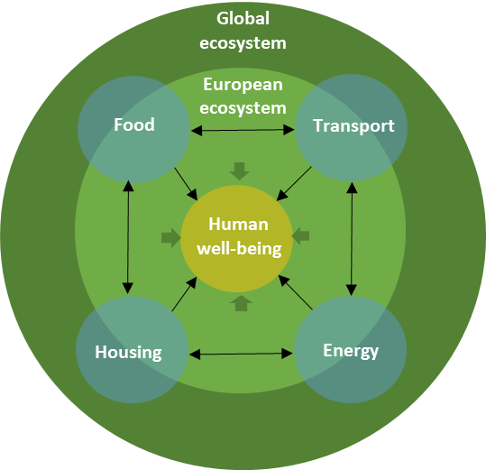


SOER 2020 Integrated assessment logic
PART 1
Setting the scene
PART 2
Environmental and climate trends
PART 3
Sustainability prospects
PART 4
Conclusions
Sectors
Fisheries & aquaculture
Part 1
Part 2
Part 3
Fisheries & aquaculture
Forestry
Forestry
Agriculture
Agriculture
Energy
7EAP
Energy
Transport
Transport
Key messages
Industry
Biodiversity & nature
Industry
Freshwater
Land and Soil
Marine
Climate change
Air pollution
Noise
Waste and resources
Chemicals pollution
Biodiversity & nature
Industrial pollution
Low–carbon economy
Themes
Bio-economy Blue economy
Circular economy
Policy context
Global and European context
SOER2015 conclusions
integrated assesments from a thematic (chapters 3 – 12)
and sectoral perspective (chapters 13 & 14)
summary assessment of progress to 7EAP objectives (chapter 15)
Environmental acquis
systems perspective
Global interactions
sustainability challenges and
prospects for Europe‘s long-term
responses
Sustainability transitions
integrated assesments from a thematic
and sectoral perspective
summary assessment of progress to 7EAP objectives,
Environmental acquis
From 7th EAP
to 8th EAP
MFF 2021-2028
Research and development
needs

Slide 9
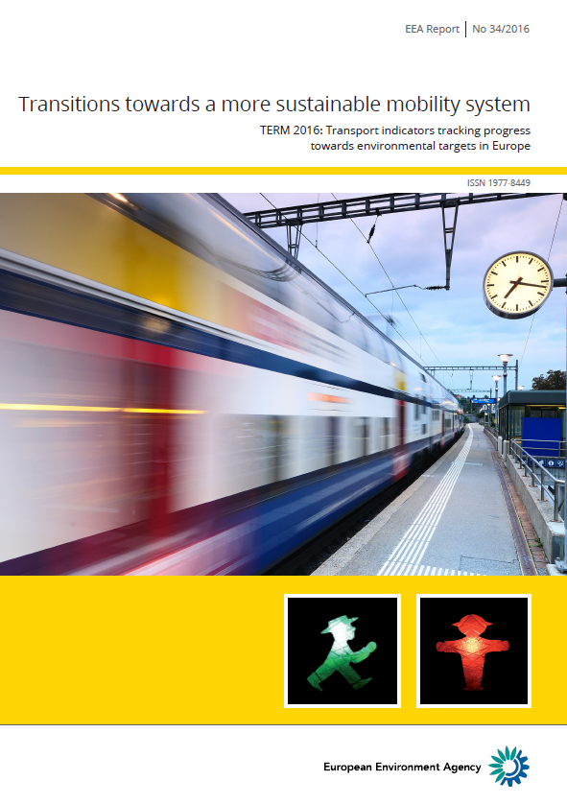
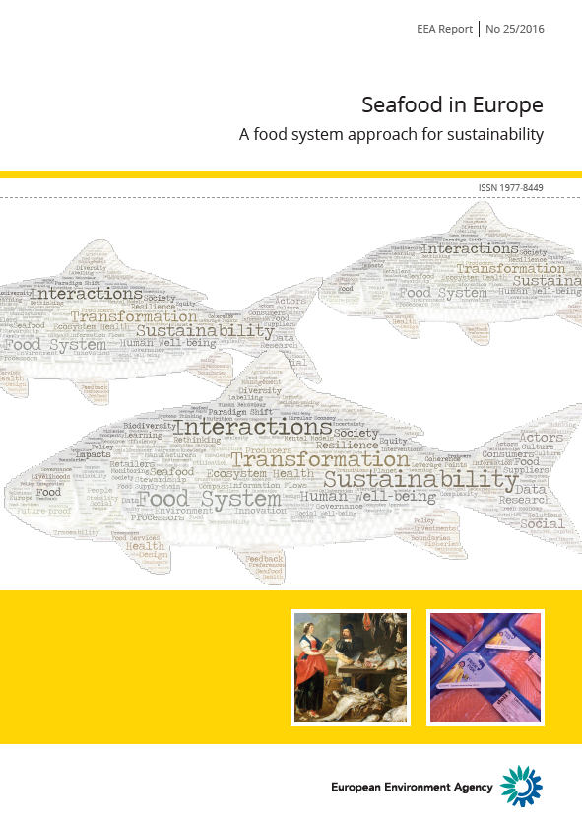
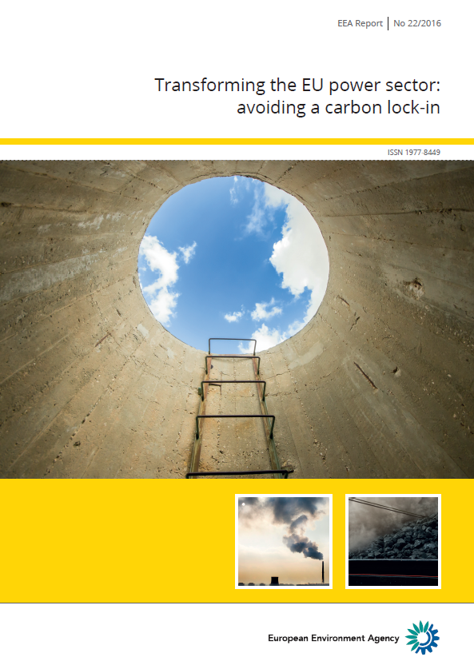

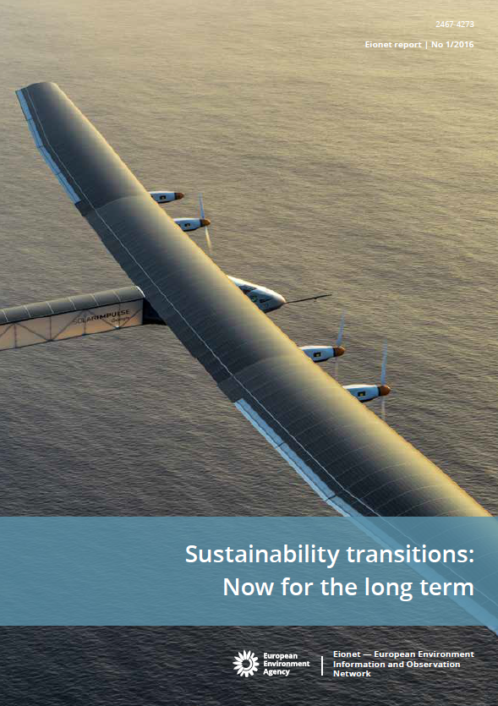

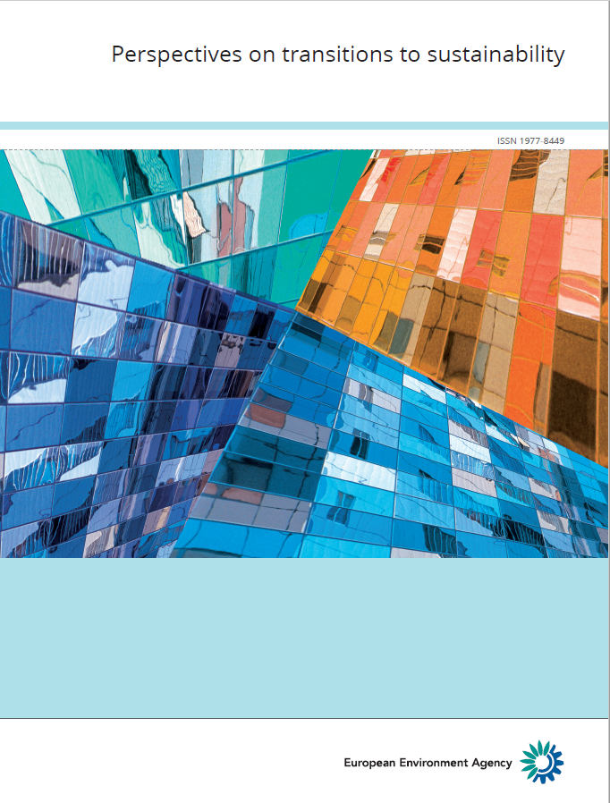
New knowledge needs: Sustainability transitions
  EEA reports (2016- )
  Exploring implications of transitions theory
  in different thematic contexts, links to established indicators and policies, and how to communicate
  Improve understanding through
  case studies approach (Eionet report)
transport
energy
sea food
food
  Circular economy/bio-economy
  Research perspectives – relevance for EEA
2018
  Implications for
  governance,
  examples of practices
2019
…and more

Slide 10
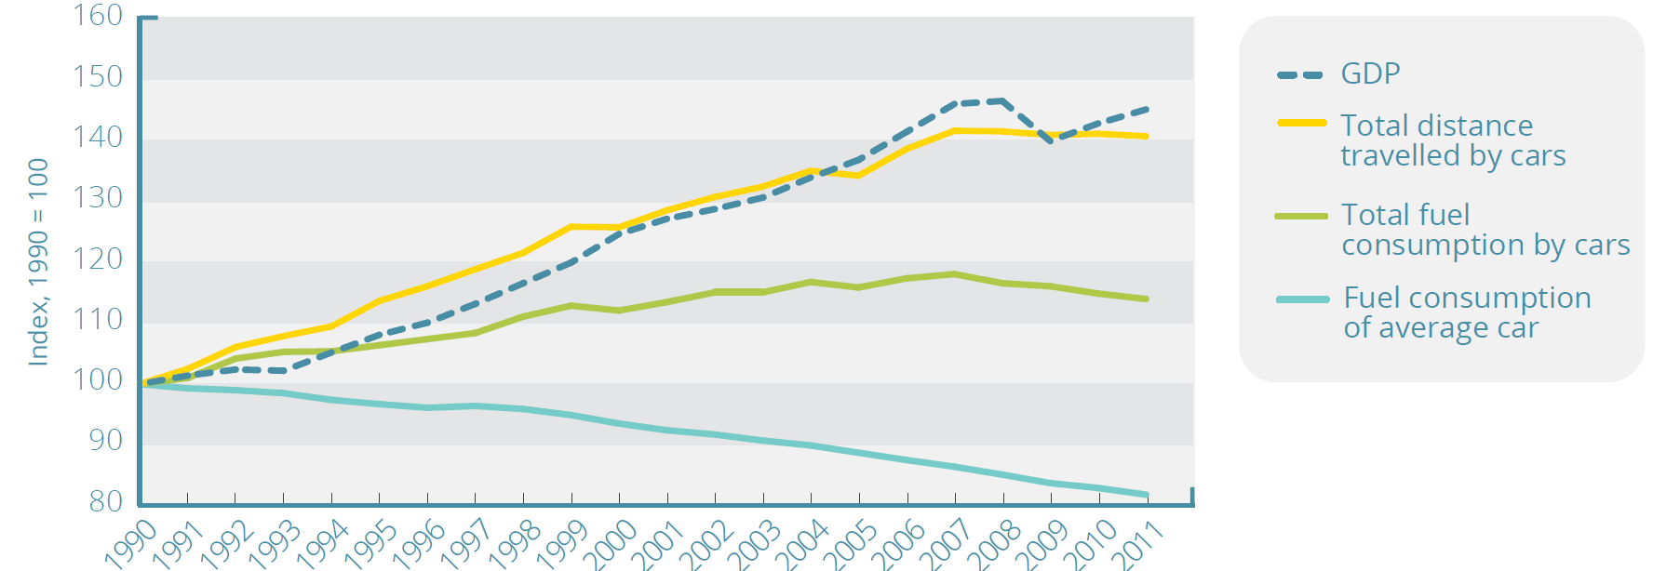
Understanding systemic challenges – rebound effects
Achieving needed change is very hard because of a variety of challenges such as lock-ins, rebound effects, trade-offs, burden shifting, market failure, uncertainty, etc.
Rebound effect

Slide 11
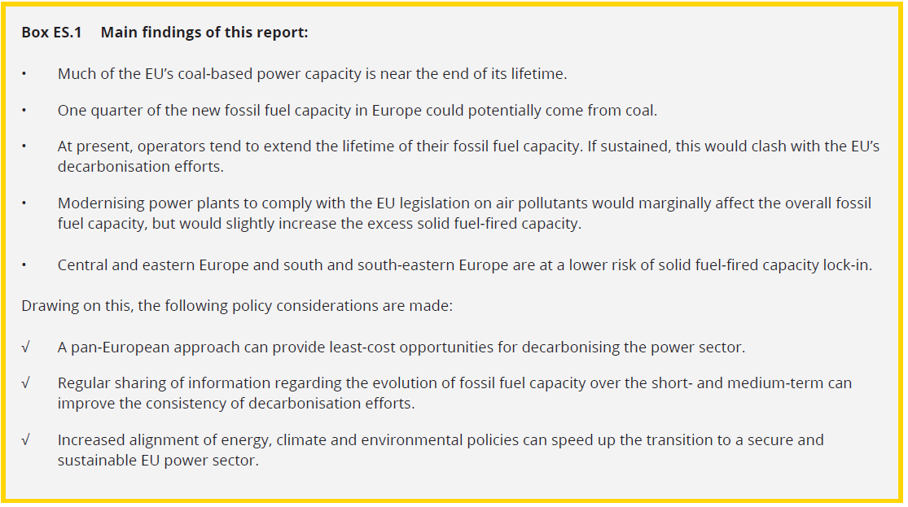
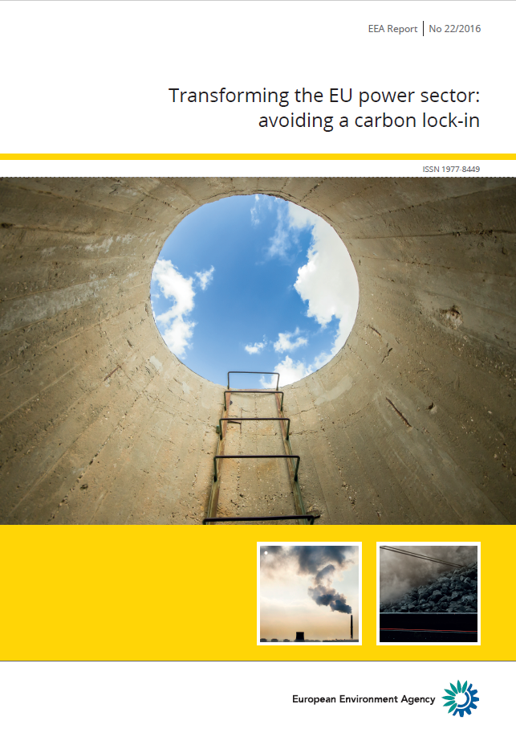
Understanding systemic challenges – lock-ins
Excessive fuel capacity by 2030 compared to optimal capacity defined by Energy Roadmap 2050 - higher costs of decarbonisation
Transforming the EU power sector: avoiding a carbon lock-in (EEA, 2016)

Slide 12
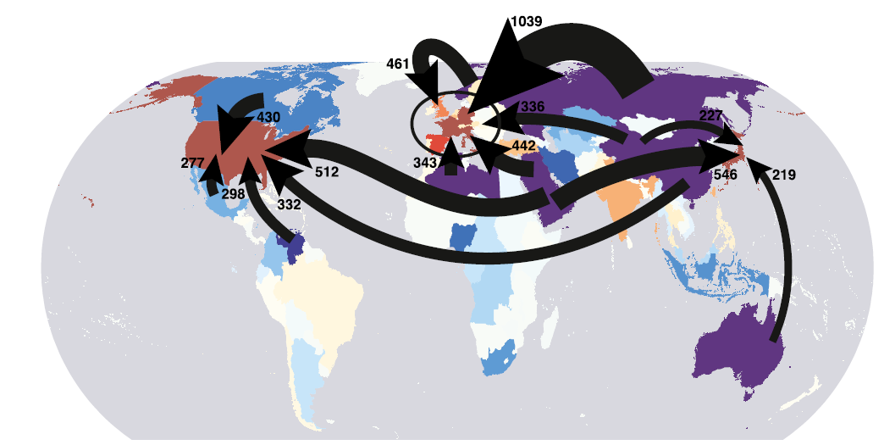
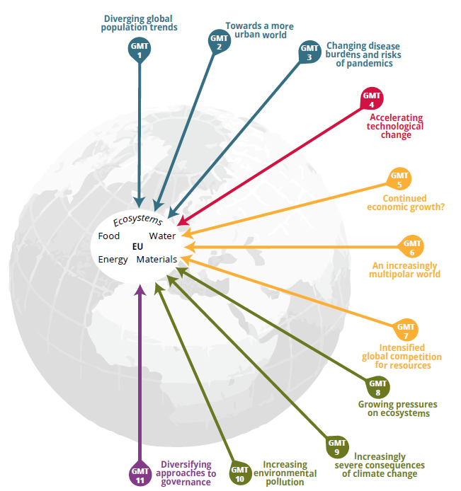
Understanding systemic challenges – global interlinkages
Global dimension and trade
e.g. Emissions embodied in trade
Davis et al., 2011 – CO₂ net import/export

Slide 13
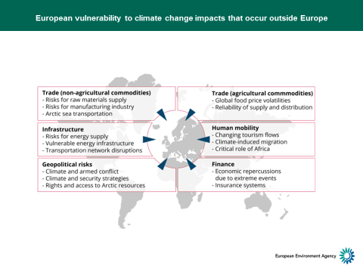
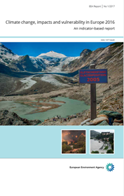

Slide 14
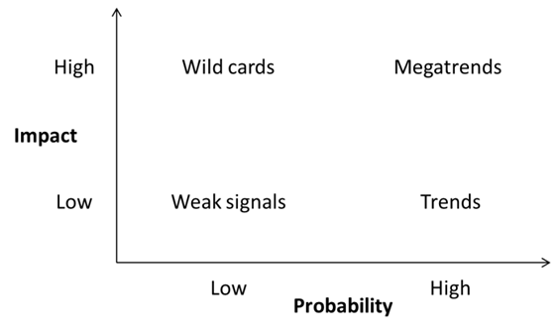
Drivers of future change
EIONET
NRC FLIS
- GMT COUNTRIES CASE STUDIES
- HORIZON SCANNING
.
Notes:
Trends and global megatrends are to be understood in a larger context, as they are not the only drivers of change potentially influencing future developments.
can help to anticipate the future by looking at the direction of current developments, whereas weak signals and wild cards can be used to sense the possible but improbable events (Saritas and Smit 2011, Dufa et al. 2012).
Weak signals are early signs of currently small change. They may indicate a strategic discontinuity. but which could be the trigger for major events in the future.
Wild Cards are high-impact events that seem too incredible, or are considered too unlikely, to happen, yet many of them do

Slide 15
Country case studies on global megatrends and their impacts
Impacts at 2040-2050, three of them at 2020-2030
Work in progress (2018)

Slide 16
Expected impacts of GMTs as identified in countries cases studies

Slide 17
Lessons learned
All of the case studies applied some kind of a participatory process in identifying GMTs and assessing their impacts.
Getting experts around one table can be very beneficial even for a half-a-day workshop
Limited participation may bring bias into the analysis
New working methods can reveal new approaches, aspects, opinions and ideas and attract new experts to engage
Widening the perspective in environmental thinking helps. Some experts still tend to think mostly within country borders.

Slide 18
Thank you
THANK YOU

Slide 19




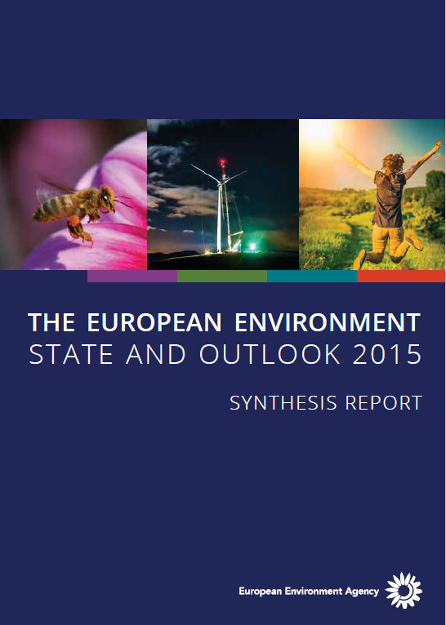
SOER support to EU environmental policies
1995
5th EAP (1993-2002) Towards sustainability
1999
Support to final evaluation of 5th EAP, framing 6th EAP
2005
Support to mid-term evaluation of 6th EAP
2010
Support to final evaluation of 6th EAP (2002-2012), framing of 7th EAP
2015
7th EAP (2013-2020) Living well within the limits of our planet
2020
Support to evaluation of 7th EAP and framing of a possible 8th EAP
8 EAP
SOER
Notes:
Note: this could be included as slide 8 but for the SC audience it might be better not to include it. The key messages for the SC session (particularly bullets 2 and 3) are addressed in the subsequent four slides, so using this slide as well might appear a bit repetitive.
Moreover, bullets 1 and 4 are oriented more towards policy audiences. I think it’s better to focus in on persist, globalised problems and the need for transitions.

Slide 20
Responses to GMT impacts on national level – work in progress
Responses to GMT impacts relate to following areas:
Changes in behavior and consumption patterns
Work, income and equality
Economy at cross road
Spatial structure and mobility
Structural changes in energy system
Resource scarcity
Water management
Notes:
In the field of work and income, the responses in the Finnish case study highlighted two issues:
Taking the division of wealth and earnings into the core of political considerations. This covers also renewal of social security system taking into account the new ways of working
Lifelong learning assisted with new technologies.
In order to support economy at a crossroads, the proposed responses in several case studies covered the following issues:
Assessing the economy, well-being and the planet’s carrying capacity by using intelligent indicators which will help us to achieve the desired objectives
Circular economy initiatives
Setting ambitious targets for both global and national politics and creating regulation and incentives to reach these targets (in economy, environment, and technology). Global cooperation & decision-making and strong local democracy. Decision-makers and information providers should solve our common problems.
Promoting technological development and related new business models to promote scale-up of innovations.
In the fields of spatial structure and mobility, the following responses was proposed:
Cooperation between all public authorities and with other societal actors to jointly orient spatial planning into the directions of multifunctional use of the space, using the underground space and building high rise clusters
Innovative thinking, an integrated vision and a coherent framework for the spatial planning system. Coordination and collaboration with other domains: the environment, mobility, public works, housing, energy and recreation in the areas of (policy) visions and plans, taxation, regulation and subsidy policy
Redefining the societal function of the mobility system. This covers integrated vision and policy for efficient land use, improving and greening the mobility offer, and selectively reducing mobility demand at all levels.
To support structural changes in energy system to make it more sustainable, resilient, integrated long-term vision, and international collaboration should be initiated. This should include topics such as reducing total energy use, better balancing of supply and demand, focusing on renewable energy, and investing in (technologies for) energy storage.
As regards resource scarcity, the Northern Europe case study presents eight measures or measure groups to mitigate the responses. Those are:
Ecological agriculture
End-of pipe technologies
Energy efficiency
Life cycle extension
Recycling of resources
Renewable energy
Technological innovation
Resource efficiency.
In the case of achieving the Swedish environmental goals, the study proposes that the near term areas of mitigations should focus on renewable energy and recycling-reuse (material cycles). In medium terms consumption and health related issues are important (as well as natural resource stewardess ). The long-term mitigation should focus on Ecosystem health and biodiversity.
In the context of water management in Western Balkans, several responses were identified:
Improving transboundary/institutional cooperation in relation to water management and associated trade-offs (e.g. water for energy, drinking, agriculture).
Seeking the opportunities to access funding (national/EU/private) to improve water management. Also increasing competences to apply funding.
Improving policy enforcement and policy coherence. Both horizontal (across sectors) and vertical (within sectors) policy harmonisation. Addressing corruption actively.
Sharing best practices as well as applying the principles of twinning (e.g. twinning projects) with neighbouring countries within and outside the region.
Applying for international funding to address wastewater treatment.
Increasing fines for violations of existing regulations. Currently it can be cheaper to pay fines than respect legislation in water pollution/management.
In addition, changes in behaviour and consumption patterns were seen as important responses in several cases.
Especially the Hungarian, case study presents detailed lists of the responses relating to many of the GMTs. In the Finnish case study, potential responses are described briefly under each of the GMTs. Also Belgian (Flanders) study presents further information on potential responses. For more information, see the case study templates in Annex II.

Slide 21
Responses to GMT impacts on national level – work in progress (cont.)
Economy at a crossroads, the proposed responses in several case studies covered the following issues:
  Assessing the economy, well-being and the planet’s carrying capacity by using intelligent indicators which will help us to achieve the desired objectives
  Circular economy initiatives
  Setting ambitious targets for both global and national politics
  Global cooperation & decision-making and strong local democracy.
  Promoting technological development and related new business models to promote scale-up of innovations.

Slide 22
Fact sheets – comments (10min)
Extreme weather events and infrastructure damage
Food security
2. Implications for Slovenia: risks and opportunities
Individual work 2 x 10min
Team work 2 x 20min
Consolidate 3 prioritised risks and 3 opportunities (10 min)

Slide 23
Food for thoughts
According to a Joint Research Centre (JRC) study, climate‑related damage to large investments and critical infrastructures could triple by the 2020s, could increase six‑fold by the middle of the century and could increase by more than ten‑fold by the end of the century, compared with the 1981–2010 baseline (Forzieri et al.,2015). The greatest increase in damage is projected forthe energy and transport sectors, and for EU regional investments in environment and tourism. Southern and south‑eastern European countries will be most affected

Slide 24
The fact that terrestrial ecosystems are affected by climate change is also recognised in the EU's CAP.
One of the priorities under the support for rural development is promoting resource efficiency and
supporting the shift towards a low-carbon and climate-resilient economy in agriculture, food and
forestry sectors (with a focus on increasing efficiency in water use). Member States have to specify agri-environment-climate measures and forest-environment and climate commitments that go beyond the basic standards. These measures often include provisions for soil
(EU, 2013).
What could cc impacts mean in relation to prices and import dependence?
Impact to health?
In which part of the food chain impacts could be biggest for Slovenia (effects during storage, transpsort nd handling;

