Slide 1
Influence of global megatrends on the state of environment in Slovenia: assessment of risks and opportunities, response needs & gaps
Delivered as part of contract no. 43016-18/2017-12 on the analysis of the impact of megatrends on the state of the environment in Slovenia
11th April
Ljubljana, Slovenia
Rolands Sadauskis,
Špela Kolarič, Owen White (all CEP)

Slide 2
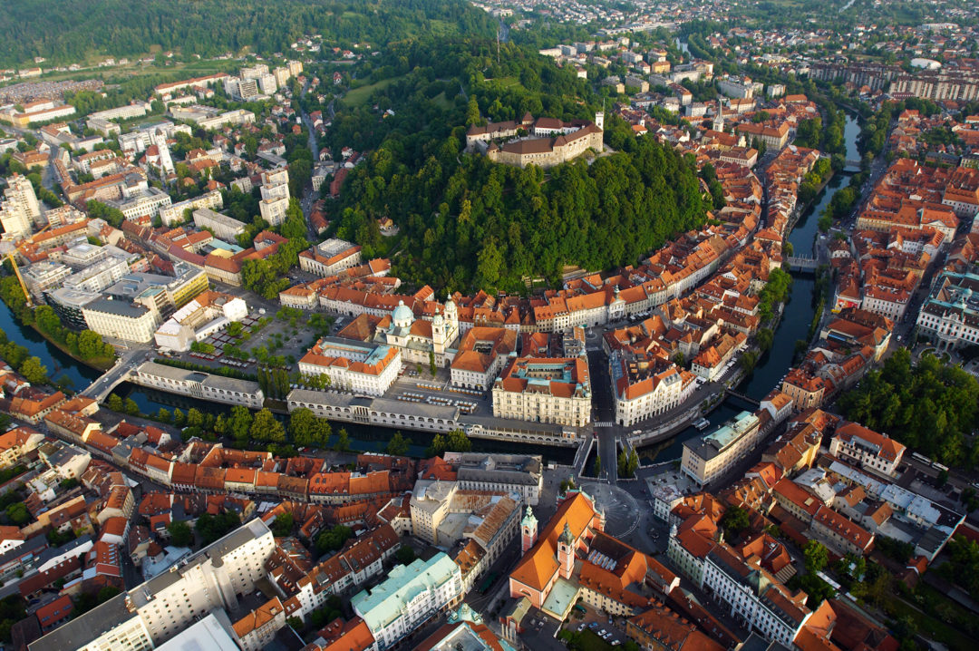
Welcome and introductions
Image via Flickr / Lorenzo Magnis
Notes:
I’d like to Welcome you all to the 2nd Workshop as part of the project: Influence of global megatrends on the state of environment in Slovenia. Firstly I’d like to thank Barbara and her colleagues from the Environment and Spatial Planning and the Slovenian Environment Agency for organising and hosting us here in Ljubljana.
Great to see so many of you who were present in 1st workshop and we are happy to have some additional experts to bring their expertise to the discussions we will be having here today.
Following the introductions I will provide more information and overview of the project

Slide 3

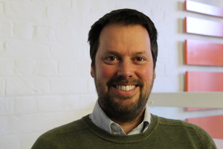


Workshop facilitators
Owen White
Špela Kolarič
Rolands Sadauskis
Support from: Anita Pirc-Velkavrh, Barbara Bernard-Vukadin, Nataša Kovač,
Other project team members
CEP: Dr Bill Sheate
Notes:
Thank … for the welcoming
I’d like to introduce the team that has worked on this project and we will be facilitating the working sessions so you will get the chance to talk to us and ask questions when needed

Slide 4
Workshop objectives and outcomes
Project objective: Provide an opportunity to reflect on the evidence on whether or not GMTs will have implications for the state of environment in Slovenia, and when these implications may occur
Identify risks and opportunities from implications of GMT’s
A list of potential risks and opportunities
Assess the likelihood and magnitude of these risks and opportunities
Assessment of the potential risks and opportunities – likelihood / extent / timeframes
Consider response gaps and needs related to the risks and opportunities
Identifying existing / required responses that relate to the risks & opportunities
Objectives
Outcomes
Notes:
We hope that this workshop will provide an opportunity for all of us to discuss and reflect whether GMTs will have implications for the state of environment in Slovenia, and when these implications may occur
Here you see the 3 main objectives and the outcomes linked to those. What we’d like to achieve through our discussions is to firstly….
Type of responses:
Practical actions
Policy
Long term strategy
Cooperation between institutions/sectors (gov&business, gov/research etc)
Monitoring/indicators
Research

Slide 5
Value added / Participants take away
Improved knowledge and understanding of the risks and opportunities from GMTs to Slovenia’s environment and strategic goals
Materials and knowledge related to the risks and opportunities from GMT implications considered a priority and may need to be integrated into national responses
Possibility to follow up with activities for example in the process of state of the environment reporting
Notes:
Based on the objectives and desired outcomes of this workshop we hope that you will have an improved knowledge and understanding of the risks and opportunities from GMT implications and gain knowledge on those that may need to be integrated into national responses by following up with activities at the national level for example in the process of national state of the environment reporting.

Slide 6
Workshop principles
The agenda is intended to provide time for open discussion and exchange
Everyone should have an opportunity to contribute and all views are valid
Feel free to express views
Specific contributions not attributed to individuals
Opportunity to review and comment on workshop outputs
Notes:
What we would like to emphasise when it comes to the main principles of this workshop is:
that this is not meant to be a lecture
What we aspire to is having an open discussion with you all so that you can exchange views and knowledge –
thus we hope you all will have an opportunity to contribute and please be assured that all views are valid thus don’t keep them by yourselves and feel free to express them and ask questions when needed
In our reporting we will not assign any names to the views expressed and you will have an opportunity to review and comment on the Workshop report we will be circulating shortly after this event.

Slide 7
Outline agenda
Item | Title
1 & 2 | Arrival, Introductions & Welcome | Presentations/introductions: Ministry of the Environment and Spatial Planning and CEP
3 | Setting the scene | Presentations by EEA and CEP
4 | Linking implications to national evidence | Presentations by CEP
5 & 6 | Working session 1: Identifying risks and opportunities | Working session and plenary
Notes:
Now briefly on the agenda for today…

Slide 8
Outline agenda
Item | Title
7,8 & 9 | Working session 2: Assessment of risks and opportunities (magnitude, likelihood and time scales of effects) | Working session
10,11 & 12 | Working session 3: Responses to risks and opportunities | Working session
13 | Reflections and next steps

Slide 9

Introductions
Source: http://housecentral.info – royalty free clipart
Notes:
Now that you know a little about us and todays agenda I propose to have a brief Tour de table to – considering our busy schedule I would like to ask you to keep it short: maybe just Name, Country if relevant and institution you represent

Slide 10
Setting the scene

Slide 11
EEA Presentation on GMTs and SOER
Presentation by Anita Pirc-Velkavrh (EEA)

Slide 12



EEA State of the Environment and Outlook
An analysis of global megatrends (GMTs) was first included in EEA SOER 2010
Updated in SOER 2015
To be further updated for SOER 2020, including Global – Europe – National perspectives
Background analysis
Notes:
The SOER 2015 stated that GMT analysis is intended to: ‘stimulate thinking, spark discussion … and encourage strategic decision makers in Europe to consider emerging threats and opportunities’.
Note developed by EEA for SOER 2010, updated to SOER 2015 – to be further updated for SOER 2020

Slide 13
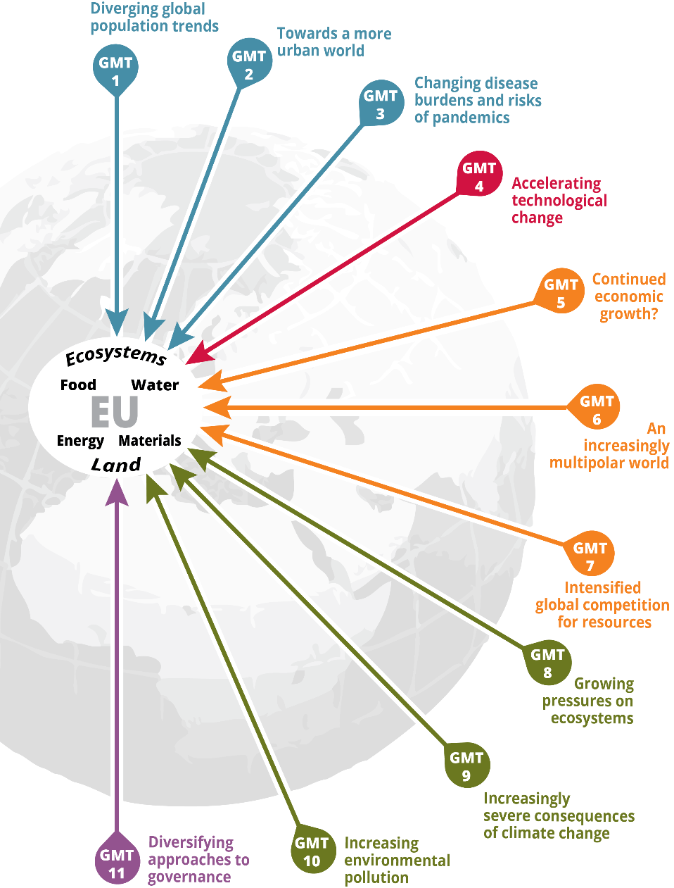
What is a global megatrend?
Large-scale and high-impact social, economic, political, environmental or technological long-term change processes with decisive and critical implications

Slide 14
But, really, what is a global megatrend?
EEA GMTs based on review of literature / outlooks combined with consultation and expert opinion
Collection(s) of global drivers and trends and analysis of what they may mean
Other perspectives are possible: other institutions develop megatrend studies for their own needs (e.g. private sector)

Slide 15
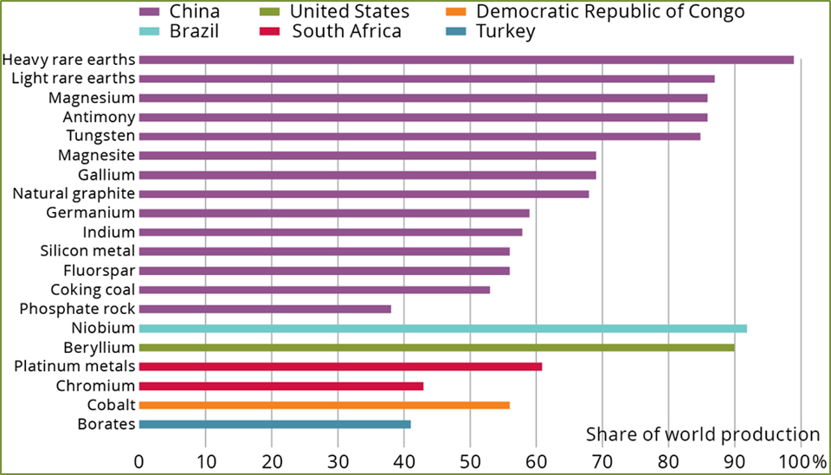
GMT 7 : intensified global competition for resources
World materials use has grown 10-fold since 1900 and may double again by 2030
The geographic concentration of some reserves creates supply risks
Imports from outside the EU accounted for 58 % of EU-27 consumption of metal ores and products in 2011 and 79 % of fossil fuels.
Proportion of global production of EU critical raw materials within a single country, 2010–2012
Notes:
Alongside rising environmental burdens, their uneven geographic distribution implies increasingly insecure access to some essential resources, fostering supply restrictions, loss of standards of living, and even geopolitical conflict.
Growing scarcity and rising prices should create incentives, encouraged by governments, for investment in research and innovation, for example, in mining and reducing waste streams.

Slide 16
What might we see?
Rebalancing of ‘productive potential’
Global shifts in consumption patterns
Shifting land-use drivers
Increased global migration
Resource supply / price volatility
Notes:
Global megatrends help marshal evidence to improve understanding of emerging policy needs / threats

Slide 17
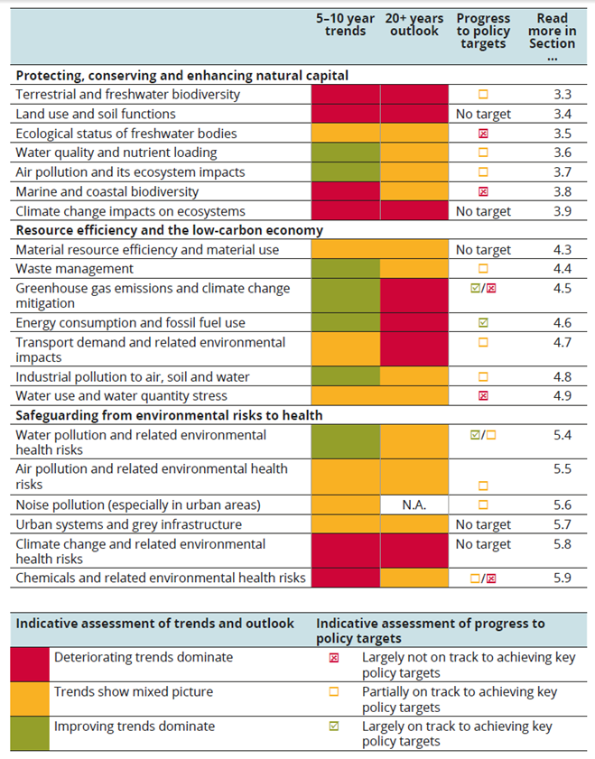
Why seek to understand GMT implications?
Respond to the uncertainty and complexity
Better understand emerging risks and opportunities
Improve (environmental) responses including policy and strategy
Basis for communication with people outside the environment field

Slide 18
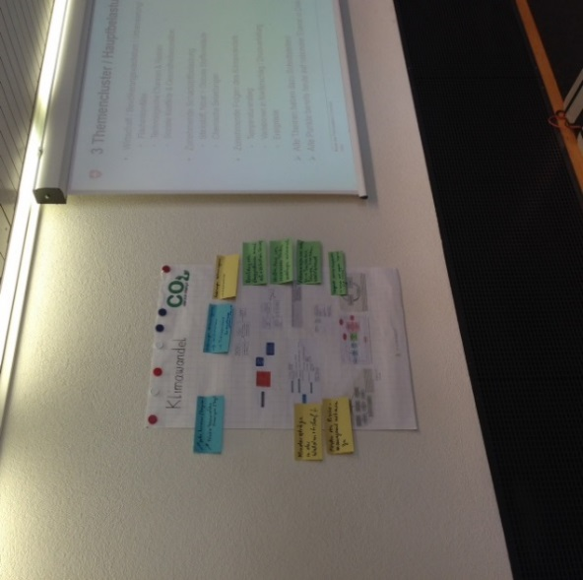
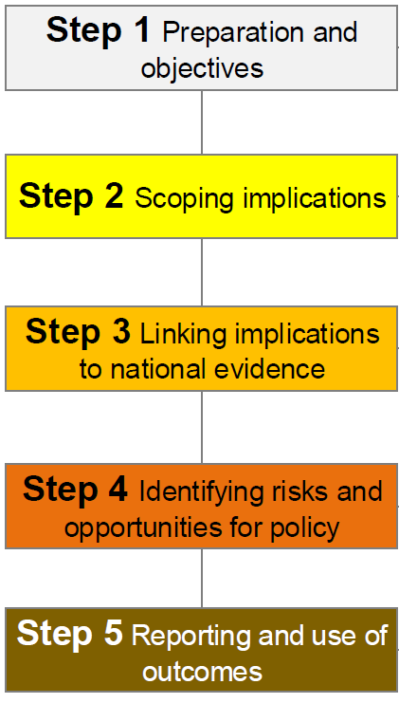
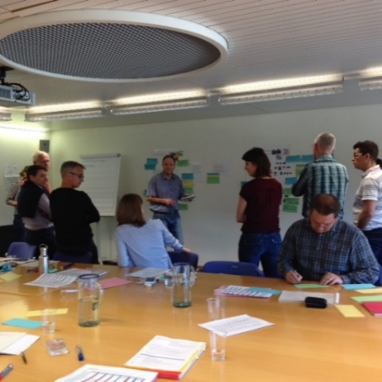
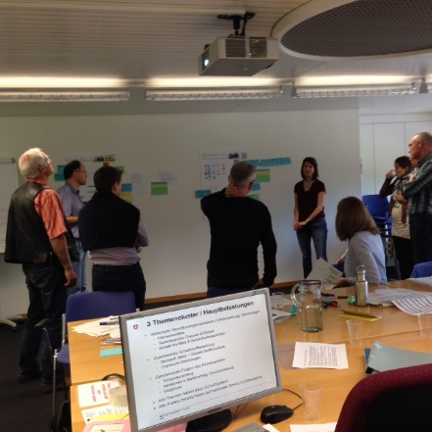
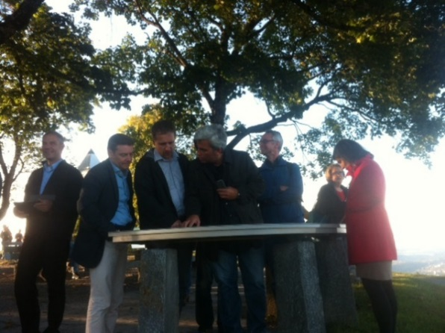
How might we understand GMT implications?
GLOBAL MEGATRENDS
ENVIRONMENT
NATIONAL LEVEL
ENVIRONMENTAL POLICIES
Challenge
Method
Toolkit for deeper understanding GMTs
Notes:
Toolkit developed through the cooperation of EIONET actors, and with the support of the Swiss Federal Office for the Environment (FOEN).
EEA supported the process and many countries contributed through participation in workshops, webinars and by providing other feedback.
Toolkit published in early 2017 as an EIONET report – available in the workshop background documents folder on EIONET.

Slide 19

Project introduction
Ministry of the Environment and Spatial Planning, Slovenian Environment Agency
“Influence of global megatrends on the state of environment in Slovenia”
Adapt and apply the methodology ‘Mapping Europe's environmental future: understanding the impacts of global megatrends at the national level’ to analyse the potential implications of GMTs on the State of the environment in Slovenia
Notes:
In October 2017 CEP commissioned by ministry to support them in undertaking a study to understand the Influence of global megatrends on the state of environment in Slovenia.
'owner' of the study → Ministry
The main aim of the study is to adapt...

Slide 20
Overview of methodological approach
Step 1: Preparation and objectives
Step 2: Scoping implications
Step 3: Linking implications to national evidence
Task 1:
Project team
Decide level of detail
Setting objectives
Involvement of experts
Planning
Task 2:
Familiarisation and preliminary research
Workshop 1
Write-up and feedback
Task 3:
Desk research / expert input
Factsheets on national information
Draft report
Step 4: Identifying risks and opportunities for policy
Step 5: Reporting and use of outcomes
Task 4:
Workshop 2
Write-up and feedback
Task 5:
Final reporting
Notes:
Today we look at how GMT’s might impact the state of environment in Slovenia. Based on these we then in the next step we will look into ways how implications might support or undermine Slovenia's ability to meet environmental goals.
'owner' of the study → Ministry
Small team of experts including Slovenia Environment Agency
Project inception meeting held in late September

Slide 21

Project timeline
Preliminary research and scoping (Task 1 & Task 2)
Research / linking evidence (Task 3)
Risks / opportunities (Task 4)
Desk based research and info request from national experts
Reporting (Task 5)
Workshop 1
Workshop 2

Sept 2017
Nov 2017
late Nov 2017
Apr 2018
Sept 2018

Slide 22
Project introduction
Project objectives:
Identify implications of GMTs for the state of environment in Slovenia, focussing on GMT 7 and GMT 9 (Task 2 & 3)
Identify risks and opportunities from GMT implications, including responses (Task 4)
Consider potential GMT implications for meeting environmental goals in Slovenia
Notes:
Task 1: Preparatory work and project management
Task 5: Reporting
Based on the potential GMT implications - consider the ability of Slovenia to meet environmental goals set out in national strategic documents and the UN Sustainable Development Goals

Slide 23
Task 2: Activities
Adapted and applied Step 2 (Scoping implications) in the GMT implications methodology (EIONET Report)
Reviewed national issues and indicators related to GMT 7 and GMT 9
Identified thematic areas of focus as basis for discussions at the Scoping workshop
Prepared and facilitated Scoping workshop (Workshop 1) and engaged with national experts to share experiences
Prepared Interim report based on the outcomes of Workshop 1

Slide 24
Some reflections from Workshop 1
Systematic, deliberative process, appropriate for thinking about GMTs
Tapping into intellectual wisdom and seeking collective subjective insights
Use of simple causal mapping was a useful way of exploring potential implications
Prioritised implications from Workshop 1 are varied and illustrate some of the key ways in which the environment in Slovenia is being, and will be affected by GMTs
Notes:
Having a systematic process in place allowed participants to thoughtfully consider the implications from GMTs 7 & 9 and prioritise those implications most important for Slovenia. Such process is deemed appropriate considering they are characterised by irreducible and systemic complexity.
The set-up of the working sessions allowed facilitators to …
prioritised implications by experts are varied (economic/energy import dependence – extreme weather events – environmental burden – privatisation of natural resources)…..

Slide 25
Task 3: Activities
Adapted and applied Step 3 (Linking implications to national evidence) in the GMT implications methodology (EIONET Report)
Researching information and evidence based on the scoping outcomes from Workshop 1 including:
Indicators
Outlooks and possible future developments
National policies, plans and strategies
Prepared factsheets for each priority implication
Notes:
And the next section of the presentation give an overview of these activities and the implication factsheets. Give floor to Spela.

Slide 26
Linking implications to national evidence

Slide 27
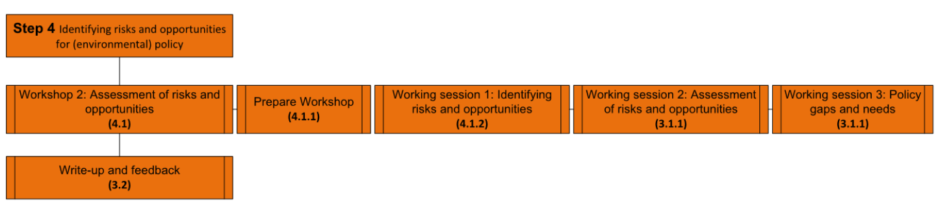
Where are we now? Step 3 / Step 4
Notes:
Notes:
Step 1: Preparation and objectives
clarifying the needs and expectations of the Ministry of the Environment
identifying experts to be involved in the study
and setting out the project programme and outputs
Step 2: Scoping implications
workshop 1 in Ljubljana
identified and prioritised implications of GMT7: Intensified global competition for resources and GMT9: Increasingly severe consequence's of climate change for the environment in Slovenia
This is where we are now
Step 3: Link the implications to national evidence (done prior to this workshop)
To link the prioritised implications identified in the scoping phase with national evidence
Desk base research of relevant literature ( e.g. reports, national environmental indicators , data from EUROSTAT, papers)
Supported by expert consultations (with help of Slovenian Environment Agency) ; national experts were asked to provide possible literature, information on identified implications
Fact sheets on national information an outlooks related to identified GMTs’ implications were prepared
Will explain later in more detail
Step 4: Identifying risks and opportunities for (environmental) policy
Brings together the results of Step 2 and 3 to be discussed in 2nd expert workshop (today’s workshop)
Rolands will introduce you to the steps of today’s Workshop in detail
Identify and assess the risks and opportunities for the state of the environment in Slovenia, arising from the identified GMTs’ implications
A chance to discuss policy gaps and responses to identified risks and opportunities

Slide 28
Outcomes from Scoping GMT implications
GMT | Implications | Estimated likelihood (high/low) | Magnitude of effect (high/low) | Timescale over which implication may occur
GMT 7 Intensified competition for natural resources | Increased privatisation of natural resources | high | High | medium term (has already started but the implications are not felt yet)
 | Economic dependence | high | High | short /medium /long term
 | Increasing environmental burden | high | high | short term (increased burden) long term (decreased/increased burden)
 | Demand on natural resources (increasing) | high | low (transition to circular economy) | medium term
 |  |  | high (no transition to circular economy
 | Energy import dependence | high | high | long term
 | Pressure on water quality and supply | high | high | long term
Notes:
Example of assessment sheet from workshop 1 for GMT7
where we identified and prioritised the implications of GMTs
Altogether (29) 17 implications identified by experts for GMT 7 and 12 implications for GMT 9
6 ranked as ‘important’; meaning they were high in likelihood and magnitude, and occurring over the short term timescale
These were then taken forward to Step 3
They were presented on factsheets:
We merged energy import dependence with economic dependency as the evidence suggested that energy import dependence is one of the more important factors of Economic dependence, which was also suggested by Slovenian Environment Agency.
Food security as an implications was also included later at the request of Environment Agency as from further discussion it was considered to be a possible challenge for Slovenia. The reason it was not included in the first place was that it was evaluated to occur in medium term , whilst those occurring in the short term were considered a priority.

Slide 29
‘Connecting’ national issues to GMT implications
Document |  | Relevance to Rank 1 implication |  |  |  |  |  |  | Type of information source
Title and date of study/indicator | Year | Increased privatisation of natural resources | Economic dependence | Increasing environmental burden | Energy import dependence | Pressure on water quality and supply | Extreme weather events | Infrastructure damage | Indicators/data | Reports and studies | Foresight (outlooks, scenarios, etc.) | Existing policy/strategy
Increased privatisation of natural resources
Note to European Union Trade Policy Committee from the Ministry of Economic Development and Technology, Slovenia | 2016 | ü |  |  |  |  |  |  |  |  |  | ü
Market Sector Scan of water management in Slovenia | 2013 | ü |  |  |  |  |  |  |  | ü
Public and private environmental expenditure | 2012 | ü |  |  |  |  |  |  | ü
Notes:
In depth review of the national evidence related to the prioritised implications was conducted
Example of our literature review table, in Excel
Left are sources that we looked at, year of publication
Ticks in the boxes identify to which implication the source relates to, and what type of information source it is (e.g. indicators, reports, foresights, policy/strategy)

Slide 30
Approach to Task 3: linking evidence
1: Desk based research
historical and current national (trend) data or study outcomes;
2: Requesting input from experts
Identify national experts
indicators
evidence of the possible future developments (e.g. projections, scenarios, horizon scanning, outlooks);
research studies or reports
existing national policies and plans
Circulate existing information relevant to each implication
Compile a complete table of references and sources for each implication
Notes:
Now I will briefly introduce our approach on linking implications to national evidence.
First we conducted a desk based research
which drew particularly on literature list identified in the scoping stage before Workshop 1
This was then updated with additional sources relevant to the implications considered as “important” in workshop 1 (rank 1 implications)
The literature and information included:
historical and current national (trend) data or study outcomes
Indicators
evidence of the possible future developments (e.g. projections, scenarios, horizon scanning, outlooks)
research studies or reports
existing national policies and plans
The information availability across these various sources varied ranging from detailed national data / information / to no information at all when it comes to relevance for a particular implication.
2. Additional input from experts was requested
Note: At this point I would like to thank all the experts for providing the information based on the request, as well as Slovenian Environmental Agency which supported this process
Before circulating the requests we prepared summary tables for each cluster of implications setting out identified and current relevant literature sources for each implication within the cluster
Note that we were not able to incorporate all information provided due to the specific nature and national focus however we will make sure to reference and acknowledge all contributors in our Final reporting.

Slide 31
Approach to Task 3: linking evidence
3: Draft 'factsheets'
Implication summary
4: Prepare Background note
Overview of the scoping of GMT implications for Slovenia
Present implication factsheets
Initial suggestions of risks and opportunities for Slovenia
Summary of existing evidence
Overview of existing policy (where possible)
Notes:
3. Drafted the factsheets, which include:
Summary of the identified implication (as recognised by experts at the first workshop)
Summary of existing evidence (from literature, databases, stat offices, etc.)
Overview of existing policy (where possible; which might support the mitigation of implication)
Rolands will shortly present all the factsheets that we have drafted.
This is not an overall comprehensive overview of all the evidence there is on the topics that we looked at. This just a screenshot based on data we have gathered and reviewed in the limited time available
4. Lastly – before the workshop we prepared a background note (that has been sent to you via e-mail with invitation and I hope you’ve had the opportunity to look at) which includes:
Overview of the scoping of GMT implications for Slovenia (workshop 1)
Presents all implication factsheets
It gives initial suggestions of risks and opportunities for Slovenia

Slide 32
Implication factsheets
Environmental pressures cluster:
Increasing environmental burden
Pressure on water quality and supply
Resources and economy cluster:
Economic and Energy import dependence
Increased privatisation of natural resources
Climate cluster:
Extreme weather events and Infrastructure damage
Food security
Notes:
Altogether we prepared 6 factsheets
Please note that the factsheets present a snapshot of available evidence based on our review. We focused on national sources and in the time available the review was not exhaustive and we were unable to systematically review all information available.
Our decision to cluster implications for discussions in this workshop were based on:
Recognition of the limitations of the time available for discussion
To have a balance of implications across the 3 clusters
To reflect specific issues identified in Workshop 1 (e.g. food security)
The evidence review suggests that implications in some cases are strongly related (e.g. in the climate cluster)

Slide 33




Increasing environmental burden
Characteristics
Impacts on air quality from private transport and transit transport
Increasing consumption, resource use and production of waste
Increase in population leading to increased pressure on local environment
Pressure on aquatic ecosystems from growing energy demand and development of new energy infrastructure
All icons © the noun project: https://thenounproject.com/

Slide 34
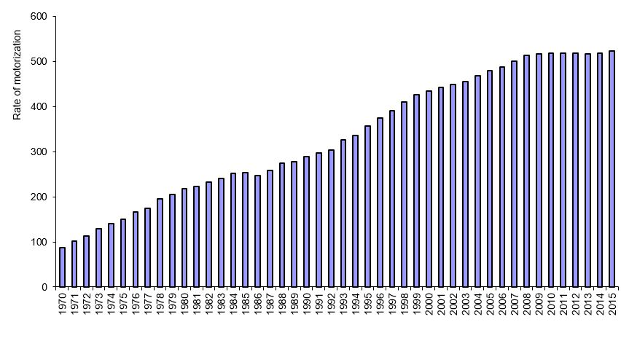
Increasing environmental burden
Evidence in Slovenia:
↑ use and stock of private transport and ↑ transit transport
Real GDP growth and rise in municipal waste generated per capita
Mostly + total net migration in coastal areas since 2008
Figure: The rate of motorization (number of passenger vehicles/1000 inhabitants) in Slovenia, 1970-2015
Source: Statistical Office of the Republic of Slovenia, 2016
↑ Energy consumption and large number of planned hydropower projects
All icons © the noun project: https://thenounproject.com/
Notes:
1: Since 2000 the number of passenger cars per 1,000 population accelerated from 435 to 523 in 2015
In the period from 2000-2010 freight transport (tonne/km) increased by 18.1%
2: GDP growth in Slovenia has annually surpassed 2% since 2014 with OECD projecting that in 2017 the growth was 4.86%
Municipal waste generated in Slovenia has increased by 29.7% 2002-2016 - per capita per year this corresponds to a rise from 425 kg in 2002 to 476 kg in 2016
3: +Migration - increases pressure on the local environment – coastal municipalities recorded increasing pressure on water supply with 4.3% increase from 2012-2016
4: Since 2000, final energy consumption has increased by ~8% (transport sector being the largest consumer – 39%). In 2015 - 181 hydropower projects planned in Slovenia and 5 being under construction

Slide 35





Pressure on water quality and supply
Characteristics
Management of small water supply systems and wastewater treatment
Pressures from agricultural activities (irrigation/ pollution)
Emerging global middle class, trade policies, and growing exports
Tourism and leisure activities
Regional and inter-annual variability of groundwater recharge
All icons © the noun project: https://thenounproject.com/

Slide 36
Pressure on water quality and supply
Evidence in Slovenia:
Periodical microbiological pollution of small water supply systems
Small fraction of agricultural land is irrigated. In NE groundwater aquifers under pressure from agricultural pollution, pumping, and drainage.
Exports exceeded pre-crisis levels of 2008 in 2011 – growing ever since
Increase in international tourist arrivals by 12% 2015 - 2016
Figure: Total number of tourist arrivals and overnight stays in Slovenia 2006-2016.
Source: Slovenian Tourist Board
Abstracted water for public supply has declined by 12.5 % since 2002.
All icons © the noun project: https://thenounproject.com/
Notes:
Share of samples containing E.coli for small water supply systems have declined, in 2015 though they still had the highest share of contamination (5.8%) compared to samples from medium (1.1%) and large (0.2%) systems
Irrigation constitutes to only 2.1% of the total consumption of water in Slovenia - small fraction of agricultural land is irrigated (3,133 ha in 2016 from 60,000 ha considered suitable for irrigation systems
3. Between 2016 & 17 exports increased by 13.1% - indicate increasing use of resources - total use of water in industry for production purposes from 2002-2016 has grown by 35.6%
4. Water consumption rates are in the range of 84-2,000 litres per tourist per day, In 2016 tourist arrivals and overnight stays increased by 9.9% and 8.1% respectively, than in 2015
In general it is reported that there is sufficient quantities of water on average in Slovenia

Slide 37




Economic and Energy import dependence
Characteristics
Industries (especially transport) depend on imported energy, fossil fuels (mainly oil), gas, and other raw materials
Economic growth rate and trade policies
Internationalisation of business and use of EU funds
Low material productivity and energy intensive economy.
All icons © the noun project: https://thenounproject.com/

Slide 38

Economic and Energy import dependence
Evidence in Slovenia:
Energy import dependency of all fuels in line with the EU average (~50%) however much higher than EU for petroleum products (Sl:96%; EU28:87%)
Average GDP growth per year - 2.6% since 2014. Almost equal export/import trade ratio in 2017 (Markets: Germany, Italy, Croatia) indicating high dependence on EU markets
Rapid increase in foreign direct investment since 2014. Highly reliant on EU funds for strengthening competitiveness and investing in infrastructure (transport etc.)
Low-carbon technology patent applications & share of public expenditure on energy and environment R&D behind EU average. Low ambitions regarding energy savings among SMEs
All icons © the noun project: https://thenounproject.com/
Notes:
1. FUTURE Energ dependency: 2 main power plants (nuclear & coal) expected to close by mid-century - capacity predicted to be replaced by gas and solar energy increasing energy dependency
2. About a fifth (20.4%) of total Slovenian exports go to Germany, 11.5% to Italy, followed by Croatia (7.6%), Austria (7.6%) and France (5.7%).
3. 2014 - Unexpectedly strong tenfold FDI recovery (746m €) in comparison to a previous year (71m €). As reported by the Ministry of Economic Development and Technology (2018), FDI flows expected to surpass 1,4 billion € in 2018.
4. A European commission report states low ambitions amongst Slovenian SMEs regarding energy savings as well as material and waste reduction
Transport also significantly contributes to the negative picture of the high energy intensive Slovenian economy

Slide 39



Increased privatisation of natural resources
Characteristics
Undervaluing local/regional natural resources
Price and consumption of bottled water
Internationalisation of the national economy and public management of natural resources
All icons © the noun project: https://thenounproject.com/

Slide 40
Increased privatisation of natural resources
Evidence in Slovenia:
Internationalisation of national economy (i.e. foreign investment, exports) is critical to catch up with other developed EU economies - GDP is 1.5 times lower than the EU28 average
Growth in global consumption of bottled water. In Slovenia the number of water permits and concessions increased by ~ 1,000 (2014-2016), however more then a half of these were granted for household drinking water supply
Strong lobbying, short term political interests and lack of an integrated approach in water management likely increase pressures for privatisation of natural resources
All icons © the noun project: https://thenounproject.com/
Notes:
Currently - lack of evidence of large-scale privatisation of natural resources
Considering the abundant and high quality groundwater availability….
From the data available (on prices, concessions, and accessibility) the assumptions that the privatisation of water resources is already taking place is difficult to confirm.

Slide 41





Extreme weather events and Infrastructure damage
Characteristics
Increase in extreme events, including droughts, heavy rainfall/flooding (riverine, flash floods), tornado like winds and storms.
Annual average temperature increase above global average with ↑ number of hot days causing droughts
↑ number of days with thunderstorms mainly in the East of Slovenia
Flash floods are the prevailing type of floods in Slovenia, with more than 1/8 of the entire territory being threatened
Damage to infrastructure and settlements
All icons © the noun project: https://thenounproject.com/

Slide 42
Extreme weather events and Infrastructure damage
Evidence in Slovenia:
From 2010-2018 there have been 272 occurrences of extreme weather events
In SE & SW Slovenia, groundwater levels at certain locations reached the lowest values on record
In 2014 freezing rain storm caused considerable damage to forests and forest roads, as well as energy infrastructure.
In 2012 more than 100 municipalities affected by floods causing damage to agricultural areas, industry, civil engineering works, water courses and buildings
Up to 800 million dollars (~650 million euros) in overall losses to Slovenia’s economy 2012 – 2017 from natural hazards
All icons © the noun project: https://thenounproject.com/

Slide 43



Food security
Characteristics
Extreme weather events affecting crop yields
Abandonment of agricultural land and land use change
Dependency on food imports
All icons © the noun project: https://thenounproject.com/

Slide 44
Food security
Evidence in Slovenia:
Above average temperature variations affect vegetation period with drought and extreme rainfalls further having an impact on agricultural production
From 2006–2015 utilised agricultural area per capita has declined by 5%
Net importer of food – in 2016 self-sufficiency was the lowest for vegetable (42%), fresh fruit (44%), and potato (55%)
All icons © the noun project: https://thenounproject.com/

Slide 45

Working Session 1: Identifying risks and opportunities
Source: http://kingofwallpapers.com/

Slide 46
Working session 1: introduction
This working session aims to stimulate thinking and discussion
It will use the factsheets developed by the project team and a template to gather views of participants on key risks and opportunities
Notes:
As mentioned earlier in the workshop principles our work today is intended to stimulate thinking and discussion

Slide 47
Working session 1: General approach
3 groups (defined in advance), each with a facilitator
3 clusters of implications (6 implications in total – 2 implications per group)
Group working
Introduction from facilitator (5 mins per implication)
Working individually to identify relevant risks and opportunities (10 mins per implication)
Group working to discuss similarities / differences on identified risks and opportunities and fill worksheet (20 mins per implication)
Once worksheets completed for both implications - group to select up to 3 risks and 3 opportunities per implication (10 mins)

Slide 48
Working session 1: overview
For each implication in the cluster discuss the ways in which they have effects in the region and identify:
Who (which groups in society, types of business, etc.) / what (environmental receptors, ecosystems, resource types, etc) is likely to be affected by a risk or opportunity?
What is the geographical scale(s) (regional, local, etc.) of a risk or opportunity?
What is the timeframe which a risk or opportunity is expected to occur?
Notes:
Here we have proposed a few questions to guide the discussion once you have familiarised with your 2 implications that are in your cluster
Each facilitator will have a worksheet for both risks and opportunities to complete based on these discussion points.
As for the questions for each risk and opportunity try and identify
Who is affected; Groups of society – coastal communities, urban communities etc
Types of business – energy companies, small businesses, farmers etc
What is affected:
Environmental receptors: plants, soil animals, small rodents (rats, mice etc), freshwater organisms
Ecosystems : freshwater, marine, forest, grassland etc
Resource types: water, minerals, fossil fuels, timber
Geographical scale
What is the timeframe
Short term (to 2020); medium term (2020–2030); long term (2030–2050) - (choose 1 based on likely first appearance)

Slide 49
Working session 1 Outcome
Completed worksheets of risks and opportunities
Selection of up to 3 priority risks and up to 3 priority opportunities for the environment or environmental policy of each implication (use sticky dots)
Increasing environmental burden
Potential risks | Who / what is likely to be affected? | Geographical scale(s) (Whole country, specific region, urban / rural etc.) | Timeframe which risk is expected to occur (Short, Medium, Long)
Increased risks for aquatic ecosystems
Notes:
Note – the numbers on their badge indicate the group they need to be in initially
Selection of “top 3” risks and “top 3” opportunities per GMT implication:
Each group has 6x sticky dots per implication
Apply them using only one sticky dot per risk / opportunity to prioritise
Only those risks / opportunities for each implication voted for - will be assessed in the following working session!
Outcome: list of prioritised risks and opportunities (3 & 3 - up to 6 altogether) related to a particular implication

Slide 50
Working Session 2: assessment of risks and opportunities
Source: http://kingofwallpapers.com/

Slide 51
Working session 2: Introduction
Working session based on outcomes of working session 1
This working session aims carry out an assessment of each risk and opportunity based on the available evidence and expert’s judgement
Notes:
In this session we will continue on our discussions from yesterday as we will try and assess the risks and opportunities for each implication that we identified earlier.
What we expect is for you to use your own judgement based on your knowledge and available evidence – I will introduce you with the principles of this assessment in due course and facilitators will also provide you with a handout to familiarise in more detail with the criteria

Slide 52
Working session 2: general approach
3 groups (defined in advance), each with a facilitator
3 clusters of implications (6 implications in total)
Group working
Working individually to assess prioritised risks and opportunities (10 mins per implication)
Group working to discuss similarities / differences on assessing prioritised risks and opportunities (20 mins per implication)
Experts review all assessments within their group and by using sticky dots indicate those risks / opportunities they consider most important (each expert has 6 dots) Time available: 15 mins
Notes:
It is not a formal assessment and is based on expert judgement and knowledge.
The next steps in the method (and therefore project) will seek to identify evidence and if possible data relating to the prioritised implications, and in the second project workshop a more in-depth assessment will be made of risks and opportunities associated with the GMTs in the region.

Slide 53
Working session 2: Activities
A standard risk assessment
For magnitude apply (+) for opportunity or (–) for risk
For likelihood apply (●)
3 levels of magnitude and likelihood:
High (+++ / - - - or ●●●)
Medium (++ / - - or ●●)
Low (+ / – or ●)
Notes:
When it comes to assessment itself we see it as a standard risk assessment when looking at the magnitude and likelihood of a risk while applying a 3 grade criteria
For assessing magnitude please apply…
For assessing likelihood apply…
As mentioned earlier the descriptions of criteria to be used for assigning levels of magnitude / likelihood are included in the handout on risk and opportunity assessment provided for this session – and you’ll have time to familiarise with this as part of the session

Slide 54
Working session 2 Outcome
Completed assessment worksheets
Based on the assessment and sticky-dot exercise one most important risk and one most important opportunity for each implication is selected to consider in working session 3

Slide 55
Working Session 3: Responses to risks and opportunities
Source: http://kingofwallpapers.com/

Slide 56
Working session 3: Introduction
Working session based on outcomes of Working sessions 1 & 2
Groups reflect on what the key response gaps and needs might be to manage identified risks / maximise opportunities.
Notes:
Note: It may be useful to reflect on national policy and strategy as well as opportunities and needs for regional and transboundary cooperation.

Slide 57
Working session 3: General approach
Experts work individually then reconvene in group from Working Session 3
Session is structured in two sub-sessions:
experts individually reflect on the risks and opportunities from the ‘cluster’ they were assigned in Working Session 1&2 (20 mins)
Group working to discuss similarities / differences in identified response gaps and needs & complete worksheets (55 mins)
Groups reconvene for full plenary (15 mins)
Notes:
The logic behind the individual working is that it gives the chance for you to think from national level up
In full plenary our hope is to identify a few key national needs and opportunities

Slide 58
Working session 3: Activities
Experts should consider the following questions:
Do responses exist that relate to the risks or opportunities?
If they do exist, to what extent do these responses address the identified risks and opportunities?
What opportunities may be missed given current responses?
Which emerging and future risks do not appear to be considered by current responses?
What new responses or changes to existing responses or planning might be needed to prepare for identified risks, and cope with them should they occur (recognising that not all risk can be prevented)?
What new responses or changes to existing responses or planning might be needed to maximise opportunities?
Notes:
We have suggested some questions that could help guide the thinking and discussions in this sessions – these are included in the handout provided

Slide 59
Working session 3: Outcomes
Completed worksheets of the key response gaps and needs identified for each risk and opportunity per implications cluster

Slide 60
Closing reflections
Thank you!

