Slide 1
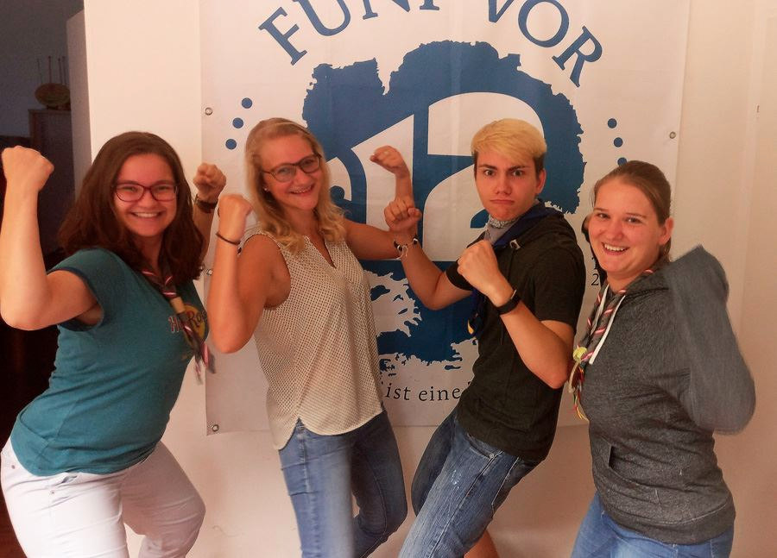

Youth Participation
in Austria
Sarah Zauner
Environment and Health Youth Delegate
Austrian National Youth Council

Slide 2
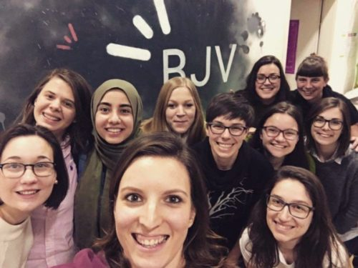
Outline:
I.) Youth Representation (Austrian National Youth Council)
Youth Delegate Programmes
II.) Projects
JUMP
Other Projects
III.) Project support

Slide 3
Outline:
I.) Youth Representation (Austrian National Youth Council)
Youth Delegate Programmes
II.) Projects
JUMP
Other Projects
III.) Project support

Slide 4
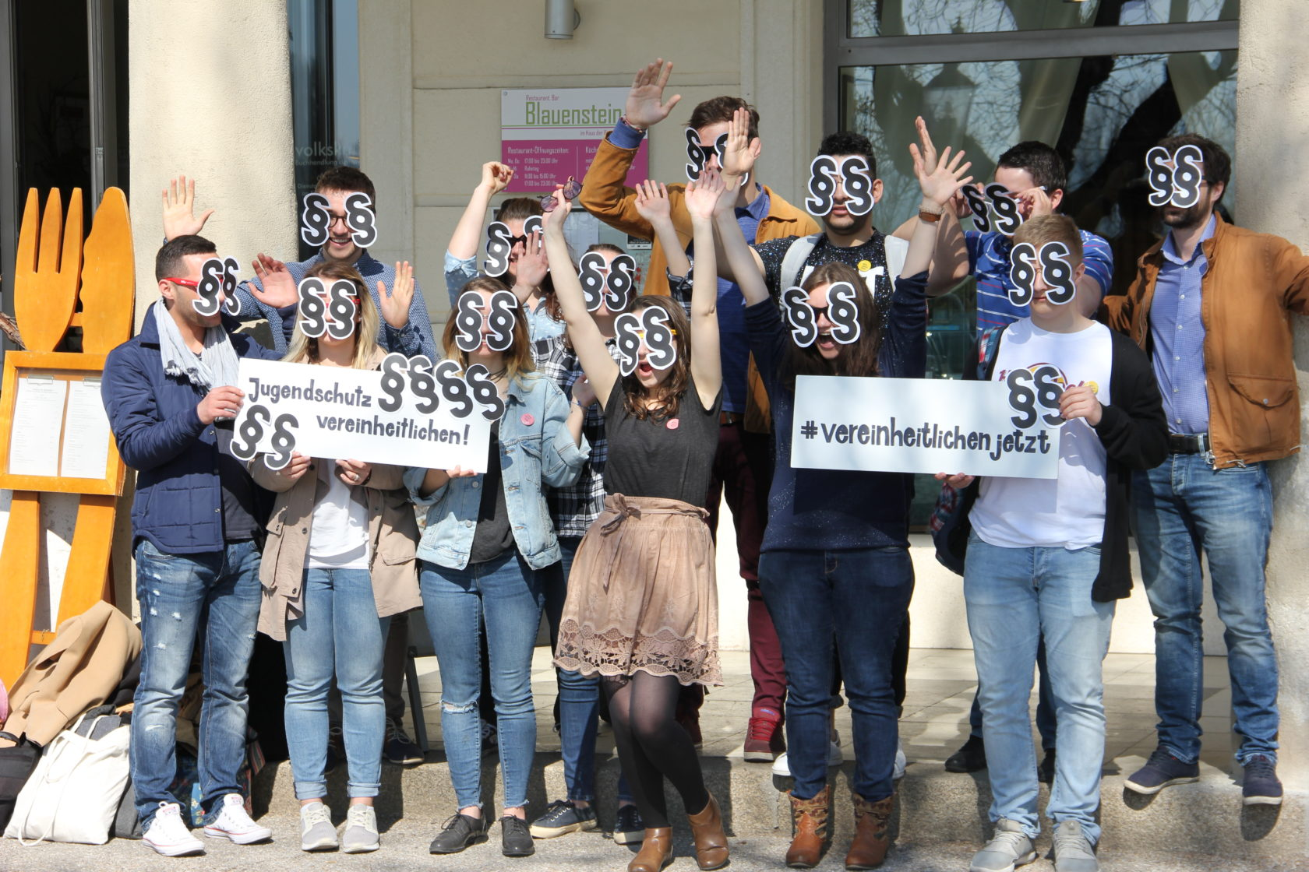
Youth Representation
Austrian National Youth Council
legally established representation of all children and young people in Austria
≤ 30 years
3 million young people
53 organisations
social partnership
participation, security, rights, chances
education
volunteer engagement
sexuality
job market
children‘s rights
non-formal education
gender equality
living
youth protection
anti-discrimination
military/alternative service
sustainability

Slide 5
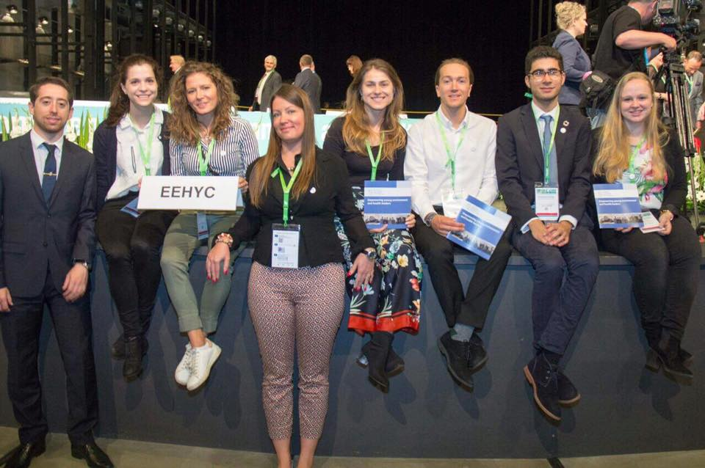


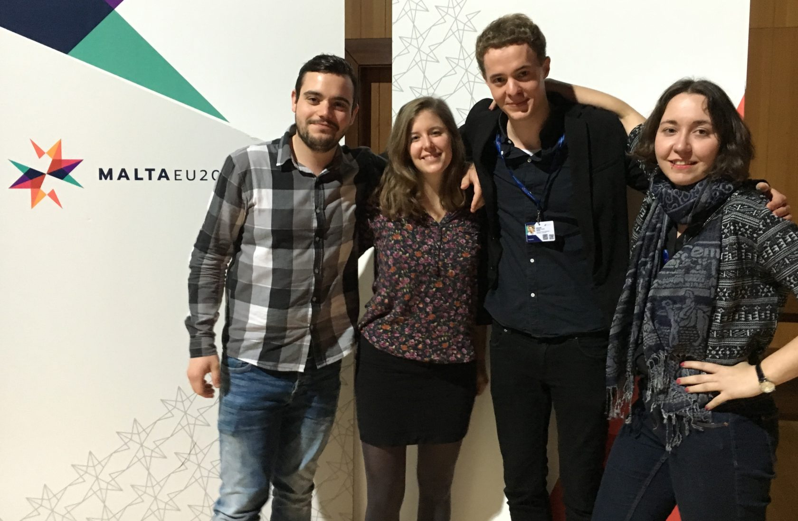



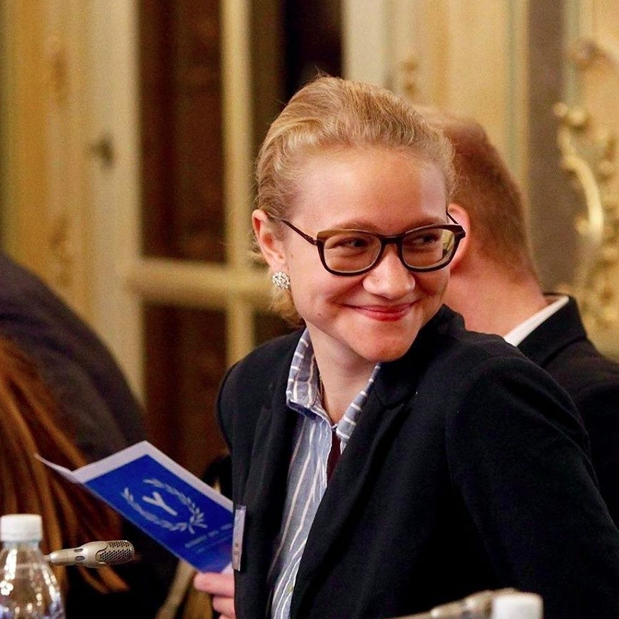
Austrian National Youth Council
Youth Delegate Programmes
Environment and Health Youth Delegate
Environment, Health, Mobility
European Youth Delegates
UN Youth Delegate
Workshops
UN General Assembly

Slide 6
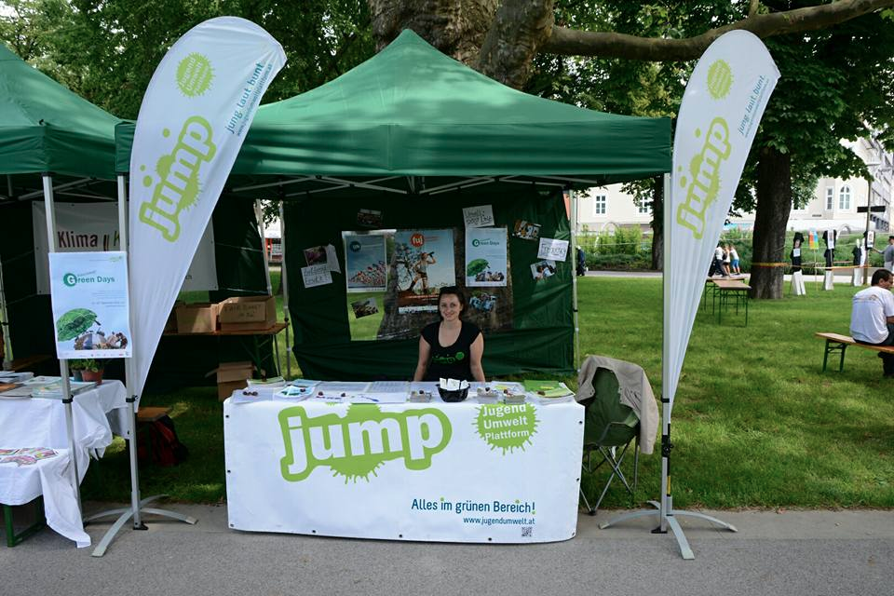
Outline:
I.) Youth Representation (Austrian National Youth Council)
Youth Delegate Programmes
II.) Projects
JUMP
Other Projects
III.) Project support

Slide 7
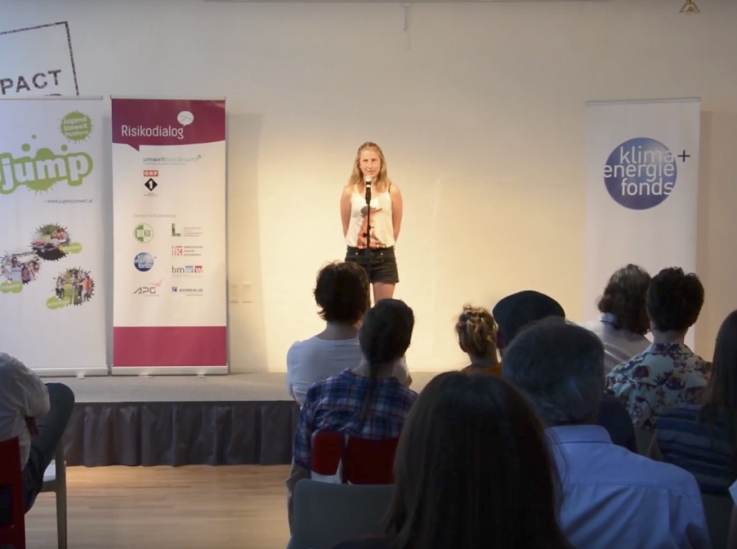
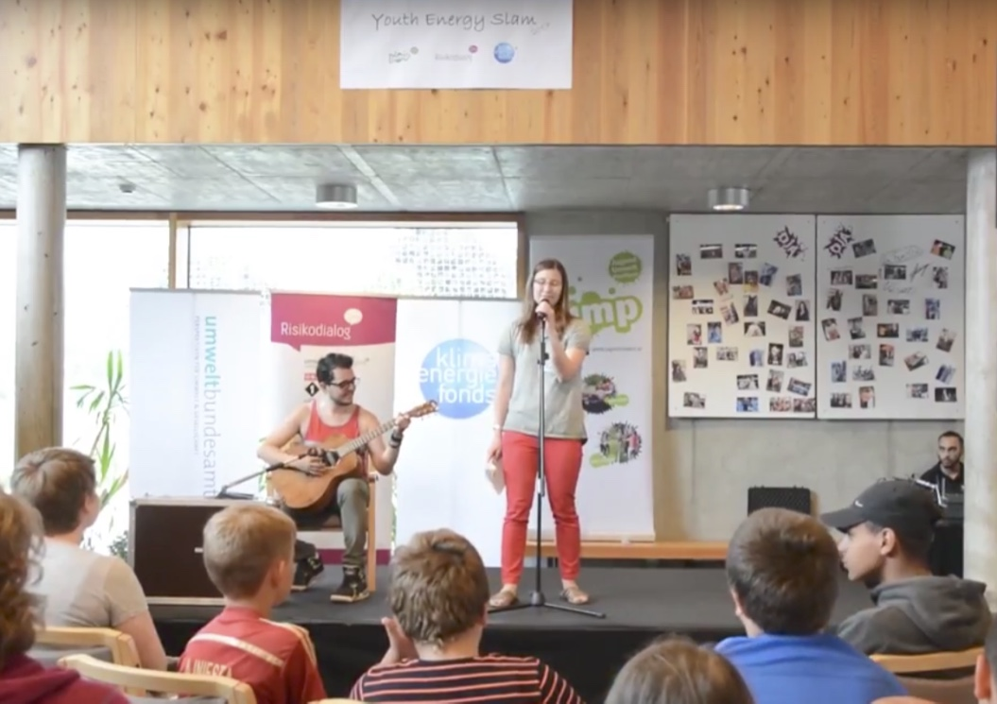
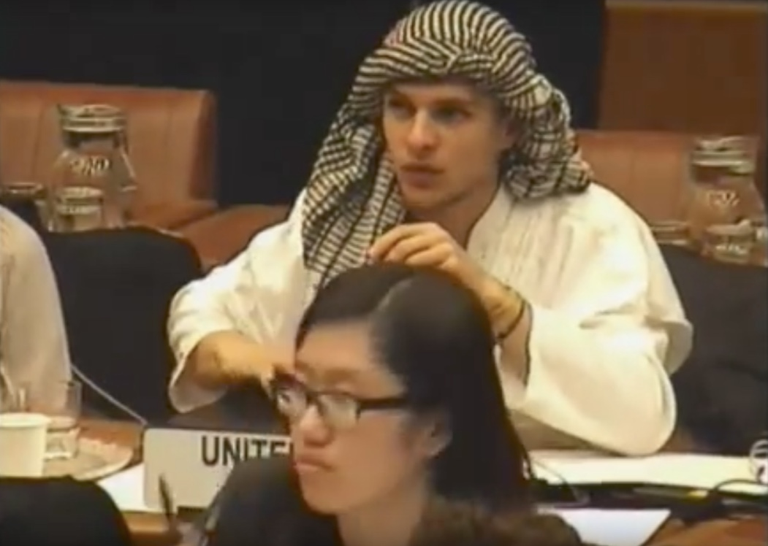
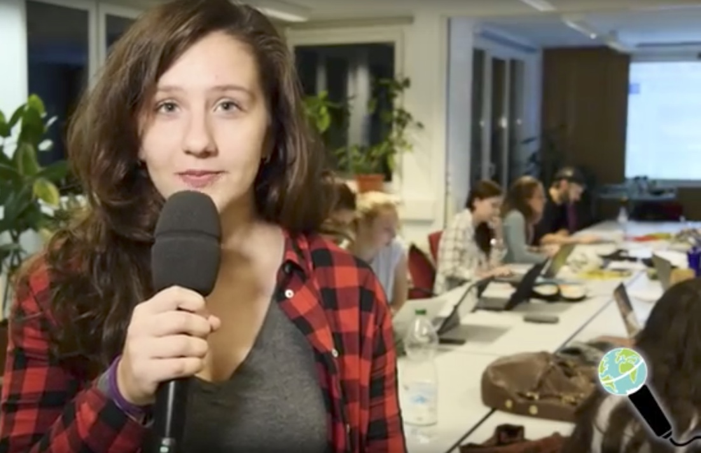
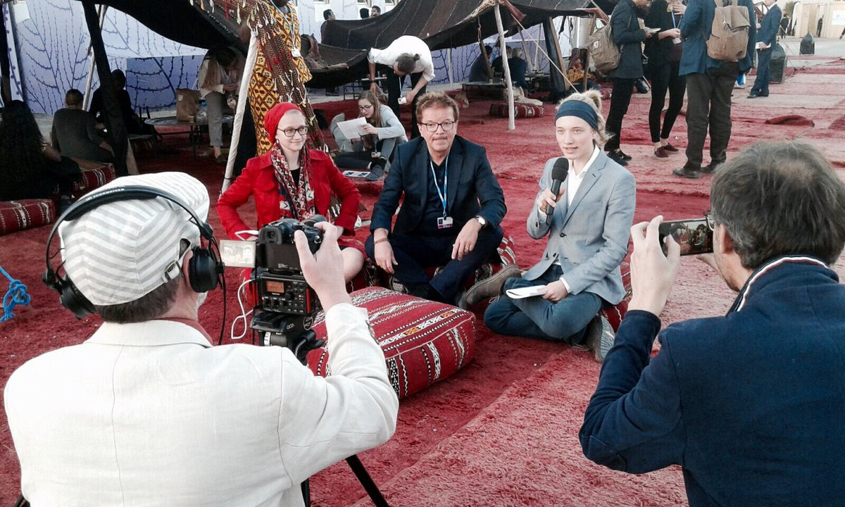

JUMP
independent platform that works with young adults in the area of environment and sustainability
Youth Energy Slam
creative competitions
“world without oil”
platform to be heard
UN Climate Reporter
Model United Nations
journalism
inform young people
COP participation

Slide 8
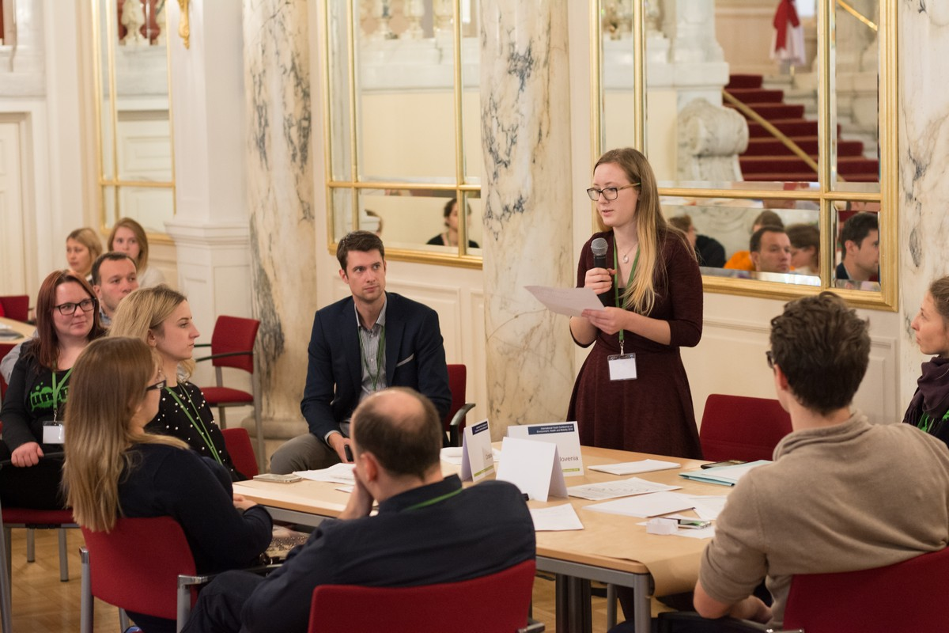
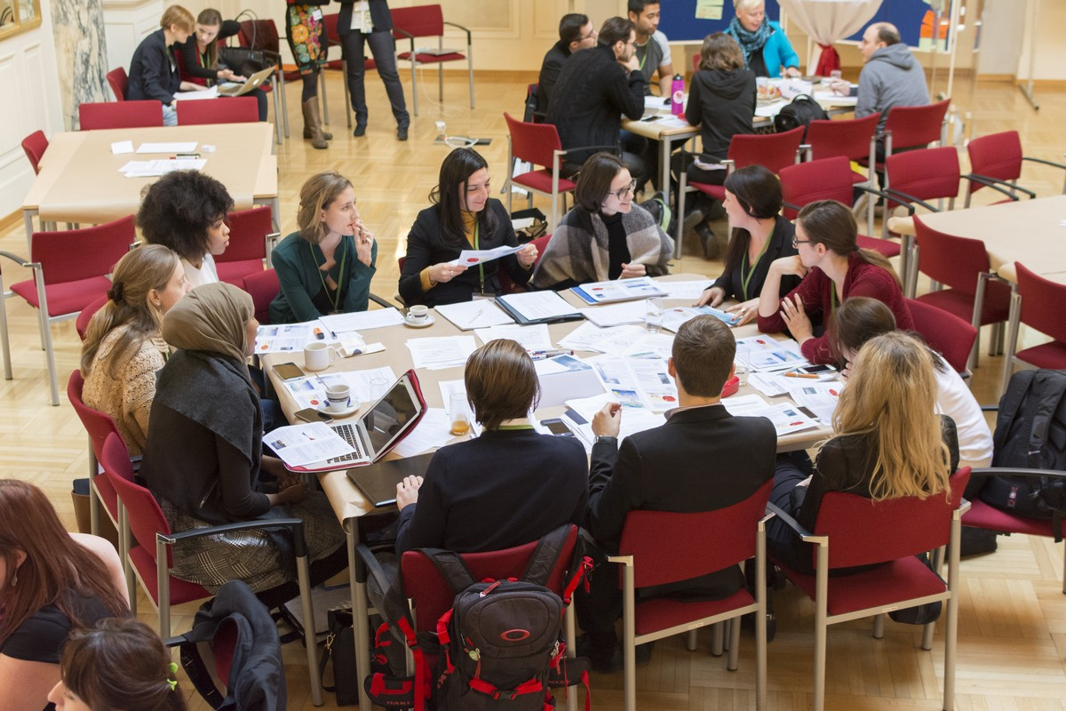
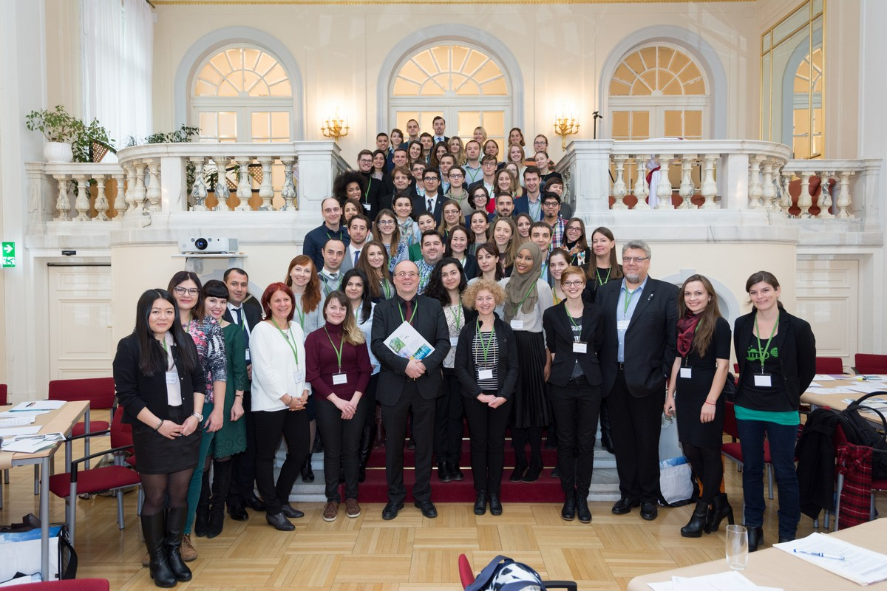
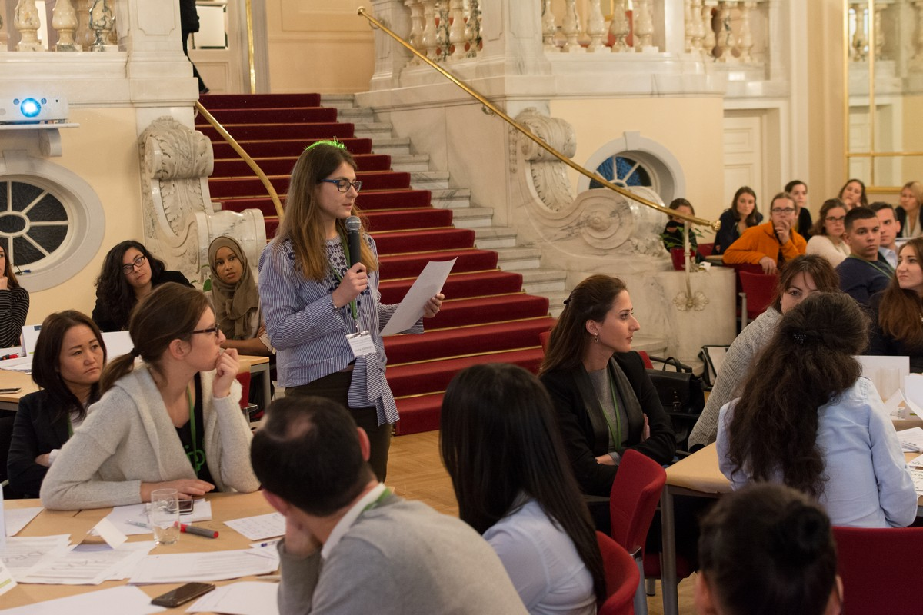
JUMP
International Youth Conference
70 participants, > 30 countries
share opinions, network
feedback to the WHO Ministerial Declaration
7 working groups
Vienna Youth Position Paper

Slide 9
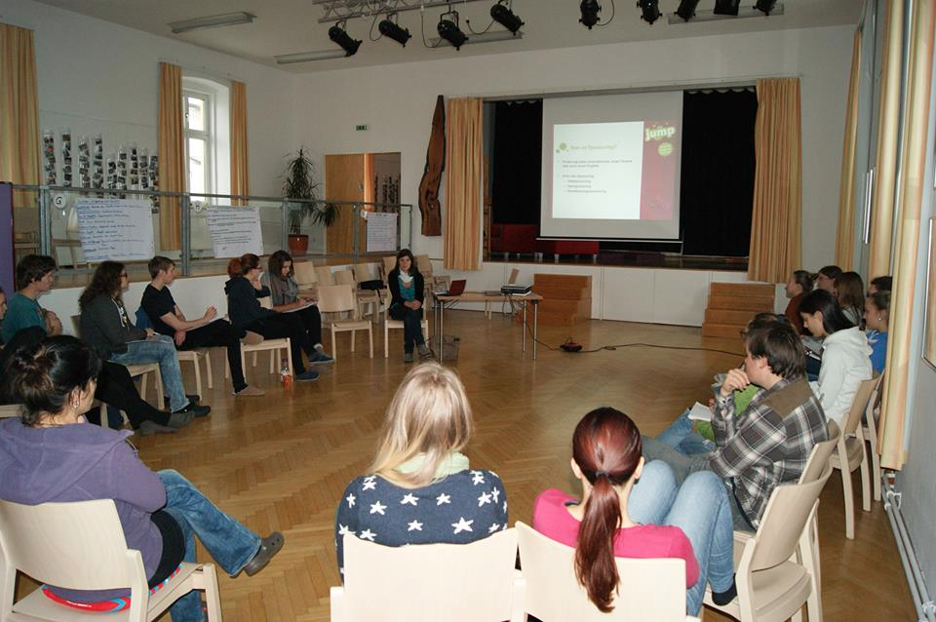
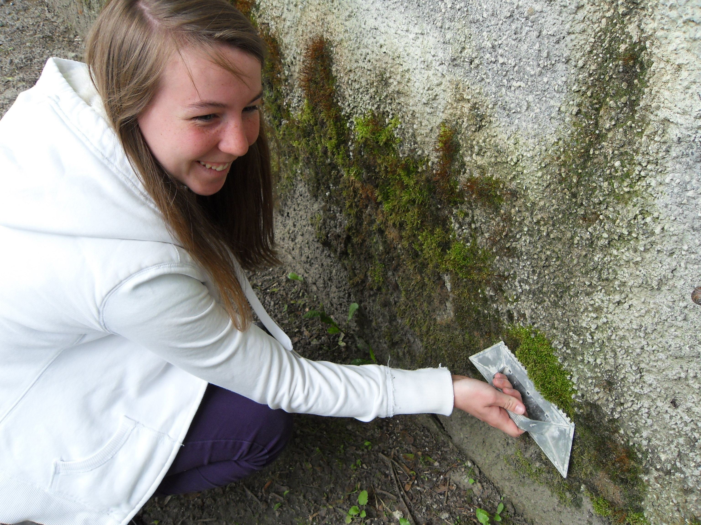
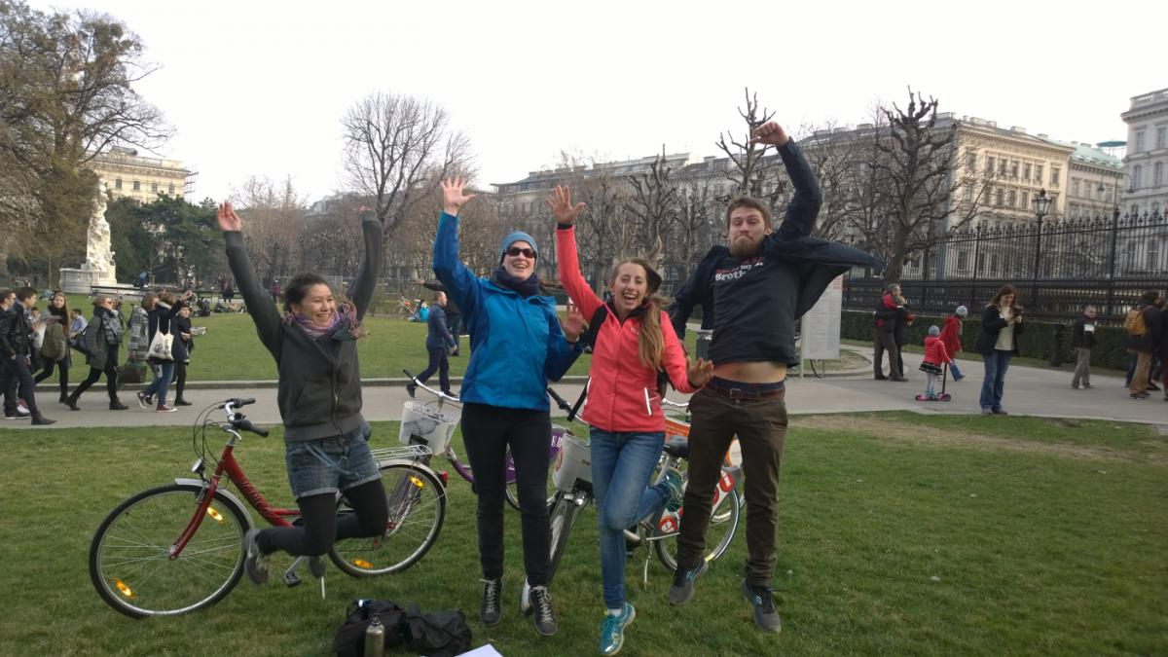

JUMP
CEHAPE
Children’s Environment Health Action Plan for Europe
young people as CEHAPE peers
thematic areas: water, air, mobility, pollutants
Projects:
upcycling workshop
waste workshop
moss graffiti on walls
river cleaning canoe-tour
cycling event
awareness-raising about chemicals
borrowing shop

Slide 10



Other Projects
Youth Strategy
strengthen and develop youth policy
exchange of knowledge and information between stakeholders
Forum Youth Strategy to thematic priorities (e.g. sustainability)
Interdisciplinary Survey
mobility of young people
transport planning
benefits of including the youth
base for the implementation of youth projects
THE PEP
Transport Health and Environment Pan European Programme
youth mobility in Austrian mobile programme
youth mobile coach for mobility projects

Slide 11
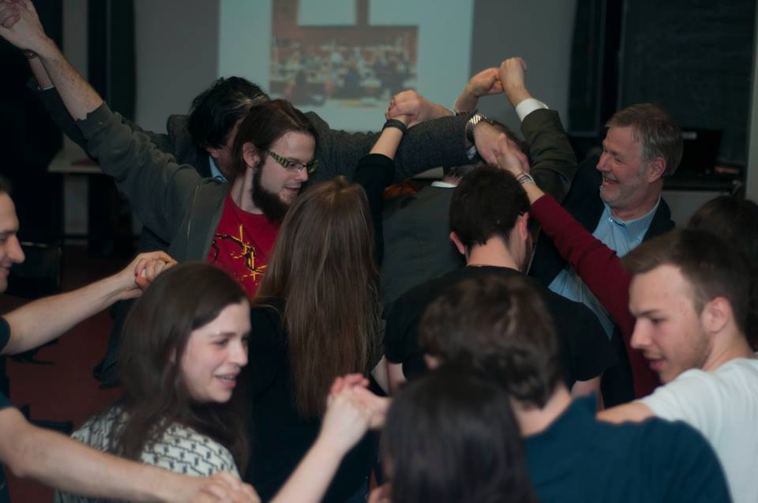
Outline:
I.) Youth Representation (Austrian National Youth Council)
Youth Delegate Programmes
II.) Projects
JUMP
Other Projects
III.) Project support

Slide 12
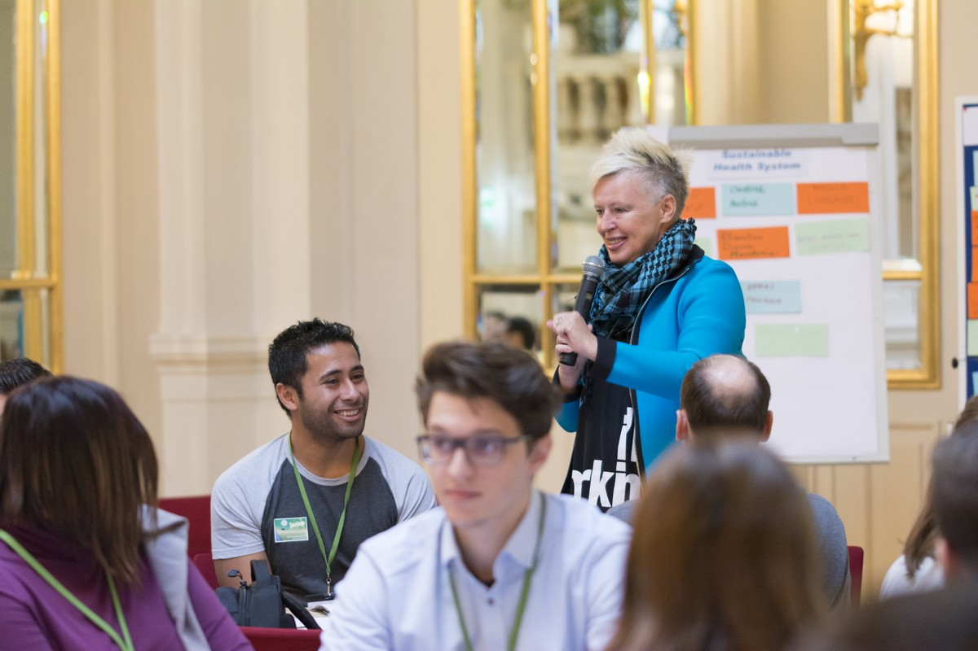
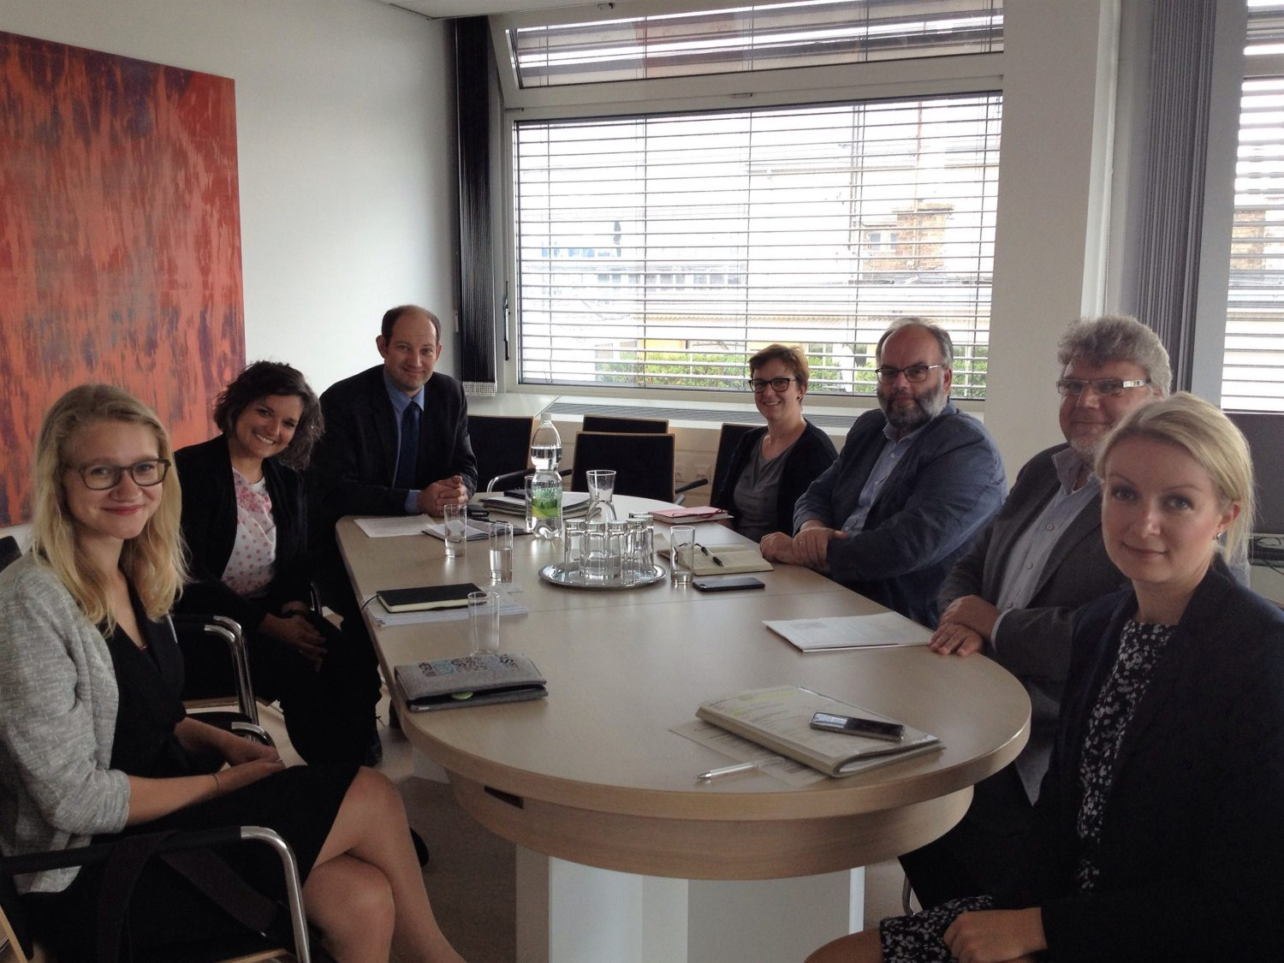
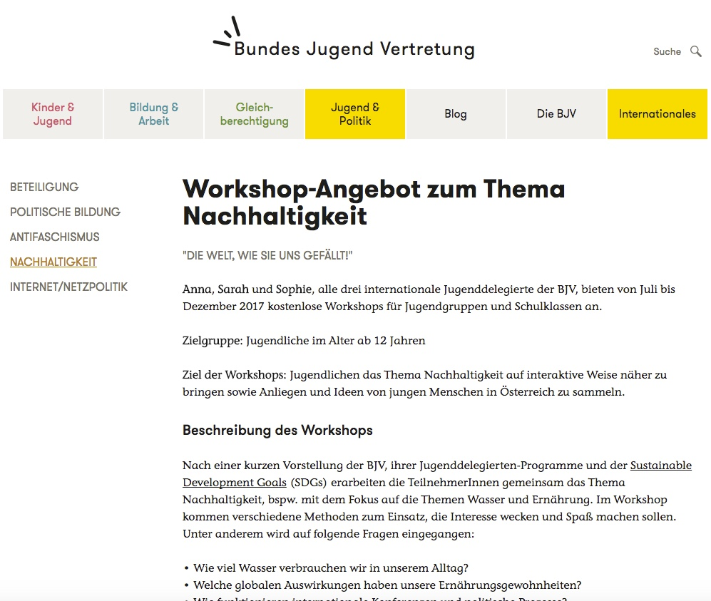
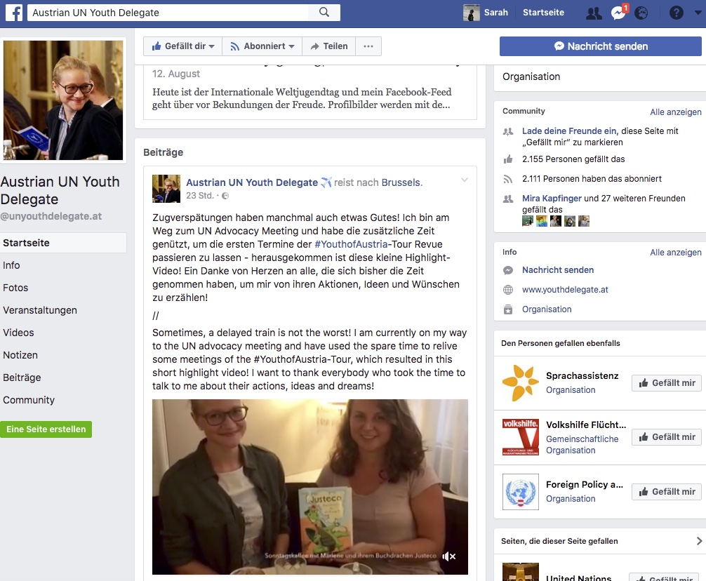
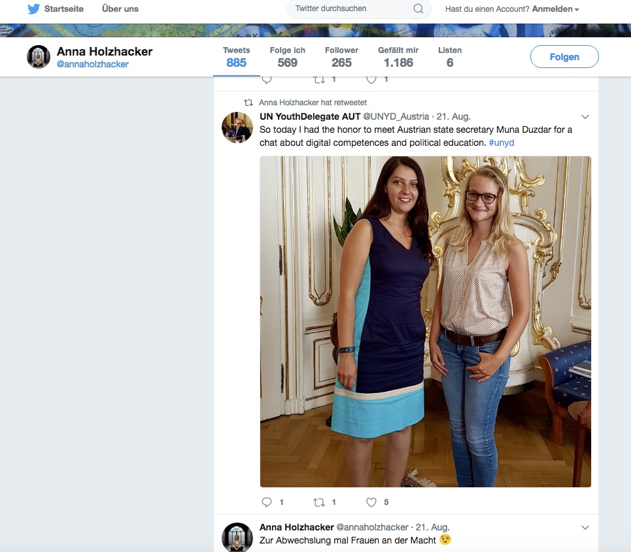
Project Support
financial support (e.g. by ministries, funds)
dissemination of knowledge (experts, material)
establish contacts with relevant persons and groups, local and regional partners (e.g. ministers, politicians, experts, activists)
publicity (share new information and offers via
websites, newsletters, different channels, ...)

Slide 13
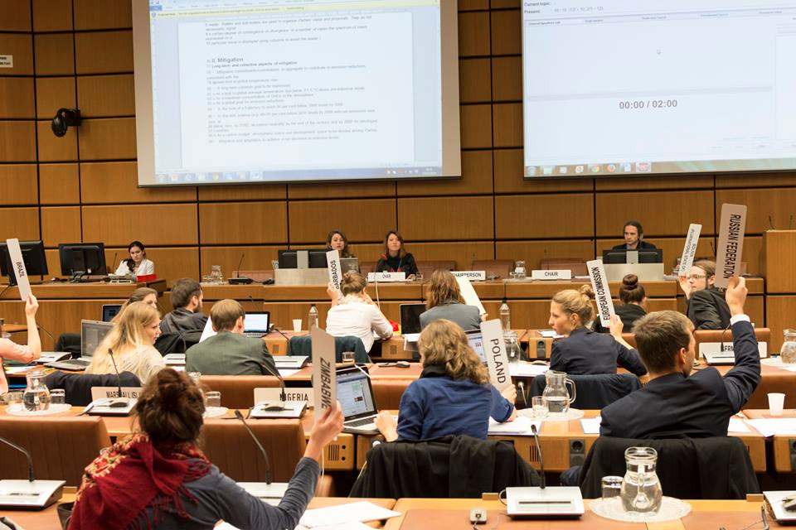
Thank you
for your
attention!
Sarah Zauner
zauner.s.j@gmail.com

