Slide 1

Environment and well-being
Nataša Kovač
Ljubljana, 11th October, 2022

Slide 2
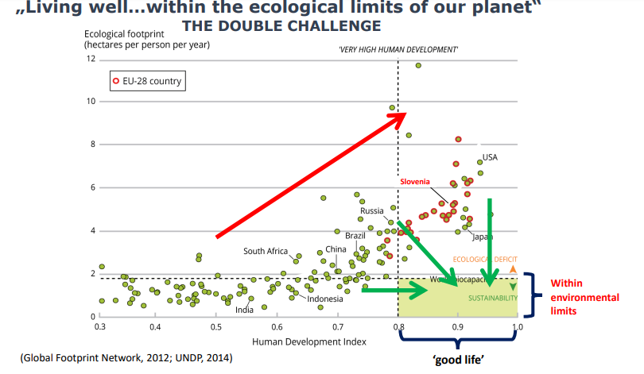

Slide 3
European Environment Action Programme
The 8th EAP shall have the long-term priority objective that
by 2050 at the latest,
people live well, within the planetary boundaries
in a well-being economy
where nothing is wasted, growth is regenerative,
climate neutrality in the Union has been achieved
and inequalities have been significantly reduced.
Source: EUR-Lex - 32022D0591 - EN - EUR-Lex (europa.eu)

Slide 4
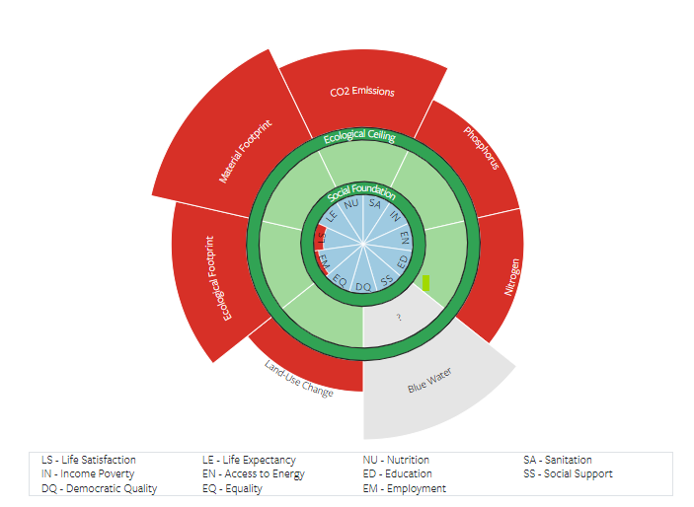
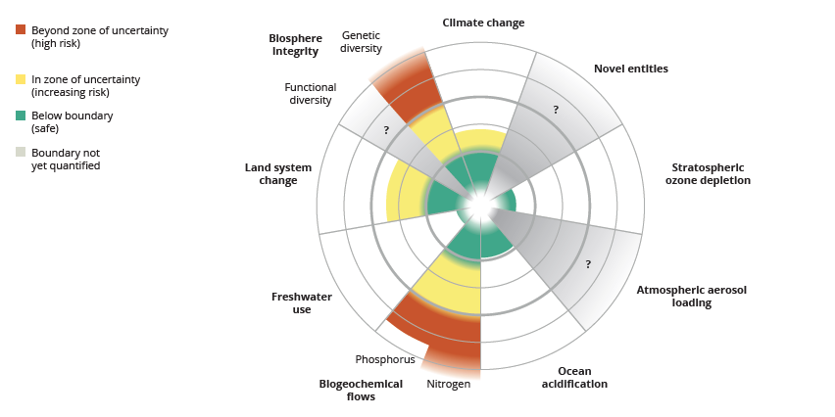
Environmental wellbeing in strongly connected with socio-economic indicators
Source: bgate.ec.europa.eu/commfrontoffice/conrep/public/login
Source: University of Leeds

