Slide 2
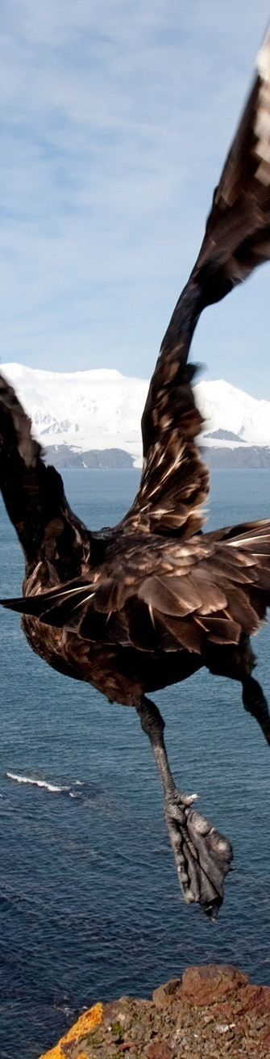
Introduction to SOER 2015
The European Environment Agency
The EEA is an independent agency of the EU established under Regulation EC/1210/90.
Based in Copenhagen since 1994 with c 210 staff
Aims to help achieve significant and measurable improvement in Europe's environment.
Through the provision of timely, targeted, relevant and reliable information to EU policymakers, business, NGOs and informed public
Working closely with a network of 39 countries – known as Eionet.
© Victor Troyanov, Environment & Me /EEA

Slide 3
SOER 2015
A comprehensive assessment of past trends and future outlooks that informs policy implementation and reflects on opportunities to recalibrate policies, knowledge, investments and innovations in line with the long-term 2050 vision of the 7th EAP.
SOER 2015 Synthesis report
SOER 2015 Assessment of global megatrends
Global
megatrends
European
briefings
Cross-country
comparisons
Countries and regions
11 briefings
25 briefings
9 briefings
39+3 briefings

Slide 4
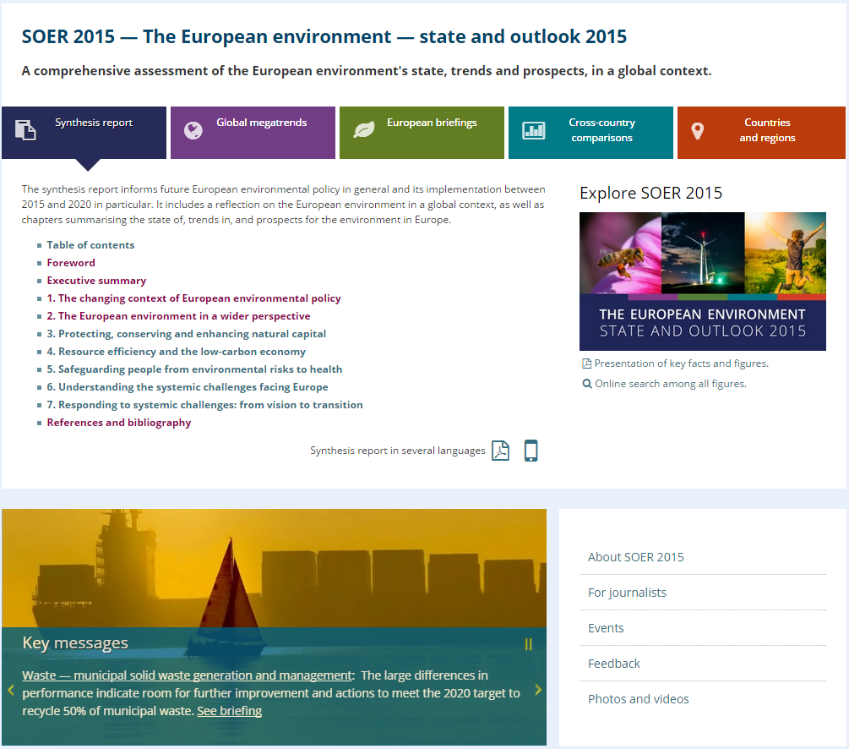
Explore SOER 2015 online: eea.europa.eu/soer

Slide 5
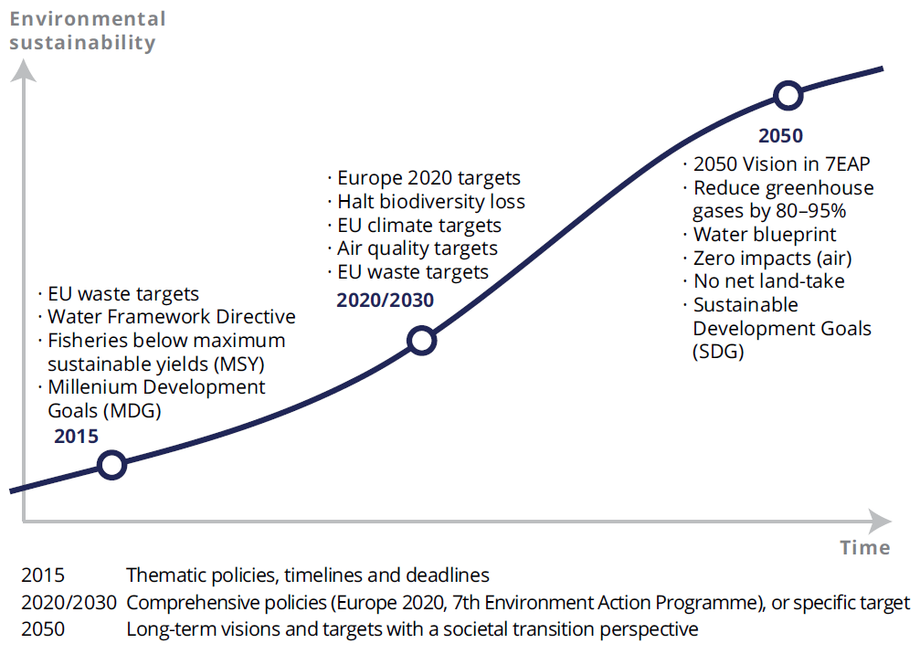
The policy context for SOER 2015
Source: EEA Multiannual Work Programme 2014–2018

Slide 6
Vision of the 7th Environment Action Programme
‘In 2050, we live well, within the planet's ecological limits.
Our prosperity and healthy environment stem from an innovative, circular economy where nothing is wasted and where natural resources are managed sustainably, and biodiversity is protected, valued and restored in ways that enhance our society's resilience. Our low-carbon growth has long been decoupled from resource use, setting the pace for a global safe and sustainable society.’
Source: 7th EU Environment Action Programme

Slide 7

Key messages from SOER 2015
Policies have delivered substantial benefits for the environment, economy and people’s well-being; major challenges remain
Europe faces persistent and emerging challenges linked to production and consumption systems, and the rapidly changing global context
Achieving the 2050 vision requires system transitions, driven by more ambitious actions on policy, knowledge, investments and innovation
Doing so presents major opportunities to boost Europe’s economy and employment and put Europe at the frontier of science and innovation
© Daniel Danko, Environment & Me /EEA
Notes:
I just want to show you where I’m going to end up with the main messages….
I’m going to go into each of these messages in a bit more detail in the coming slides.
Bullet 1: this is the message that emerges from integration.
Bullet 2: we face systemic challenges > what we mean by this is…
Bullet 3:

Slide 8
Europe’s economy and employment have reaped benefits from ambitious EU environmental policies
Eco-industry value added
Eco-industry employment
Total EU GDP
Total EU employment
© Daniel Danko, Environment & Me /EEA
Source: Eurostat, 2014.
Notes:
I just want to show you where I’m going to end up with the main messages….
I’m going to go into each of these messages in a bit more detail in the coming slides.
Bullet 1: this is the message that emerges from integration.
Bullet 2: we face systemic challenges > what we mean by this is…
Bullet 3:

Slide 9

Trends and outlooks: major challenges remain linked to production and consumption systems
Synthesis report addresses the three priority objectives of the 7th EAP:
  Protecting, conserving and enhancing natural capital
  Resource efficiency and the low-carbon economy
  Safeguarding from environmental risks to health
  Three overall patterns emerge:
EU environment and climate policies have been most notable for delivering resource efficiency improvements
Ensuring ecosystem (and social) resilience is more challenging
The long-term outlook is often less positive than recent trends imply
© Ana Skobe, Environment & Me /EEA

Slide 10
Thematic priority objective 1:
Protecting, conserving and enhancing natural capital
 | Past (5–10 year) trends |  | Progress to policy targets
Terrestrial and freshwater biodiversity |  |  | ◻
Land use and soil functions |  |  | No target
Ecological status of freshwater bodies |  |  | ☒
Water quality and nutrient loading |  |  | ◻
Air pollution and its ecosystem impacts |  |  | ◻
Marine and coastal biodiversity |  |  | ☒
Climate change impacts on ecosystems |  |  | No target
20+ years outlook
Improving trends dominate
Largely on track
☑
Trends show mixed picture
Partially on track
◻
Deteriorating trends dominate
Largely not on track
☒
Source: EEA. SOER 2015 Synthesis report.

Slide 11
Thematic priority objective 2:
Resource efficiency and the low-carbon economy
 | Past (5–10 year) trends |  | Progress to policy targets
Material resource efficiency and material use |  |  | No target
Waste management |  |  | ◻
Greenhouse gas emissions and climate change mitigation |  |  | ☑ / ☒
Energy consumption and fossil fuel use |  |  | ☑
Transport demand and related environmental impacts |  |  | ◻
Industrial pollution to air, soil and water |  |  | ◻
Water use and water quantity stress |  |  | ☒
20+ years outlook
Improving trends dominate
Largely on track
☑
Trends show mixed picture
Partially on track
◻
☒
Source: EEA. SOER 2015 Synthesis report.
Deteriorating trends dominate
Largely not on track

Slide 12
Thematic priority objective 3:
Safeguarding from environmental risks to health
 | Past (5–10 year) trends |  | Progress to policy targets
Water pollution and related environmental health risks |  |  | ☑ / ◻
Air pollution and related environmental health risks |  |  | ◻
Noise pollution (especially in urban areas) |  |  | ◻
Urban systems and grey infrastructure |  |  | No target
Climate change and related environmental health risks |  |  | No target
Chemicals and related environmental health risks |  |  | ◻ / ☒
20+ years outlook
/
Improving trends dominate
Largely on track
☑
Trends show mixed picture
Partially on track
◻
Deteriorating trends dominate
Largely not on track
☒
Source: EEA. SOER 2015 Synthesis report.

Slide 13
The overall picture:
Efficiency improvements have not secured long-term resilience
 |  | Protecting, conserving and enhancing natural capital |  |  |  |  |  |  |  | Resource efficiency and the low-carbon economy |  |  |  |  |  |  |  | Safeguarding from environmental risks to health
Past (5–10) year trends
20+ years outlook |  |  |  |  |  |  |  |  |  |  |  |  |  |  |  |  |  |  |  | /
Improving trends dominate
Trends show mixed picture
Deteriorating trends dominate
Source: EEA. SOER 2015 Synthesis report.

Slide 14
Understanding past trends and future outlooks
Two major factors explain the uneven progress and prospects:
  The changing global context
  Competition for resources
  Pressures from outside Europe
  Planetary boundaries
  Systemic characteristics of environmental challenges
  Complexity
  Uncertainty
  Environmental, social and economic interdependencies
© Ana Skobe, Environment & Me /EEA

Slide 15

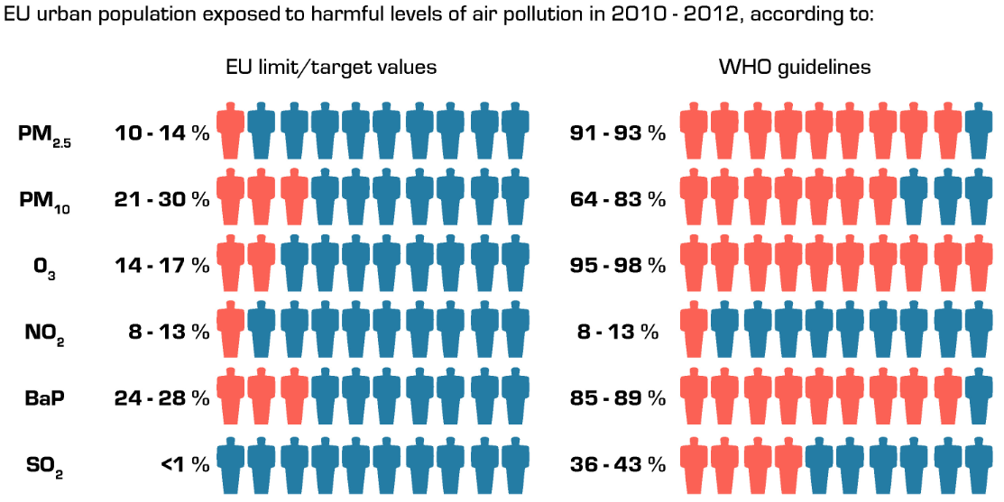
Understanding past trends and future outlooks:
Safeguarding from environmental risks to health
Impacts resulting from climate change are expected to worsen
Changing exposures, urbanisation and ageing increase vulnerability
Good urban design delivers benefits to health and well-being
© Alexander Goranov, Environment & Me /EEA
Sources: Eurostat, Gisco - Urban Audit 2012; EEA, AirBase and Indicator CSI004.

Slide 16
Looking ahead:
Systemic challenges require systemic solutions
Where efficiency, resilience, well-being and equity objectives and targets are achieved together
Through fundamental transitions in food, energy, mobility, urban, finance and fiscal systems.
Requiring profound changes in dominant practices, policies and thinking.
Source: Tesla

Slide 17
Systemic transition: the roles of public policy
  Provide a stable and ambitious framework that links the short-term and long-term perspectives for investment, innovation, knowledge.
  Reform taxation policies from taxing labour to taxing resources in the light of long-term resource use, pollution and demographic trends
  Phase out environmentally harmful subsidies and invest in sustainable food, mobility, energy and urban infrastructures
  Provide clear sustainability criteria for financial markets around:
    decarbonising production and consumption systems
    delivering circular economy jobs
    maintaining ecosystem services within planetary limits
    ensuring human health and well-being

Slide 18

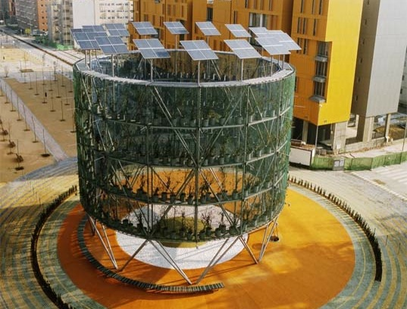
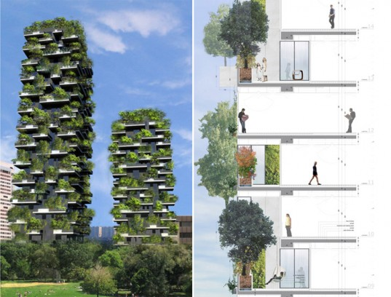
Innovation in urban systems: green infrastructure
Air trees, Madrid
Urban forest, Milano
© Victor Troyanov, Environment & Me /EEA
Notes:
Collaborative consumption focuses on the ways that consumers can obtain products or services more effectively and resource-efficiently.
Prosumerism reduces the distinction between the producer and consumer and is occurring through distributed energy production systems.
Social innovation is a problem-solving approach that entails developing new concepts, strategies and organisational forms to better meet societal needs.
Eco-innovation and eco-design go further than technological innovation and incorporate environmental considerations into product design, production and life cycle.

Slide 19


Innovations in energy systems: light
Cadmium light bulb
Nano- quantum dot light
© Victor Troyanov, Environment & Me /EEA
Notes:
Collaborative consumption focuses on the ways that consumers can obtain products or services more effectively and resource-efficiently.
Prosumerism reduces the distinction between the producer and consumer and is occurring through distributed energy production systems.
Social innovation is a problem-solving approach that entails developing new concepts, strategies and organisational forms to better meet societal needs.
Eco-innovation and eco-design go further than technological innovation and incorporate environmental considerations into product design, production and life cycle.

Slide 20
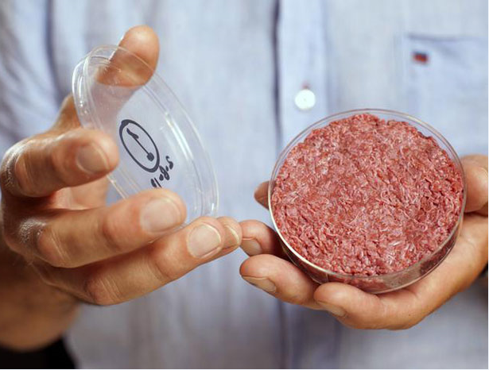
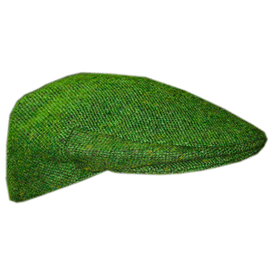
Innovations in food systems: “natural” resources
Plant-based meat
Resource-efficient green CAP
© Victor Troyanov, Environment & Me /EEA
Notes:
Collaborative consumption focuses on the ways that consumers can obtain products or services more effectively and resource-efficiently.
Prosumerism reduces the distinction between the producer and consumer and is occurring through distributed energy production systems.
Social innovation is a problem-solving approach that entails developing new concepts, strategies and organisational forms to better meet societal needs.
Eco-innovation and eco-design go further than technological innovation and incorporate environmental considerations into product design, production and life cycle.

Slide 21
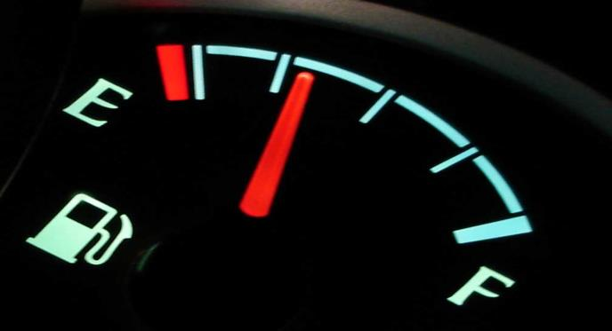
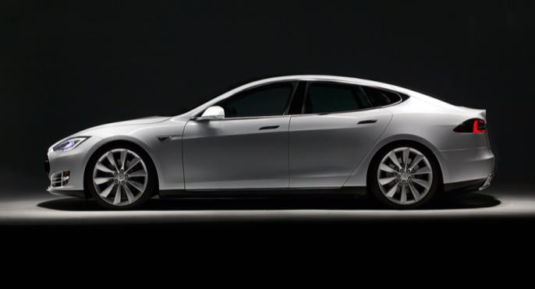
Innovations in mobility systems: incremental vs fundamental
Not just incremental efficiency gains Nor the electric car
Source: Tesla
Rather fundamental rethinking about how spatial planning and access to social, economic and ecosystem services especially given expected climate change impacts, urban depopulations, lifestyle disease trends

Slide 22
Environment fiscal policy has decoupled from GDP in EU27 since 2000
Late 1990s similar growth rates of GDP and tax revenues
Since 2003 energy and environment tax revenues growth flat
Large differences between Member States – see EEA paper
© Daniel Danko, Environment & Me /EEA
Source: EEA, 2015, based on Eurostat data.
Notes:
I just want to show you where I’m going to end up with the main messages….
I’m going to go into each of these messages in a bit more detail in the coming slides.
Bullet 1: this is the message that emerges from integration.
Bullet 2: we face systemic challenges > what we mean by this is…
Bullet 3:

Slide 23
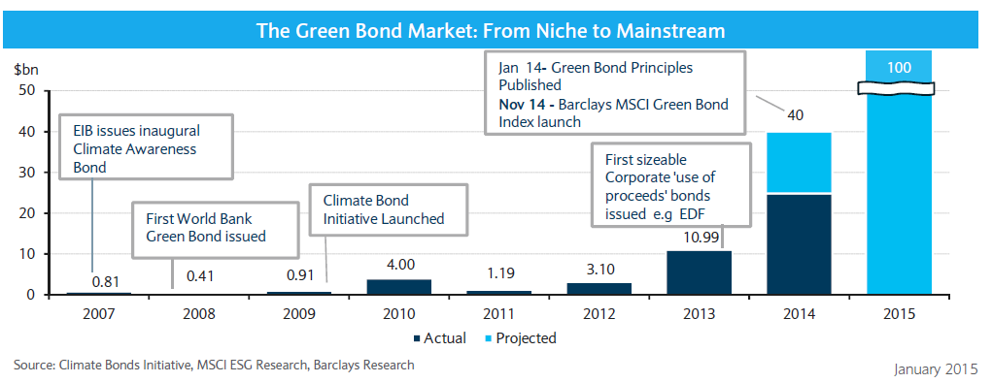
The green bond market: from niche to mainstream?
  Adequate financial resources are essential to the realisation of a resource-efficient, low carbon EU economy. Green bonds are a growing hybrid investment combining public and private sources
© Victor Troyanov, Environment & Me /EEA

Slide 24
Looking ahead:
Living well within the limits of the planet by 2050
Achieving the 2050 vision is possible but it depends on our actions and investments today across six key domains.
Criteria for long-term systemic change should deliver decent employment and salaries and be equitable, while respecting environmental limits.
SOER 2015 illustrates the many successes of European environment and climate policies. EU should be confident to initiate a new stage of sustainability governance globally.
Thank you!
© Victor Troyanov, Environment & Me /EEA
Notes:
- although full implementation of existing policies will be essential, neither the environmental policies currently in place nor economic and technology-driven efficiency gains will be sufficient to achieve Europe’s 2050 vision.
Europe needs more coherent and ambitious policies, alongside better knowledge and smarter investments aimed at transforming key systems such as food, energy, housing, transport, finance, health and education.
In setting out the challenge and identifying potential respnoses, SOER 2015 expands the knowledge base for effective decision-making.

