Slide 1
Framework for Transition to Green Economy in Slovenia
SOER presentation, 5. 6. 2015
Tatjana Orhini Valjavec, Environmental Directorate
Ministry of the Environment and Spatial Planning

Slide 2
Why Green Economy in Slovenia?
Welfare of people, quality of living, sustainability
In future only green economy will be competitive
SI_ndustry 4.0: smart factories
Smart buildings and homes
Smart use of resources
Health
Smart cities and communitiesi
VISION
Draft Strategy of Smart Specialisation: priorities after process of collecting initiatives and analysis
Clean and healthy
Attractive and circular
Smart and innovative
Inspirational and open
Tolerant and safe

Slide 3
Green economy and environmental goals
ENVIRONMENTAL GOALS
reducing environmental pollution
preserving the environment
sustainable use of natural resources
reducing energy use and use of renewable sources of energy
improving caused imbalances in nature
Improving resource efficiency in production and consumption
eliminating and substituting use of dangerous substances
ECONOMIC GOALS
growth
jobs
welfare provision
strenghtening of international competitiveness
GREEN ECONOMY: opportunities, entering new markets, new knowledge and competences enabling more permanent and sustainable growth and jobs

Slide 4
Framework for change in Slovenia
need for changes in policies, habits and management
  needs expressed by SMEs: study on resource efficiency in manufacturing sector
sustainable management of resources as a key factor (natural capital, human capital, space)
  cross-sectoral work

Slide 5

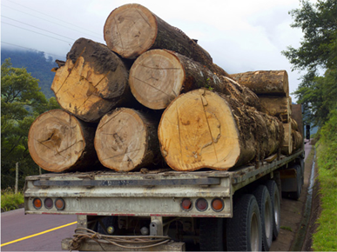

Start: Framework Programme
        basis: structured, active and continuous dialogue among stakeholders
connecting ongoing activities and upgrading
them
support for focused investments
new knowledge and skills and their
transfer to economic and policy actors

Slide 6


Framework Programme Goals
link activities from existing strategies
to upgrade them with some new measures
to support faster transition to green economy
actively protect and manage natural resources
                to link environmental protection with economic opportunities

Slide 7

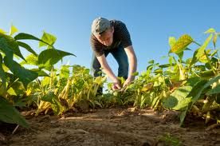

Proposed key work packages
            Sustainable management of resources
            Support for enterprises for green growth
Increasing demand for green products and services, green public procurement
Green fiscal reform
Education for green growth
            Sustainable urban development
            Green practises in agriculture and forestry
            Public sector as a positive example

Slide 8

Suggestions for effective process
Using existing potentials
Linking policies and sectors
Smarter planning
Better dialogue
Making a decision by everyone that we all have to contribute for effective transition to green economy

