Slide 1
Green Economy at EEA

Slide 2

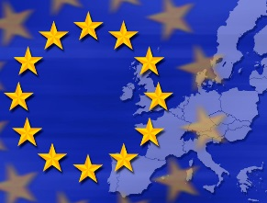





Green economy
GO TO ONLINE BRIEFING
Green economy: four dimensions
Resource-use efficiency
Ecosystem resilience
Human well-being
Societal equity
© Steve Mynhardt, Environment & Me /EEA

Slide 3
7th EAP vision → long-term green economy transition
‘In 2050, we live well, within the planet's ecological limits.
Our prosperity and healthy environment stem from an innovative, circular economy where nothing is wasted and where natural resources are managed sustainably, and biodiversity is protected, valued and restored in ways that enhance our society's resilience. Our low-carbon growth has long been decoupled from resource use, setting the pace for a global safe and sustainable society.’
Source: 7th EU Environment Action Programme

Slide 4
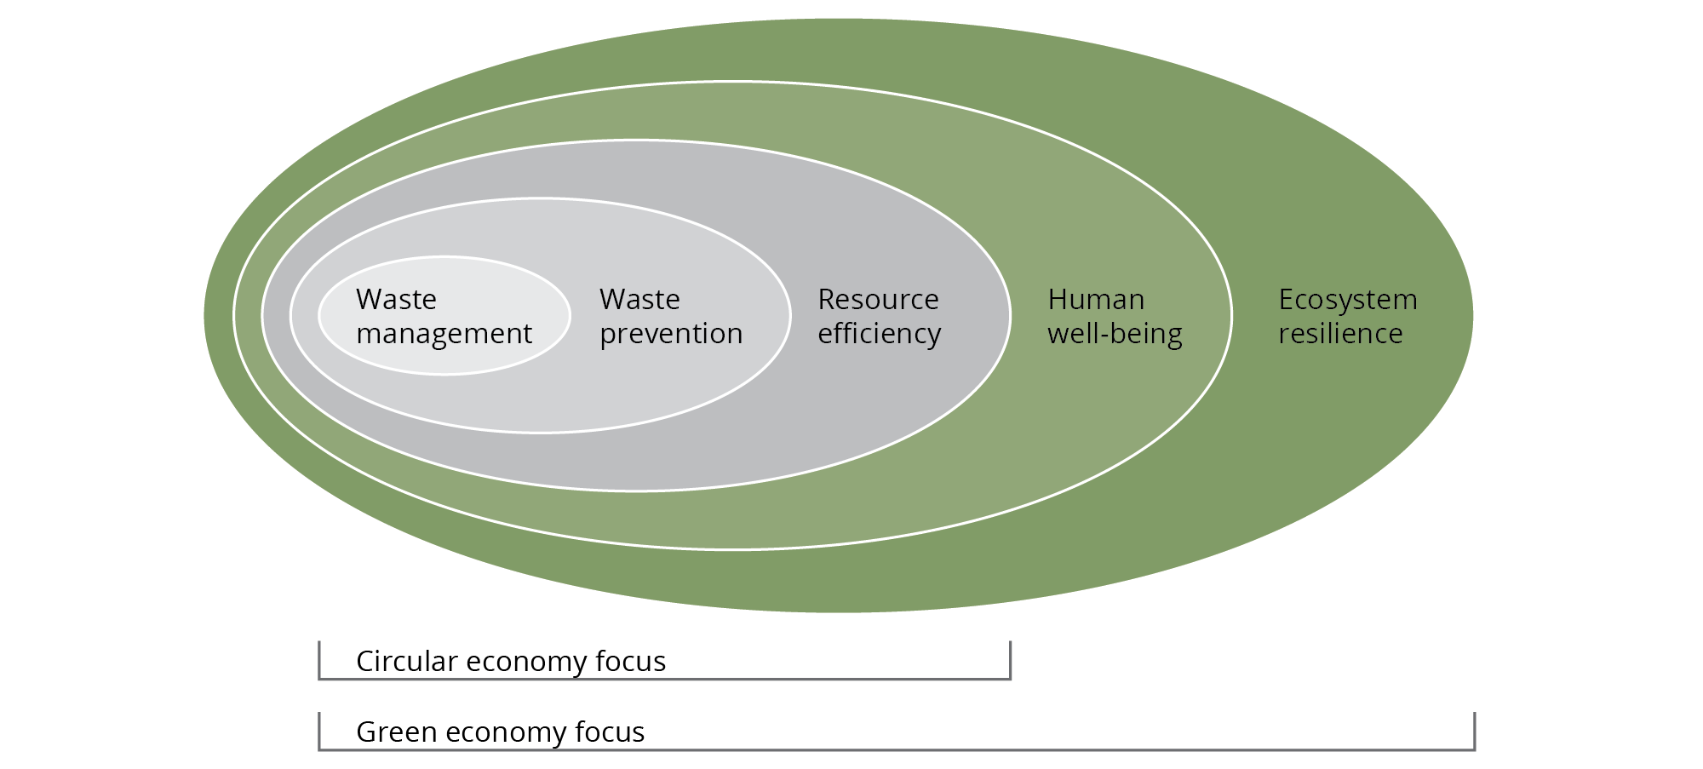
Green economy
Green economy and circular economy
Source: EEA.

Slide 5
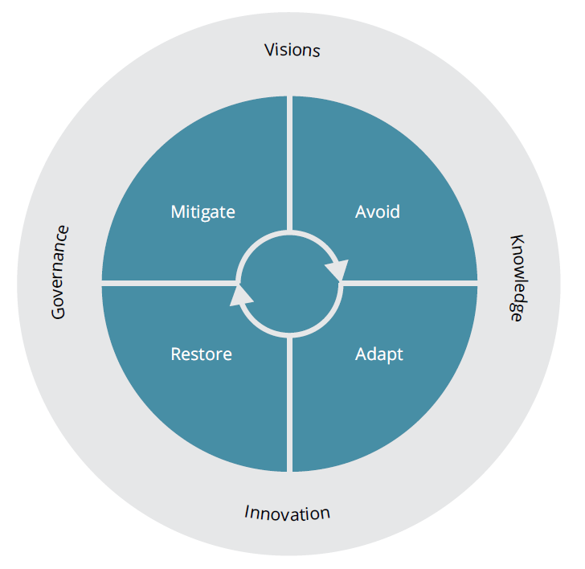
Enabling factor: joined-up policy responses
Reducing environmental pressures or offsetting harmful effects
Precautionary principle: avoid potential harm (or counter-productive actions) in highly complex and uncertain situations
Remediating environmental degradation (where possible) or other costs imposed on society
Some environmental change inevitable: anticipate adverse effects of specific environmental changes
Source: EEA.

Slide 6

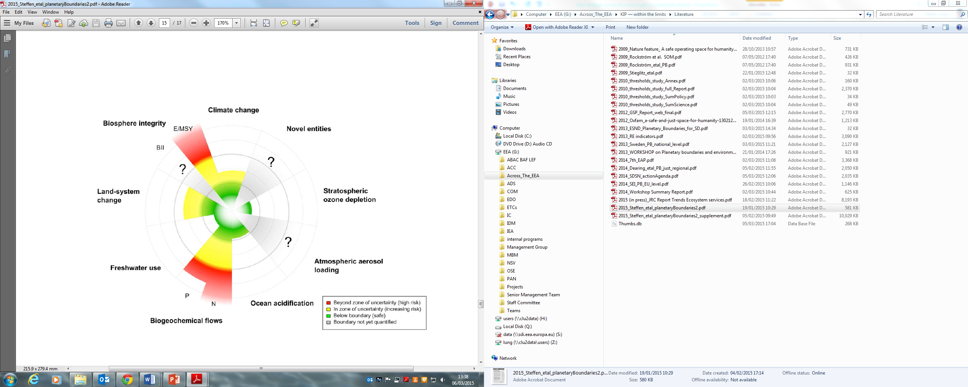

Planetary boundaries and green economy
PB – ”framework for resilience, growth, poverty eradication and human health”
© Ana Skobe, Environment & Me /EEA

Slide 7
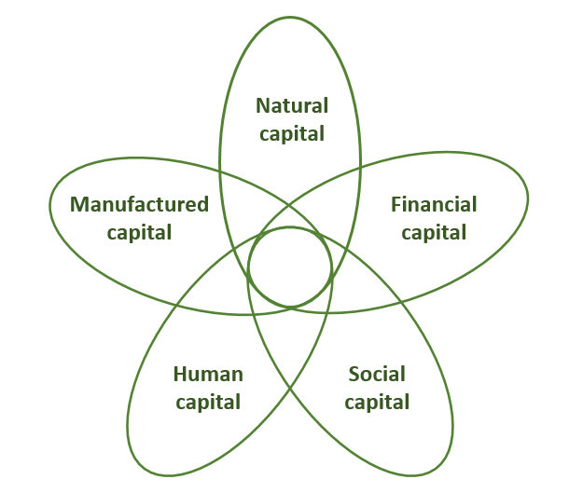
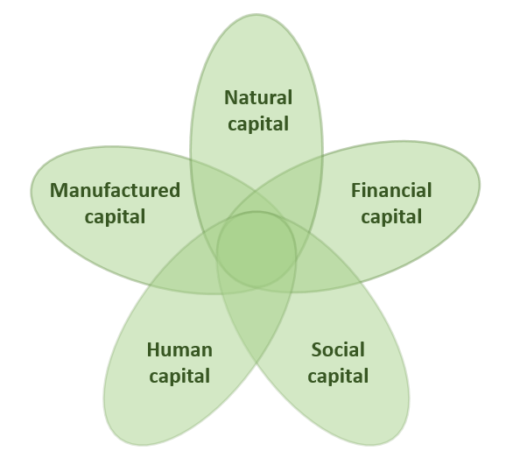
Green economy
GO TO ONLINE BRIEFING
Enabling factor: joined up indicators
© Steve Mynhardt, Environment & Me /EEA

Slide 8
An integrated accounting and indicator framework for green economy assessment
Aim is to develop a small indicator set that can be used to measure progress and inform policy and decision making
Conceptual framework now under development
Builds on the UNECE conference of European statisticians recommendations on measuring sustainable development
Preference given to accounting derived indicators
Resources/capital | Green economy dimension
 | Efficiency | Resilience | Well-being | Equity
Financial resources
Manufactured resources
Natural resources
Human resources
Social resources
Notes:
8

Slide 9
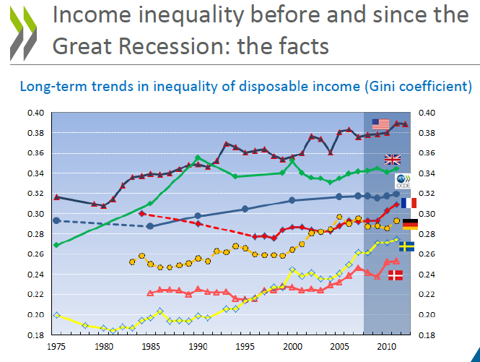
Green economy
GO TO ONLINE BRIEFING
Societal inequity: a growing issue in Europe
© Steve Mynhardt, Environment & Me /EEA
Source: Stefano Scarpetta, presentation at the OECD Green Growth and Sustainable Development Forum, 13.11.2014

Slide 10
An integrated accounting and indicator framework for green economy assessment
 | Driving forces | Pressures | State | Impacts | Responses
Accounting frameworks | SEEA Central Framework – physical flow and asset accounts SNA 2008 EU Regulation 691/2011 on environmental economic accounts |  | SEEA Central Framework –asset accounts SEEA Vol.2 – experimental ecosystem accounts Ecosystem capital accounts |  | SEEA Central Framework – monetary flow accounts EU Regulation 691/2011 on environmental economic accounts
Individual accounts | Economy-wide Material Flow Accounts GHG/Air emissions Products (raw material equivalents) Energy (due 2017) Water flow (SEEA methodology) Waste (?) |  | Corine Land Cover Biomass carbon Water (EEA methodology) Biodiversity Forest (?) Nutrients (?) |  | Environmental taxes Environmental protection expenditure (due 2017) Environmental goods and services (due 2017) Environmental subsidies and similar transfers Resource use and management expenditure
Related statistics and Data | Population Economic growth |  | Human health and wellbeing Air quality Noise
EU-27 Supply Use Input-Output Table extensions | Material resources GHG emissions Air pollutant emissions Energy (due 2014) Water quantity (?) Waste (?) |  | Land Carbon Water Nutrients (?) |  | Linked to labour, taxes, subsidies and expenditure
Notes:
10

Slide 11

Efficiency standards have driven eco-industries that have prospered despite the recession in Europe
Eco-industry value added
Eco-industry employment
Total EU GDP
Total EU employment
© Daniel Danko, Environment & Me /EEA
Source: Eurostat, 2014.
Notes:
I just want to show you where I’m going to end up with the main messages….
I’m going to go into each of these messages in a bit more detail in the coming slides.
Bullet 1: this is the message that emerges from integration.
Bullet 2: we face systemic challenges > what we mean by this is…
Bullet 3:

Slide 12
Fiscal policy signals have decoupled in wrong direction from GDP (EU27)
Late 1990s similar growth rates of GDP and tax revenues
Since 2003 energy and environment tax revenues growth flat
Large differences between Member States – see EEA paper
© Daniel Danko, Environment & Me /EEA
Source: EEA, 2015, based on Eurostat data.
Notes:
I just want to show you where I’m going to end up with the main messages….
I’m going to go into each of these messages in a bit more detail in the coming slides.
Bullet 1: this is the message that emerges from integration.
Bullet 2: we face systemic challenges > what we mean by this is…
Bullet 3:

Slide 13
Green economy
GO TO ONLINE BRIEFING
Enabling factor: joined up indicators
© Steve Mynhardt, Environment & Me /EEA

