Slide 1
Anita Pirc Velkavrh
Foresight and sustainability,
Integrated assessment programme,
European Environment agency,
Copenhagen, Denmark

Slide 2
European challenge and opportunity to deal with global threats and uncertainties.
Notes:
Evropski izziv in priloznost da upravlja z glbalnimi groznjami in negotovotimi.

Slide 3
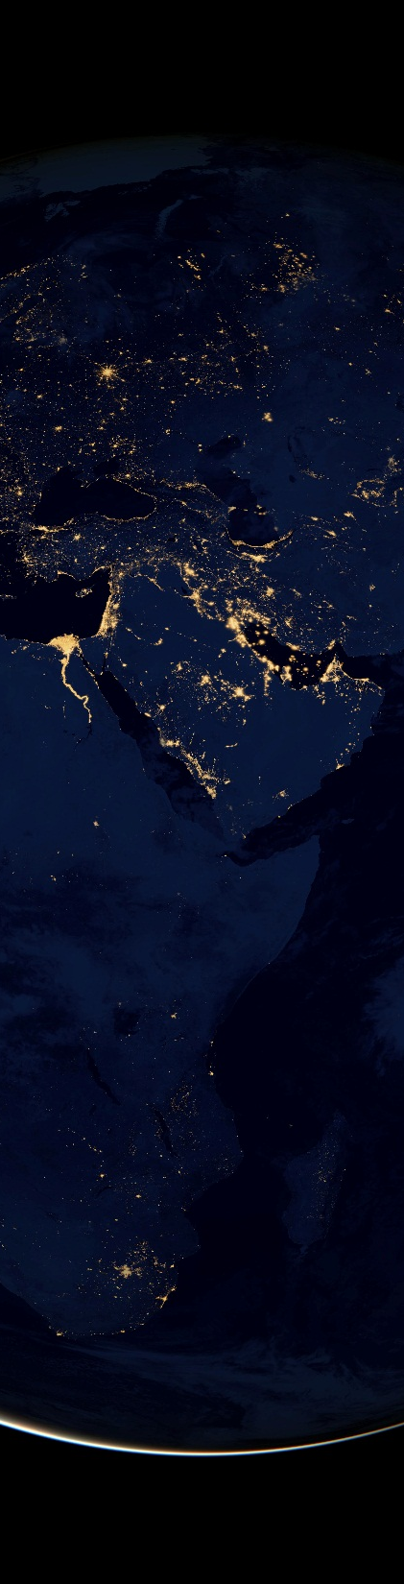
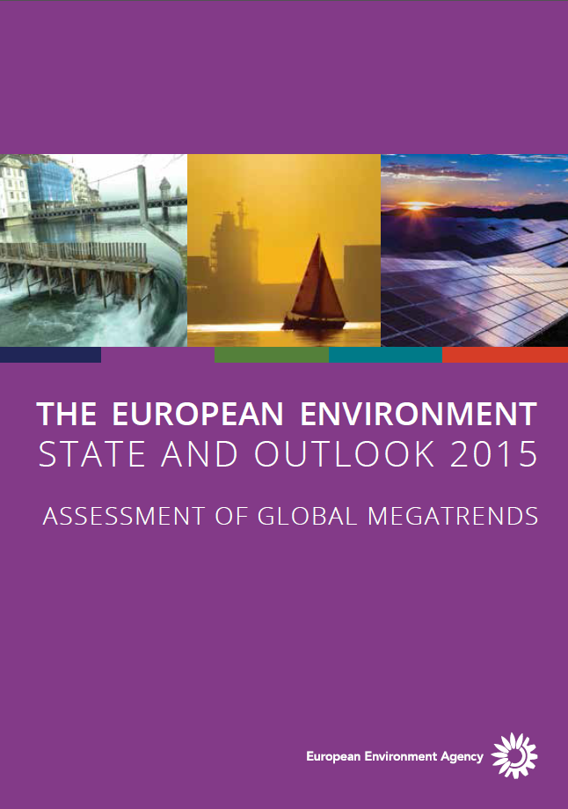
Setting the scene
Setting the scene: global megatrends relevance
Global megatrends are large-scale, high impact, expected to extended over decades and often interdependent social, economic, political, environmental or technological changes.
Europe is bound to the rest of the world through multiple systems. This means that global megatrends will significantly affect Europe’s future ecological and societal resilience and its response options.
Challenges for European environment governance arise from increasingly globalised drivers, trends and impacts.
© NASA Earth Observatory
Notes:
Evropa je povezana z ostalim svetom skozi vecplastne sistemske kompleksne povezave, ki smo jih ilustrirali z 11 GMT.
Morda je najvecja tezava za evropsko okoljsko upravljanje izhaja iz dejstva da so gonila, trendi in vplivi ki se nanasajo na okolje vse bolj globalizirani

Slide 4
11
Notes:
1 Razhajanje v svetovnih prebivalstvenih trendih:
2 Na poti k bolj urbaniziranemu svetu:
3 Spreminjajoča se bremena bolezni in nevarnost pandemij:
4 Pospešene tehnološke spremembe:.
5 Nadaljnja gospodarska rast?:
6 Čedalje bolj večpolarni svet:
7 Okrepljeno svetovno tekmovanje za vire:
8 Vse večji pritiski na ekosisteme:
9 Vse hujše posledice podnebnih sprememb:
10 Vse večja onesnaženost okolja:
11 Vse večja raznovrstnost pristopov k upravljanju:

Slide 5
3
Social
Population characterisation
Notes:
Razhajanje svetovnih prebivalstvenih trendov
Na poti k bolj urbanizranemu svetu
Spreminjajoca se bremena bolezni in nevarnost pandeimj

Slide 6
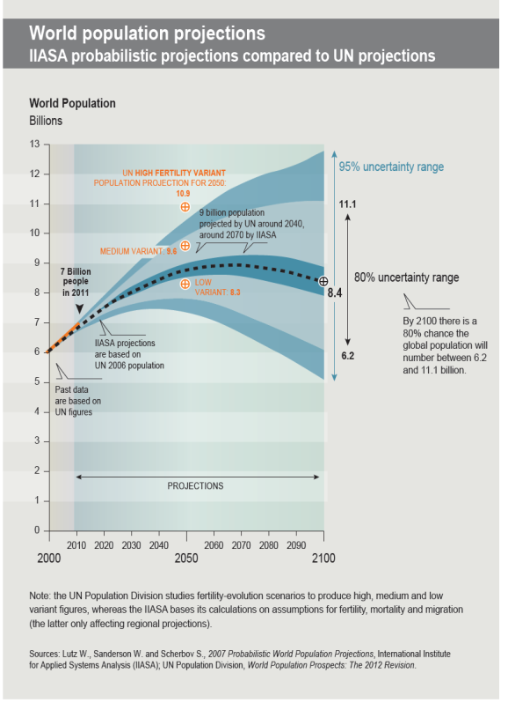
GMT 1: Diverging global population trends
The world population may rise beyond 9.6 billion by 2050, despite the rate of growth slowing..
43%
...growth of the global population by 2050
Notes:
Svetovno prebivalstvo lahko doseze 9,6 mio v letu 2050, kljub dejstvu da se globalna rast prebivalstva upocasnjuje.
Njahiterje rastoca regija absolutno in relativno bo Afria.
Globalno gledano se prebivalstvo stara, v razvitih dezelah (Eu) bolj kot v razvijajocih. Tam bo se vedno prisoten v dolocenih letih 2030 velik kohort mlade delovne sile. Glede na moznosti, ki jim jih bo nudila druzba, bodo predstavljali lahko problem in vir nemirov v drzavi ali pa bodo proizvajali dodano druzbeno vrednost doma ali pa v tujih drzavah kot emigranti.
Strukturne spremembe v sestavi prebivalstva so tesno povezane z izobrazevanjem Skupaj predstavljajo druzbeni capital, ki bo v najvecjem porastu v Aziji

Slide 7
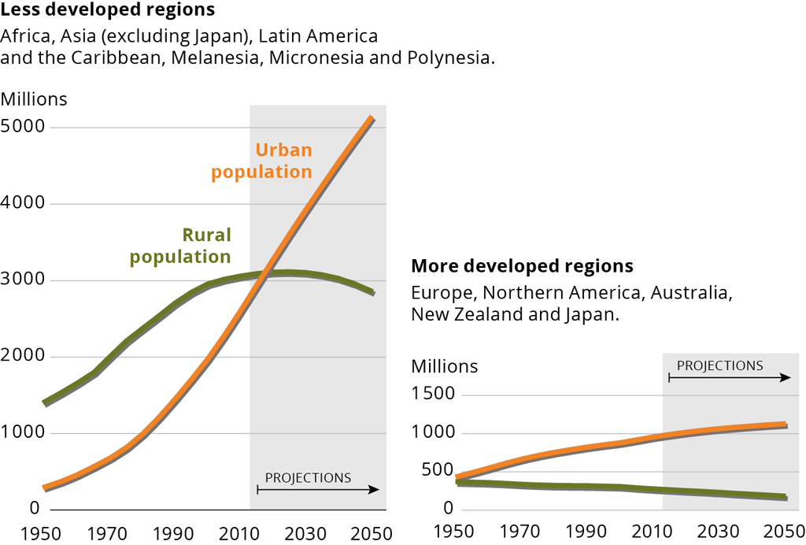
GMT 2: Towards a more urban world
GMT 3: Changing disease burdens and risks of pandemics
67%
… of the world population will live in cities by 2050
25%
Most of the population increase will occur in developing world urban areas, particularly slums and megacities.
...of the global burden of disease and deaths can be attributed to environmental causes (mostly urban air pollution, PM, ozone)
Source: UN World urbanization prospects: The 2012 revision
Urban and rural population in developed and less developed world regions, 1950–2050
Notes:
Danes smo na kriziscu trendov, ko je svetovni delez urbanega prebivalstva prerastel podezelskega. 67% svetovnega prebivalstva bo 2050 zivelo v mestih. Skoraj vsa rast prebivalstva do leta 2050 bo locirana v urbanih obmocjih razvijajocih se drzav, v slamih in mega mestih.
Kompaktne urbane zdruzbe bodo v okviru dobrega upravljanja naujcinkovitejsi in okoljsko najprimernejsi nacini naseljevanja prebivalstva. Smart
Compact cities are the most efficient and environmentally sustainable way to house a growing population. Smart cities (komunikacijske tehnologije, internet, inovacije, TR, kakovost zivljenja) planiranje zagotavlja ucinkovito rabo, ponovno uporabo in mulitfunkcijsko/mesano rabo urbanega prostora.
V Evropi peri-urbana obmocja rastejo 5x hitreje kot urbana.
Urban growth is driving land-use change in Europe, with peri-urban areas developing at four times the rate of towns and cities. Smart planning and governance could increase environmental resilience of Europe’s cities, particularly in the east and south.

Slide 8
1
Technologicalacceleration
Notes:
Pospesene tehnoloske spremembe

Slide 9
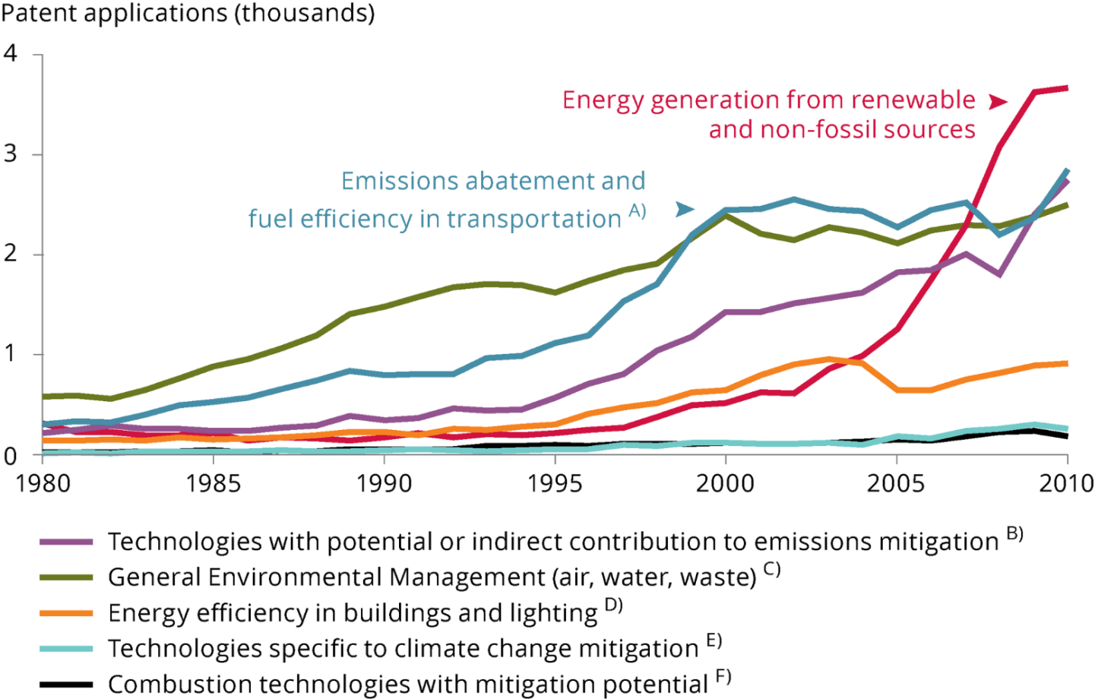
GMT 4: Technological innovation is rapid and accelerating, including in the field of green technology
The unprecedented pace of technological change provides opportunities to reduce humanity’s impact on the environment and reliance on non-renewable natural resources, while improving lifestyles, stimulating innovation and green growth.
Innovation, however, brings also risks, which could be minimised with policies.
Source: OECD, 2014.
Environment-related patent applications to the European Patent Office, 1980–2010
Notes:
Nove tehnologije korenito spereminjajo svet. Se zlasti na pdorocju nano in biotehnologije in informacijske in komunikaijske tehnologije. To odpora moznosti za zamnjsanje vplivov na okolje, povecanje preskrbe z viri a tudi prinasea negotovisti in tveganja vplivov.
Okoljski patenti registrirani na evropskem patentnem uradu - narascajoci trendi.
----------------------------------------------------------------------------------------------------------------------
Racing into the unknown
The pace of technological change, particularly in the fields of information, communication, nano- and bio-technologies, is unprecedented.
This provides opportunities to reduce humanity’s impact on the environment and reliance on non-renewable natural resources, while improving lifestyles, stimulating innovation and green growth.
Innovation, however, brings risks. Those associated with technological change should be minimised through the application of the precautionary principle and regulatory frameworks.
Europe’s research institutions and environmental knowledge base should enhance its position as a green leader.

Slide 10
3
Economic
growth and patterns of production and trade
Notes:
Nadaljna gospodarska rast?
Cedalje bolj vecpolaren svetr
Okrepljeno svetovno tekmovanje za vire

Slide 11
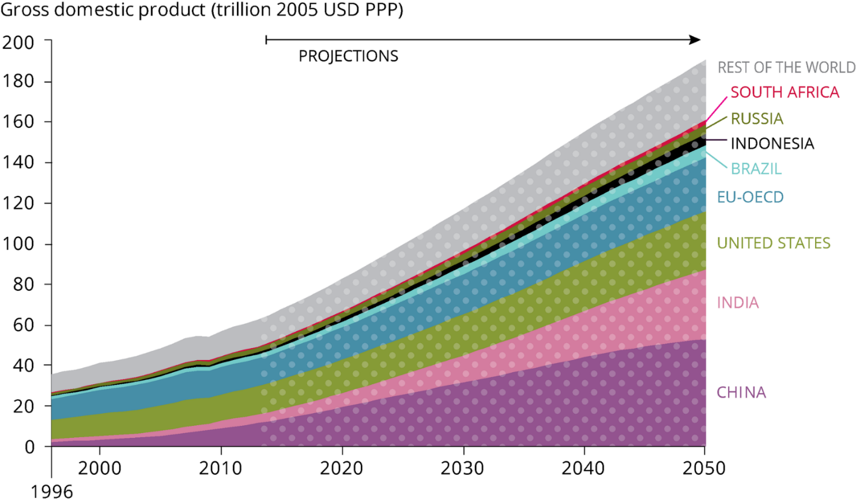
GMT 5: Continued economic growth?
GMT 6: An increasingly multipolar world
World economic output has increased 25-fold since 1900
In the period 2010-2050, global GDP is expected to grow by…
300%
but growth rates are slowing as countries become more prosperous
Shrink of OECD share
of global GDP
2000 2050
77%
42%
Growing of middle consumer class.
Source: OECD Long-term Baseline Projections 2014.
Notes:
Nadaljna gospodarska rast?
Gospodarski capital porast
Porast srednjega porabniskega razreda.
Continued acceleration of global consumption, mobility and resource use could undermine future living standards, including in Europe. However, there is some positive evidence suggesting that the decoupling of economic growth from natural resource use is possible.
International efforts to introduce environmental and natural resource considerations into systems of national accounts are underway. Without these, economic and environmental considerations will continue to be applied separately and inequitably for the planet and its people.

Slide 12
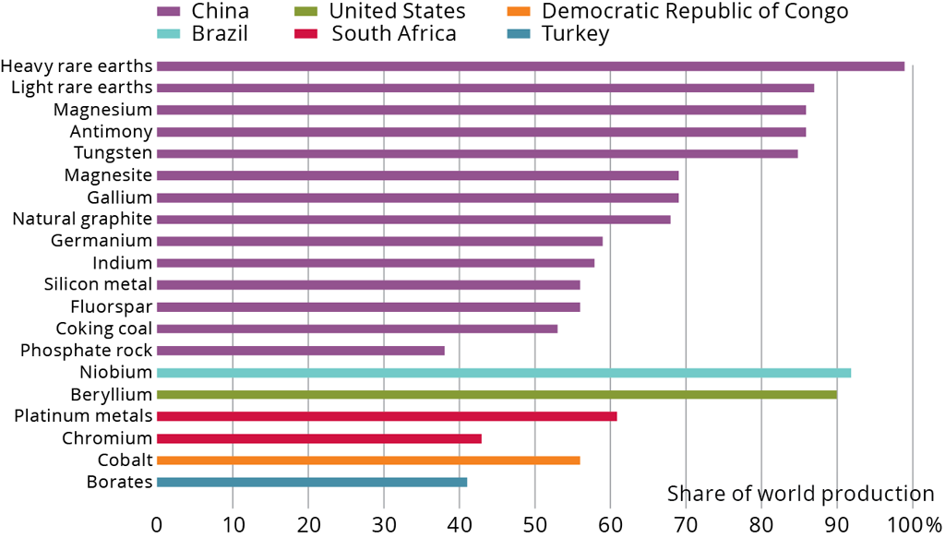
GMT 7: Intensified global competition for resources
World materials use has grown 10-fold since 1900 and may double again by 2030
The geographic concentration of some reserves creates supply risks.
Source: European Commission 2014.
Proportion of global production of EU critical raw materials within a single country, 2010–2012
Imports from outside the EU accounted for 58 % of EU-27 consumption of metal ores and products in 2011 and 79 % of fossil fuels.
Notes:
Okrepljeno svetovno tekomovanje za vire.
Gospodarstva v razvoju porabijo vec obnovljivih in neobnovljivih virov (indistrijski razvoj in vzorci potrosnje).
Neenakomerna razporeditev zalog virov predtavlja prihodnje tveganje za zagotovljen dostop do osnovnih virov,
Kar lahko povzroca restrikcije v dobavi, nizanje kvalitete zivljenja in celo geopoliticne konflikte.
Povecano pomanjkanje virov in porst cen bi lahko vzpodbudila vlade da investirajo v znanost in inovacije.
--------------------------------------------------------------
Alongside rising environmental burdens, their uneven geographic distribution implies increasingly insecure access to some essential resources, fostering supply restrictions, loss of standards of living, and even geopolitical conflict.
Growing scarcity and rising prices should create incentives, encouraged by governments, for investment in research and innovation, for example, in mining and reducing waste streams.

Slide 13
3
Environmental
- degradation of ecosystems
Notes:
Vse vecji pritiski na ekositeme
Onesnazenje ekositemov
Vplivi klimatskih sprememb?

Slide 14
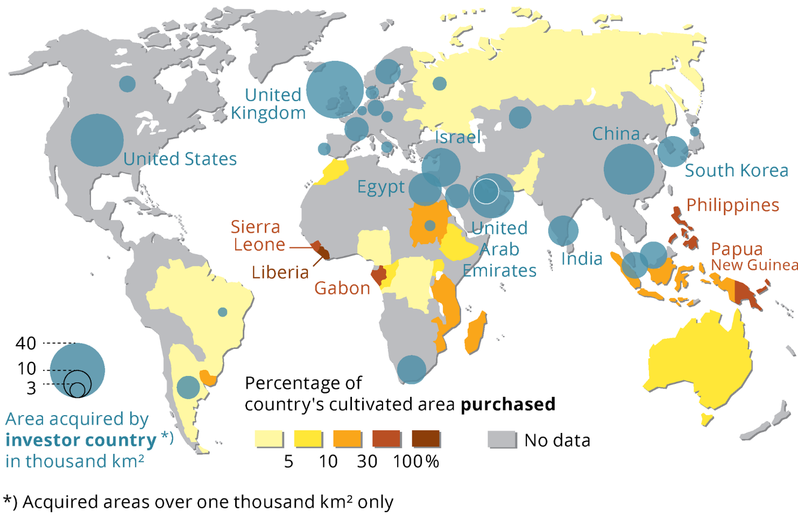
GMT 8: Growing pressures on ecosystems
Transnational land acquisition, 2005–2009
Source: Rulli et al., 2013.
Demand for meat, water and bioenergy is driving global competition for land resources
Notes:
Vse vecji pritiski na ekosisteme
Porast potreb po hrani in energiji in hitro se razvijajoci vzorci potrosnje bodo se naprej povzrocali pad bioioiverzitete, in zivljenski standard/ekksistenco predvsem ogrozenih ljudi in narodnosti.
S tem povezan je tudi pojav land grab- prisvajanje zemljisc:
Modri krogi drzave, ki si prisvajajo zemljo, drzava vlagateljica
Rumeno prisvojena/kupljena zemlja
-------------------------------------------------
The demands of a growing global population with evolving consumption patterns for food, mobility and energy are exerting ever-increasing pressure on the Earth's ecosystems and their life-supporting services. Current trends also challenge existing meat-heavy consumption patterns and strategies for bioenergy production.
Exacerbated by climate change and continued pollution, rates of global habitat destruction and biodiversity loss are predicted to increase, including in Europe.
The effects of continued ecosystem degradation on poverty and inequality in regions outside Europe may lead to increased immigration to Europe.
Grabbing countries – blue circles
Grabbed countries - coulors

Slide 15

GMT 9: Increasingly severe consequences of climate change
Recent changes in the global climate are unprecedented over millennia and will continue.
This megatrend is strongly interlinked to other GMTs which are clearly shaping future GHG emissions, which are in turn also the driver of environmental change in its own right.
It represents the pressure on the top of other socio-economical pressures (urban sprawl, use of natural capital) aggravating the complexity of problems.
Impacts damage ecosystems and biodiversity, as well as infrastructure and human well-being.
© Manuela Aldeghi, Environment & Me /EEA
Notes:
Nedavne klimatske spremembe so rekordnega znacaja skozi stoletja in se bodo nadaljevale.
Povezan je z drugimi GMT, ki predstavljajo gonilne sile klimatskih spremembe (prebivalstvo, urbanizaija, tehnoloske spremembe..), kakor je tudi sam po sebi ta gmt gonilan sila prihodnjih okoljskih sprememb. Ti spiralni feedback mehanismi pridajajo k zapletenosti problemov in stopnjujenjo njihove uinke na okolje in druzbo.
Vplivi so stresni za ekosisteme, zmanjsujejo njihovo odpornost proti drugim pritiskom
Tudi ce bi izpuste toplogrednih plinov danes ustavili, bi se podnebne spremembe nadaljevala se veliko desetletij zaradi preteklih izpustov in inercije podnebnega sistema (IPPCC2013)

Slide 16
Key impacts of climate change in European regions and Slovenia
Notes:
Na splosno je sposobnost prilagajanja Evrope relativno visoka, vendar obstajajo obutne razlike med razlicnimi deli Evrope glede vplivov, ki jim bodo izpostavljeni in njihove sposobnosti prilagajanja.
Morja-zakisljevanje
Obale –erozija in dvig morske gladine
Pretoki rek-manjsi, intenzivnost sus, visje T vode
Tujerodne vrste
Kmetijstvo: spremenjene fenoloske razmere za poljscine, spremenjen obseg in razporeditev poljscin
Spremenjeni donosi
Povecana potreba po namakanju
Gore v Sredozemlju: okrnjeni ekosistemske storitve
Ocene tveganj in obcutljivosti so narejene za 22 drzav, vendar pogosto ni podatkov o stroskih in koristih prilagajanja in tudi vplivov na biodiverziteto.

Slide 17
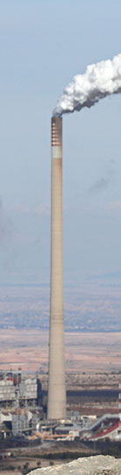
GMT 10: Increasing environmental pollution
Globally, levels of air pollution and releases of nutrients from agriculture and wastewater remain high, causing acidification and eutrophication in ecosystems, and losses in agricultural yield.
In the coming decades, overall pollution levels are projected to increase strongly, particularly in Asia.
Although Europe’s pollutant releases are expected to continue declining, European ecosystems and citizens are likely to be affected by developments in other regions.
Despite a fall in air pollutant emissions there has not been an equivalent improvement in air quality across Europe, partly as a result of the transboundary transport of air pollutants.
© Jonathan Díaz Marbá, Environment & Me /EEA
Notes:
Ekosistemi so po svetu izpostavljeni kriticnemu onesznazenju z vse bolj kompleksnimi mesanicami onesnazeval.
Onesnazenje s hranili – del dusikovega globalnega kroznega toka -zakisljevanje
Prekomejno onesnazenje
------------------------------
Recent changes in the global climate are unprecedented over millennia and will continue. Climate change is expected to increasingly threaten natural ecosystems and their biodiversity, slow economic growth, erode global food security, threaten human health and increase inequality.
The risk of pervasive and irreversible impacts is expected to increase. They could, however, be reduced by emissions abatement and adaptation measures, both in Europe and internationally.
Key risks for Europe include flood events, droughts and other weather extremes, threatening human well-being and infrastructure as well as ecosystems and biodiversity.

Slide 18
1
Governance
- diversifying
Notes:
Raznovrstnost pristopov k upravljanju
Nevladni delezniki imajo vse vecjo vlogo

Slide 19
Impacts

Slide 20
Impacts of GMTs
Global challenges:
Food ( + 70% meat by 2050)
Good water availability
Energy (+30-40% in 20 years)
Raw materials (+100% by 2030)
Ecosystem depletion (10-40% loss by 2050)
Four of the top 10 global risks are linked to the environment:
(extreme weather events; natural catastrophes, failure of climate change adaptation, water crises, biodiversity loss and ecosystem collapse)
WEF report Global Risks 2015

Slide 21
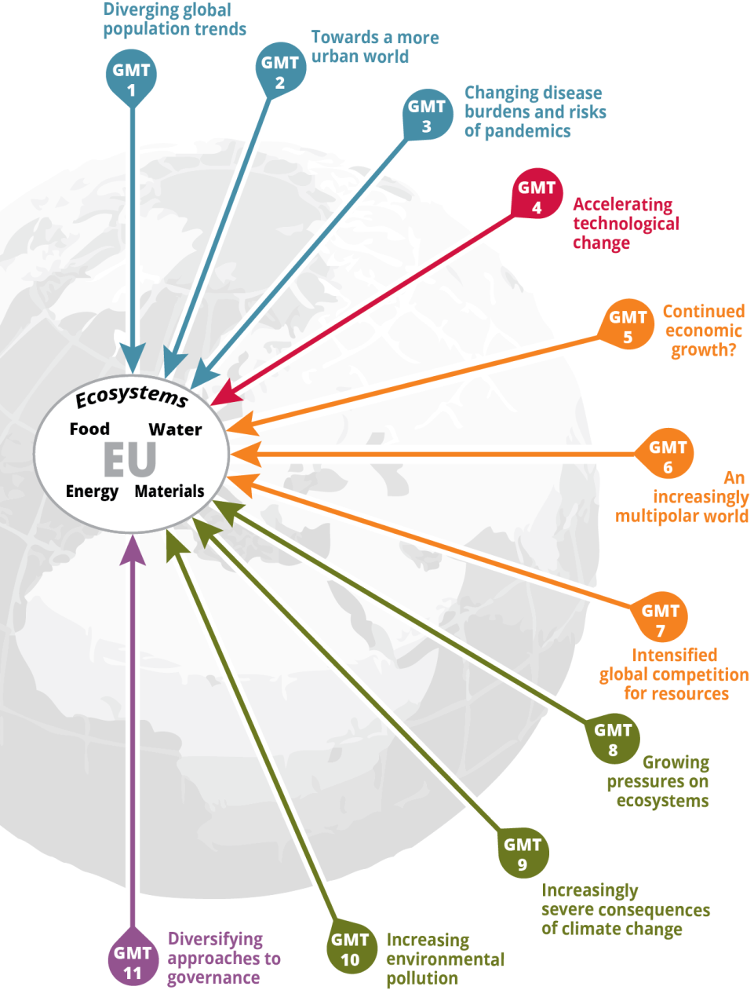
Impacts of GMTs
Global megatrends strongly impact Europe’s ability to meet its basic resource needs:
Food
Water
Energy
Materials
Ecosystems and their services
Europe has opportunities through different response options to shape and adapt to global megatrends
© NASA Earth Observatory
Notes:
Dolgorocna oskrba s hrano, vodo, energijo, surovinami ni odvisna le od izboljsane ucinkovitosti njihove rabe in povecevanja odpornosti ekositemov, temvec je tudi odvisna od svetovne dinamike nad katero Evropa nima nadzora, ali le v omeji meri. Evropska prizadevanja za amanjsanje pritiskov na okolje imajo vse manjsi ucinek zaradi neustavljivih trendov v drugih delih sveta.. Zato bi bilo potrebno izkoristiti vse mozne priloznosti.

Slide 22
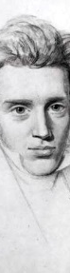
Increasing Relevance of Foresight
EU’s Foresight use has grown significantly in the past 20 years
Used across different domains and sectors e.g.
To guide policymaking, to develop strategies,
To explore new markets, products and services,
To raise general public awareness of developments to influence future etc.
Main EU institutions: EEA/Eionet, DG RTD, Joint Research Centre, European Parliament, European political strategy center
Life can only be
understood
backwards;
but it must be
lived forwards.
© Martijn Bergsma, Environment & Me /EEA
Soren Kierkegaard
1813 - 1855

Slide 23
Impacts of GMTs – National level
EIONET NRC FLIS –project coordinated by CH to collectively investigate national impacts of GMT under the same methodology (2015-2016-2017)
Some countries already specifically included GMTs and their impacts in latest SoE reports (Belgium, Switzerland, Austria)
ARSO- indicator database – many links to GMT can enable assessment, lack of forward-looking indicators
Slovenian national indicator | Link to GMT
6 | Diverging global population trends:
13 | Towards a more urban world:.
18 | Changing disease burdens and risks of pandemics:
 | Accelerating technological change:
3 | Continued economic growth?:
1 | An increasingly multipolar world:.
20 | Intensified global competition for resources:
18 | Growing pressures on ecosystems:
18 | Increasingly severe consequences of climate change:
41 | Increasing environmental pollution:
5 | Diversifying approaches to governance

Slide 24
Explore SOER 2015 online:
eea.europa.eu/soer

