Slide 1
Anita Künitzer/19 June 2017/Freshwater Eionet workshop 2017
Update on ETC/ICM activities

Slide 2

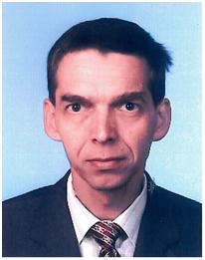



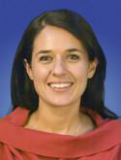


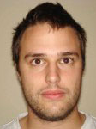

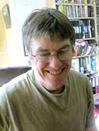

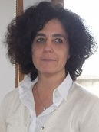
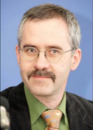

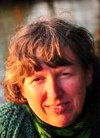
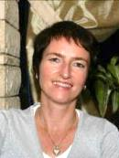
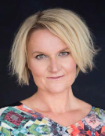
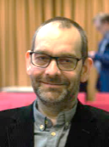
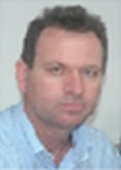
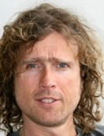

ETC/ICM teams 2017
Hans Mose Jensen
Miroslav Fanta
Jørgen N.
Jensen
Data team
Core team
Team lead
CENIA
Ad
Jeuken
Jørgen N.
Jensen
Neil
Holdsworth
Freshwater
team
Marine
team
Claudette
Spiteri
Ursula Schmedtje
Jiří Kvapil
Štefan
Trdan
Team lead
UBA Dessau
Team lead
JNCC
Lidija Globevnik
David Vaughan
Kari Austnes
UFZ:
ETC Manager: Anita Künitzer
ETC Assistant
Financial contact
Scientific key experts
Sabrina Agnesi
Ursula Schmedtje
David Vaughan
Volker Mohaupt
Benjamin Boteler
Petra Ronen
Monika Peterlin
Jesper H. Andersen
Evangelos Baltas
Gerjan J.
Piet
Bethany
Stoker

Slide 3
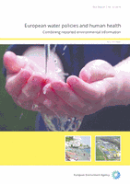
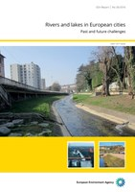
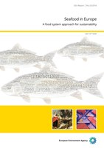
Publications 2016 based on ETC-ICM work (1)
EEA Report No 32/2016 ‘European water policies and human health — Combining reported environmental information’ ISBN 978-92-9213-834-9
Authors: J. Völker, A. Künitzer, L. Globevnik, S. Isoard, P. Kristensen, J. Kvapil, H. Prchalova, P. Ronen, U. Schmedtje, L. Snoj, G. Šubelj, B. Werner, C. Whalley
EEA Report No 26/2016 ‘Rivers and lakes in European cities’, ISBN 978-92-9213-821-9
Authors: E. Kampa, G. Anzaldúa, S. Langaas, P. Kristensen, U. Schmedtje, S. Isoard, B. Georgi, M. Cugny‑Seguin
EEA Report No 25/2016 ‘Seafood in Europe — A food system approach for sustainability’, ISBN 978-92-9213-818-9
Authors: C. Belchior, B. Boteler, H. Jansen, G. Piet, M. Dickey-Collas, K. McFarland, L. Olivia Smith, C. Maguire, E. Gelabert, J. Reker, I. Vidal

Slide 4
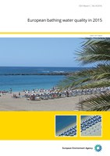
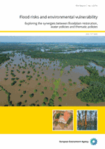
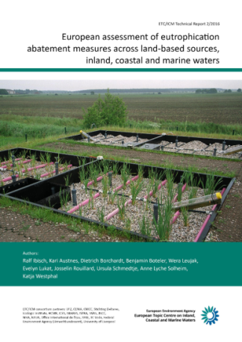
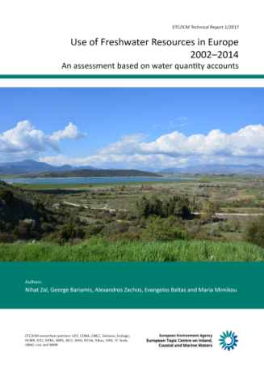
Publications 2016 based on ETC-ICM work (2)
EEA Report No 9/2016 ‘European bathing water quality in 2015’ ISBN 978-92-9213-734-2
Authors: L. Globevnik, L. Snoj, G. Šubelj, P. Kristensen
EEA Report No 1/2016 ‘Flood risks and environmental vulnerability — Exploring the synergies between floodplain restoration, water policies and thematic policies’, ISBN 978-92-9213-716-8
Authors: W. Vanneuville, H. Wolters, M. Scholz, L. Snoj, L. Globevnik, J. Mysiak, Ch. Seijger, Ch. Schulz-Zunkel
ETC/ICM Technical Report 2/2016 ‘European assessment of eutrophication abatement measures across land-based sources, inland, coastal and marine waters’, ISBN 978-3-944280-55-4
Authors: R. Ibisch, K. Westphal, D. Borchardt, J. Rouillard, E. Lukat, B. Boteler, A. Lyche Solheim, K. Austnes, W. Leujak, U. Schmedtje, Ed.: A.Künitzer
ETC/ICM Technical Report 1/2016 ‘Use of freshwater resources in Europe 2002-2012 - Supplementary document to the European Environment Agency’s core set indicator 018’, ISBN 978-3-944280-54-7
Authors: E. Baltas, N. Zal, G. Bariamis, A. Zachos, D. Panagos, I. Konstantinou, M. Mimikou , Ed.: A.Künitzer

Slide 5
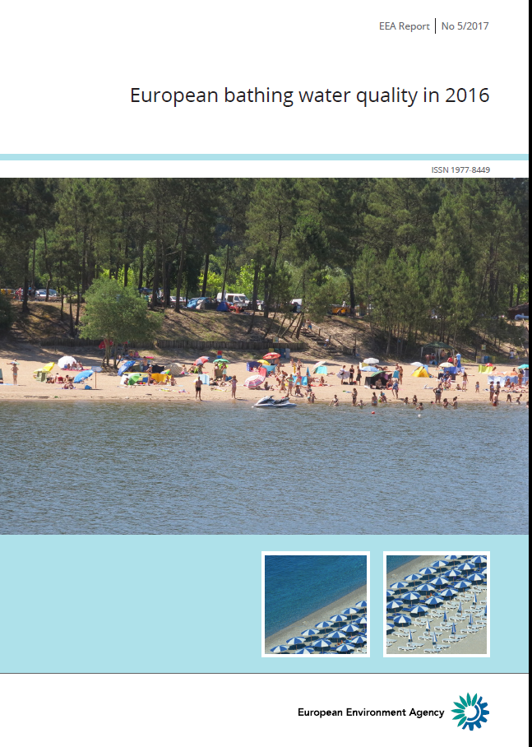
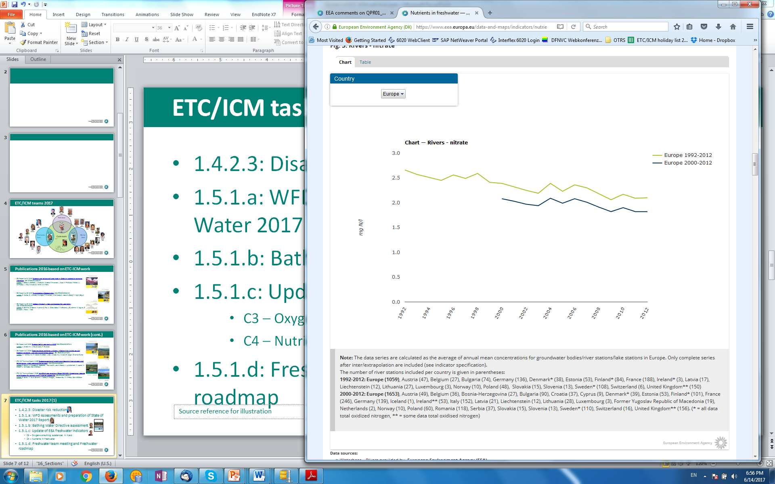
ETC/ICM tasks 2017 (1)
1.4.2.3: Disaster risk reduction
1.5.1.a: WFD Assessments and preparation of State of Water 2017 Report (this meeting)
1.5.1.b: Bathing Water Directive assessment
1.5.1.c: Update of EEA freshwater indicators
C3 – Oxygen-consuming substances in rivers
C4 – Nutrients in freshwater
1.5.1.d: Freshwater team meeting, Freshwater roadmap

Slide 6
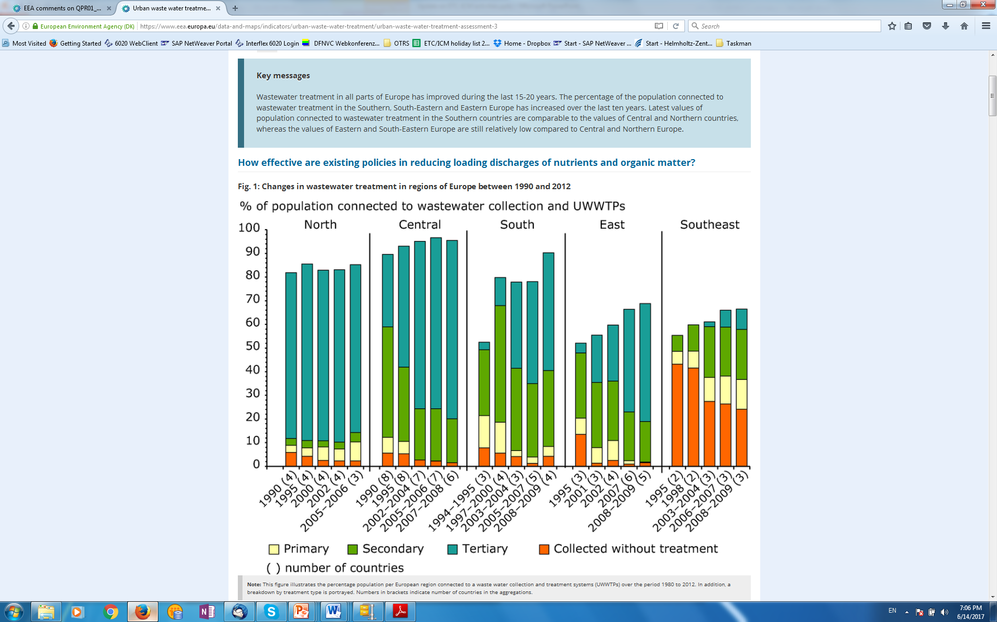
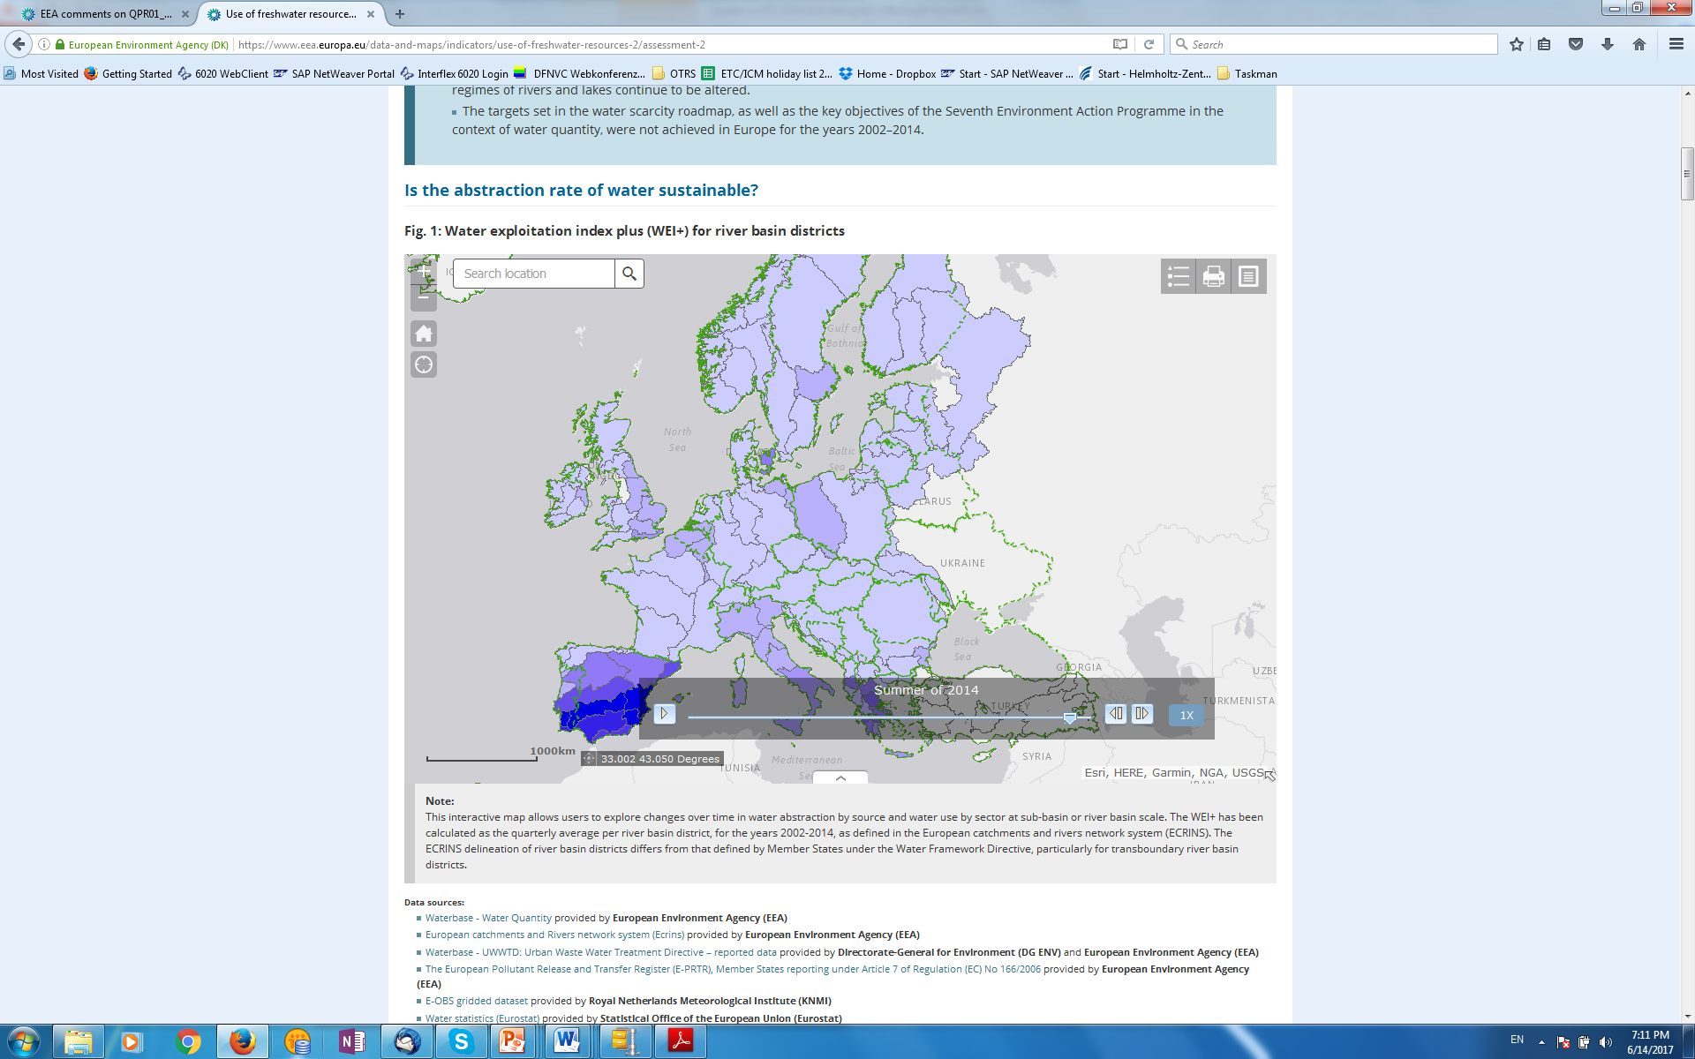

ETC/ICM tasks 2017 (2)
1.5.2.a: Chemicals in Europe’s Surface Waters ,(ppt session 4)
Publication of ETC/ICM Technical report 3/2017 Emissions of pollutants to Europe’s waters - sources, pathways and trends
1.5.2.b: Urban Wastewater Treatment Directive
UWWTD Waterbase, map viewer and data viewer, CSI024 UWWT
Preparation for the 10th call of UWWTD on Art 15 and Art 17
1.5.4.a: Assessment of water quantity and water accounts
CSI 018, use of freshwater resources
WREI 004, agricultural water resources efficiency
Publication of ETC/ICM Technical report 1/2017 Use of freshwater resources in Europe (launch tomorrow, session 4)

Slide 7
ETC/ICM tasks 2017 (3)
1.5.5.a: WISE SoE data flows - WISE-1, WISE-3, WISE-4
Waterbase 2016, Reportnet ready for 2017 SoE data request, ,(ppt session 4)
1.5.5.b: WISE-5 and spatial data products
reference spatial data sets for countries not reporting under WFD
Publication of updated European datasets for spatial data (monitoring sites, surface water bodies, groundwater bodies, subunits and river basin districts)
Publication of updated EEA map services (and map viewers)
1.5.6.a/1.6.4.a: ETC management and networking with Eionet
Action Plan, Quarterly Progress reports, Cost statements, NFP meetings, Freshwater and Marine Eionet workshops, country visit to Turkey, ETC website, Forum interest groups, ETC/ICM Technical Reports

Slide 8
ETC/ICM tasks 2017 (4)
1.6.1.a: Spatial reference layers
1.6.1.b: WISE-TCM and WISE-2 data flows
1.6.1.c: Marine Strategy Framework Directive (MSFD) reporting
1.6.1.d: EEA indicators
1.6.1.e: Development of WISE-Marine
1.6.1.f: Marine LitterWatch

Slide 9
ETC/ICM tasks 2017 (5)
1.6.2.a: Marine biodiversity in Europe
1.6.2.b: Marine protected area network assessment
1.6.2.c: Sustainable use of Europe’s seas
1.6.2.d: Pressures and impacts in Europe´s seas
1.6.2.e: Development of SoE assessment contributions for Mediterranean and Black Seas
1.6.2.f: Contaminants in Europe’s seas
1.6.2.g: Eutrophication in Europe’s seas
1.6.2.h: Marine team meeting and marine road map

Slide 10
ETC/ICM tasks 2017 (6)
1.6.3.a: EEA 2018 Report on ‘Development of EU-policy based marine ecosystem (services) assessments’
1.6.3.b: Development of a methodology to calculate a pilot ‘European seafloor integrity account’ on the basis of the assessment of the state of seabed habitats from fishing pressure

