Slide 1
ETC/ICM has recently published a report, providing a comprehensive assessment on renewable water resources and water use by economic sectors in Europe
http://icm.eionet.europa.eu/ETC_Reports/
Nihat Zal
George Bariamis
Alexandros Zachos
Evangelos Baltas
and
Maria Mimikou
EIONET Freshwater Meeting
19-20 June 2017
Copenhagen

Slide 2
Main focus on water use-pressures- 2017
Focusing on water resources -2016

Slide 3
Main focus on water use-pressures- 2017
Based on various data sources;
Reported data; SoE, Eurostat and ad-hoc data compilation e.g. Cooling water
Modelled data; LISFLOOD, Phenology, E-OBS
Data assimilation/interpolation; water use for agriculture, households and industry
Focusing on water resources -2016

Slide 4
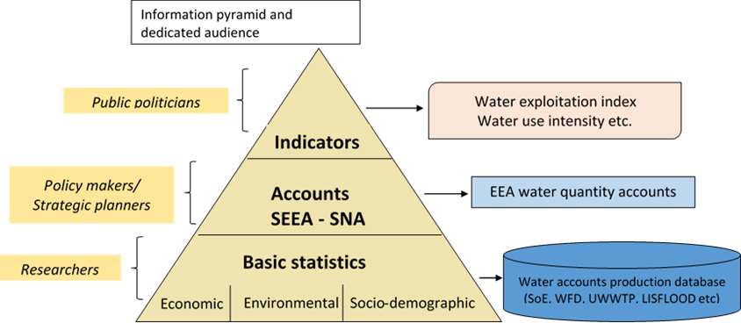
Information pyramid from data to the implementation of WEI+
  Policy links with water scarcity assessment in Europe
The 7th Environmental Action Programme has set three key objectives,which provide the provisions to water scarcity assessment:
Protecting, conserving and enhancing the Union’s natural capital
Resource-efficiency, green, and competitive low-carbon economy in Europe
Safeguarding citizens from environment-related pressures and risks to health and wellbeing
Source; modified from Nordic Council of Ministers et al, 2013

Slide 5
Water balance in Europe

Slide 6
Pressures
Water abstraction by source - 2014
Share of groundwater and surface water in total water abstraction (2002-2014)

Slide 7
Water abstraction by source
Water abstraction by sectors

Slide 8
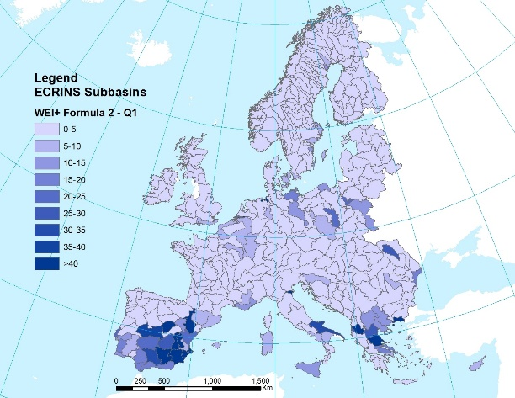
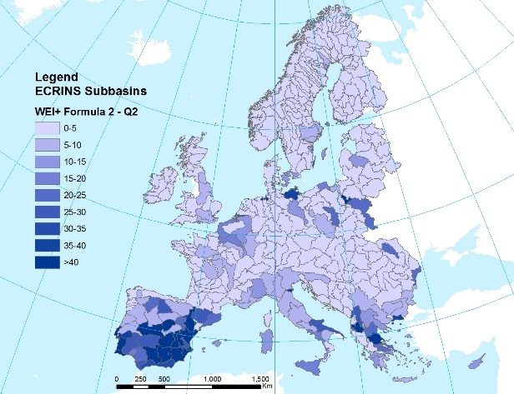
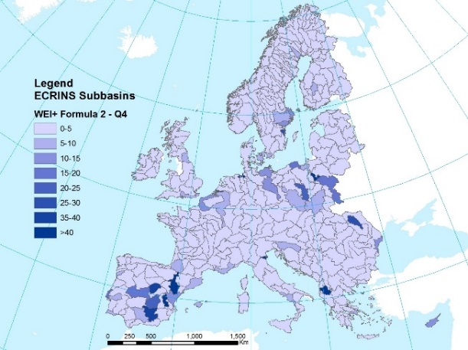
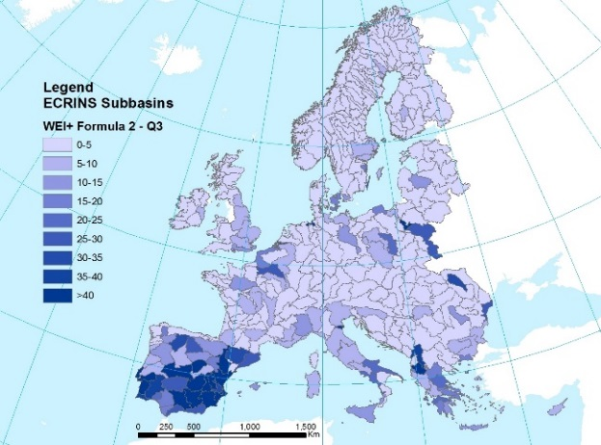
Affected area and population by water stress conditions across Europe (2014)
Season | Population (%) | Area (%)
Winter | 6.6% | 6.7%
Spring | 11.4% | 11.5%
Summer | 12.8% | 11.0%
Autumn | 3.0% | 3.3%
Water Exploitation Index Plus

Slide 9
Affected area and population by water stress conditions across Europe (2014)
Season | Population (%) | Area (%)
Winter | 6.6% | 6.7%
Spring | 11.4% | 11.5%
Summer | 12.8% | 11.0%
Autumn | 3.0% | 3.3%
Dam construction – cumulative in Europe (1900-2012)
Water Exploitation Index Plus

Slide 10
Trend in renewable water resources per capita in Europe (1962-2014)
Share of irrigated area and irrigation water per region in Europe - 2013
Source: Eurostat¹⁵
Region | Irrigated area (%) | Water irrigation (%)
East | 5.8 | 3.6
South | 59.5 | 83.9
West | 34.7 | 12.5
Regional total water supply
Data source: World Bank, 2016
Region | Population (%) | Water supply (%)
East | 31.3 | 21.9
South | 21.4 | 30.1
West | 47.3 | 48.0

Slide 11
Water abstraction for cooling in producing electricity by power plants in Europe - 2014
Gross electricity production by source – 2014
Development with hydro-electrical capacity in Europe (1990-2014)

Slide 12
Many other aspects of water abstraction and water use including water use by tourism can be found in recently published report!
in 2017;
A complete database is planned to be published on; streamflow for all European rivers (presented in Ecrins) 1990-2016
Climate variables at the catchment scale - 1990-2016
Water abstraction and water use (households, agriculture, industry)
A new indicator on crop water intensity will be on EIONET consultation soon

