Slide 1
EEA multiannual work programme 2014-2018
and
identification of possible benefits for countries from cooperation with the EEA
Anita Pirc Velkavrh
Strategic futures, EEA
Slovenian EIONET network meeting, 2 October 2013, ARSO

Slide 2
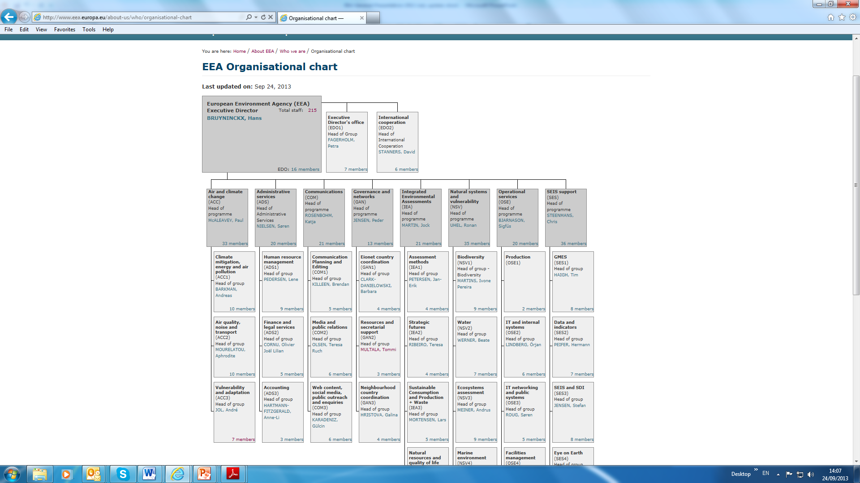



EEA
Milan

Slide 3
EEA Multiannual work programme
MAWP
2014-2018

Slide 4
EU strategic directions
transition to a sustainable future
The thematic policies: timelines and deadlines for implementation, reporting and revision;
EU environmental and sectoral policies and ambitions are formulated in the perspective of either more comprehensive policies (Europe 2020, 7th EAP), or specific 2020/30 targets for the environment and climate.
EU has formulated long term visions and targets, mostly with a 2050 societal transition perspective.
EEA ambition: to contribute to the knowledge base needed in support of the EU’s stated objectives regarding long term transition towards a resource-efficient, low-carbon economy in which natural capital is protected and enhanced, and the health and well-being of citizens is safeguarded.

Slide 5
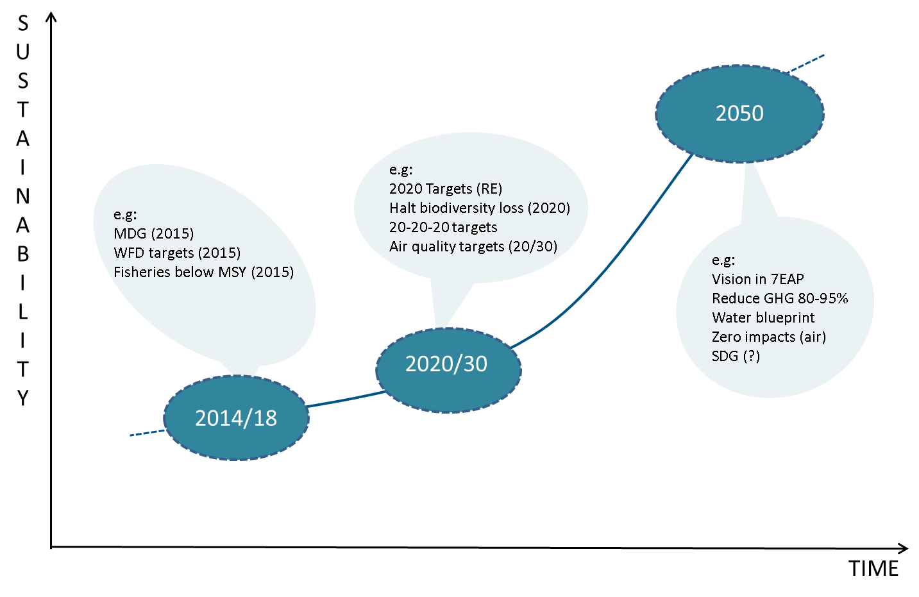
Long-term transition/intermediate targets

Slide 6

7 EAP priorities
7 EAP priorities
Three thematic priority objectives
Protect nature and strengthen ecological resilience
Boost sustainable resource-efficient low-carbon growth, and
Effectively address environment-related threats to health.
The thematic priorities are supported by an enabling framework with four further priority objectives :
promote better implementation of EU environment law,
ensure that policies benefit from state of the art science,
secure the necessary investments in support of environment and climate change policy,
improve the way environmental concerns and requirements are reflected in other policies.
Two more priority objectives focus on:
enhancing the sustainability of EU cities, and
improving the EU's effectiveness in addressing regional and global challenges related to the environment and climate change.

Slide 7
Societal transitions needed
long-term policy frameworks, e.g. the EU’s 2050 agenda on energy and climate, biodiversity, resource efficiency and green economy.
high level government support, e.g. the support by EU member states, EU institutions across different policy areas, and international organizations
long-term technology programs public funding and private sector engagement as embedded in the 2020 budget and Horizon 2020, and at level of the member states
strong support of public opinion, as changes in socio-technical systems have fundamental impacts on citizens.
European semester: monitor progress

Slide 8
EEA support to EU policy making
right questions - right data – right quality - right resolution – right assessment –
right answers
The EEA operates in a complex multi-level and multi-actor governance setting at EU, national and global levels, also with research institutes and NGOs.
The specific role of the EEA is to support policy making at the EU level, and build capacity in countries, using EIONET as its unique partnership to generate two-way quality assured environmental data and information

Slide 9








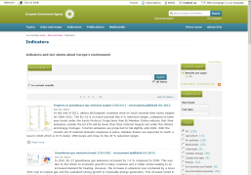
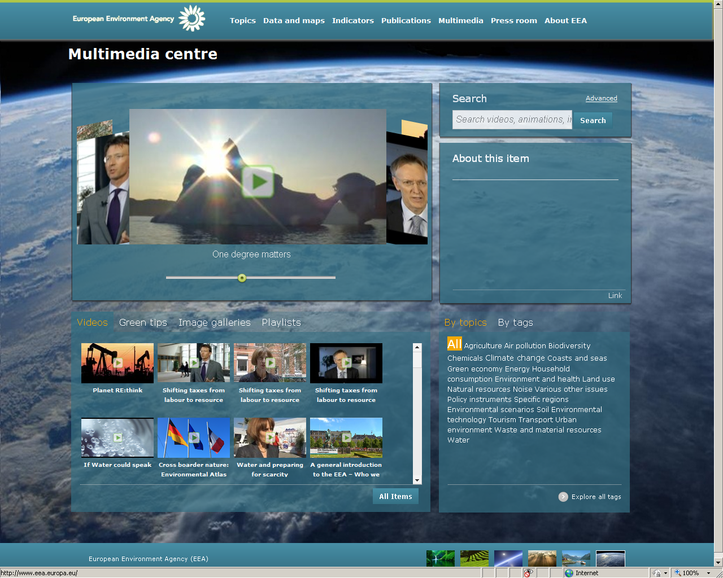

EEA Strategic areas 2014-2018
:
Informing policy implementation
Assessing systemic challenges
dynamic interactions
Knowledge creation, sharing and use
Notes:
SA 3, SA 4
This is not linear, dynamic interactions across the strategic areas will ensure that EEA meets expectations of its stakeholders of increased support to policy implementation will have to be met within a context of diminishing resources at national and EU level, which will require prioritisation, and an increased focus on stronger partnerships
Strategic area 3: Knowledge co-creation, sharing and use (SA3)
Providing support to the work in the strategic areas 1 and 2 by building and maintaining networks of people and information systems as the basis for sharing and co-creating content, be it data, indicators or assessments, with other actors at national, European and global levels. Communications, in the broadest sense of the word, will also play a major role in making sure that information targets and ensures a dialogue with stakeholders and the society at large. Targeted information, communication and participation remain important instruments to achieve significant and measurable improvement in Europe’s environment, responding to emerging challenges and societal developments.
Strategic area 4: EEA management (SA4)
EEA management, administration and operational services make up a fourth area of work. Strict adherence to all principles, rules and regulations that apply to the EEA, in combination with maximising efficiency and effectiveness of EEA management are the guiding principles. SA 4 will ensure the Agency’s response to the recommendations formulated in the evaluation.
.

Slide 10
1: INFORMING POLICY IMPLEMENTATION
Goal:
Improve content, accessibility and use of European-level environmental information
by providing policy-relevant feedback to long- established and emerging policy frameworks, objectives and targets
through reporting on progress in recognised environmental themes.
Notes:
Goal, objectives
Failing to implement environment legislation is estimated to cost the EU around €50 billion every year in public health costs and direct costs to the environment (COM(2012)95 Final).
Targeting knowledge about implementation is paramount. This covers providing knowledge about the expected impacts of environmental policies. Better information at national, regional and local level would allow identification of the main problems and the most appropriate and efficient ways to address them.
The 7th EAP calls for simplifying, streamlining and modernising environmental and climate change data and information collection, management and sharing; a greater application of principle of the Shared Environmental Information System of "report once, use often" would help streamline information demands and usability
The EEA and Eionet at national and European level will ensure a continuous and targeted coverage and flow of data and information around the many correlated themes, and about their inter-linkages.
With strong support from the European Topic Centres across all areas, the Agency should thus contribute with others partners (ESTAT, JRC, research bodies, regional and international partners etc.) to filling gaps in the knowledge base in order to allow policy responses to be optimised.
Picture: Commissioner J. Potocnik visiting the EEA 2011

Slide 11



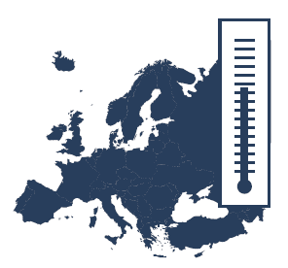

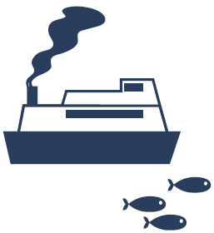



1: INFORMING POLICY IMPLEMENTATION
Air pollution, transport and noise
Industrial
pollution
Climate change mitigation and energy
Climate change impacts, vulnerability and adaptation
Water management, resources and ecosystems
Marine and maritime, fisheries and coastal
Biodiversity, ecosystems, agriculture and forests
Urban, land use and soil
Waste and material resources
Notes:
Areas of activities, strategic area 1
Given the nature of environmental challenges, the principal areas of activity of the Agency all require a continuous, long-term focus.
The current policy priorities, of air pollution, climate change, water management, nature protection, land use and natural resources, waste management, noise, coastal and marine protection will be continued across the 2014-2018 period (Chemicals are covered under SA2).
It is already evident that requests for EEA support in several of these core areas will increase in the coming years.
Such activities and developments also include the need to continue to focus on key economic sectors such as energy, transport, agriculture and fisheries, which are among the foremost sources of pressures on the environment.
EEA indicator and assessment activities, along the DPSIR analytical framework, are already firmly established in these areas and will be enhanced; resources permitting, other important sectors such as tourism will be covered with the view to informing policy progress and accountability.

Slide 12

1: INFORMING POLICY IMPLEMENTATION
Achieve by 2018:
Measurable uptake of EEA findings
Acknowledged contribution to reporting processes under EU comitology and multi-lateral agreements
Timely and reliable delivery databases, indicators, assessments, briefings, workshops, communication
Notes:
Performance indicators
In 2018 we want to be judged upon achieving these objectives:
Tailor, harmonise and speed up data-flows (including near-real-time where appropriate), and their integration in information systems
Timely provision, analysis and dissemination of data sets, indicators and assessments
Close important information gaps by further developing concepts, analytical methods and indicators to better understand the inter-linkages between different themes and sectors in support of enhanced policy coherence.
Mainstream new data and information needs through incorporating the outcomes of EU-FP7 and Horizon 2020 research projects, as well as of similar ventures at international level;
Continuous active engagement with stakeholders as a policy-science interface across themes and sectors to ensure relevant findings are taken up and used
Picture:
Contamination” by Javier Arcenillas
Winner of ImaginAIR 2012 photostory competition, category air and cities
“Although fortunately there are still places in Romania almost wild and spectacular, where nature is unstained by the hand of man, in more urbanized areas there is an obvious ecological problem. Contamination of Romanian cities, for example, is a serious matter, and authorities, which continue not to take any steps, and citizens, which have yet to become aware, do nothing.
The industrial centers of Copsa Mica, in central Romania, and Giurgiu, southern, have serious air pollution problems. Bucharest, the capital, also has serious air pollution levels. The leaks just from factories on the Danube and other rivers, make the water not drinkable and threaten diverse ecosystems of the Danube Delta”.

Slide 13
SA1 Informing policy implementation-2014
Climate change - supporting the implementation of the EU climate and energy package (including support through the European Semester process) and the Monitoring Mechanism Regulation, as well as delivering the EEA road map in support of the EU climate adaptation strategy. The latter includes improvement of Climate-ADAPT and assessment work on national and sub-national adaptation policies.

Slide 14
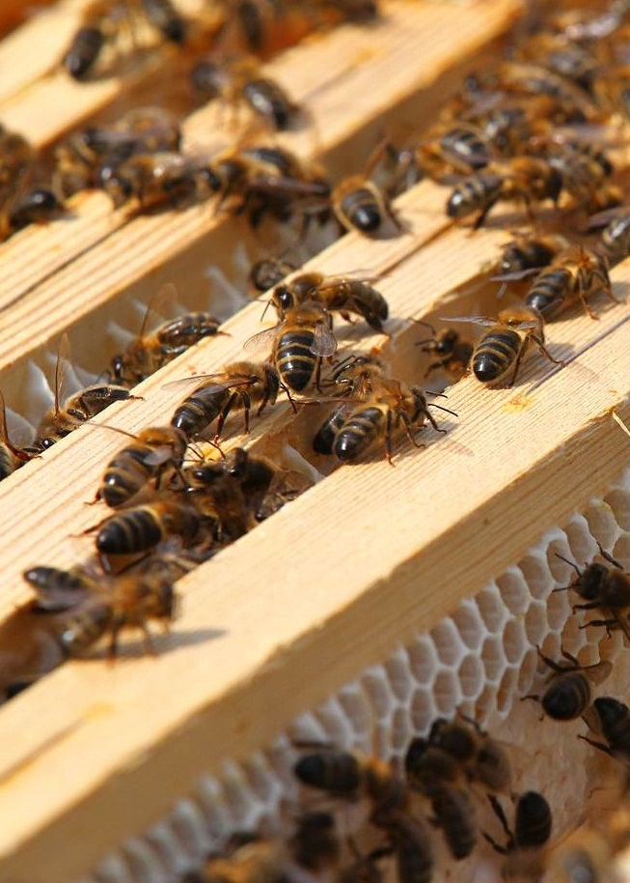
2: ASSESSING SYSTEMIC CHALLENGES
In the context of transitions:
Provide integrated assessments to signal synergies in support of policy coherence
Provide prospective analyses to signal emerging issues
Provide knowledge and analysis to assess progress towards fundamental transitions.
Notes:
Key goal and objectives
Goal
To assess systemic challenges in the context of short, medium and long-term transitions and signal opportunities for (re)framing / recalibration of environmental policy
objectives
Providing support to improving synergies and policy coherence across environmental, economic and social systems by applying established and experimental integrated assessment techniques and prospective analysis, both with a short and a long time perspective.
The work is in support of a long term vision for 2050 set out in the 7th EAP. It underpins policy initiatives in the Europe 2020 strategy, including the EU climate and energy package, the Roadmap for moving to a low-carbon economy in 2050, the EU Biodiversity Strategy to 2020, the Roadmap to a resource-efficient Europe and the Innovation Union Flagship Initiative.
Picture: bees at EEA roof 2011

Slide 15
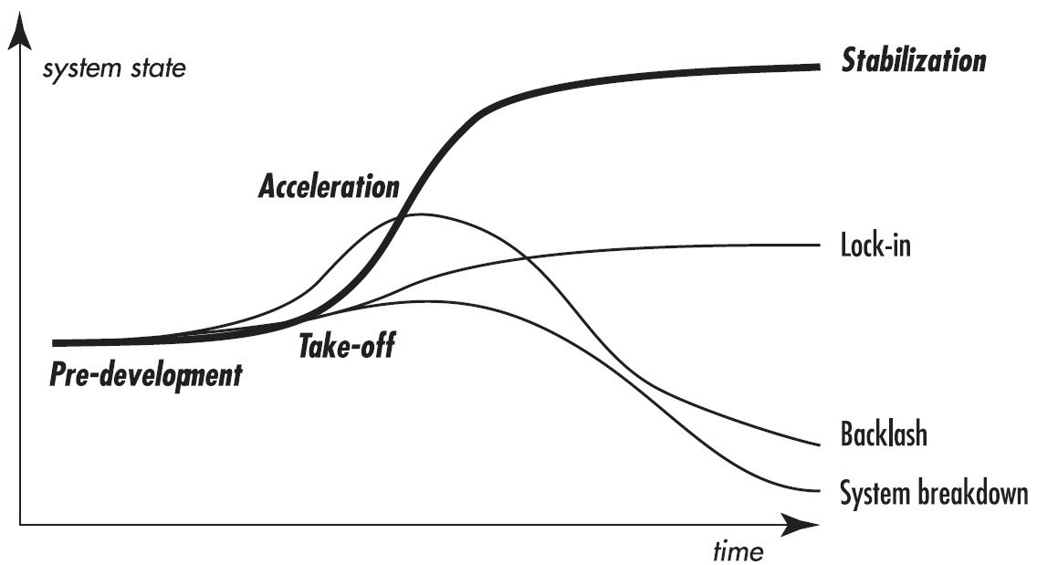
transition to a sustainable future
change
3 levels:
Makro: megatrends
Dominant: socio‘technical regimes
Micro: innovations, novelties
Notes:
These are crucial times for Europe:
When the European Parliament launched its awareness and information campaign in the run-up to the 2014 European elections 10 September, they stated:
„These are turbulent times in the history of Europe. The crisis has made citizens aware that Europe touches the heart of their living conditions. They have understood more than ever that European countries are interdependent, and what is happening in another EU member state fully affects everyone's future prospects.
The logo with the baseline ACT.REACT.IMPACT. stresses that EU voters can exercise their power, through the ballot box, to determine the future shape of Europe.
European citizen rate Environmental and climate concerns not as high as in the past (Eurobarometer 2013, environment: rank 9, climate: rank 11 of most concerning topics for Europeans). But as with overcoming the economic crisis we will have the choise: are we able to prepare a system transition leading towards stabilization of our ecosystems?
The overall aim with EEAs work in the coming 5 years is to step up the contribution of environment policy to the transition towards a resource-efficient, low-carbon economy in which natural capital is protected and enhanced, and the health and well-being of citizens is safeguarded. They are also the basis for EU involvement in global and wider European activities, which increasingly are framed in a 2050 perspective.
Picture: EP president Martin Schulz presenting 2014 EP election campaign on 10 September 2013

Slide 16
EEA Strategic areas 2014-2018
:
Informing policy implementation
Assessing systemic challenges
dynamic interactions
Knowledge creation, sharing and use
Notes:
SA 3, SA 4
This is not linear, dynamic interactions across the strategic areas will ensure that EEA meets expectations of its stakeholders of increased support to policy implementation will have to be met within a context of diminishing resources at national and EU level, which will require prioritisation, and an increased focus on stronger partnerships
Strategic area 3: Knowledge co-creation, sharing and use (SA3)
Providing support to the work in the strategic areas 1 and 2 by building and maintaining networks of people and information systems as the basis for sharing and co-creating content, be it data, indicators or assessments, with other actors at national, European and global levels. Communications, in the broadest sense of the word, will also play a major role in making sure that information targets and ensures a dialogue with stakeholders and the society at large. Targeted information, communication and participation remain important instruments to achieve significant and measurable improvement in Europe’s environment, responding to emerging challenges and societal developments.
Strategic area 4: EEA management (SA4)
EEA management, administration and operational services make up a fourth area of work. Strict adherence to all principles, rules and regulations that apply to the EEA, in combination with maximising efficiency and effectiveness of EEA management are the guiding principles. SA 4 will ensure the Agency’s response to the recommendations formulated in the evaluation.
.

Slide 17


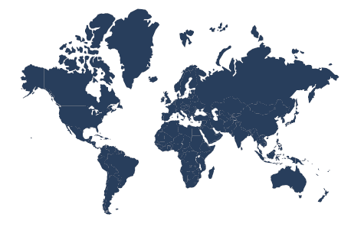

2: ASSESSING SYSTEMIC CHALLENGES
Resource-efficient economy and the environment
Environment, human health and well-being
Megatrends and transitions
Sustainability assessments and state of the environment reporting
Notes:
Areas of activities, strategic area 2
Challenge to respond to the unprecedented change, interconnected risks and increased vulnerabilities the European environment faces (increasing complexity, and appreciation of the human-made systemic risks and vulnerabilities which threaten long-term ecosystem security.)
A fundamental transition to a green economy – as called for, for example, in the Roadmap to a Resource-efficient Europe, the Low Carbon Economy Roadmap, the Energy Roadmap, the EU’s climate policies, and the 7th EAP requires proper consideration of the interplay between socio-economic and environmental factors, and an understanding of the linkages between environmental trends, emerging issues, associated uncertainties and the resulting systemic risks.
Assessing these systemic risks is the focus of SA2 area, with the 5 year state of the environment reports (SOER) and annual indicator reports being the vehicles for drawing together all the relevant threads of knowledge developed through the activities in SA1 and 2.
The need to provide a path to renewed economic growth and job creation in response to the current severe economic crises facing Europe and longer term prospects is widely acknowledged. In its simplest form, the overarching policy concept of a green economy recognises that ecosystems, the economy and human well-being, and the related types of capital they represent, are intrinsically linked.

Slide 18

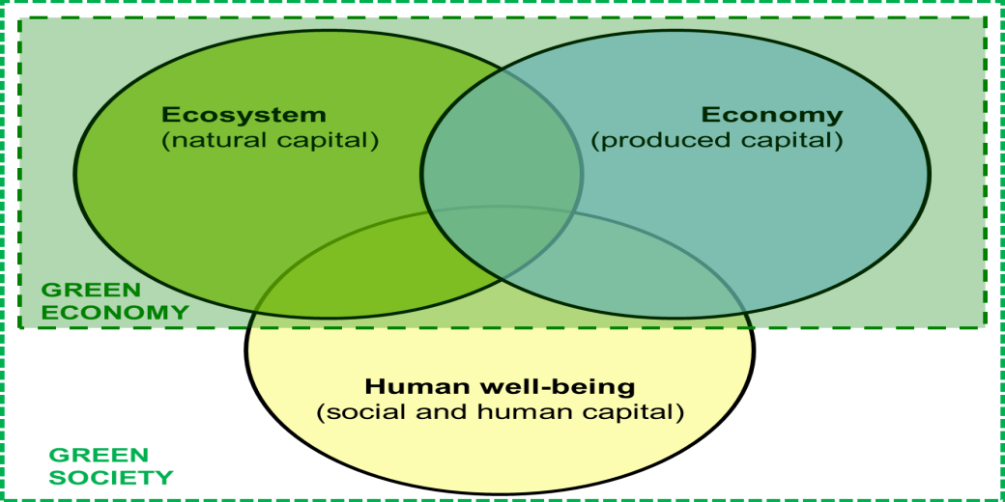
2: ASSESSING SYSTEMIC CHALLENGES:
Achieve by 2018:
Prompt delivery of SOER2015
Annual Indicator Reports 2014-2018;
Contribution to the processes for evaluations of the 7th EAP.
Notes:
Performance indicators
For future policy target identification in a green economy setting it is appropriate to consider more fundamentally the relationship between the three pillars of green economy where both the economy and the society are constrained by environmental limits.
In this model, the economy exists within society, and both the economy and society exist within the environment. Targets can then be set and indicators established to measure the extent to which these boundaries are respected.
Against this backdrop, EEA, in partnership with others and with ETC support, will continue to ensure that the environmental dimension is properly addressed in the broad green economy (and green society) agenda. This includes reflections on emerging challenges and pathways to the future that can facilitate the inclusion of environmental considerations such as ecosystem resilience and discussions about societal transition and governance models.
Assessing these interplays is the overarching focus of SA2 and as such aims to support especially priority objectives 1-3 and 5 of the 7th EAP. Furthermore, work under SA2.4 supports the evaluation of the 7th EAP, as stated in the 7th EAP itself.
Pictures: 7th EAP logo, DG ENV; EEA green economy definition

Slide 19
SA2 ASSESSING SYSTEMIC CHALLANGES - 2014
Sustainability assessments and SOE reporting – i) publish 2014 annual indicator report; ii) complete SOER2015 for publication in early 2015; and, iii) support the European Commission and countries on the activities related to the Sustainable Development Goals (SDGs).
Circular economy and the environment – publish a first analysis of the contributions fully implemented environmental policies’ objectives and targets can make to transition to a circular economy.
Megatrends and transitions – complete update of 2010 Global Megatrends, inter-alia, as a contribution to SOER2015.
Notes:
The circular economy is a generic term for an industrial economy that is, by design or intention, restorative and in which material flows are of two types, biological nutrients, designed to reenter the biosphere safely, and technical nutrients, which are designed to circulate at high quality without entering the biosphere.

Slide 20
EEA Strategic areas 2014-2018
:
Informing policy implementation
Assessing systemic challenges
dynamic interactions
Knowledge creation, sharing and use
Notes:
SA 3, SA 4
This is not linear, dynamic interactions across the strategic areas will ensure that EEA meets expectations of its stakeholders of increased support to policy implementation will have to be met within a context of diminishing resources at national and EU level, which will require prioritisation, and an increased focus on stronger partnerships
Strategic area 3: Knowledge co-creation, sharing and use (SA3)
Providing support to the work in the strategic areas 1 and 2 by building and maintaining networks of people and information systems as the basis for sharing and co-creating content, be it data, indicators or assessments, with other actors at national, European and global levels. Communications, in the broadest sense of the word, will also play a major role in making sure that information targets and ensures a dialogue with stakeholders and the society at large. Targeted information, communication and participation remain important instruments to achieve significant and measurable improvement in Europe’s environment, responding to emerging challenges and societal developments.
Strategic area 4: EEA management (SA4)
EEA management, administration and operational services make up a fourth area of work. Strict adherence to all principles, rules and regulations that apply to the EEA, in combination with maximising efficiency and effectiveness of EEA management are the guiding principles. SA 4 will ensure the Agency’s response to the recommendations formulated in the evaluation.
.

Slide 21
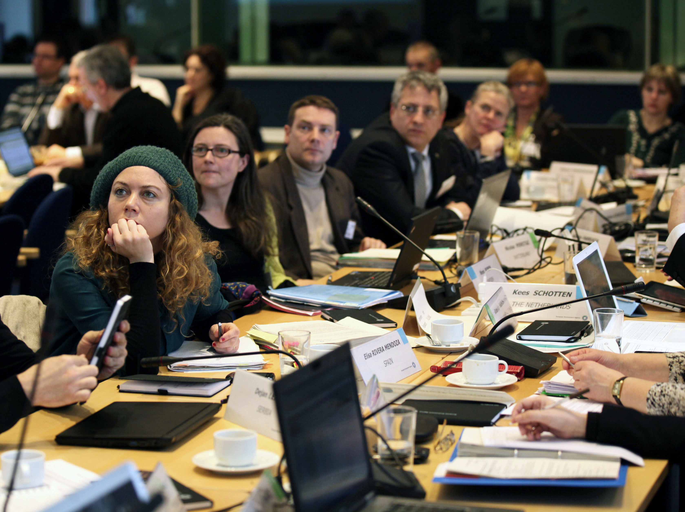
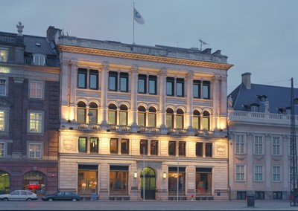
3: KNOWLEDGE CO-CREATION, SHARING AND USE
Goal: To be the authoritative European environment information node and hub within networks of knowledge co-creation, sharing and use.
Notes:
Knowledge is increasingly co-created, shared and used in networks (flexibility in terms of membership, roles assumed, goal orientation, type of knowledge created, shared or used, etc). A flexible and strategic vision on our role as initiator, node, hub or switch is important to continue playing our role in networks of knowledge co-creation, sharing and use.
Strengthening the integration of EEA and Eionet activities, including capacity building, remain central to the 2014-18 strategy. An integral part of this is a deepening of Eionet via an enhanced collaboration and integration between member country and EEA activities following the principles of SEIS.
Key objectives
Ensure the quality, availability and accessibility (based on SEIS principles) of data and information needed to support SA 1 and 2.
Communicate actively data, information and knowledge to policymakers, the public, the academic world, to regional and international processes including those of the UN and its specialised agencies.
Promote information governance as a driver of public empowerment and behavioural change.
Providing support to the work in the above areas by building and maintaining networks of people and information systems as the basis for sharing and co-creating content,
Communications will also play a major role in making sure that information targets and ensures a dialogue with stakeholders and the society at large. Targeted information, communication and participation remain important instruments.
Pictures: NFP EIONET meeting, EEA building, quote from EEA learning day 2012

Slide 22





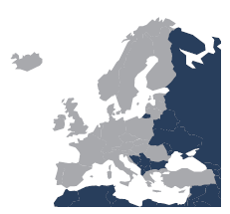

3: KNOWLEDGE CO-CREATION, SHARING AND USE
Networking and partnerships
Technical systems development
Monitoring, data
and information management
Communication, outreach and
user analysis
QUALITY MANAGEMENT AND OPERATIONAL SERVICES
Copernicus operational services
Capacity building in
west balkan and european neighbourhood countries
Notes:
Areas of activities, strategic area 3
Work in SA3 is strongly linked to Priority objective 5 of the 7th EAP: To improve the knowledge and evidence base for environment policy, and through that to all other priority areas. Priority objective 9: To increase the EU’s effectiveness in addressing regional and global environmental and climate challenges, is of special relevance to SA3, not least in the framework of UNEP assessments and the post Rio+20 process.
Adoption of the EEA/Eionet model and SEIS principles at regional/pan-European and international/global level can ensure coherence at all levels and also help streamlining efforts at national level.
Consequently, and taking into account the fast developments in information systems and related technologies, links and synergies will need to be strengthened and further explored with initiatives such as the EU Digital Agenda, the European Earth Observation Programme (Copernicus), the Global Earth Observation System of Systems (GEO/GEOSS), UNEP live, the Eye on Earth network and other key initiatives related to data and information sharing.
EEA will further enhance and focus its outreach capacities responding to emerging challenges and societal developments. Societal trends such as the ways to access information, networking, and co-creation of knowledge are influencing the way the EEA is asked to work and communicate.

Slide 23
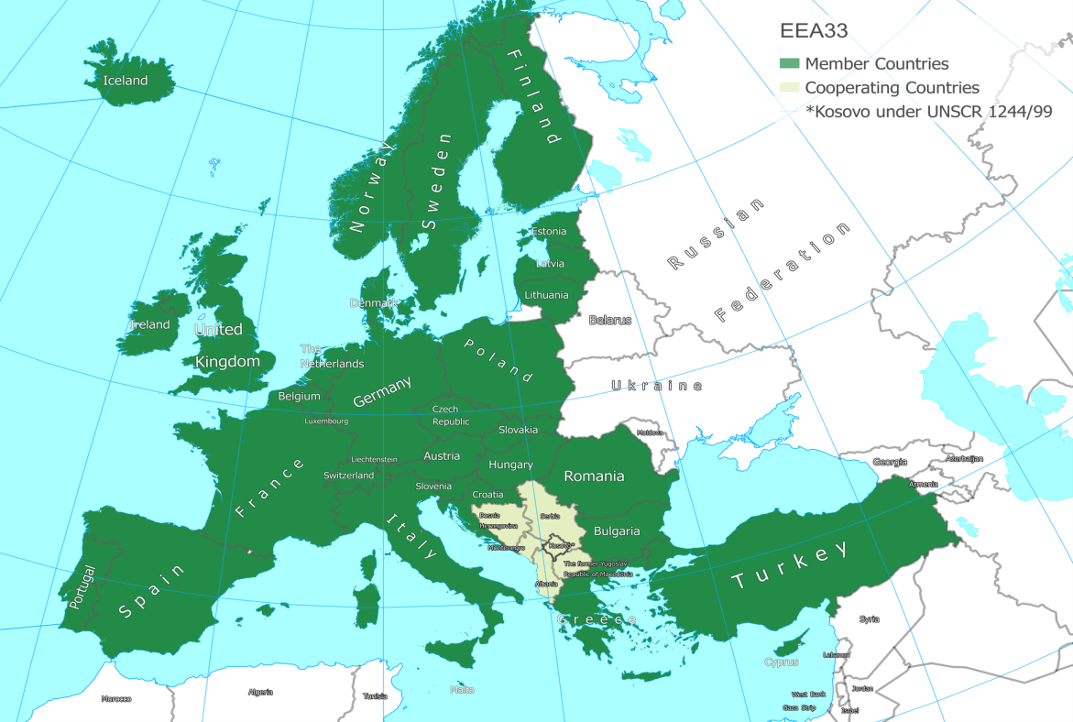
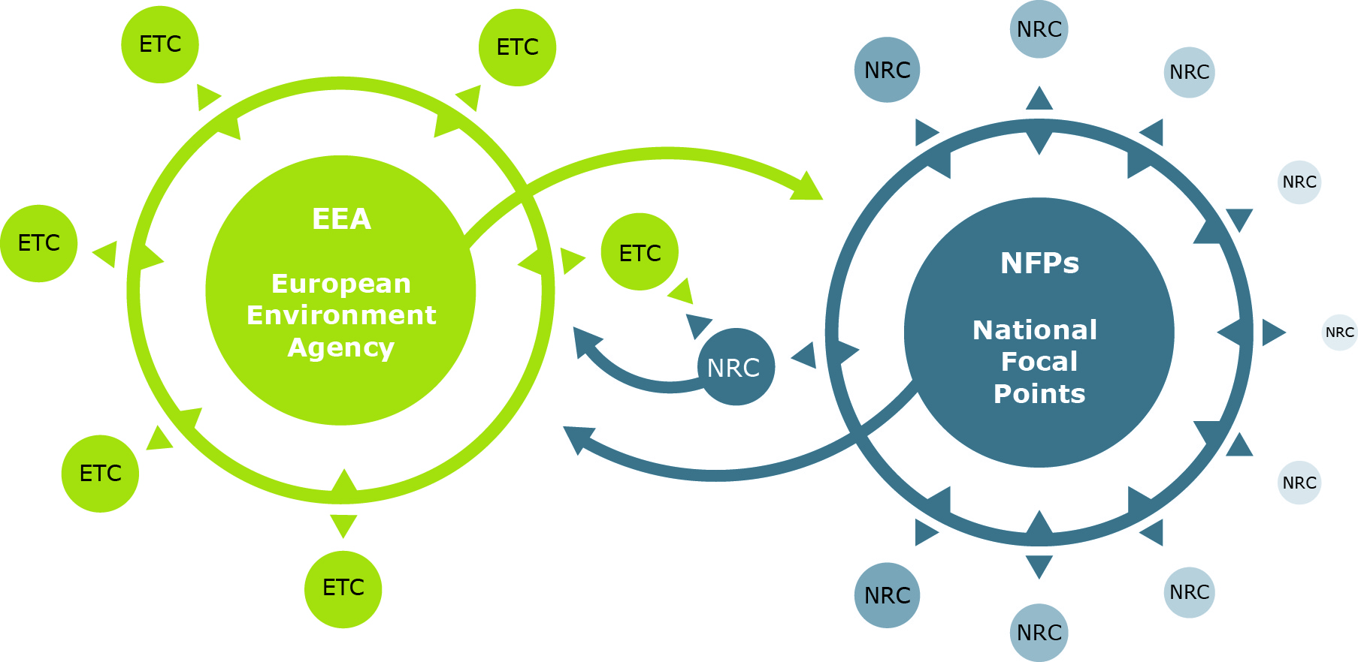
3: KNOWLEDGE CO-CREATION, SHARING AND USE
Achieve by 2018:
Strenghten Eionet, and other functional networks
Metrics to measure the active participation of Eionet
Online availability of EEA data and information products and services
Impacts of communication efforts
Notes:
Performance indicators
Eionet includes some 350 national institutions across EEA member and cooperating countries
The Eionet
Enhanced involvement of Eionet will be sought across the three strategic areas, in the areas of data flows, indicators, policy effectiveness analysis, integrated assessments, communications and the use of new analytical methods and technologies.
Increasing the value of the knowledge base for the member countries will be a key element; building on better articulation of member countries needs in the Management Board and Eionet fora.
European Topic Centres (ETCs), key components of Eionet, will continue to play an important role in the chain from data to assessments, supporting the development and maintenance of the knowledge base in all areas of work under SA1, and also parts of SA2.

Slide 24
SA3 Knowledge co-creation, sharing and use -2014
A revised Eionet functional structure
Evaluation of the progress of implementation of the INSPIRE directive.
Delivery of the outputs of the GMES Initial Operations (GIO) land monitoring and kick off of the provision of services for Copernicus for 2014-2020 (conditional, depending on final approval).

Slide 25
Role of EIONET in new MAWP
Increasing the value of the knowledge base for the member countries will be a key element;
building on better articulation of member countries needs in the Management Board and Eionet fora.
European Topic Centres (ETCs) supporting the development and maintenance of the knowledge base in all areas of work
Notes:
EIONEt network of around 1000 experts, from more than 350 national institutions and other bodies dealing with environmental information. These national institutions are anchored by National Focal Points (NFPs) and National Reference Centres (NRCs).

Slide 26
3. EIONET CORE PROCESSES
M
D
I
A
K
Member countries/
Eionet
KNOWLEDGE
BASE
SA1
DATA
SA2
Member States/
Eurostat
Horizon 2020,
JRC
SA1
INDICATORS
SA2
Remote sensing
Copernicus
SA1
ASSESSMENTS
SA2
Citizens, civil society,
business
SA1 Informing policy implementation
SA2 Assessing systemic challenges
SA3 Knowledge co-creation, sharing and use
Notes:
The strategic areas and EEA/Eionet core processes
The figure illustrates more explicitly how SA1-3 fit within the overall business model of the EEA/Eionet.
Across the top of the figure is the overall process from Monitoring (in the broadest sense) through Data, Indicators and Assessments to Knowledge. This value-adding chain is at the heart of the work of the EEA and Eionet.
As an enabler for the other two strategic areas, it is important to note that SA3’s support function stretches along the entirety of the MDIAK chain and across the whole policy cycle. The most obvious example of this is the Eionet, which shares the entire business model together with the EEA, but is also in essence based on networking, information systems, content-sharing and communications as these elements play a role in all links in the chain.

Slide 27
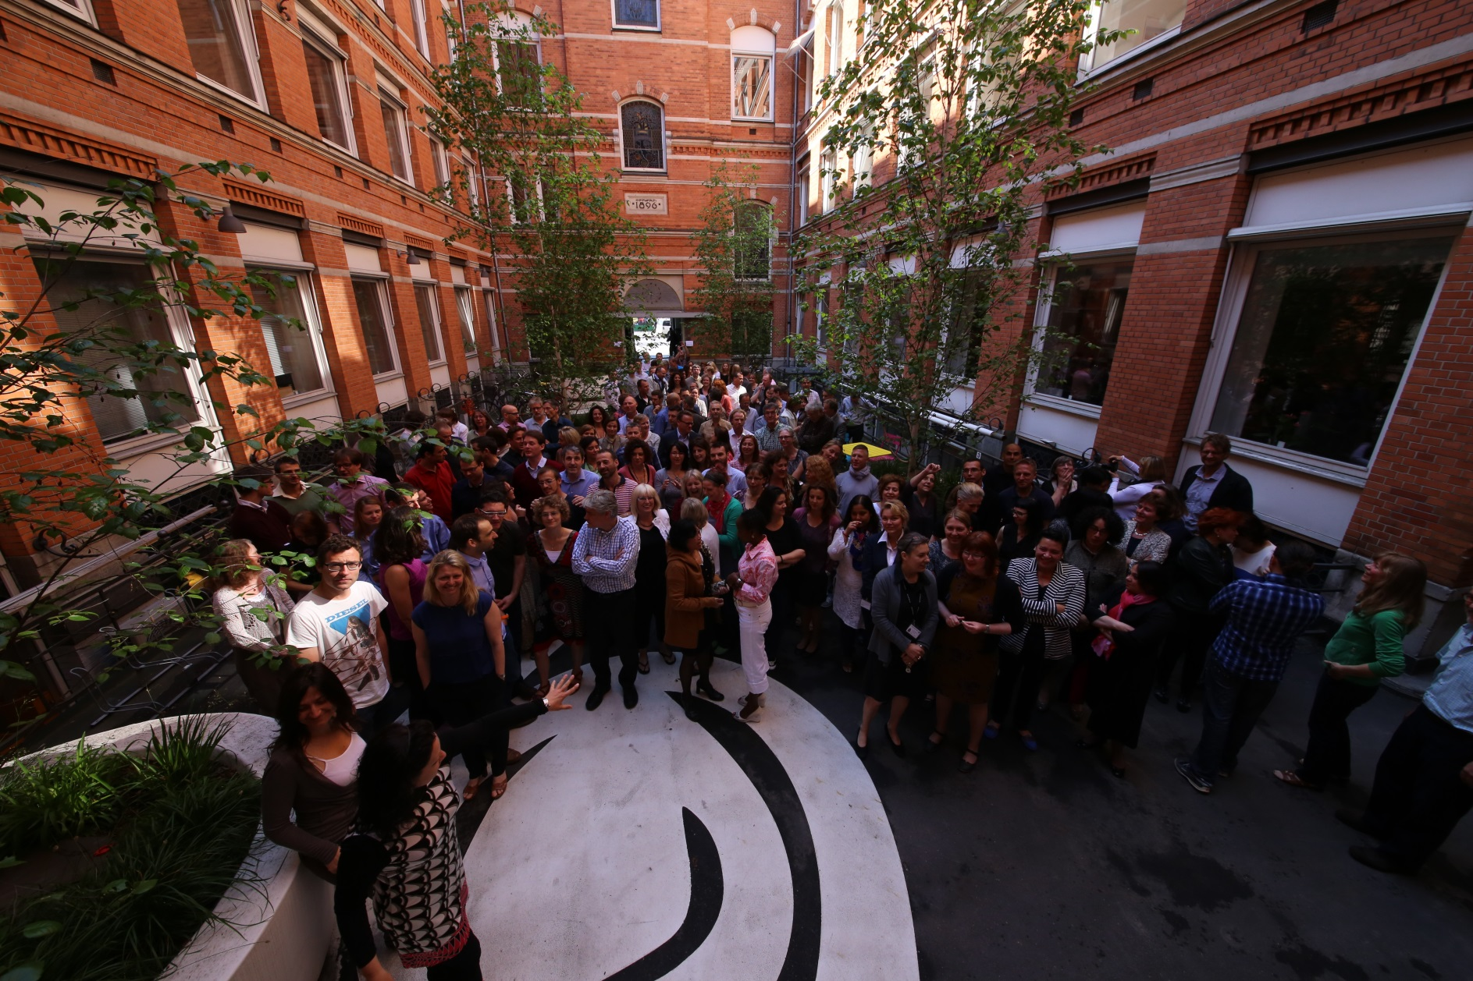
4: EEA MANAGEMENT
Goal: Excellence in delivering the work programme.
Notes:
Goal, key objectives
Provide efficient and effective management and administration of the Agency’s work programme and resources (financial, human and infrastructures) through a total quality management approach to planning, execution, monitoring, control and reporting of activities.
Meeting stakeholder expectations under diminishing resources
The recent evaluation of the EEA did not identify a large scope or potential for efficiency gains; nonetheless, meeting the challenges is expected to require a combination of:
Streamlining – finding ways of carrying out the same activities with fewer resources;
Innovation – finding new approaches to meeting existing and new challenges with fewer resources.
Rationalisation – discontinuing certain activities and focusing others down;
EEA’s management activities and horizontal administrative and operational services are brought together under SA4 to ensure that the core horizontal activities are planned, implemented, monitored and reported in a coherent and consistent way to facilitate efficient and effective delivery of the EEA work programme and sound financial management.
Picture: EEA staff, 2013

Slide 28
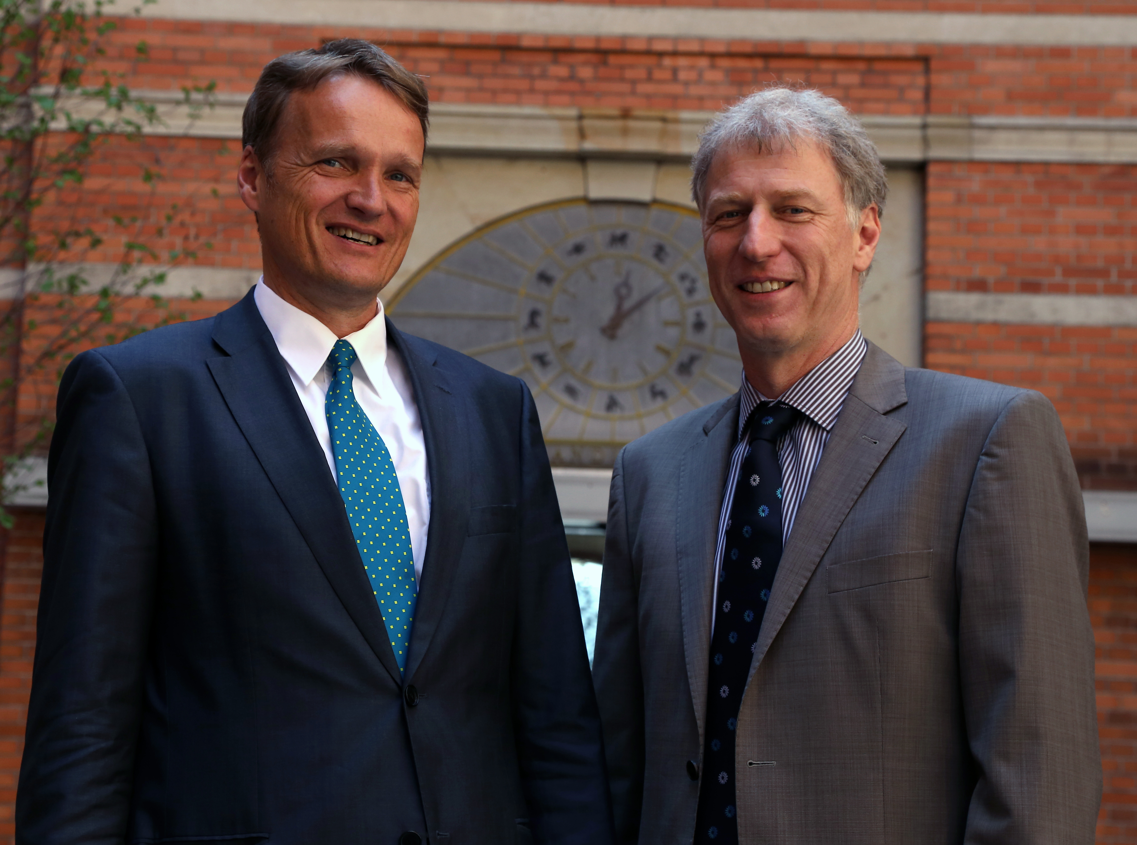
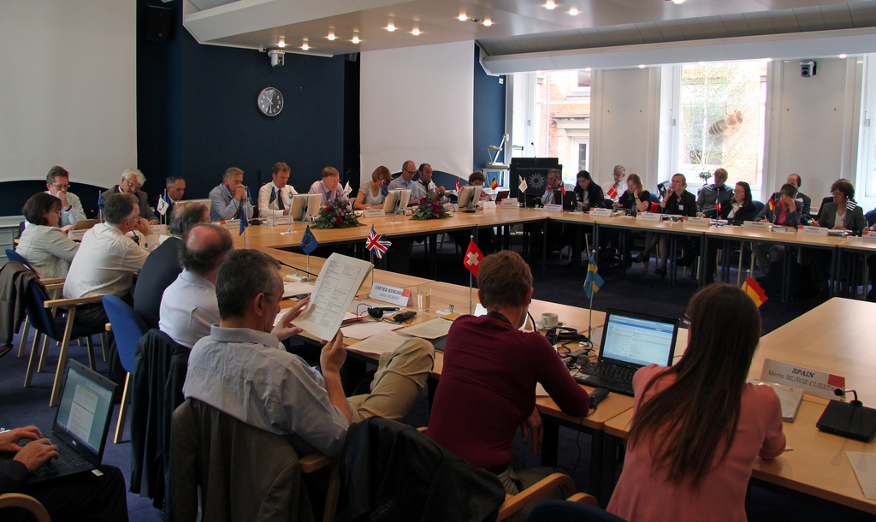
4: EEA MANAGEMENT
Achieve by 2018
Work programme delivered;
Positive outcome of next 5-year
external evaluation (2018).
Notes:
Performance indicators
EEA Management Board, in its recommendations regarding the COWI report on the evaluation of the EEA, March 2013, agreed, together with EEA management (e.g.) to
regarding effectiveness:
improve the already well-functioning dialogue with key stakeholders; further strengthening the relationship with Eionet.
to maintain the necessary high quality of its outputs;
regarding efficiency:
to further improve the current procedures in order to strengthen the strategic governance functions of the Management Board and its Bureau;
to simplify the structure, specify objectives and performance indicators and add more information on resource allocations to priorities in the strategy and the Annual Management Plans in order to increase transparency and the accountability of the Agency;
to continue the joint work with the Scientific Committee on the use of the Scientific Committee with a view to establishing a clear framework for cooperation, in order to ensure enhanced value added to the work of the EEA;

Slide 29
Potential benefits for countries
Reporting
Assessment
Capacity building
Accessing EU funds
Influencing EU practices
Implementation of legislation

Slide 30
Benefits: Reporting
Assessment
Reporting:
Aggregation of country data at EU level- this step is requested by EU legislation, but not so visible for countries
Standardization of reporting workflows and methods
Assessment:
Indicators system
Seen countries position in the wider context, distance to targets and in comparison with other countries
Showcasing good practices
Identification of driving forces outside the countries which influence countries policies (global, EU)

Slide 31
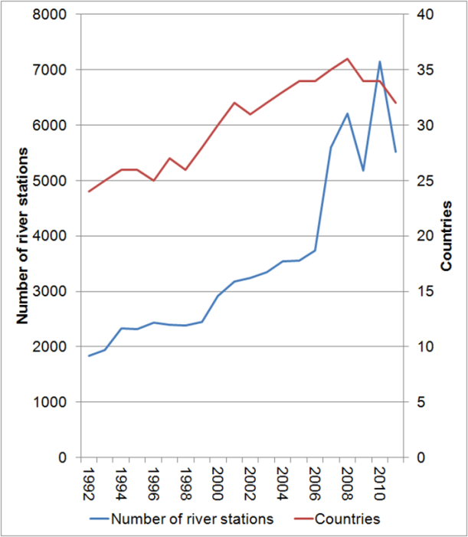
WISE-SoE dataflow - a success
EEA group for water
Example of benefits:
Reporting for water
Over the last 20 years countries have reported
More than 11 000 river stations (38 countries)
  – only Malta has not reported rivers
More than 3200 lake stations (36 countries)
More than 1500 groundwater bodies
covering the last 20 years 1992 to 2011.
Number of river stations and countries reporting per year

Slide 32
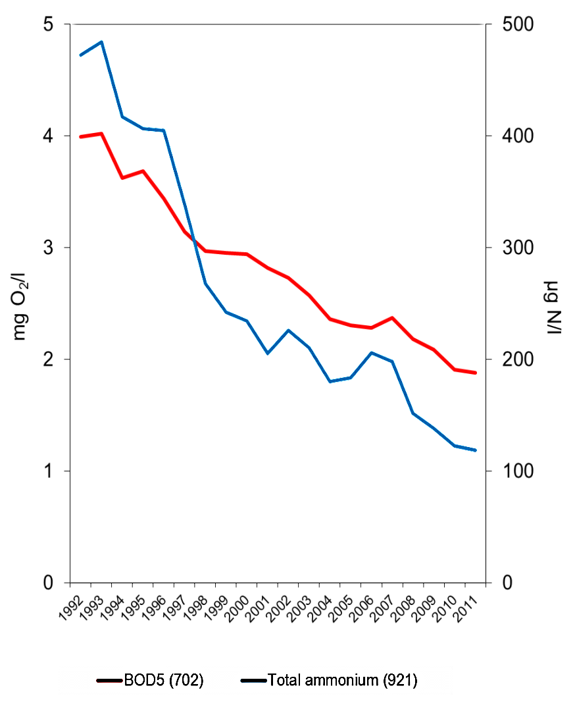
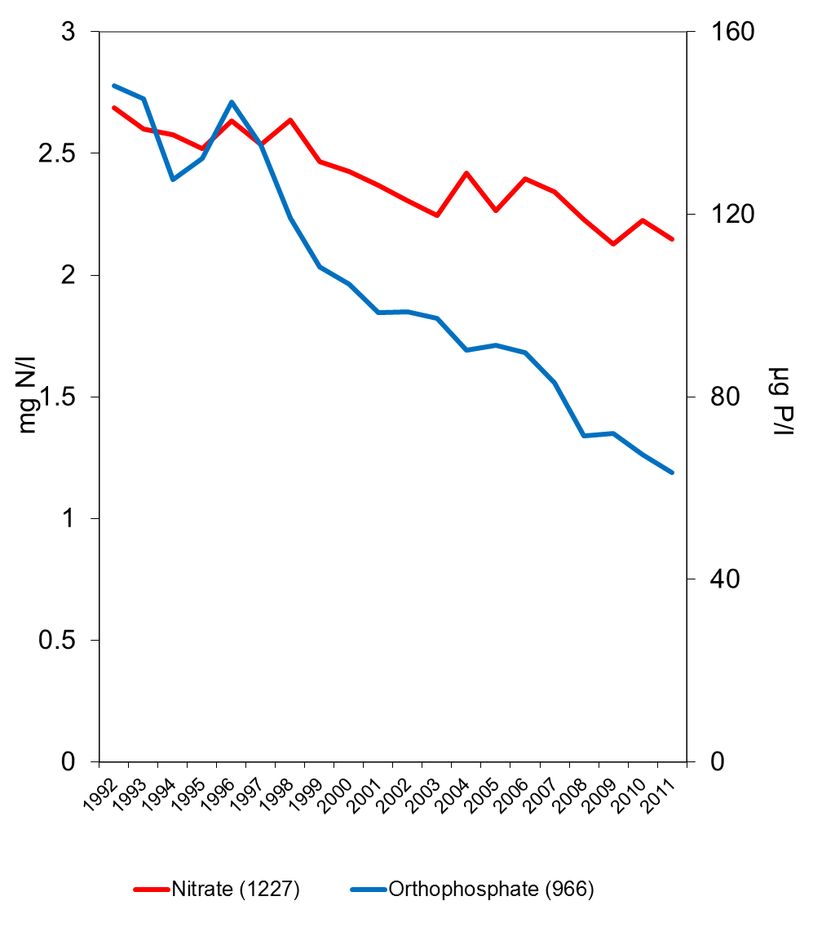
Assessment - indicators
SOE data on river quality (1992-2011)
BOD
Total ammonium
Nitrate
Orthophosphate
Good and high ecological status levels
Good and high ecological status levels
EEA group for water
Source: EEA 2012
Notes:
Based on this work, we know that rivers are getting cleaner - so the focus has changed to other problem areas
These charts show the average levels of certain pollutants recorded in European rivers, and illustrate the overall trend in water quality recorded by the EEA for the period 1992 to 2011.
[Left]
The diagram to the left shows the trend in organics matter, measured as biochemical oxygen demand (BOD) and total ammonia.
These are key indicators of pollution by oxygen-consuming substances. Concentrations have decreased by 53 % and 75 % respectively.
This is mainly due to the implementation of secondary biological wastewater treatment under the Urban Waste Water Treatment Directive.
[Right]
The diagram to the right shows the trend in orthophosphate and nitrate. Excess levels of these nutrients can create eutrophication.
With orthophosphates, concentrations have decreased significantly over the past 2 decades, by 72 %.
This decrease is due to measures introduced by national and European legislation, including the Urban Waste Water Treatment Directive.
The situation with nitrates is more problematic.
Average concentrations decreased by 20 % in the same period, reflecting efforts to reduce the agricultural inputs of nitrate at a European level.
Despite the progress made with reducing the levels of pollutants in rivers, Europe is still a long way from achieving good and high ecological status targets (illustrated here by the green boxes). These targets were set by the Water Framework Directive, which I will now briefly outline.

Slide 33
Information for better implementation in the policy cycle
EEA group for water
Water reporting and assessment
ENV
EEA
Implementation
assessment
- good status
Loads
Concentrations
Pressures
Impacts
Measures
Messages on the
problem
SOE information
- long term trends
soil, forest
land use,
Research info
Public
Outside EU 28
Compliance
- Exemption
Transposition
deadlines,
Infringement
procdures
DPSIR
Policy cycle
Information needed to interpret on wider ecosystem basis
‘Policy performance’
‘Policy effectiveness’
Initial assessment and review of policy assessment
Notes:
E.g for SIIF UWWTD pilot compliance indicators are asked to be defined, which certainly is meant all implementation relevant compliance, not only the narrow understanding related to transposition
For WFD and marine assessments the implementation relevant information is what is expected in our status reports (like 2012 status report WFD art. 18) or marine baseline art. ??
Please compare the elements of initial assessment and review of assessment with figure 1 in the SIIF concept paper, if we agree that what is shown here is consistent, then the role distribution between EEA and Env is pretty clear
Behind this view on the policy cycle sits again the whole DPSIR with ist information needs on a certain aggregation level to perform a reasonable assessment.

Slide 34
SEIS principles – a more decentralise and aggregates reporting
EEA group for water
Water reporting and assessment
DG ENV and EEA are discussion options for:
Structured Information and Implementation Frameworks
SIIF
Moving in the assessment to more aggregated information ;
and focus the compliance assessment on a kind of benchmarking;
reduce reporting burden
Ensure that DPSIR consistency in assessment is kept; assessments stay policy relevant and integrated throughout themes and directives
Notes:
What does the Communication mean exactly by Structured Implementation and Information Frameworks (SIIFs) and how will the Commission support these?
Each individual EU environment law – whether it deals with end-of-life vehicles or drinking water supplies or any other subject areas – is there to improve how the world works. These improvements can only be properly understood by citizens – in particular as regards their own localities – if they have a clear picture of the key actions being carried out to implement those laws.
To give just one example, EU drinking water rules aim at providing citizens with safe drinking water. Providing safe drinking water involves a chain of interventions including protection of the drinking water source (groundwater, lake, river), physical abstraction, treatment to remove any harmful bacteria and other types of contamination, monitoring of the distribution pipework to avoid leaks and waste, infrastructure investments and measures such as water pricing to help avoid wasteful use of water. It can be time consuming to obtain joined-up information on how all of these interventions fit together. A SIIF would aim, together with the range of SEIS initiatives, to help Member States set up transparent information systems that make this information accessible online. For example, one would be able to identify on a map abstraction points, source protection zones, treatment plants and distribution networks and have links to related information such as leakage reduction programmes.
Citizens, experts and businesses would all benefit from such transparency. The Commission's role would be to assist Member States in identifying the types of information that would feature in a given information system, so that similar information could be found across the EU.
Piloting the development of structured implementation and information
frameworks (SIIFs) for selected thematic areas, linking these location-based
information systems to EU level e-Reporting systems in order to make reported
information usable in various contexts and at different geographic scales. The
SIIFs as they have been set out in the Implementation Communication24 should,
on the one hand, identify how EU environment law is implemented on the
ground, and, on the other, determine good examples and best practices ofinformation systems at local, regional and cross-border levels. As a pilot activity,
the Commission services are already developing a concept for the reporting and
dissemination requirements of the Urban Waste Water Treatment Directive.
Based on the lessons learned from the first SIIF, the Commission services will
consider ways for expanding the concept and structure of the SIIFs to other
environment policy areas. The EEA shall be closely involved.

Slide 35
The DPSIR Water Cycle - in the policy cycle
R
Integrated water resource management (IWRM)
Institutional innovation
Transboundary agreements
Water use efficiency measures
Water economics
River + Wetland restoration
‘Clean production’
Catchment control and management
Agriculture and forestry
Fisheries
Energy
Industry
Recreation
Urbanisation
Public Water Supply/Sanitation
Navigation
Monitoring
Reporting
Effectiveness evaluations of responses and policy measures
D
P
Water pollution
Water use
Kanalisation
Flow interruption
I
Water scarcity
Drought
Floods
Wetland loss
Salination
Sedimentation
Diseases
Species/habitat loss
Invasive alien species
Eutrophication
S
Driving forces
Pressures
State
Impacts
Responses
Stocks/flows of water bodies
Chemical, biological and hydromorphological status
of water bodies
Catchment ecosystems structure + resilience
EEA group for water

Slide 36
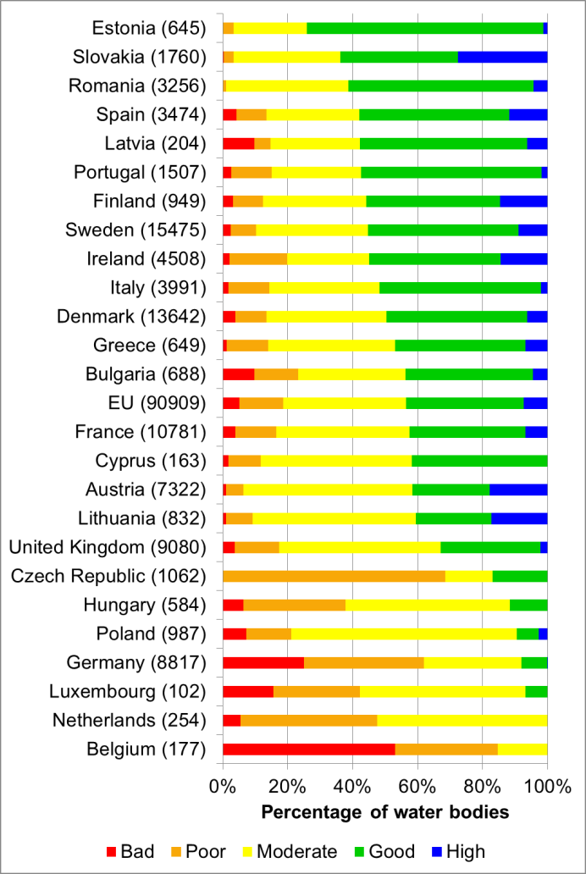
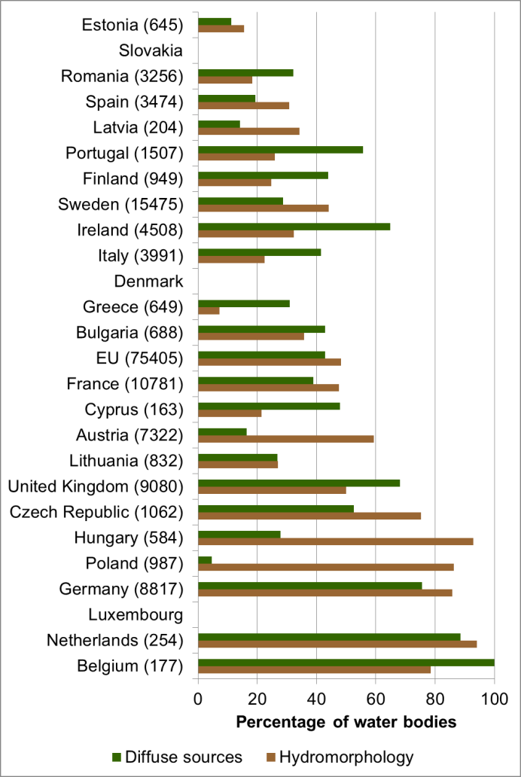
Water assessment: WFD Rivers ecological status and pressures per country
Ecological status/potential
Pressures
EEA group for water
Notes:
Countries not shown in the pressures plot is due to lack of reporting

Slide 37
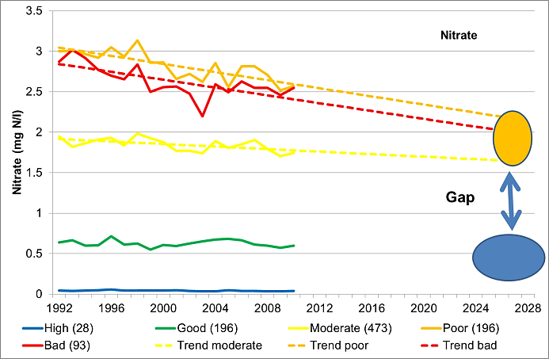
Water assessment: Pollution from diffuse sources - gap
EEA group for water
Source: EEA 2012
Notes:
However, with the case with pollution coming from diffuse sources, the second highest pressure for Europe’s rivers, the situation is very different.
This graph shows the trend and our projections for nitrates. We estimate that there will still be a significant gap in 2028 between actual nitrogen levels and those comparable to good ecological status.
If the morphology is degraded or the water flow is markedly changed, a river with good water quality will not achieve its full potential as a habitat for wildlife.

Slide 38
Benefits: Capacity building
Participation at EIONET meetings and workshops enhance the knowledge of country experts on EU level (country relevant)
Networking: possibilities of exchanging knowledge, best practices and problems with similar experts elsewhere and dealing with specific problems of interest of the country; portals as platform for cooperation in thematic issues (Climate Adapt, FLIS)
Training: making use of the EEA training: ie. AQ reporting training according to new EU requests, country visits
IT tools support: SENSE/indicators, Reportnet, Forum, Copernicus, Forward-looking information services, Climate Adapt

Slide 39
Benefits: accessing EU funds
EEA cooperation as reference; in EU tenders procedures - EEA reference is of beneficial criteria
ETC partners ( 7.700.000 EUR in 2013 )
EIONET involvement in EEA regulation Article 5 projects
LIFE+ - project application in more coordinated way with NFPs
Soft ways:
Exchange of information and building partnership and consortia for applications (FLIS..)

Slide 40
Benefits: influencing EU practices,
Implementation of legislation
With national well developed systems and practices which can be used at EU levels and by other countries
Forthcoming multiannual programme will more closely look how to support better implementation of environment legislation (by assessments, indicators benchmarking)
Cooperation in EU Semester- Each year the European Commission undertakes a detailed analysis of EU Member States' programmes of economic and structural reforms and provides them with recommendations for the next 12-18 months.

Slide 41

Thank you.

